Slide 1

SN BOSE SUMMER INTERNSHIP 2026 · NIT SILCHAR
Kernel-Based Fault Classification
in Analog Circuits
Teaching a support-vector machine to diagnose Normal, Drift, Open, Short and
Noise faults across four analog circuit topologies — from real LTspice physics to a live web app.
Presented by Karan Kaushik | B.Tech ECE, NIT Silchar
Guided by Dr. Anish Kumar Saha

Slide 2






ROADMAP
What We'll Cover
01
02
Why This Matters
Circuits & Fault Types
The real-world cost of undiagnosed analog faults
4 topologies, 5 physical fault conditions
03
04
Simulation & Data Pipeline
Feature Engineering
LTspice sweeps that generate real training data
Turning raw waveforms into 17 meaningful numbers
05
06
Machine Learning & Tuning
Results, Insights & Live Demo
SVM kernels, GridSearchCV, topology-aware logic
78.43% accuracy and what we learned getting there
KERNEL-BASED FAULT CLASSIFICATION IN ANALOG CIRCUITS
01

Slide 3





MOTIVATION
Why Fault Classification Matters
Analog circuits are everywhere
Filters, power supplies, sensor front-ends and communication links all rely on analog stages that quietly degrade before they fail outright.
Manual diagnosis doesn't scale
Reading an oscilloscope trace to guess “is this drift, or noise, or a bad connection?” takes an expert and doesn't scale to thousands of boards.
PHOTO / SCHEMATIC
e.g. lab PCB, oscilloscope capture, or
simulation workstation photo
Faults are often silent
A drifting resistor or a noisy stage can still “work” while quietly producing wrong answers downstream.
The goal
Give a machine the output waveform and let it instantly say what's wrong — and which component is likely responsible.
KERNEL-BASED FAULT CLASSIFICATION IN ANALOG CIRCUITS
02

Slide 4
PROBLEM STATEMENT & OBJECTIVE
One Waveform In. One Diagnosis Out.
Given the transient output voltage of an unknown analog circuit, automatically identify which circuit topology it is and which of five fault conditions it is currently experiencing — a 20-class classification problem solved end-to-end with physics-based simulation and a tuned SVM.
4
5
20
1019
Circuit Topologies
Fault Types
Total Classes
Real Samples
RC · RLC · Sallen-Key · RC Ladder
Normal, Drift, Open, Short, Noise
4 circuits × 5 fault conditions
From physics-based LTspice sweeps
KERNEL-BASED FAULT CLASSIFICATION IN ANALOG CIRCUITS
03

Slide 5





BACKGROUND
Five Ways an Analog Circuit Can Misbehave
Normal
Drift
Open
Short
Noise
Component values sit at their nominal, healthy design point.
A component value slowly shifts from nominal — aging, temperature, wear.
A component disconnects entirely — an infinite-resistance break in the path.
A component is bypassed — a near-zero-resistance path forms across it.
Random disturbance is superimposed on an otherwise healthy signal.
KERNEL-BASED FAULT CLASSIFICATION IN ANALOG CIRCUITS
04

Slide 6

BACKGROUND
Four Circuit Topologies Under Test
RC Low-Pass Filter
RLC Series Circuit
One resistor, one capacitor — the simplest baseline. A single-pole exponential charge/discharge response.
Adds an inductor for an underdamped, oscillatory step response — richer dynamics than RC alone.
SCHEMATIC
SCHEMATIC
Sallen-Key Active Filter
RC Ladder Network
An op-amp based 2nd-order filter — the kind actually used in real analog signal-conditioning design.
Multiple RC stages cascaded together, producing a more complex multi-pole response.
SCHEMATIC
SCHEMATIC
KERNEL-BASED FAULT CLASSIFICATION IN ANALOG CIRCUITS
05

Slide 7

BACKGROUND
Same Circuit, Five Different Personalities
Example: an RC low-pass filter's step response under each of the five fault conditions.
WAVEFORM
WAVEFORM
WAVEFORM
WAVEFORM
WAVEFORM
Normal response
Drift response
Open response
Short response
Noise response
Normal
Drift
Open
Short
Noise
KERNEL-BASED FAULT CLASSIFICATION IN ANALOG CIRCUITS
06

Slide 8




METHODOLOGY
The End-to-End Pipeline
1
2
3
4
5
6
Simulate
Sweep
Extract
Train & Tune
Correct
Deploy
Model 4 circuits in
LTspice XVII
Vary R/C values across
realistic ranges
17 features per
waveform
SVM kernels +
GridSearchCV
Topology-aware
post-processing
Live Streamlit
web app
Every stage is grounded in real simulation physics — no synthetic data augmentation was used in the final pipeline, only genuine LTspice parameter sweeps.
KERNEL-BASED FAULT CLASSIFICATION IN ANALOG CIRCUITS
07

Slide 9
METHODOLOGY - STEP 1
Simulating Real Circuit Behavior in LTspice
A step input drives every circuit
A PULSE voltage source jumps 0V to 5V (1ns rise time), mimicking a sudden real-world input change.
Transient analysis records the response
LTSPICE SCHEMATIC
A .tran directive simulates the circuit and captures Vout at 200 time points as it reacts to the step.
e.g. screenshot of the .asc
circuit diagram in LTspice XVII
The observation window depends on the circuit
RC, RLC and RC-Ladder are captured over 95ms; the faster Sallen-Key active filter over 20ms.
V1 PULSE(0 5 0 1n 1n 95m 200m)
.tran 95m
.step param Rval 100 10000 200
KERNEL-BASED FAULT CLASSIFICATION IN ANALOG CIRCUITS
08

Slide 10
METHODOLOGY - STEP 2
Parameter Sweeps: Simulating Real-World Variation
A single fixed waveform per fault would teach the model almost nothing. Instead, the .step param directive sweeps a component value — e.g. resistance from 100 to 10,000 ohms in 200-ohm increments — generating roughly 51 independent transient runs per fault class, per circuit. That reproduces the natural spread of manufacturing tolerance and component aging — real diversity, not one single textbook waveform.
SWEEP WAVEFORM FAMILY
e.g. LTspice waveform viewer showing
all ~51 overlaid sweep traces
51
51 runs x 4 circuits x 5 faults
~ 1,019 total samples
sweep runs per class
KERNEL-BASED FAULT CLASSIFICATION IN ANALOG CIRCUITS
09

Slide 11


METHODOLOGY - DATASET
1,019 Samples, Evenly Balanced Across Fault Types
Perfectly balanced classes
Each fault type accounts for about 20% of samples, so the model can't win by just guessing the majority label.
20 total labels
Each sample is tagged circuit_fault, e.g. RC_open or SALLEN_KEY_drift — 4 circuits times 5 faults.
Split for honest evaluation
Samples are divided into train and test sets before any tuning, so reported accuracy reflects unseen data.
KERNEL-BASED FAULT CLASSIFICATION IN ANALOG CIRCUITS
10

Slide 12

METHODOLOGY - STEP 3
From Waveform to Numbers
Each raw sample is 200 individual voltage readings — too high-dimensional and noisy for a classic SVM to learn from efficiently. Instead, every waveform is compressed into 17 compact, physically meaningful numbers that fall into two families:
Time-domain shape
Frequency-domain content
How the signal looks over time — peak voltage, RMS, rise time, settling time, skewness, kurtosis, DC level.
How much energy sits at which frequency — dominant frequency, spectral energy, centroid, bandwidth, entropy.
ANNOTATED WAVEFORM
e.g. a single trace with peak voltage, rise time and settling time marked
KERNEL-BASED FAULT CLASSIFICATION IN ANALOG CIRCUITS
11

Slide 13
METHODOLOGY - STEP 3
17 Features, Three Families
Time-Domain (9)
Frequency-Domain (5)
Structural (3)
Peak voltage
Dominant frequency
Zero-crossing rate
RMS value
Spectral energy
Crest factor
Mean voltage
Spectral centroid
Signal energy
Std. deviation
Bandwidth
Rise time
Spectral entropy
Settling time
Skewness
Kurtosis
DC level
KERNEL-BASED FAULT CLASSIFICATION IN ANALOG CIRCUITS
12

Slide 14


METHODOLOGY - STEP 4
Support Vector Machines: Finding the Best Boundary
An SVM draws the boundary that separates classes with the widest possible margin. A “kernel” lets that boundary bend to fit patterns a straight line can't capture.
BEST MODEL
Linear
Polynomial
RBF
Straight-line boundary. Simplest option — and a surprisingly strong baseline.
Curved boundary of degree 3. A solid middle ground between the other two.
Flexible, curved boundary. Needs careful tuning — but becomes the best model once tuned.
77.94%
78.43%
77.94%
default accuracy
final accuracy (tuned + rule)
tuned accuracy
KERNEL-BASED FAULT CLASSIFICATION IN ANALOG CIRCUITS
13

Slide 15
METHODOLOGY - STEP 4
Tuning with GridSearchCV
Default kernel settings underperform — untuned RBF scores only 71.1%. GridSearchCV automatically tries many combinations of C (regularization strength) and gamma (boundary curvature), scoring each with 5-fold cross-validation so the winner isn't just lucky on one data split.
Kernel
Best Parameters
Cross-Val. Accuracy
Test Accuracy
Linear
C = 100
77.79%
75.98%
RBF
C = 100, gamma = 0.1
77.91%
76.96%
Polynomial
C = 100, gamma = 0.1, degree = 3
78.04%
76.47%
Tuned RBF (C=100, gamma=0.1) climbs from 71.1% to 76.96% — and reaches 78.43% once the topology-aware rule is added next.
KERNEL-BASED FAULT CLASSIFICATION IN ANALOG CIRCUITS
14

Slide 16

METHODOLOGY - STEP 5 - THE NOVEL CONTRIBUTION
Teaching the Model What's Physically Possible
The 17th Feature That Fixed a Blind Spot
The Topology-Aware Correction Rule
RC_open and RC_short were originally indistinguishable (F1 = 0.000) — both waveforms look flat and settled by the end of the observation window. dc_level (mean of the last 20 samples) was added as feature #17: • RC_open settles near 0V • RC_short settles near 5V That one number gave the model the signal it was missing.
A plain SVM can still predict an impossible class — e.g. “RLC_open” for an RC circuit, which has no inductor to open. Rule: if the predicted fault belongs to a topology the sample cannot physically be, remap it to the nearest valid class for that circuit. RLC_open -> RC_open
+1.47 pts from this rule alone: 76.96% -> 78.43%
KERNEL-BASED FAULT CLASSIFICATION IN ANALOG CIRCUITS
15

Slide 17
RESULTS
RBF + Topology Rule Wins: 78.43%
KERNEL-BASED FAULT CLASSIFICATION IN ANALOG CIRCUITS
16

Slide 18

RESULTS
Not All Circuits Are Equally Easy to Diagnose
RLC — 100%
Its oscillatory, underdamped response makes each fault look distinctly different from the others.
RC & RC Ladder — harder
Smoother, more similar-looking passive responses make drift/normal/short faults subtler to tell apart.
KERNEL-BASED FAULT CLASSIFICATION IN ANALOG CIRCUITS
17

Slide 19
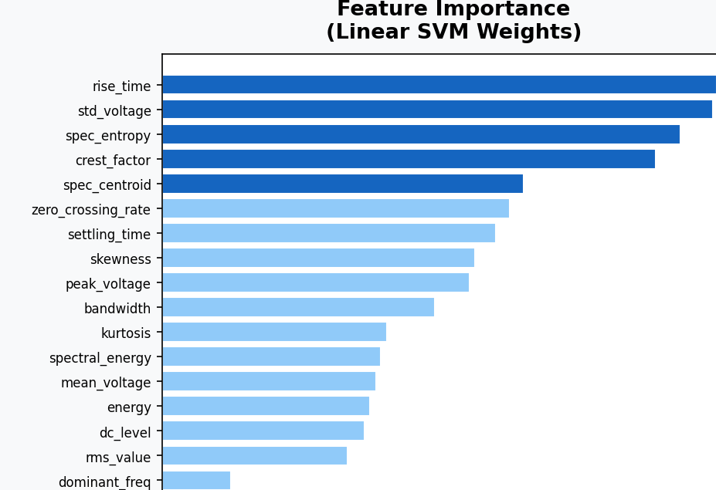
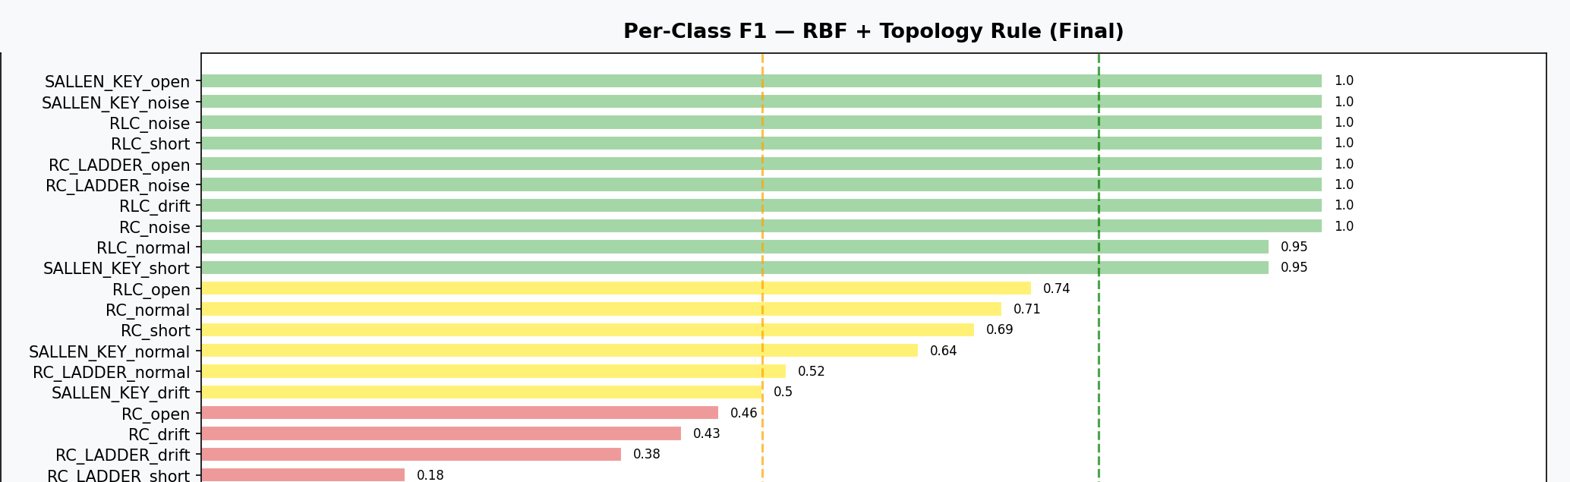
RESULTS
What the Model Weighs — and Where It Excels
rise_time and std_voltage carry the most weight in the linear model's decisions.
10 of 20 classes hit a perfect or near-perfect F1 score; RC/RC-Ladder faults trail behind.
KERNEL-BASED FAULT CLASSIFICATION IN ANALOG CIRCUITS
18

Slide 20
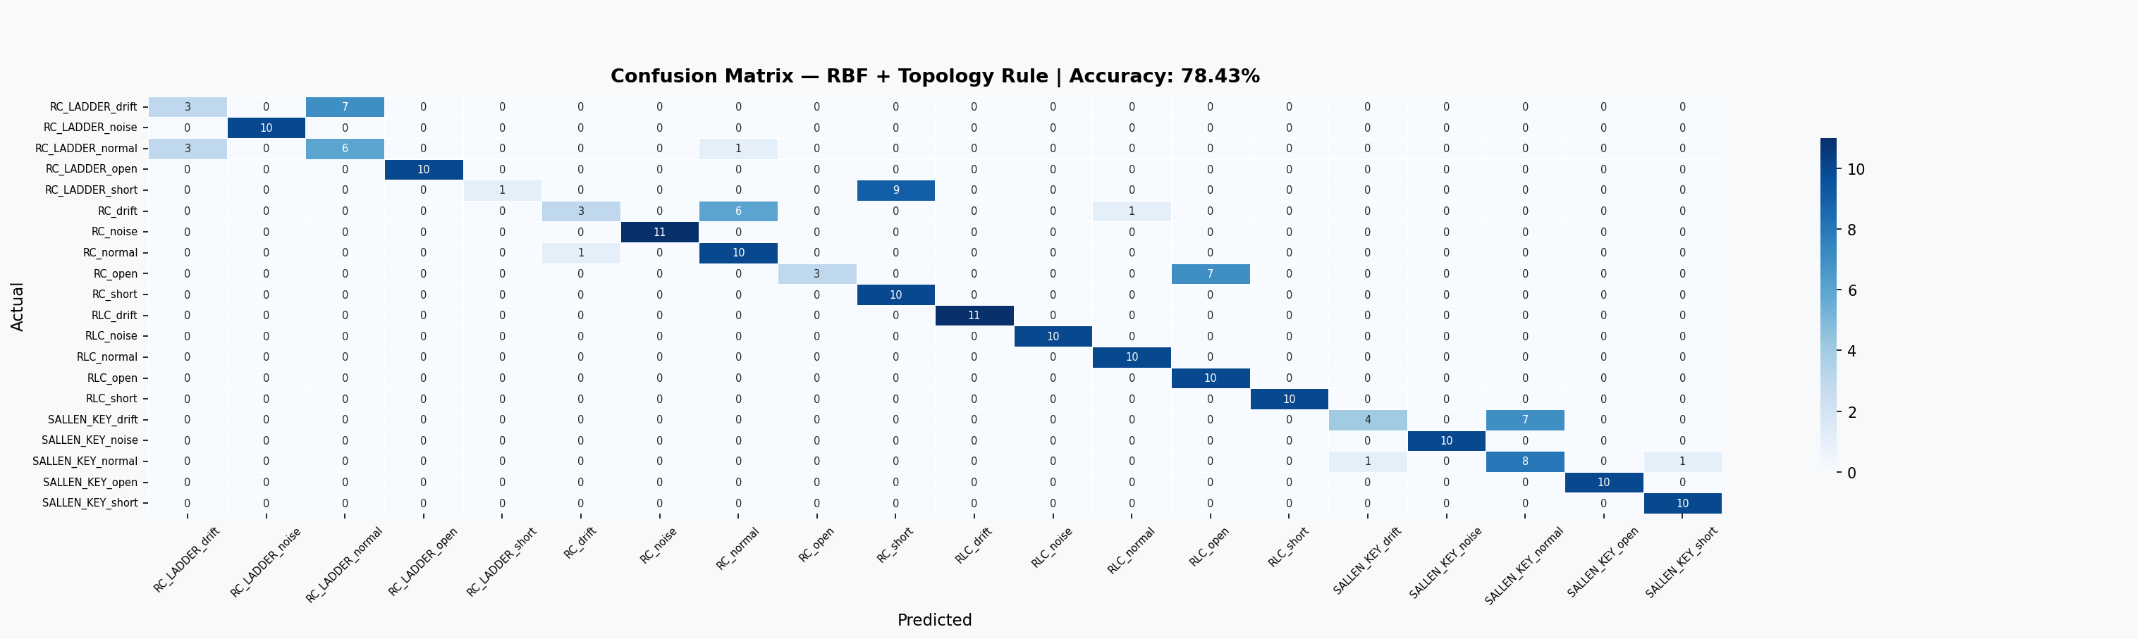
RESULTS
Every Prediction, At a Glance
KERNEL-BASED FAULT CLASSIFICATION IN ANALOG CIRCUITS
19

Slide 21

KEY FINDING
When Higher Accuracy Is the Wrong Answer
91% -> 76%
reported accuracy, before vs. after removing synthetic data augmentation
An earlier version of this pipeline trained on Python-augmented synthetic data and reported 91% accuracy. Replacing it with pure physics-based LTspice sweep data — real simulation variation, no synthetic shortcuts — dropped accuracy to ~76%. The model hadn't learned circuit fault physics — it had learned to recognise the augmentation transform itself. The lower, honest number is the more trustworthy result.
KERNEL-BASED FAULT CLASSIFICATION IN ANALOG CIRCUITS
20

Slide 22



REFLECTION
Where the Model Still Struggles
Small per-class test sets
RC & RC-Ladder confusion
Only ~10 test samples per class — a couple of misses can swing an F1 score sharply (e.g. RC_LADDER_short F1 = 0.18).
Passive-filter drift, normal and short faults can look subtly similar in the time domain, unlike RLC's distinct oscillations.
Limited scope
Simulation-only validation
Only 4 topologies and 5 fault types studied so far — real analog designs are far more diverse.
Entirely LTspice-based — no real hardware fault injection has been performed yet.
KERNEL-BASED FAULT CLASSIFICATION IN ANALOG CIRCUITS
21

Slide 23

DEMO
Try It Yourself: Live Web App
Dashboard
All results — kernel comparison, per-circuit accuracy, confusion matrix — in one view.
APP SCREENSHOT
Try Prediction
e.g. screenshot of the Streamlit
dashboard / prediction tab
Pick a sample or enter feature values manually and get an instant fault classification with confidence scores.
Dataset
Browse all 1,019 samples and their 17 extracted features directly in the browser.
analogcircuitsfaultclassification.streamlit.app
KERNEL-BASED FAULT CLASSIFICATION IN ANALOG CIRCUITS
22

Slide 24

CONCLUSION
Conclusion & What's Next
What We Built
Where It Goes Next
A physics-grounded ML pipeline: LTspice sweeps -> 17 engineered features -> tuned SVM.
78.43% accuracy on a genuinely hard 20-class fault problem.
A novel topology-aware correction rule that adds real accuracy for free.
A live, interactive Streamlit demo anyone can try.
Collect more sweep samples per class to stabilise the weaker F1 scores.
Compare against a 1D-CNN trained directly on raw waveforms.
Validate against real hardware fault injection, not just simulation.
Extend to more topologies — Wien bridge, active high-pass, and beyond.
KERNEL-BASED FAULT CLASSIFICATION IN ANALOG CIRCUITS
23

Slide 25


Thank You
Questions & discussion welcome.
Karan Kaushik | B.Tech ECE, NIT Silchar Guided by Dr. Anish Kumar Saha
karankaushik01234@gmail.com
analogcircuitsfaultclassification.streamlit.app

