Slide 1
Collections
Why a Collection used?
In Array, size is fixed and cannot be increased Dynamically and the same data types are stored in it, to overcome e this the Collection is introduced.
Collections are used to store, retrieve, manipulate, and communicate aggregate data. They typically represent data items that form a natural group.
Introduction
A collection is a set of similar types of objects that are grouped together.
System.Collections namespace contains specialized classes for storing and accessing the data.
Each collection class defined in .NET has a unique feature
Collection Interfaces :-
There are some basic operations that are possible on any Collection.
1. Search specific object in the Collection.
2. Adding and removing objects dynamically in the collection.
3. List the objects in the collections by iterating through it. And so on.

Slide 2
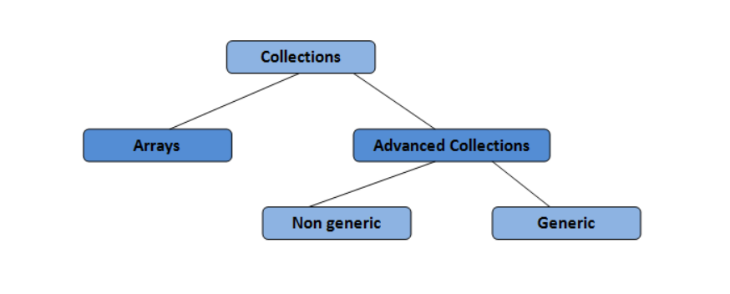
The basic operations are defined in the form of interfaces.
All the collection classes implement these interfaces to get the required functionality.
Implementation different for different classes.
Types of Collection : -
Non-generic Collection :-
1. ArrayList
2. Stack
3. Queue
4. HashTable

Slide 3
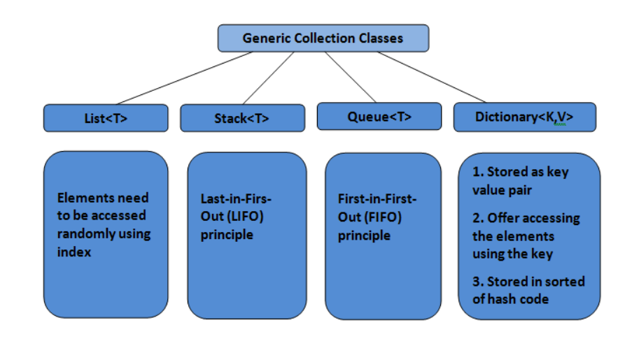
Generic Collection :-
Refer this site for extra information ,
1. https://www.c-sharpcorner.com/article/collections-in-c-sharp/
2. https://www.c-sharpcorner.com/article/collections-in-net/

