Slide 1

NATURAL LANGUAGE PROCESSING
Customer Feedback Analysis using Natural Language Processing
PRESENTED BY:
Manas Kumar — Btech/10293/24
Mohit Kumar — Btech/10296/24
Neeraj Kumar — Btech/10322/24
Kirtan Kumar — Btech/10562/24
Notes:
Introduce the team and the project title.Visual reference: use the college logo if the supplied asset is available. If unavailable, retain this reference for the presenter rather than inventing a replacement.

Slide 2





Introduction and Problem Statement
THE PROBLEM
THE SYSTEM ANSWERS FOUR QUESTIONS:
Businesses receive thousands of customer reviews, too many to read manually
Important complaints get lost in the volume
Goal: automatically understand customer feedback using NLP
Is the review positive, neutral or negative?
What topics do customers talk about?
Which aspects (delivery, refunds and so on) do they like or dislike?
What are the main complaints?
WHY NLP?
Transformer models (BERT family) understand context, not just single words
Constraint: only free, open-source models on Google Colab
OUR OUTPUT
Sentiment · topics · aspects · summaries,
all in one interactive dashboard
CUSTOMER FEEDBACK ANALYSIS USING NATURAL LANGUAGE PROCESSING
02
Notes:
Explain why manual reading doesn't scale.

Slide 3
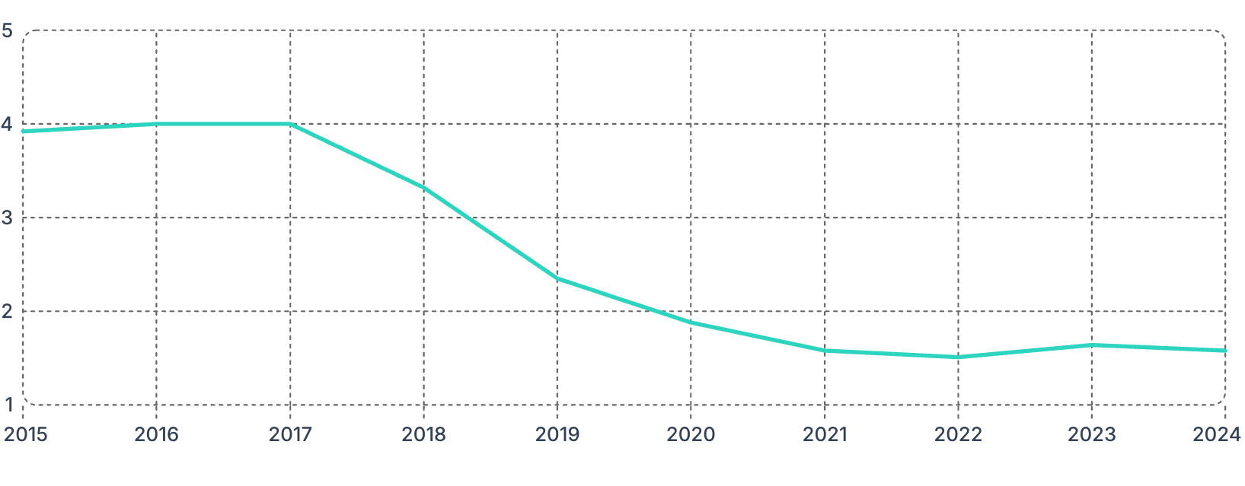
Dataset
Amazon_Reviews.csv: 20,913 public reviews of Amazon (2007–2024), mainly from the US and UK
CLEANING:
Removed broken rows and duplicates
Removed personal data (names, profile links)
Removed 630 "Review text not found" placeholders
Split: 72% train / 8% validation / 20% test
LABELS COME FROM STAR RATINGS:
69%
4%
27%
1–2 STARS = NEGATIVE
4–5 STARS = POSITIVE
3 STARS = NEUTRAL
KEY FINDING:
Average star rating per year
4.0
→ 1.6
stars
stars
The average rating fell from 4.0 stars (2016–17) to 1.6 stars (2021–24). Negative reviews rose from ~20% of each year to ~85%.
CUSTOMER FEEDBACK ANALYSIS USING NATURAL LANGUAGE PROCESSING
03
Notes:
The strong class imbalance shaped how we trained and evaluated the models.Visual reference: slide 3 uses the rating decline chart or eda_time_country.png. If the supplied visual is unavailable, retain the named reference rather than inventing replacement data.

Slide 4
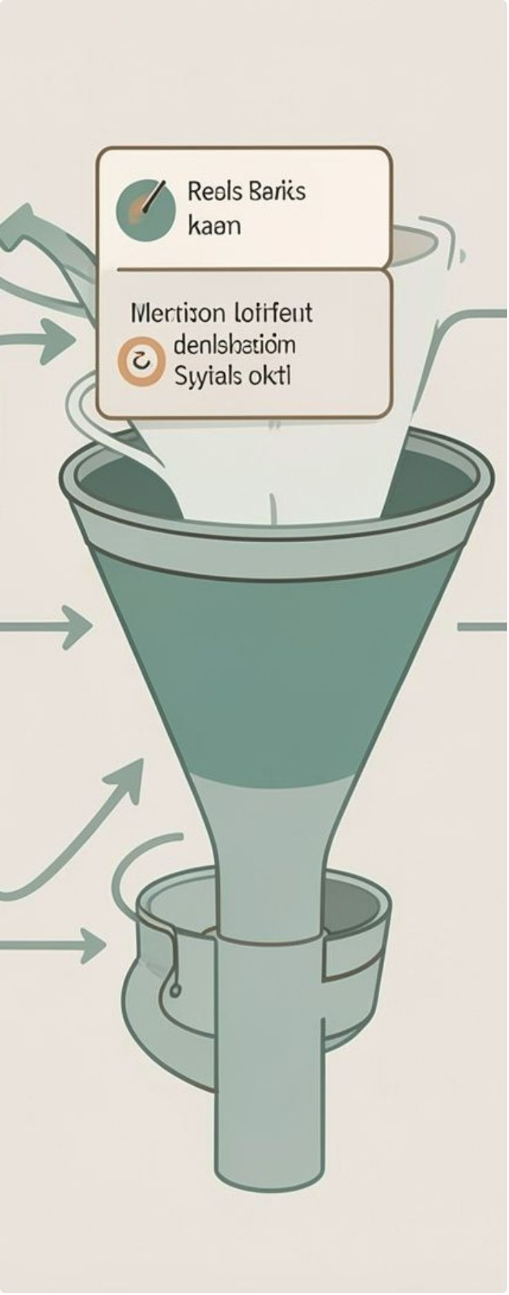
Methodology (System Architecture)
01
02
03
Raw reviews
Preprocessing
Sentiment models
04
05
06
Evaluation
Insight extraction
Dashboard
Preprocessing: Lowercase the text; remove URLs, HTML and punctuation; remove stopwords, but keep negations ("not good"); lemmatize words
Split: 72% train / 8% validation / 20% test (stratified)
Imbalance handling: rebalanced the training set only
Main metric: macro F1, which treats all three classes equally
Why: a model that always predicts "negative" would already score 69% accuracy
Also reported: accuracy, precision, recall, per-class F1 and confusion matrices
CUSTOMER FEEDBACK ANALYSIS USING NATURAL LANGUAGE PROCESSING
04
Notes:
Explain why accuracy alone is misleading with 69% negative reviews.Visual reference: use the architecture diagram from report Section 5.1 if available. If unavailable, retain the named reference rather than inventing a replacement diagram.

Slide 5
Models Used (all free and open source)
RULE-BASED:
CLASSICAL ML:
PRETRAINED TRANSFORMER:
VADER
TF-IDF + Naive Bayes, Logistic Regression, Linear SVM
RoBERTa (Twitter sentiment)
Dictionary of words with sentiment scores, plus rules for negation and punctuation. No training needed.
Transformer already trained for 3-class sentiment on tweets. Used as-is, without training on our data.
TF-IDF word weights → classifier. Trains in seconds on a CPU.
Best: macro F1 0.480
Best: LR, macro F1 0.672
Best: macro F1 0.645
FINE-TUNED TRANSFORMER:
INSIGHTS:
DistilBERT
BERTopic: discovers 12 topics
BART-MNLI: zero-shot business categories
DeBERTa-ABSA: sentiment for each aspect
BART-CNN: summaries of top complaints
(trained on our data, 2 epochs, Colab T4 GPU)
66M parameters: 40% smaller and 60% faster than BERT
Learning rate 2×10⁻⁵, batch 16, max 256 tokens
Training loss 1.08 → 0.15, no overfitting
Best model: macro F1 0.717
CUSTOMER FEEDBACK ANALYSIS USING NATURAL LANGUAGE PROCESSING
05
Notes:
We compared three levels: rule-based, classical ML and deep learning.

Slide 6
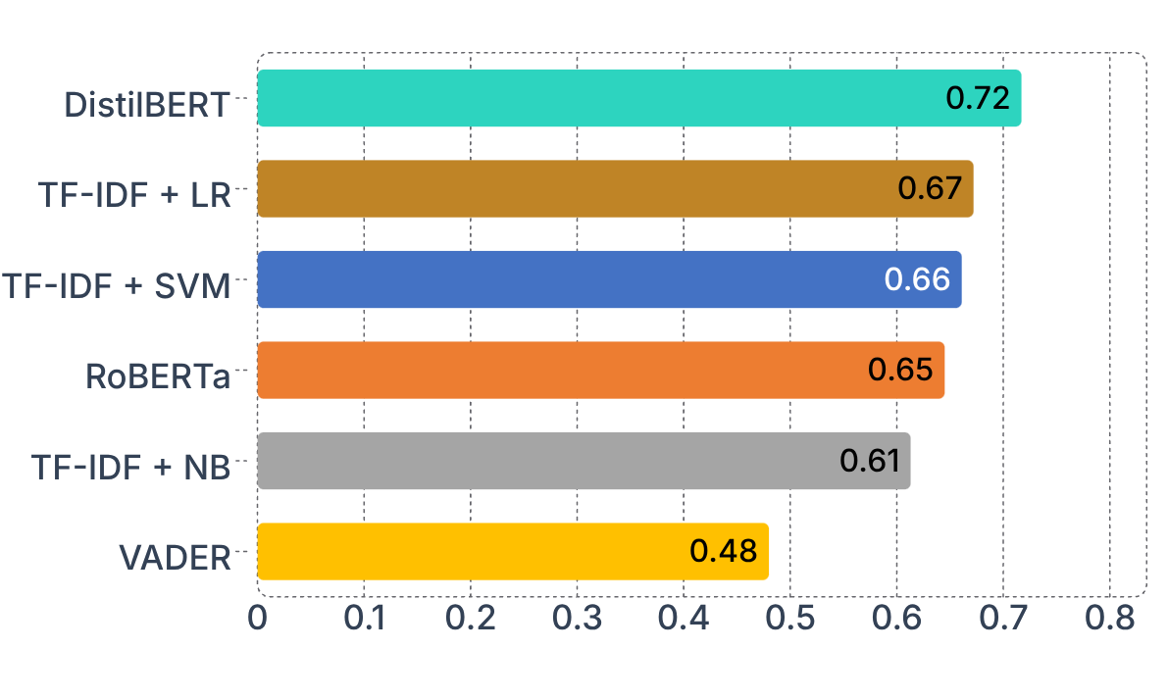
Results
MACRO F1 (TEST SET, 4,183 REVIEWS)
MODEL COMPARISON
MODEL | ACCURACY | MACRO F1
DistilBERT (fine-tuned) | 0.905 | 0.717
TF-IDF + Logistic Regression | 0.917 | 0.672
TF-IDF + Linear SVM | 0.919 | 0.661
RoBERTa (pretrained) | 0.897 | 0.645
TF-IDF + Naive Bayes | 0.908 | 0.613
VADER | 0.682 | 0.480
Fine-tuned DistilBERT is the best model: +4.4 points over Logistic Regression
It found 62 of 174 neutral reviews, 3× more than any other model
SVM has the highest accuracy (0.919) but only 3rd-best F1
Accuracy misleads on imbalanced data; macro F1 does not
CUSTOMER FEEDBACK ANALYSIS USING NATURAL LANGUAGE PROCESSING
06
Notes:
Point out that SVM has the highest accuracy but not the best F1, because of the imbalance.Visual reference: use model_comparison.png or the DistilBERT confusion matrix if available. If unavailable, retain the named reference rather than inventing a replacement visual.

Slide 7
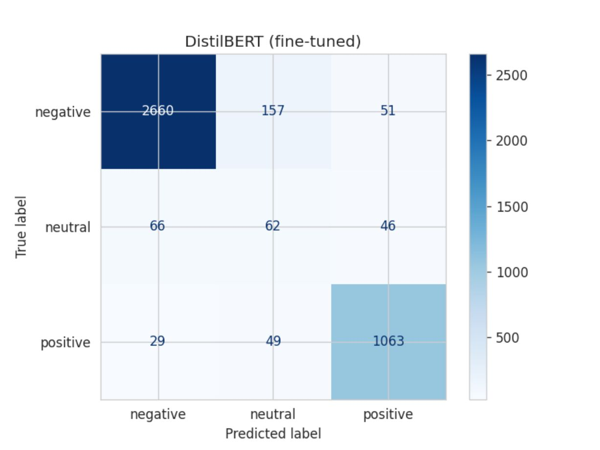
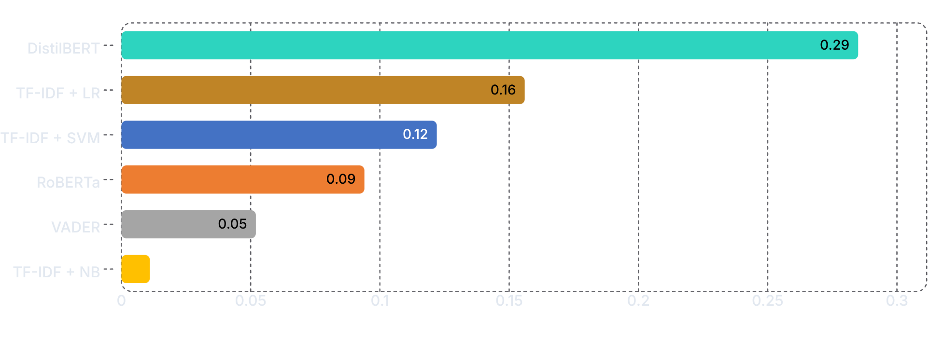
Model Performance Analysis
CONFUSION MATRIX: FINE-TUNED DISTILBERT
NEUTRAL-CLASS F1 BY MODEL
KEY TAKEAWAYS
Neutral is the hardest class: only 4% of the data, and 3-star reviews mix praise with complaints
Fine-tuning nearly doubled neutral F1 (0.285 vs 0.156 for the best classical model)
VADER called 34% of complaints positive; DistilBERT under 2%
Validation loss stayed steady at 0.32, so 2 epochs were enough
398 errors out of 4,183 reviews (9.5%)
80% of errors involve the neutral class
Biggest error: 157 negative → neutral
CUSTOMER FEEDBACK ANALYSIS USING NATURAL LANGUAGE PROCESSING
07
Notes:
Explain why neutral is the hardest class and how fine-tuning helped. Use the confusion matrix: most errors sit next to the neutral column and row.

Slide 8
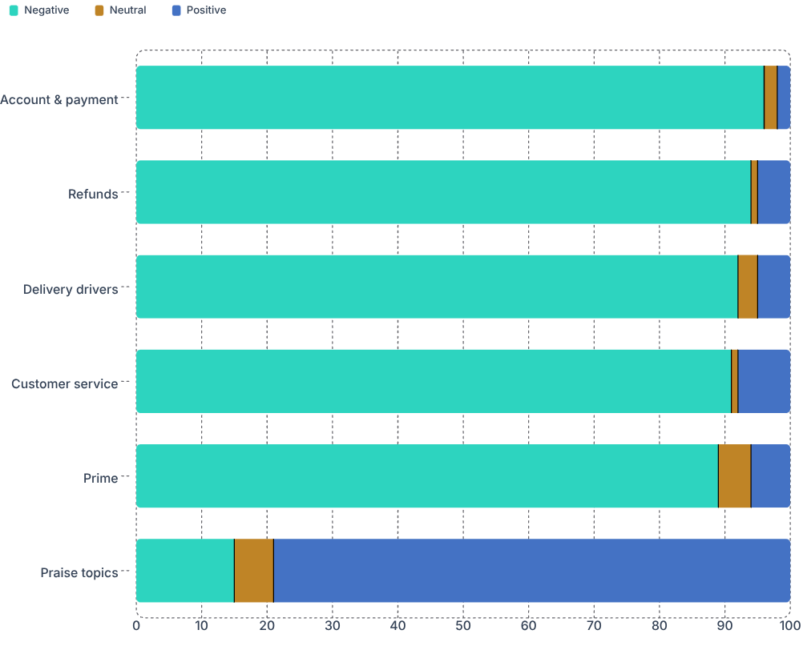
Insights from Customer Feedback
12
MOST PRAISED:
ASPECT-BASED SENTIMENT EXAMPLE:
fast delivery, books/Kindle, Prime shipping
"Product quality is great but delivery was late and customer service kept me on hold"
Result: product quality positive, delivery negative, customer service negative
topics were found with BERTopic. 76% of the reviews are complaints.
Conclusion: customers are unhappy with the service, not the products
MOST NEGATIVE TOPICS (OVER 90% NEGATIVE):
Account and payment issues
Refunds and returns
Delivery drivers
Customer service
LARGEST TOPICS (REVIEWS):
SENTIMENT SHARE PER TOPIC (%)
Refunds and returns: 824
Praise, fast service: 693
Account and payment: 690
Books and Kindle: 519
Prime and delivery speed: 512
Delivery drivers: 489
BUSINESS ACTION:
Fix account verification and refund handling first: they are the most negative topics (94–96% negative).
CUSTOMER FEEDBACK ANALYSIS USING NATURAL LANGUAGE PROCESSING
08
Notes:
Explain how the business should act: fix refunds and account checks first.Visual reference: use topic_sentiment.png if available. If unavailable, retain the named reference rather than inventing a replacement visual.

Slide 9

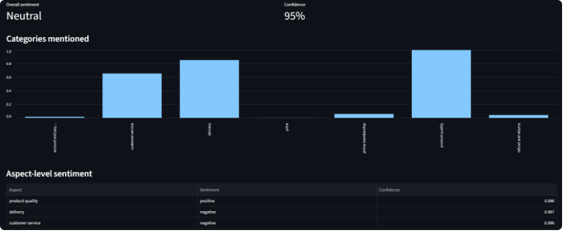
OPEN APP: http://localhost:8501/
Streamlit Dashboard (Live Demo)
SINGLE FEEDBACK TAB:
BULK ANALYSIS TAB:
Overall sentiment
Categories mentioned
Aspect-level sentiment
upload a CSV and get
Sentiment distribution
Category chart
Trend over time
The most negative reviews
Mixed review → product quality positive; delivery and customer service negative (99.6% confidence)
93%
LIVE DEMO: SINGLE FEEDBACK TAB
Predictions matched customers' star ratings for 93% of 300 random reviews
Runs on a normal laptop CPU
Bulk test (300 reviews): 70% negative · 22% positive · 8% neutral
Real output of our app
CUSTOMER FEEDBACK ANALYSIS USING NATURAL LANGUAGE PROCESSING
09
Notes:
Do the live demo here. Keep the app open before the presentation.Visual reference: use dashboard screenshots for Single feedback and Bulk analysis if available. If unavailable, retain the named reference rather than inventing replacement screenshots.

Slide 10
Conclusion and Future Scope
Conclusion
Limitations
Future scope
Built a complete NLP pipeline using only free models
Fine-tuned DistilBERT performed best (macro F1 0.717, accuracy 90.5%)
Topics and aspect analysis turn reviews into actionable insights
Found a sharp fall in satisfaction after 2018
93% agreement with star ratings in the dashboard
Very few neutral reviews (4%)
Star ratings are noisy labels
Long reviews cut at 256 tokens
English reviews of one company only
Category detection is slow on a CPU
Hindi/Hinglish feedback (IndicBERT)
Sarcasm detection
Real-time analysis with alerts
A chatbot over the feedback
Class-weighted training for neutral reviews
Online deployment (Hugging Face Spaces)
TOP PRIORITY NEXT:
0.717
4%
Hindi/Hinglish support for Indian e-commerce reviews (Flipkart, Myntra)
BEST MACRO F1 (DISTILBERT)
OF REVIEWS ARE NEUTRAL
CUSTOMER FEEDBACK ANALYSIS USING NATURAL LANGUAGE PROCESSING
10
Notes:
Summarize the key result in one line.

Slide 11

CUSTOMER FEEDBACK ANALYSIS USING NATURAL LANGUAGE PROCESSING
Thank You!
Questions?

