Slide 1
TEXT CLASSIFICATION
Karan Krishna
mail2karankrishnan@gmail.com

Slide 2
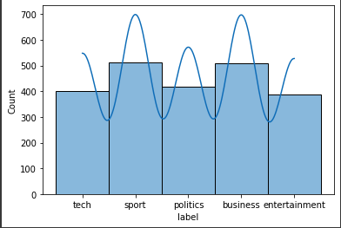
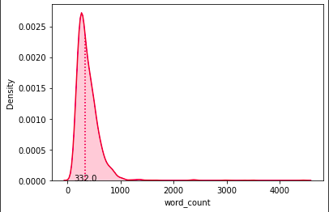
Dataset
Total of 2225 records
There are 5 target variable.
tech
sport
politics
business
Entertainment
Almost equal distribution of classes.
Median word count length is 332

Slide 3
Why Multi-Label Classification?
Given classes are not mutually exclusive so it better to use multi label classification
There can be text which contain both tech and business.

Slide 4
Why Transfer Learning?
Technique where a model trained on one task is re-purposed on a second related task.
Less resources needed
Can work smaller datasets
Improve performance

Slide 5
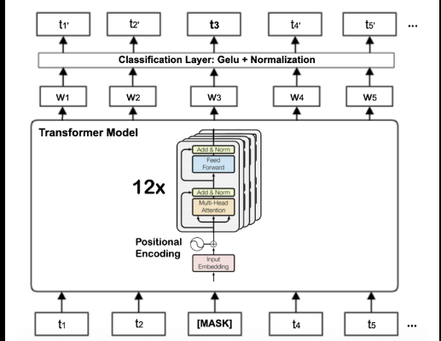
Why BERT?
Bidirectional Encoder Representations from Transformers.
Published by researchers at Google AI Language.
It can learns contextual relations between words or sub-words in a text.
Faster than RNN-based models as all the input is consume once.
Training BERT is easy when compared with LSTMs.
LSTM networks are impossible to do transfer learning.
Good for parallel computing

Slide 6
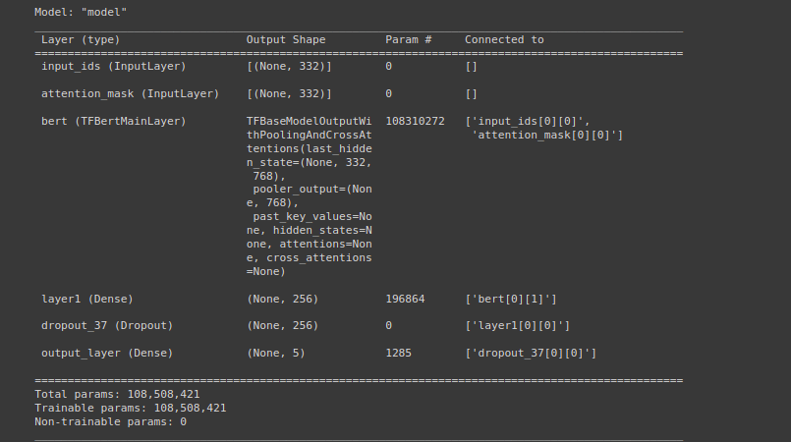
Deep Learning Architecture

Slide 7
Metrics
CategoricalAccuracy
Classes are not mutually exclusive.
distributed systems to merge the state computed by different metric instances.
F1 score:
Combines the precision and recall of a classifier into a single metric by taking their harmonic mean.
High F1 score means less False Positive and False Negative

Slide 8
Adam Optimizers
Adam optimization algorithm is a further extension of stochastic gradient descent to update network weights during training.
It updates the learning rate for each network weight individually.
It inherits the features of both Adagrad and RMS prop algorithms.
In adam, instead of adapting learning rates based upon the first moment as in RMS Prop, it also uses the second moment of the gradients.
Adam optimizer are generally better than other optimization algorithms, have a faster computation time, and require fewer parameters for tuning

Slide 9
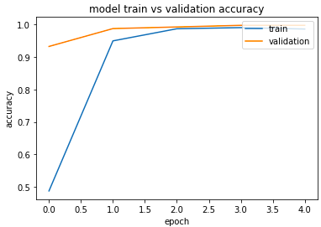
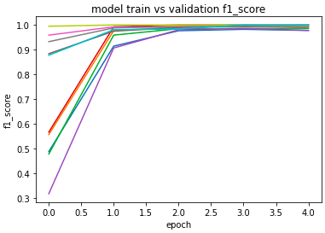
Evaluating Learning - Metrics

Slide 10
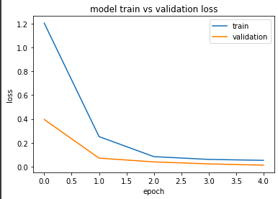
Evaluating Learning - Loss

Slide 11
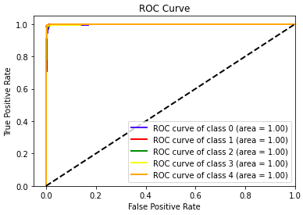
ROC CURVE
shows the trade-off between sensitivity (or TPR) and specificity (1 – FPR).

Slide 12
Conclusion
By using BERT transfer learning, with little resources and time we can able to build high accuracy, high precision and high recall.

