Slide 1

Event management system
Team members:
Karan Kumar V
Rinesh AR
Yashaswini D
Chandu Shree DS
Mohammad Suhail
Rakesh S
Varun Kumar R
Dhanush Vardhan Bommu

Slide 2
Agenda
Introduction
Objective and aim
Why is event management system essential
Purpose
Project scope
Existing system
Proposed system
User module
Software used
Django
Use case diagram
Future scope

Slide 3
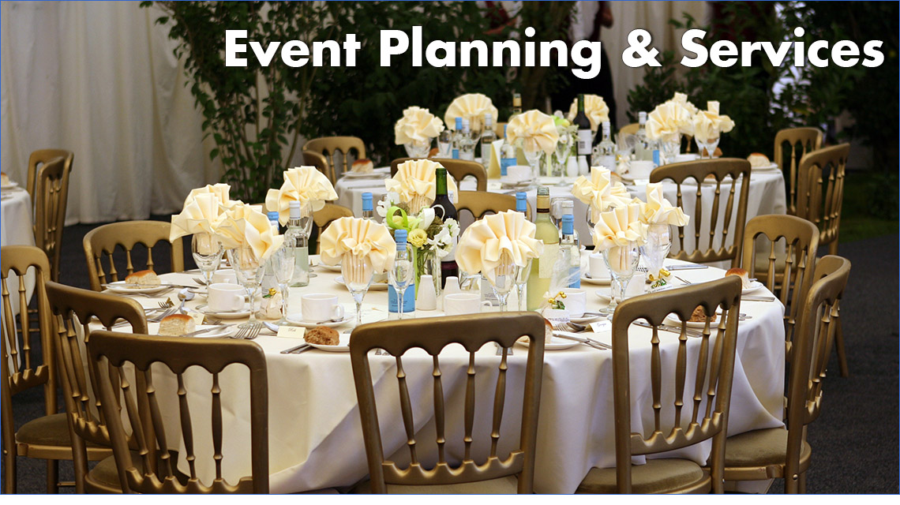
Introduction to event management
Event management is the application of project management to the creation and development of small and/or large-scale personal or corporate events such as festivals, conferences, ceremonies, weddings, formal parties, concerts, or conventions.
Overall, an event management system simplifies the complex process of organizing events, enhances attendee experience, and helps event organizers achieve their goals more effectively. It saves time, reduces manual effort, and improves overall event efficiency and success..

Slide 4

Objective and Aim
Objective:
Aim:
To efficiently organize and execute a diverse range of events, effective planning,
budget management, and communication strategies to deliver memorable experiences that align with client visions, meet project deadlines, and exceed participant expectations
The aim of event management involve the planning, execution, and supervision of events to ensure they are successful and meet the desired outcomes.
Client Satisfaction
Event Success
Efficient Team source
Risk Management
Brand Promotion

Slide 5
Why is event management system essential
There is always a need of a system that will perform online management of events and booking records.
This system will reduce the manual operation required to maintain all the records, and also generates the various reports for analysis.
1> Efficiency
2> Scalability
3> Data management
4> financial management
5> Adaptability

Slide 6
Purpose
To manage the online entry booking for upcoming event. It helps to users to book our entry online from anywhere.
This project also helps in administrative work such as keep information of events, users and booking.
Efficient Planning
Resource Management
Registration and Attendance Tracking
Communication and Collaboration

Slide 7
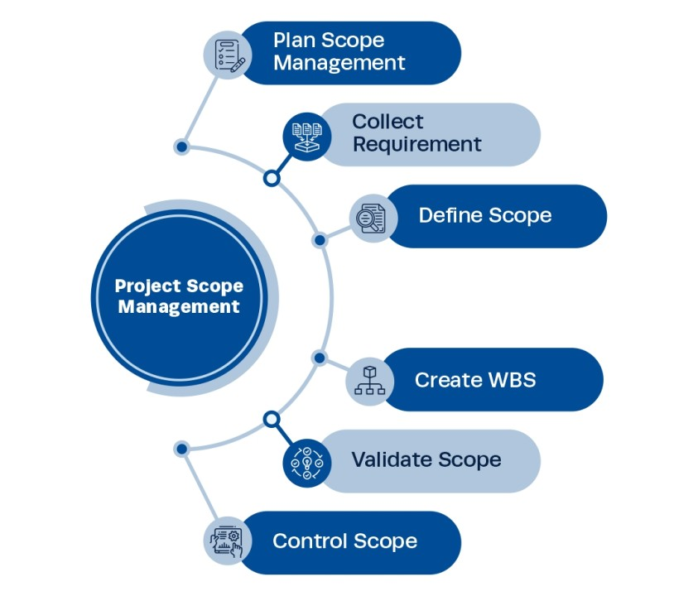
Project scope
The project has a wide scope, as it is not intended to a particular organization.
This project is going to develop generic software, which can be applied by any business organization.
More over it provide a huge amount of summary data.

Slide 8
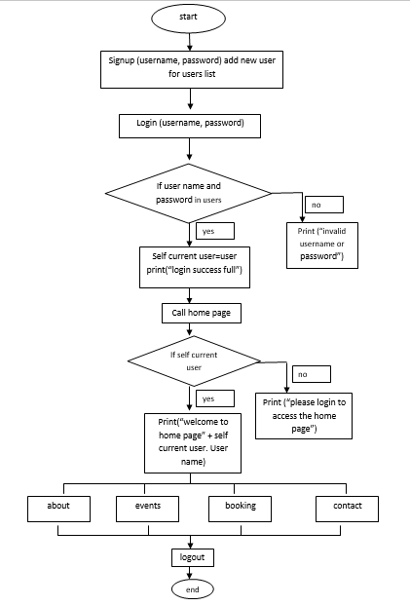
Existing System
This existing system is not providing secure registration and profile management of all the users properly. This system is not providing online help. This system doesn’t provide tracking of users activities and their progress.

Slide 9
Proposed system
The online event management/Booking system is available in the market that can serve users to book entry and view our booking status online.
User friendliness is provided in the application with various controls.
It provides high level of security with different level of authentication.
There is no risk of data mismanagement at any level while the project development is under process.

Slide 10
User module
features that allow users to interact with the system, manage their events, and perform other relevant tasks are:-
User Registration and Authentication
User Profile
Event Creation and Management
Event Registration
Event Discovery
User Interactions
User Feedback and Ratings
Security and Privacy
User Support

Slide 11
Software used
Django
Ide software
Vscode
Chrome or any other browser

Slide 12
Django
What id Django ?
Django is a high-level, open-source web framework for building web applications using the Python programming language. It follows the Model-View-Controller (MVC) architectural pattern, though in Django it is often referred to as the Model-View-Template (MVT) pattern.
Why is Django used ?
Django is widely used for :-
Django is commonly used in event management systems due to its robust features, scalability, and flexibility. Here are several reasons why Django is a popular choice for building event management systems:
Rapid Development
Scalability
Security
Community and Ecosystem
Overall, Django's combination of rapid development, scalability, security, community support, built-in features, and versatility makes it an ideal choice for building robust and efficient event management systems.

Slide 13
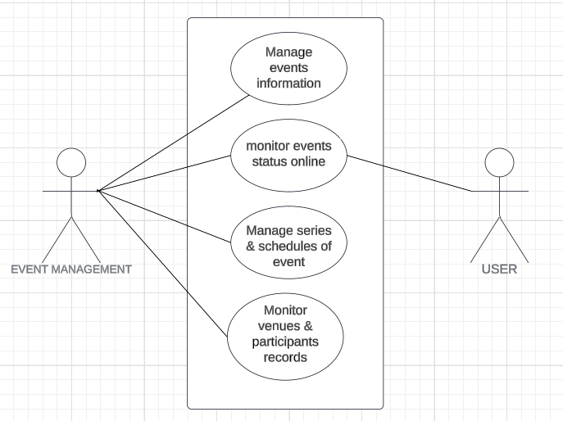
Use case diagram

Slide 14
Future scope
The scope of the project is to build an Event Management System without any issues that is designed to facilitate managing events without any trouble.
Benefits:-
- Manage College-level events
- Secured registration system
- Auto generate user reports
- Provide abstraction of implementation details.
Goals:
The goal of this project is to deploy proposed project, that is Event Management System successfully.

Slide 15


