Slide 1

What is THE
Green Chemistry ?

Slide 2
Introduction to Green Chemistry
Green Chemistry is an approach to chemistry that aims to maximize efficiency and minimize hazardous effects on human health and environment. The concept of green chemistry was coined by Paul T. Anastas.
Definition : Green Chemistry is the use of chemistry for pollution prevention by environmentally conscious design of chemical products and processes that reduce or eliminate the use or generation of hazardous substances.

Slide 3
The role of Green chemistry
Promoting innovative chemical technology to design, manufacture, and use chemical products that eliminate the generation of hazardous chemicals.
The capital expenditure required for the prevention of pollution is controlled by the use of green chemistry.
Green chemistry helps to protect the presence of ozone in the stratosphere.
Global warming (The greenhouse effect) is controlled by green chemistry.

Slide 4
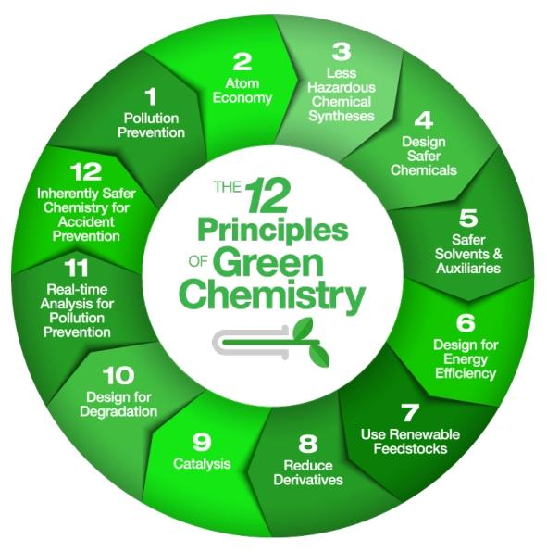
The 12 principles of green chemistry

Slide 5
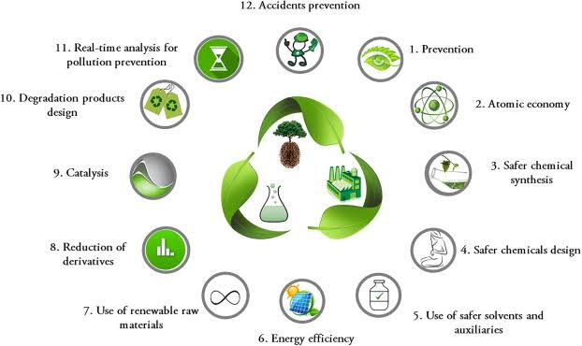

Slide 6
The 12 principles of Green Chemistry
Prevention :- It is better to prevent waste than to treat waste after it has been created.
Atom Economy :- Synthetic methods should be designed to maximize the incorporation of all materials used in the process into the final product.
Less Hazardous chemical syntheses :- Produce synthetic substances that little toxic to human health and the environment.
Designing Safer Chemicals :- Chemical products designed to affect their desired functions while minimizing their toxicity.
Safer Solvents and Auxiliaries :- The auxiliary substances should be innocuous when used.
Design for Energy Efficiency :- Synthetic methods should be conducted at ambient temperature and pressure. Energy requirements of chemical process should be recognized for their environmental impacts and should be minimized.

Slide 7
The 12 principles of Green Chemistry
Use of Renewable Feedstocks :- A feedstock should be renewable rather than depleting whenever practicable possible.
Reduce derivatives :- Unnecessary derivatization (physical/ chemical process) should be minimised or avoided, because thee additional reagents can generate waste.
Catalysis :- Catalytic reagents are superior to stoichiometric reagents.
Design for Degradation :- Chemicals products should be designed so that at the end of their function they breakdown into innocuous degradation products and do not persist in the environment.

Slide 8
The 12 principles of Green Chemistry
Real-time analysis for Pollution Prevention :- Analytical methodologies need to be further developed to allow for real-time, in-process monitoring and control prior to the formation of hazardous substances.
Inherently Safer Chemistry for Accident Prevention :- Substances used in chemical process should be chosen to minimize the potential for chemical accidents, including releases,explosions, and fires.

Slide 9


