Slide 1
IBM APPLIED DATA SCIENCE CAPSTONE

Slide 2
OUTLINE
Executive Summary
Introduction
Methodology
Results
Discussion
Conclusio

Slide 3

EXECUTIVE SUMMARY
• In this capstone project, we will predict if the SpaceX Falcon 9 first stage will land
successfully using several machine learning classification algorithms.
• The main steps in this project include:
• Data collection, wrangling, and formatting
• Exploratory data analysis
• Interactive data visualization
• Machine learning prediction
• Our graphs show that some features of the rocket launches have a correlation
with the outcome of the launches, i.e., success or failure.
• It is also concluded that decision tree may be the best machine learning
algorithm to predict if the Falcon 9 first stage will land successfully.

Slide 4
INTRODUCTION
• In this capstone, we will predict if the Falcon 9 first stage will land successfully.
SpaceX advertises Falcon 9 rocket launches on its website with a cost of 62 million
dollars; other providers cost upward of 165 million dollars each, much of the
savings is because SpaceX can reuse the first stage. Therefore if we can determine
if the first stage will land, we can determine the cost of a launch. This information
can be used if an alternate company wants to bid against SpaceX for a rocket
launch.
• Most unsuccessful landings are planned. Sometimes, SpaceX will perform a
controlled landing in the ocean.
• The main question that we are trying to answer is, for a given set of features
about a Falcon 9 rocket launch which include its payload mass, orbit type, launch
site, and so on, will the first stage of the rocket land successfully?

Slide 5
METHODOLOGY
• The overall methodology includes:
1. Data collection, wrangling, and formatting, using:
• SpaceX API
• Web scraping
2. Exploratory data analysis (EDA), using:
• Pandas and NumPy
• SQL
3. Data visualization, using:
• Matplotlib and Seaborn
• Folium
• Dash
4. Machine learning prediction, using
• Logistic regression
• Support vector machine (SVM)
• Decision tree
• K-nearest neighbors (KNN)

Slide 6
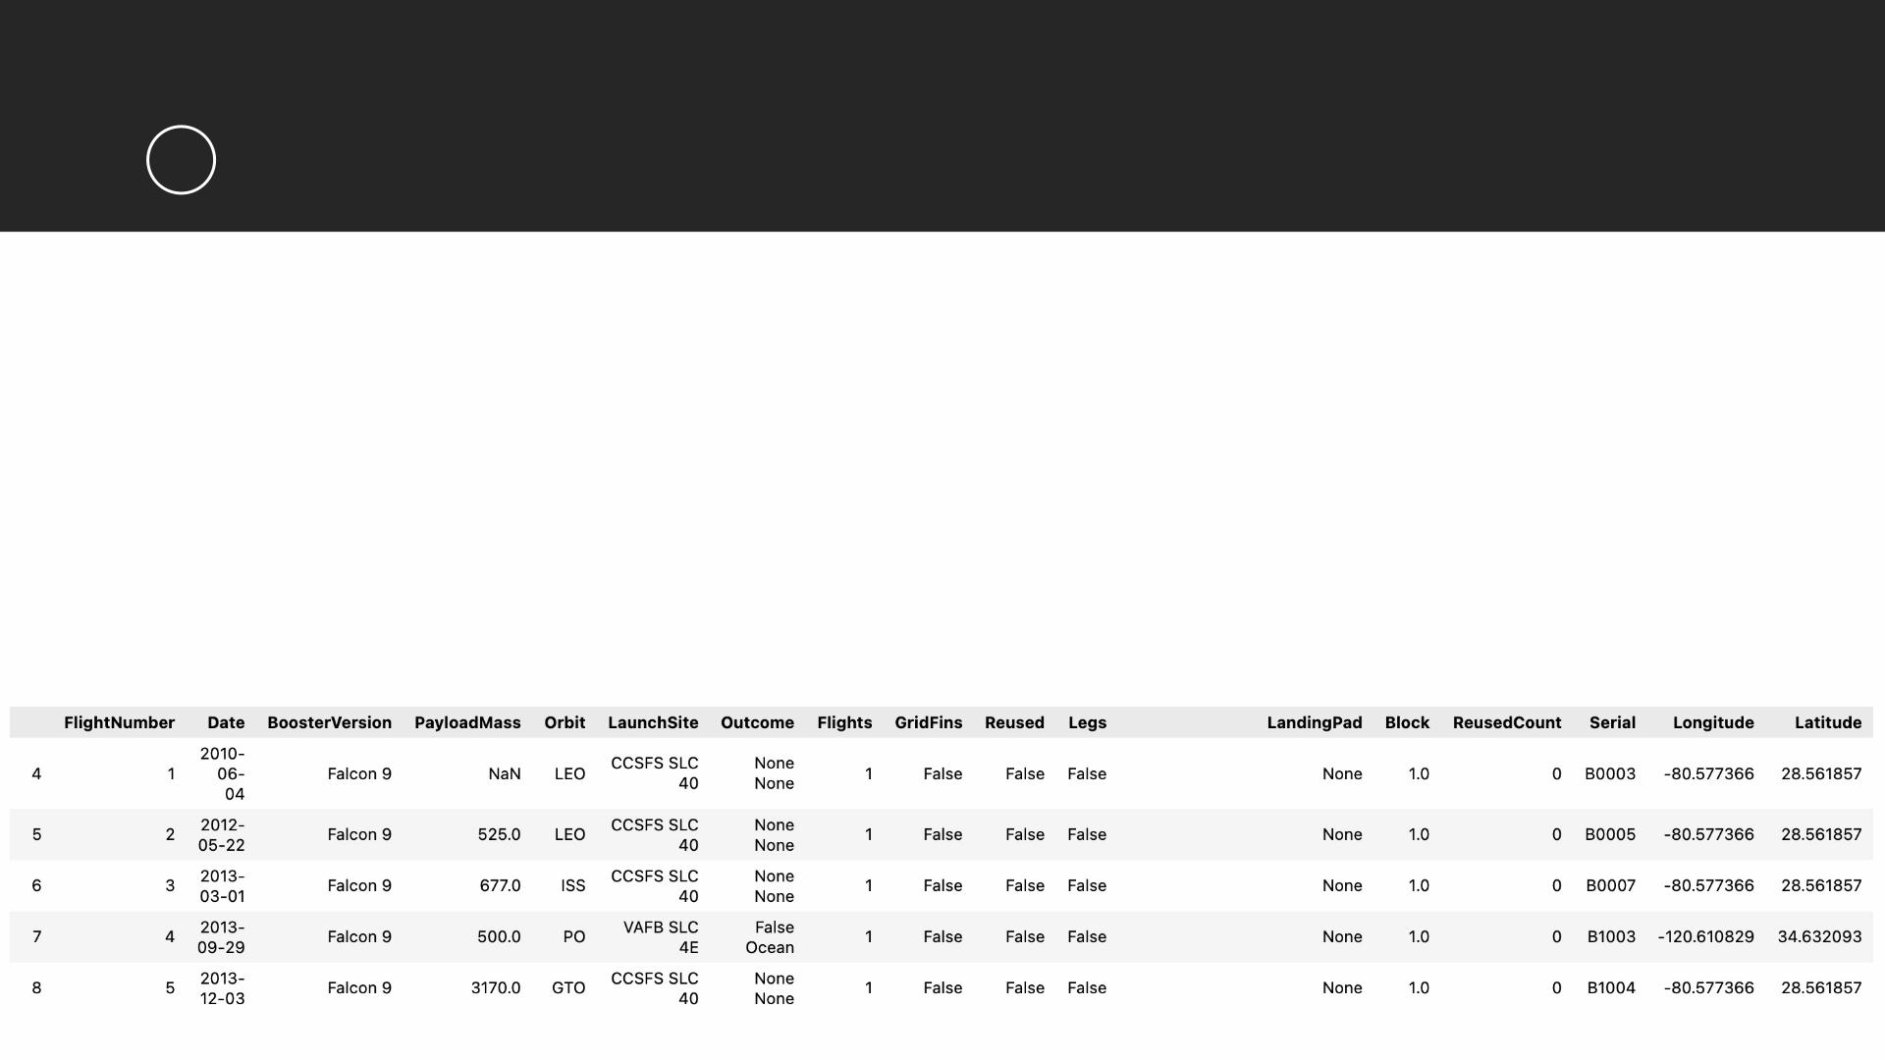
METHODOLOGY
1
Data collection, wrangling, and formatting
• SpaceX API
• The API used is https://api.spacexdata.com/v4/rockets/.
• The API provides data about many types of rocket launches done by SpaceX, the data is
therefore filtered to include only Falcon 9 launches.
• Every missing value in the data is replaced the mean the column that the missing value
belongs to.
• We end up with 90 rows or instances and 17 columns or features. The picture below shows
the first few rows of the data:

Slide 7
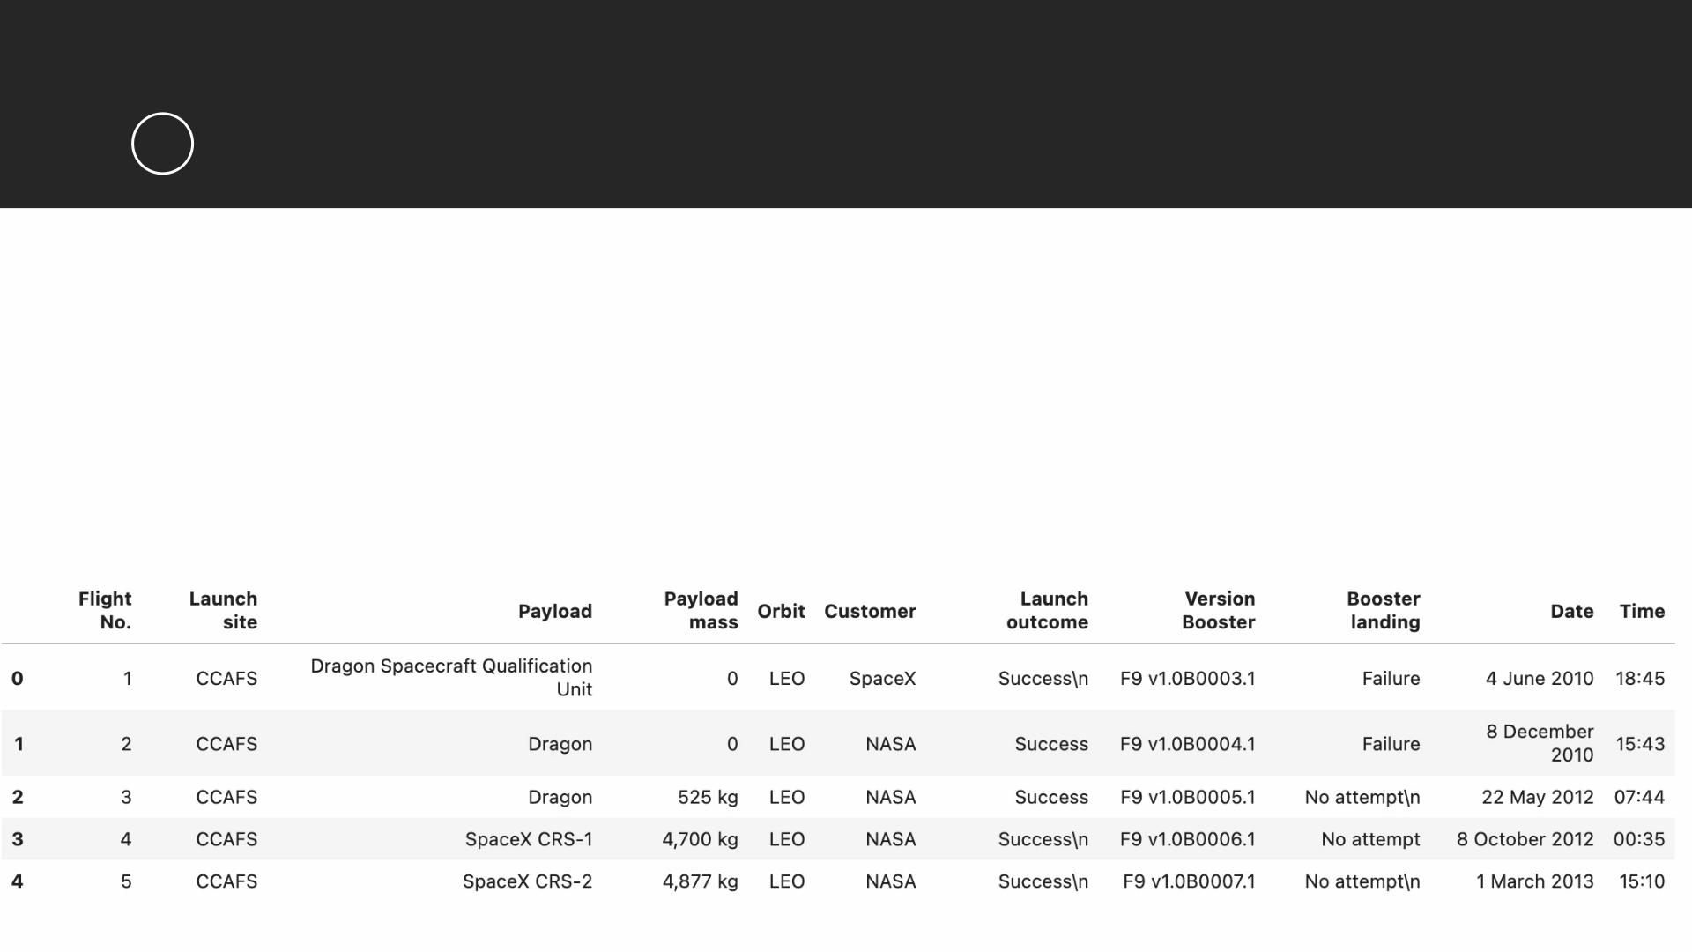
METHODOLOGY
1
Data collection, wrangling, and formatting
• Web scraping
• The data is scraped from
https://en.wikipedia.org/w/index.php?title=List_of_Falcon_9_and_Falcon_Heavy_launches&
oldid=1027686922
• The website contains only the data about Falcon 9 launches.
• We end up with 121 rows or instances and 11 columns or features. The picture below shows
the first few rows of the data:

Slide 8

METHODOLOGY
1
Data collection, wrangling, and formatting
• The data is later processed so that there are no missing entries and categorical
features are encoded using one-hot encoding.
• An extra column called ‘Class’ is also added to the data frame. The column ‘Class’
contains 0 if a given launch is failed and 1 if it is successful.
• In the end, we end up with 90 rows or instances and 83 columns or features.

Slide 9
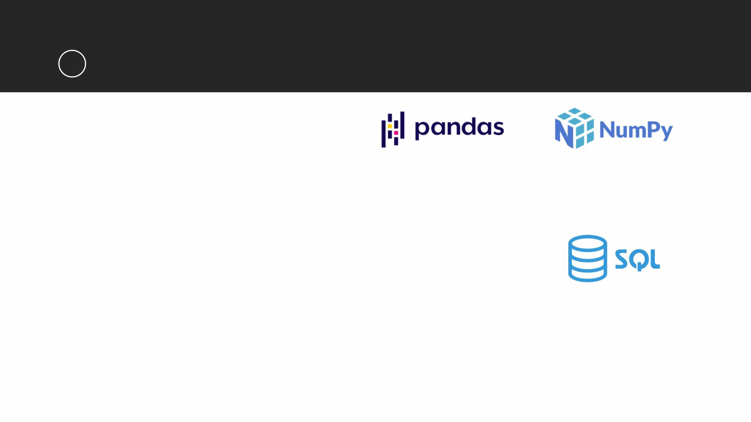
METHODOLOGY
2
Exploratory Data Analysis (EDA)
• Pandas and NumPy
• Functions from the Pandas and NumPy libraries are used to derive basic information about
the data collected, which includes:
• The number of launches on each launch site
• The number of occurrence of each orbit
• The number and occurrence of each mission outcome
• SQL
• The data is queried using SQL to answer several questions about the data such as:
• The names of the unique launch sites in the space mission
• The total payload mass carried by boosters launched by NASA (CRS)
• The average payload mass carried by booster version F9 v1.1

Slide 10
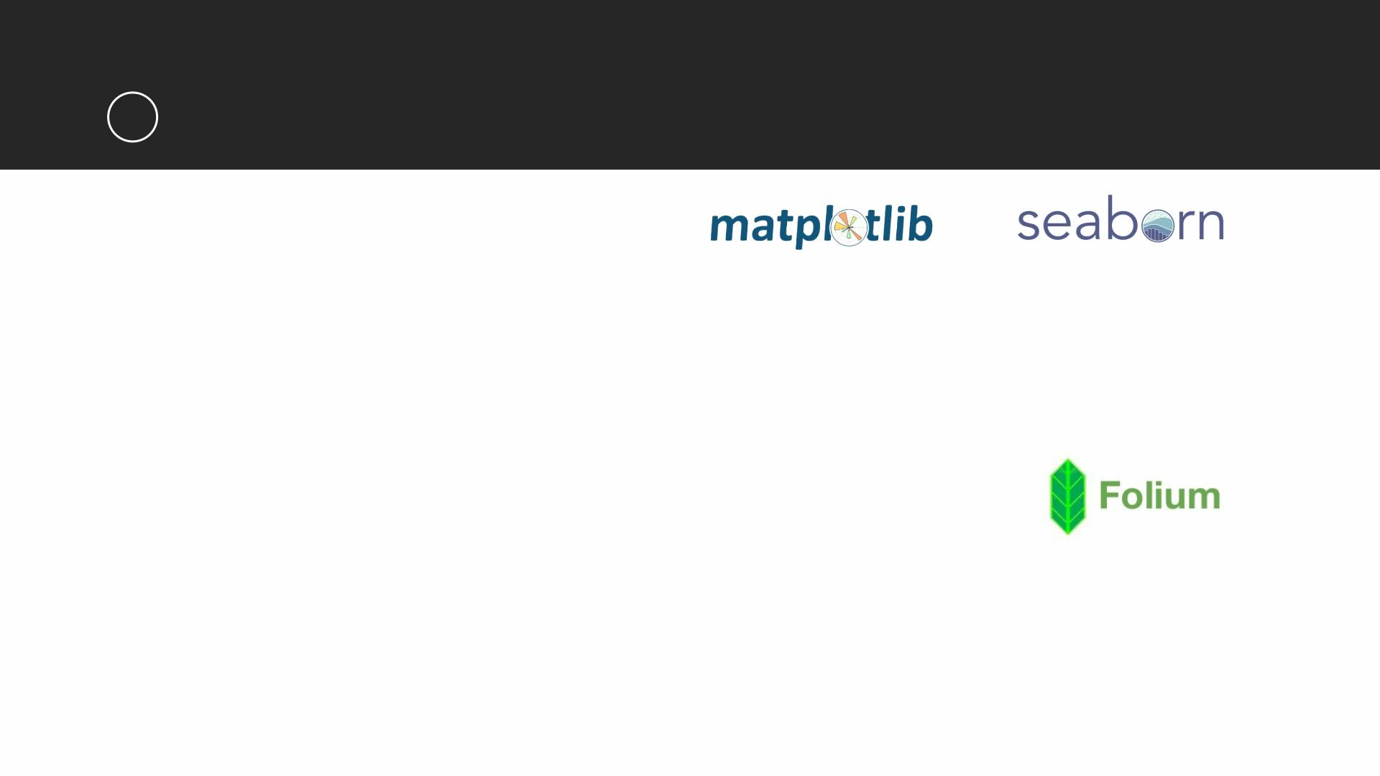
METHODOLOGY
3
Data Visualization
• Matplotlib and Seaborn
• Functions from the Matplotlib and Seaborn libraries are used to visualize the data through
scatterplots, bar charts, and line charts.
• The plots and charts are used to understand more about the relationships between several
features, such as:
• The relationship between flight number and launch site
• The relationship between payload mass and launch site
• The relationship between success rate and orbit type
• Folium
• Functions from the Folium libraries are used to visualize the data through interactive maps.
• The Folium library is used to:
• Mark all launch sites on a map
• Mark the succeeded launches and failed launches for each site on the map
• Mark the distances between a launch site to its proximities such as the nearest city, railway, or
highway

Slide 11
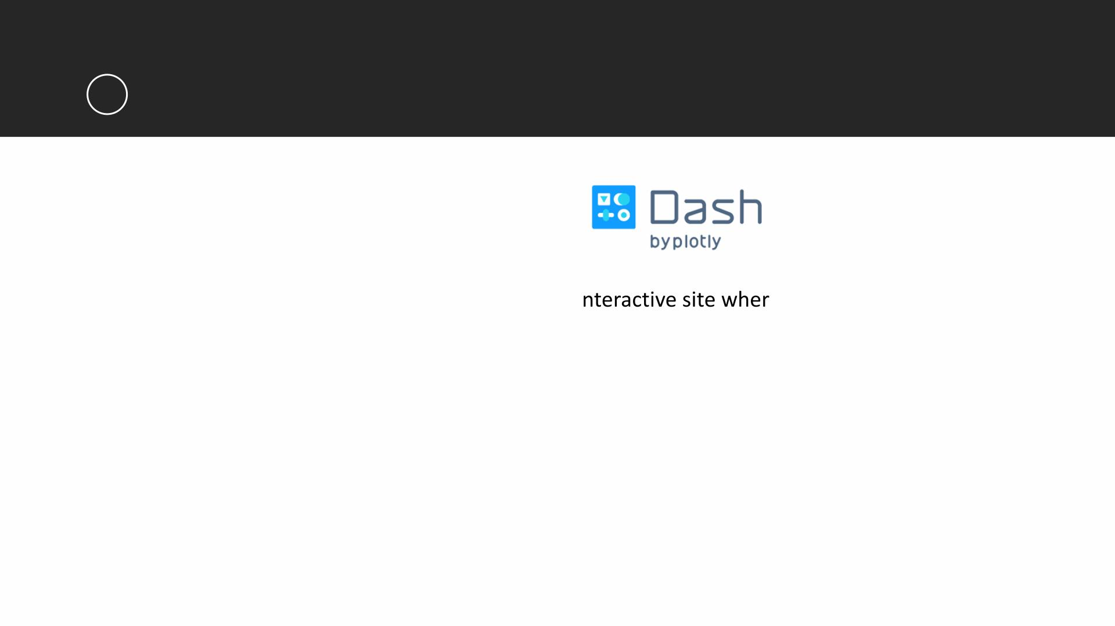
METHODOLOGY
3
Data Visualization
• Dash
• Functions from Dash are used to generate an i
e we can toggle the input
using a dropdown menu and a range slider.
• Using a pie chart and a scatterplot, the interactive site shows:
• The total success launches from each launch site
• The correlation between payload mass and mission outcome (success or failure) for each launch
site

Slide 12

METHODOLOGY
4
Machine Learning Prediction
• Functions from the Scikit-learn library are used to create our machine learning
models.
• The machine learning prediction phase include the following steps:
• Standardizing the data
• Splitting the data into training and test data
• Creating machine learning models, which include:
• Logistic regression
• Support vector machine (SVM)
• Decision tree
• K nearest neighbors (KNN)
• Fit the models on the training set
• Find the best combination of hyperparameters for each model
• Evaluate the models based on their accuracy scores and confusion matrix

Slide 13
RESULTS
• The results are split into 5 sections:
• SQL (EDA with SQL)
• Matplotlib and Seaborn (EDA with Visualization)
• Folium
• Dash
• Predictive Analysis
• In all of the graphs that follow, class 0 represents a failed launch outcome while
class 1 represents a successful launch outcome.

Slide 14
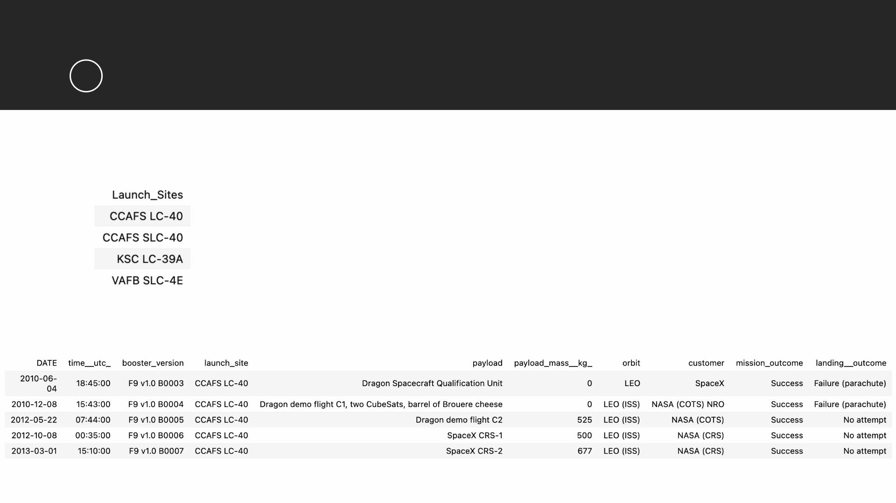
RESULTS
1
SQL (EDA with SQL)
• The names of the unique launch sites in the space mission
• 5 records where launch sites begin with ‘CCA’

Slide 15
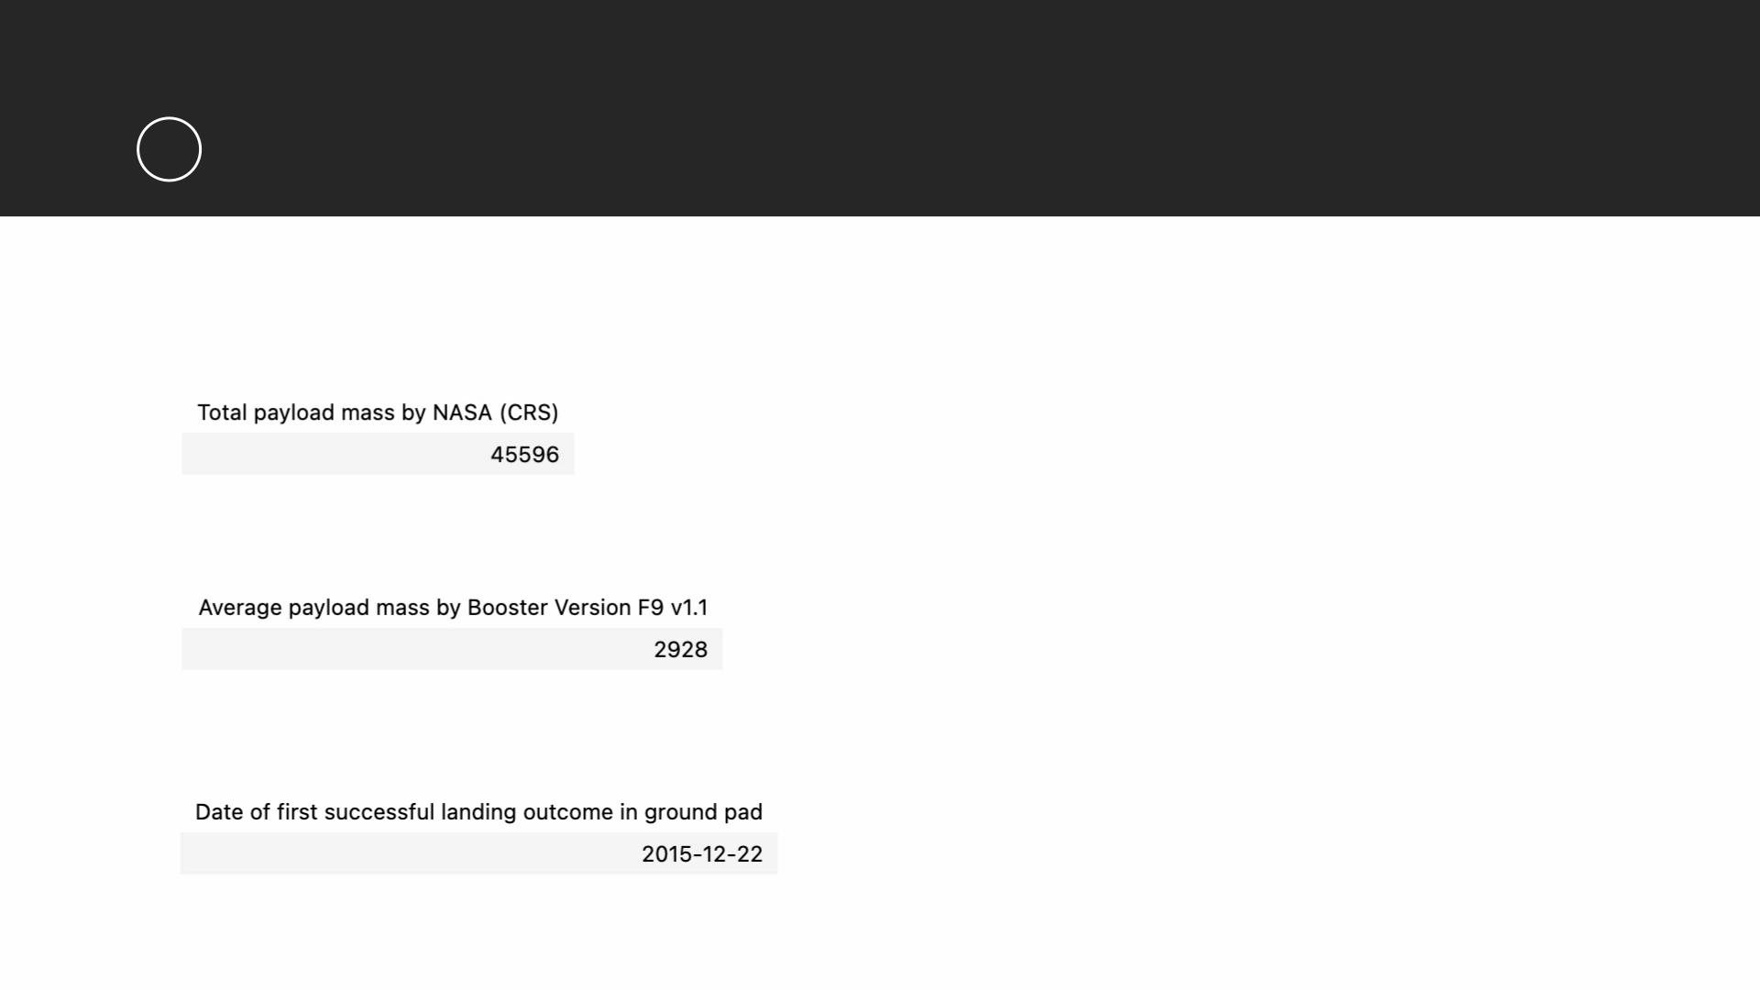
RESULTS
1
SQL (EDA with SQL)
• The total payload mass carried by boosters launched by NASA (CRS)
• The average payload mass carried by booster version F9 v1.1
• The date when the first successful landing outcome in ground pad was achieved

Slide 16
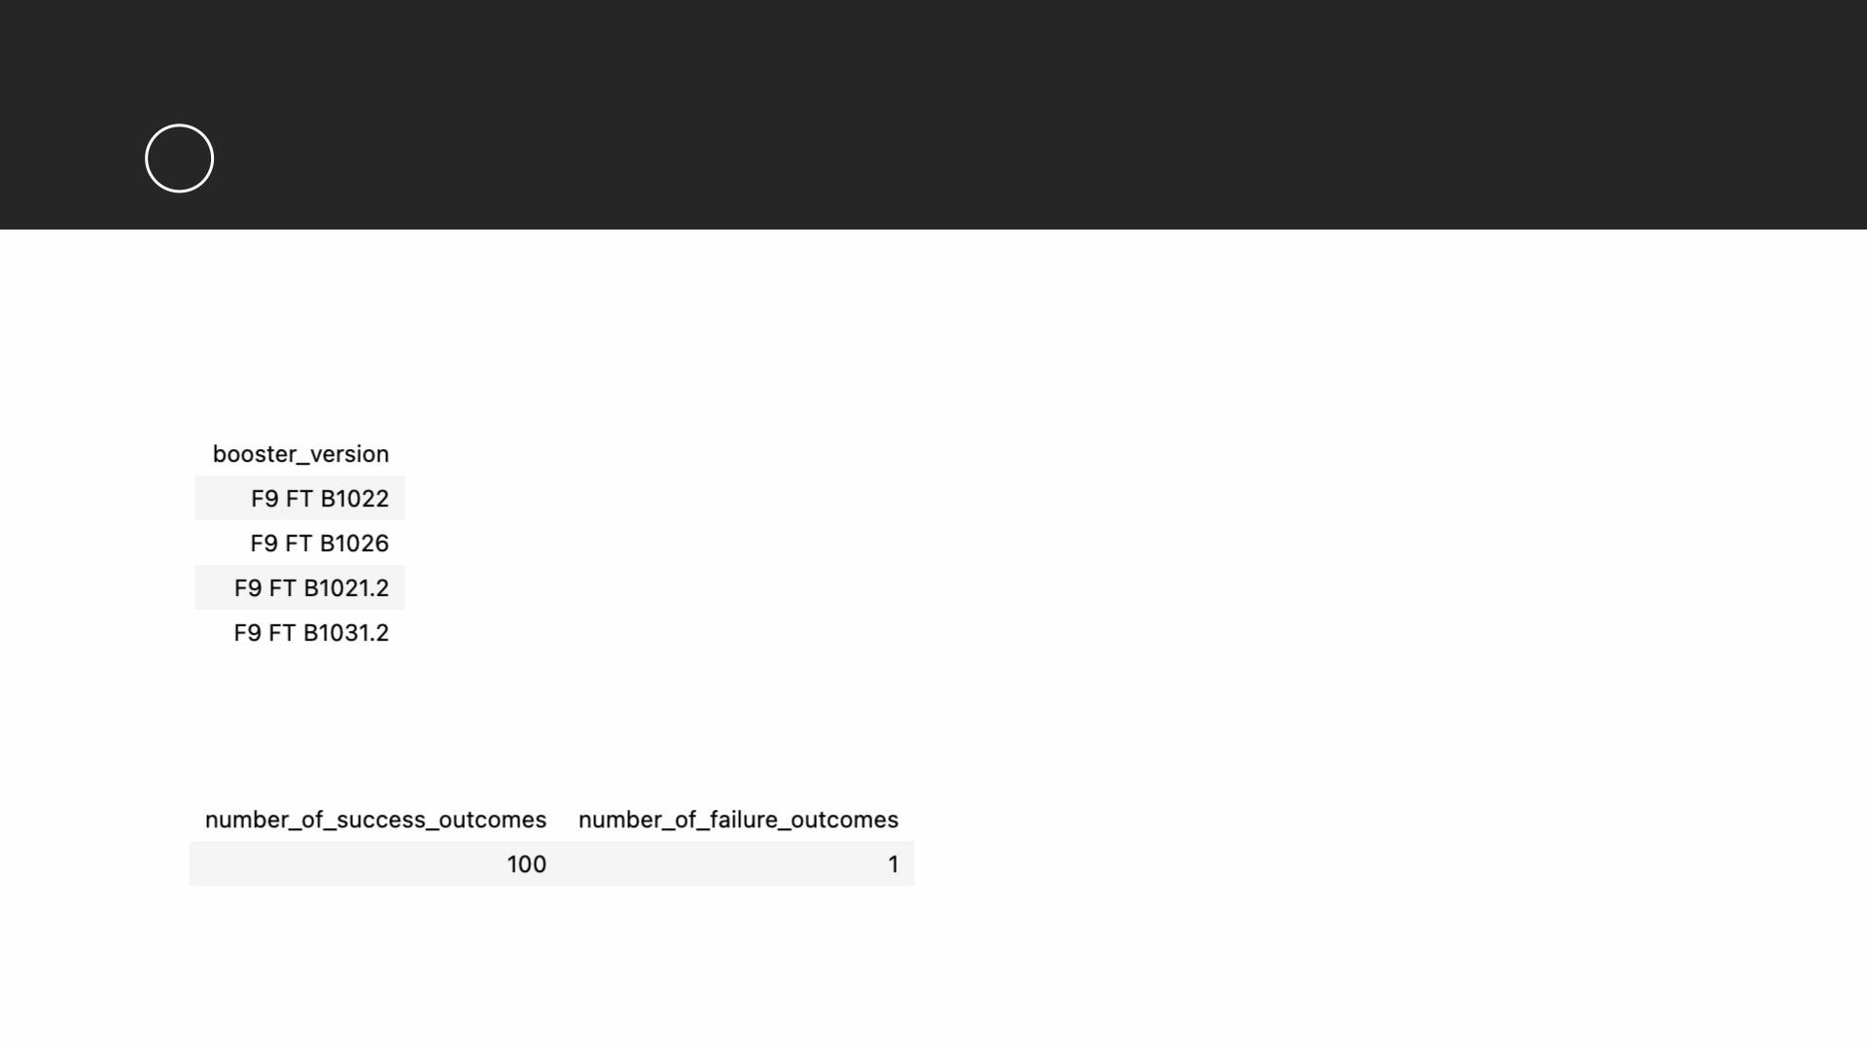
RESULTS
1
SQL (EDA with SQL)
• The names of the boosters which have success in drone ship and have payload
mass greater than 4000 but less than 6000
• The total number of successful and failure mission outcomes

Slide 17
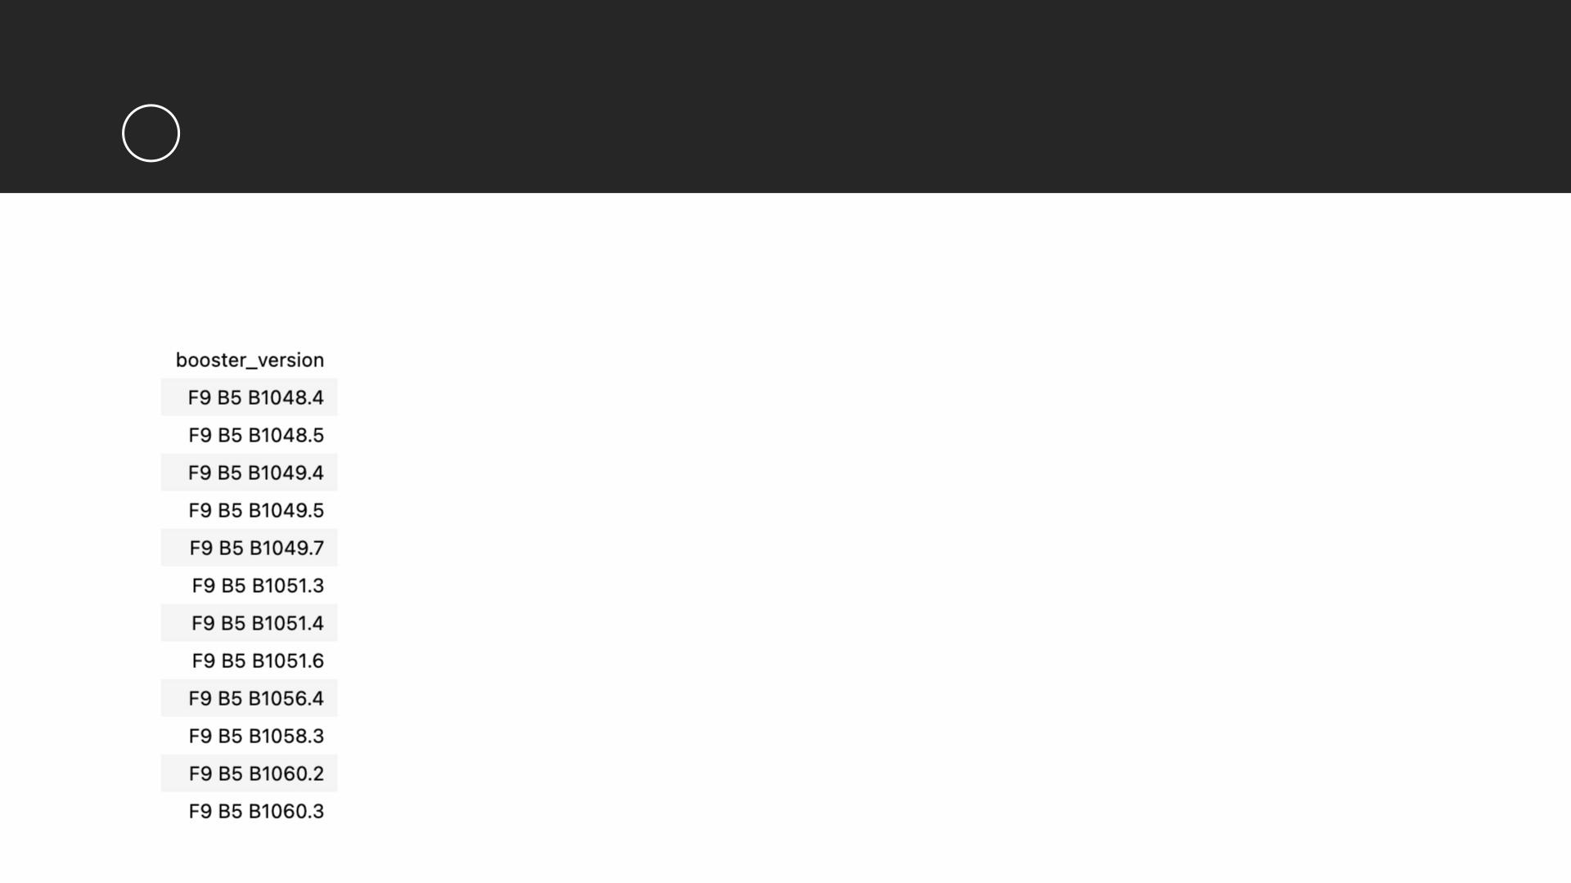
RESULTS
1
SQL (EDA with SQL)
• The names of the booster versions which have carried the maximum payload
mass

Slide 18
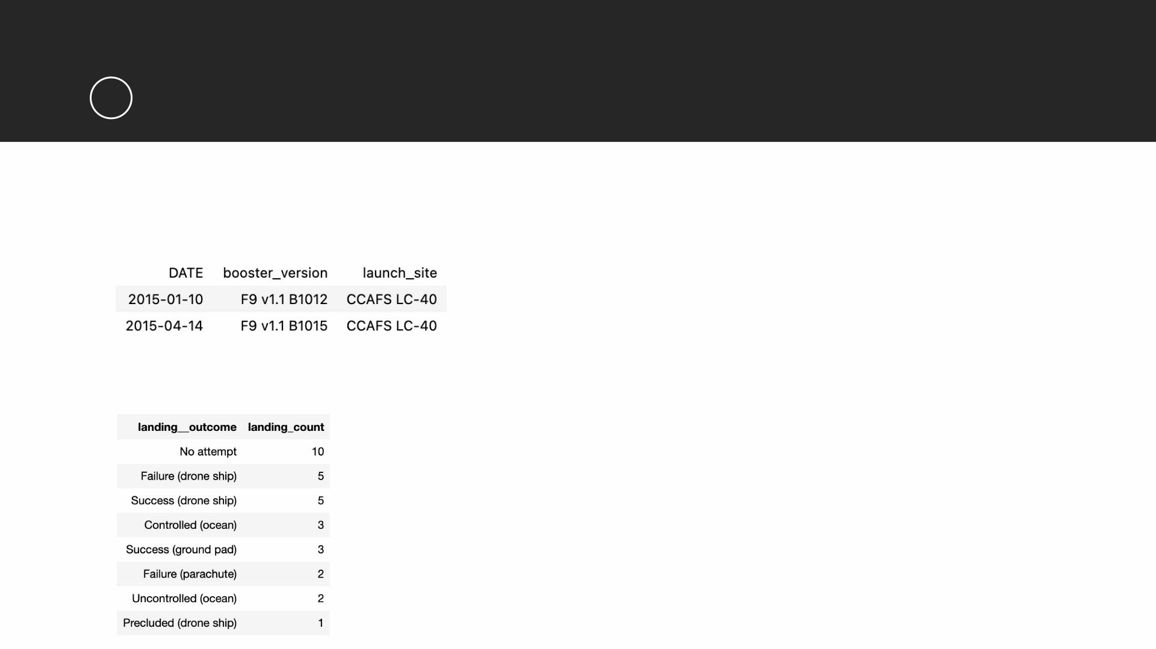
RESULTS
1
SQL (EDA with SQL)
• The failed landing outcomes in drone ship, their booster versions, and launch site
names for in year 2015
• The count of landing outcomes between the date 2010-06-04 and 2017-03-20, in
descending order

Slide 19
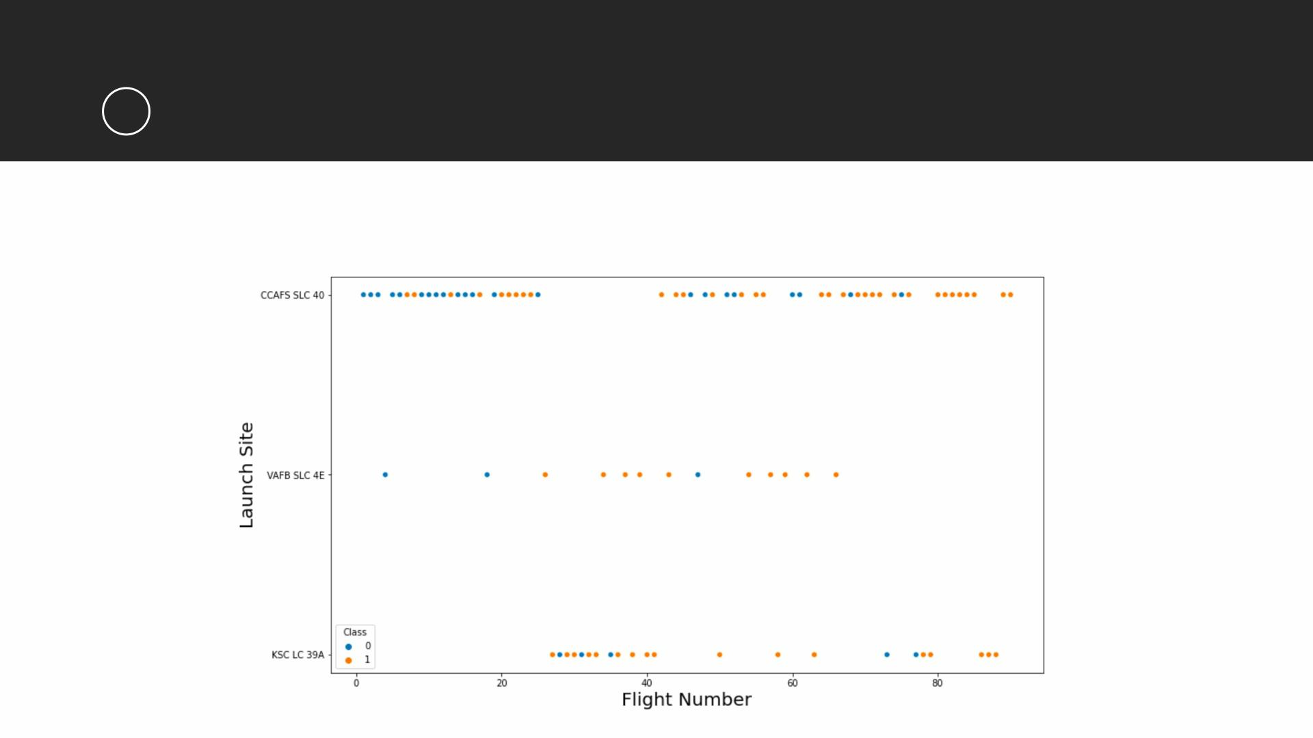
RESULTS
2
Matplotlib and Seaborn (EDA with Visualization)
• The relationship between flight number and launch site

Slide 20
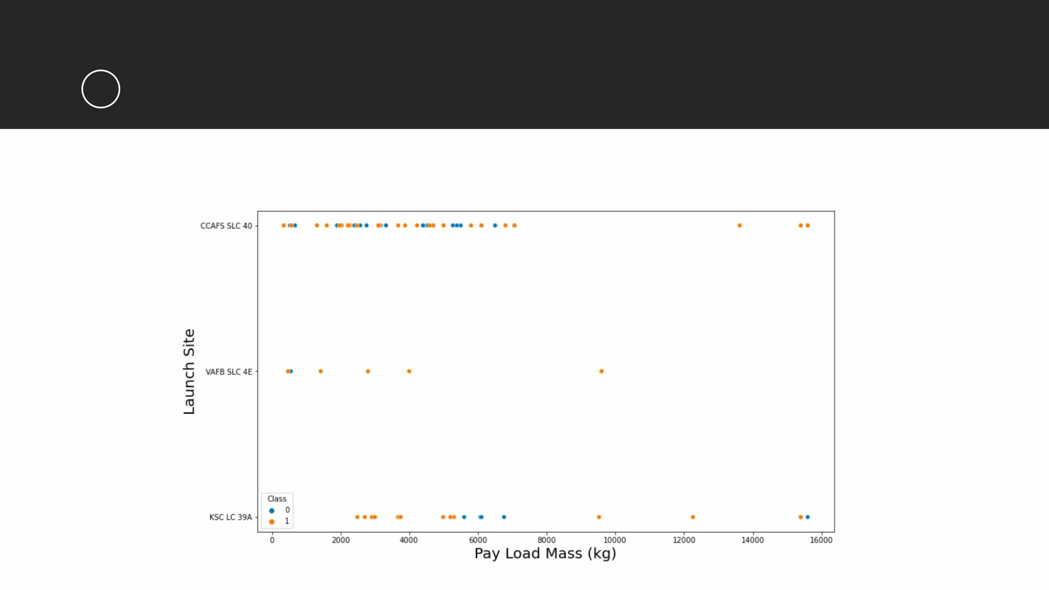
RESULTS
2
Matplotlib and Seaborn (EDA with Visualization)
• The relationship between payload mass and launch site

Slide 21
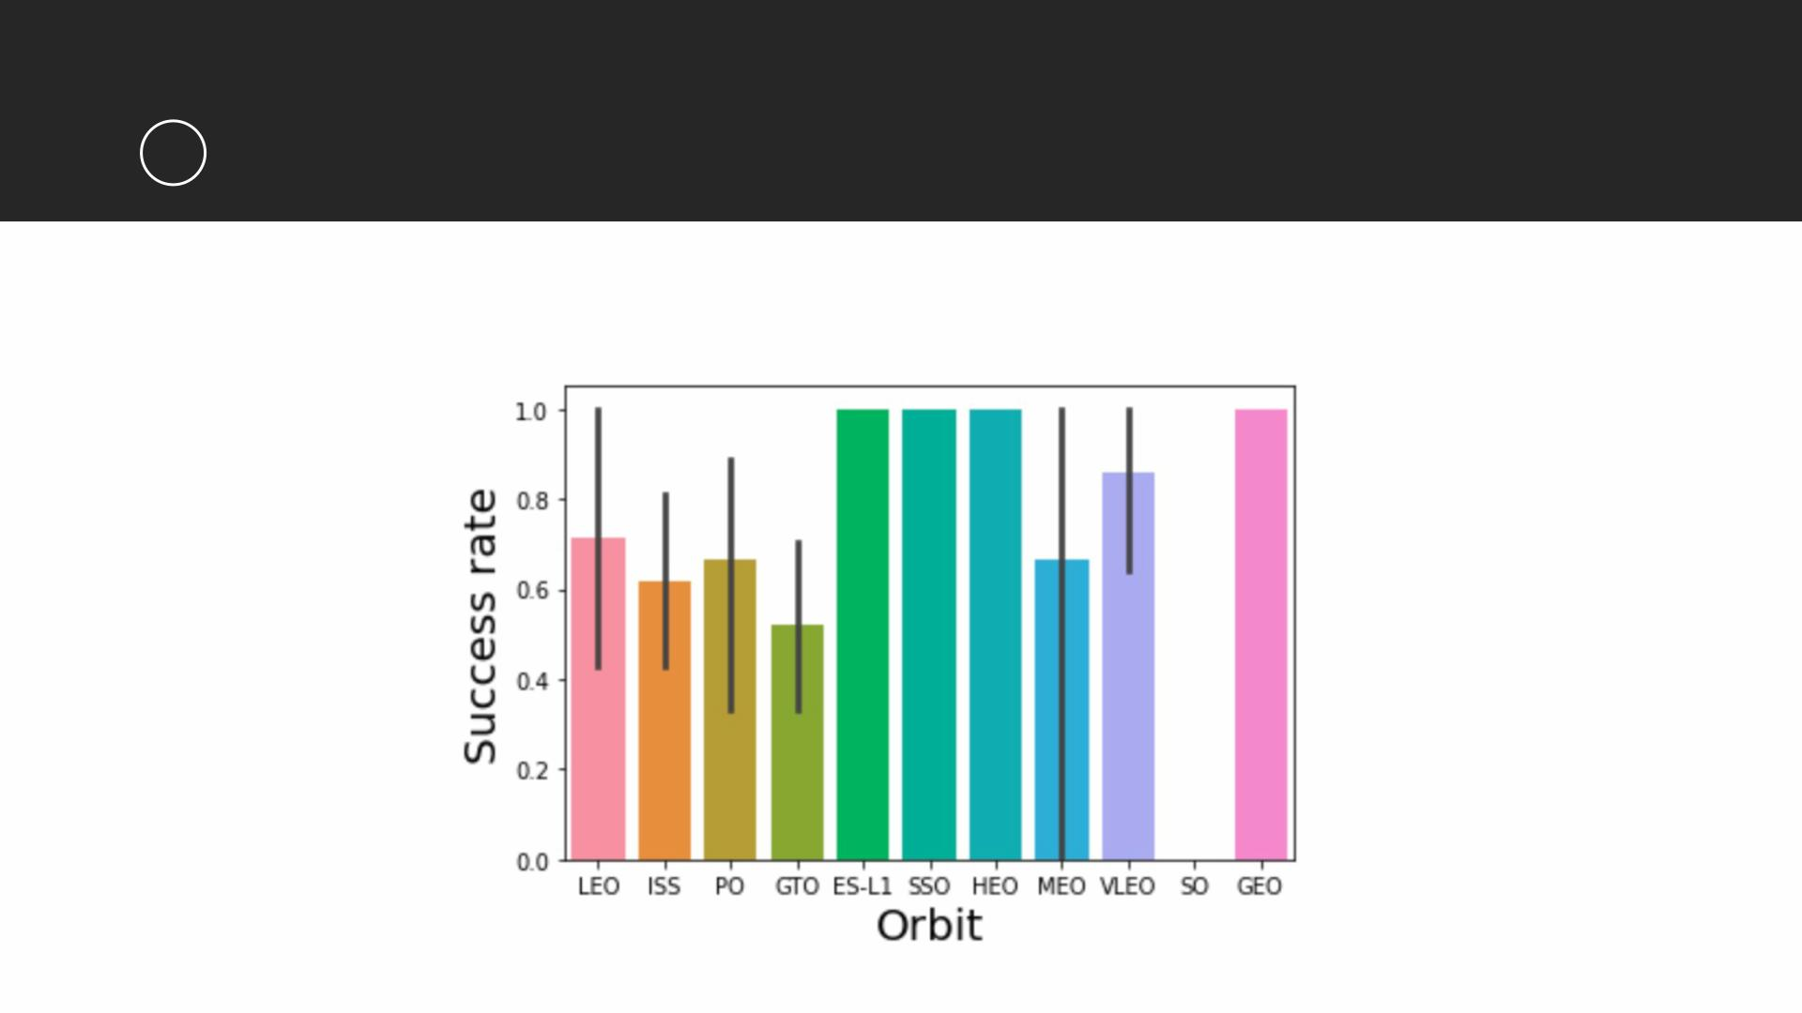
RESULTS
2
Matplotlib and Seaborn (EDA with Visualization)
• The relationship between success rate and orbit type

Slide 22
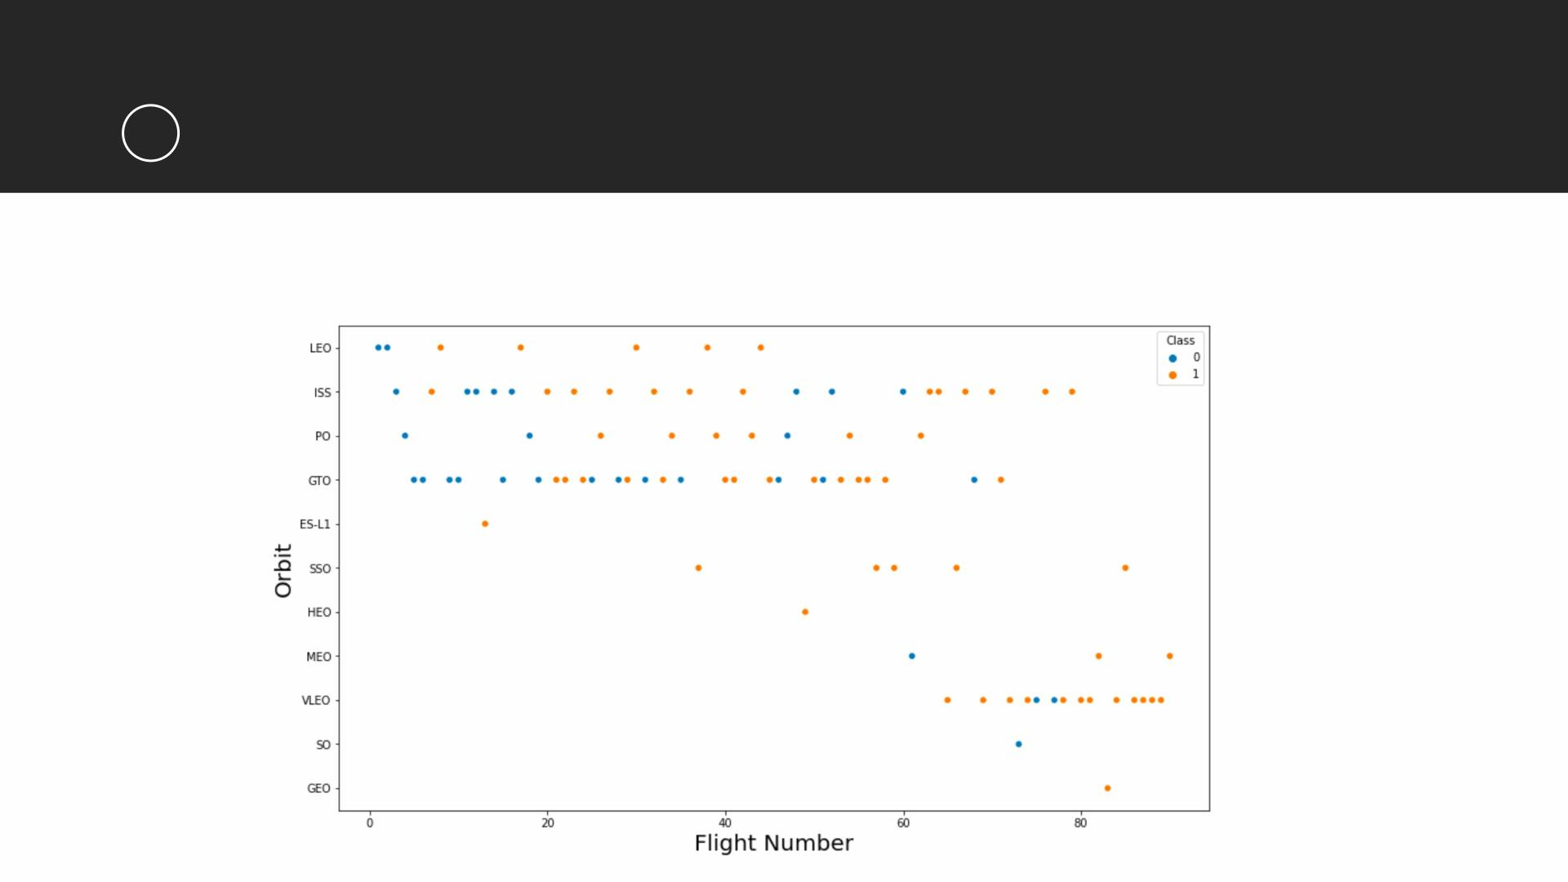
RESULTS
2
Matplotlib and Seaborn (EDA with Visualization)
• The relationship between flight number and orbit type

Slide 23
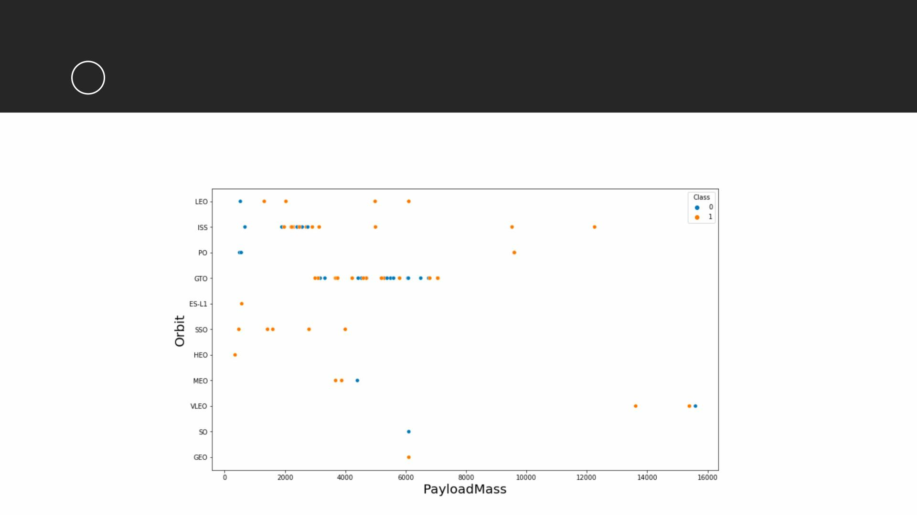
RESULTS
2
Matplotlib and Seaborn (EDA with Visualization)
• The relationship between payload mass and orbit type

Slide 24
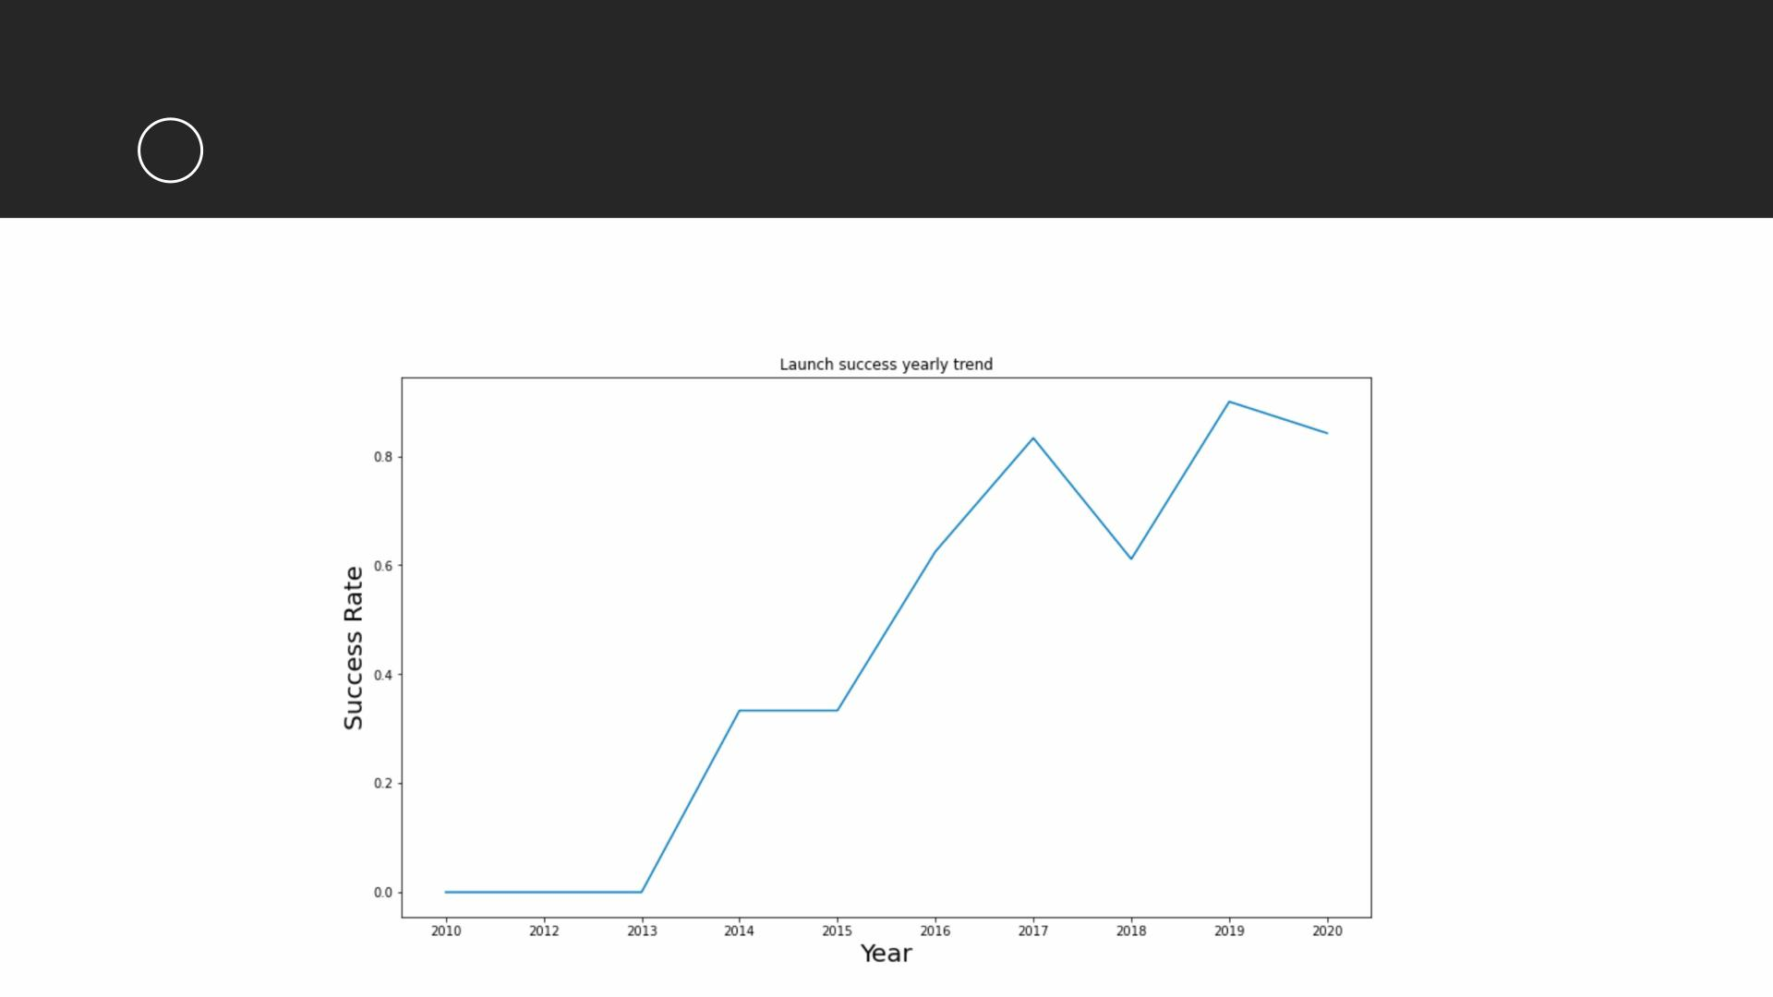
RESULTS
2
Matplotlib and Seaborn (EDA with Visualization)
• The launch success yearly trend

Slide 25
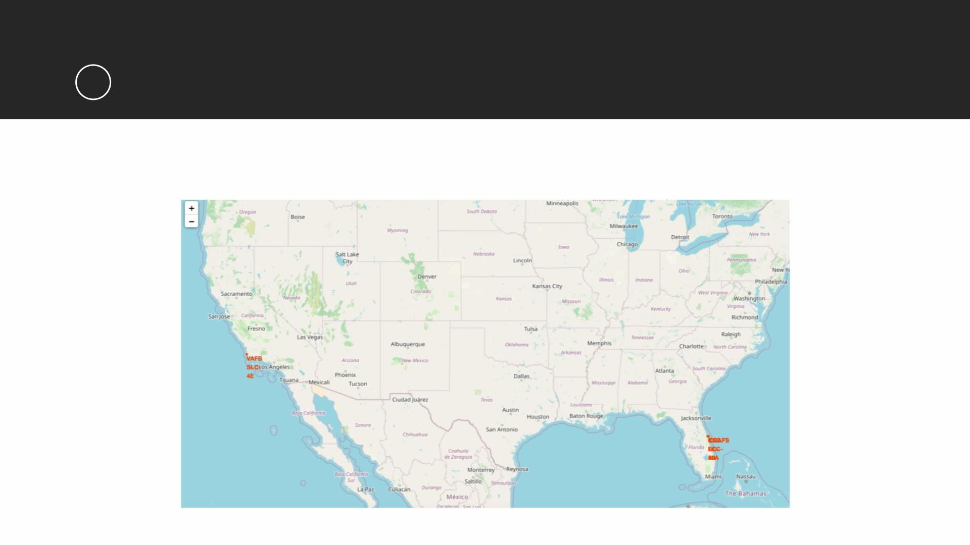
RESULTS
3
Folium
• All launch sites on map

Slide 26
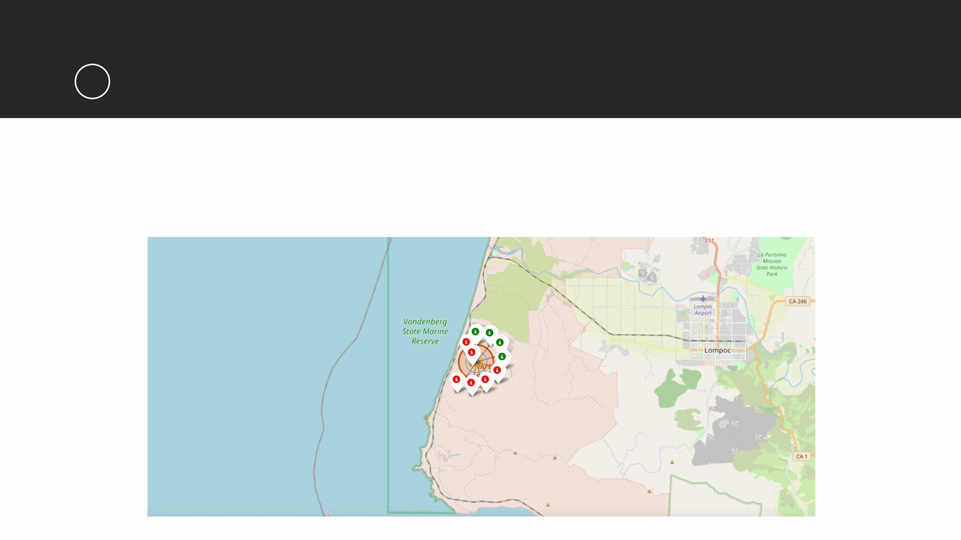
RESULTS
3
Folium
• The succeeded launches and failed launches for each site on map
• If we zoom in on one of the launch site, we can see green and red tags. Each green tag
represents a successful launch while each red tag represents a failed launch

Slide 27
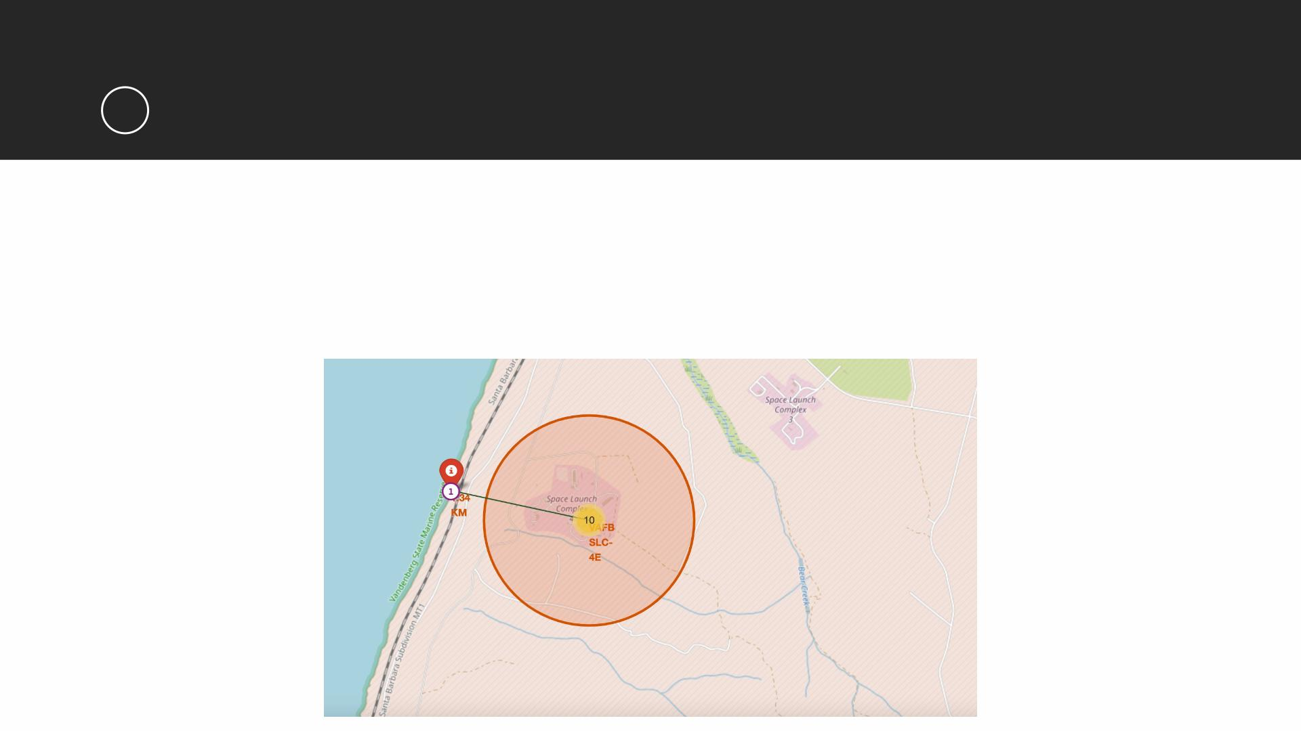
RESULTS
3
Folium
• The distances between a launch site to its proximities such as the nearest city,
railway, or highway
• The picture below shows the distance between the VAFB SLC-4E launch site and the nearest
coastline

Slide 28
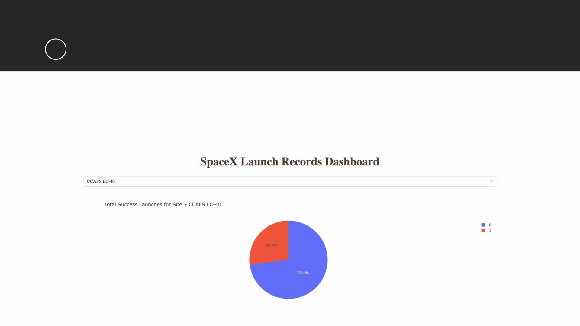
RESULTS
4
Dash
• The picture below shows a pie chart when launch site CCAFS LC-40 is chosen.
• 0 represents failed launches while 1 represents successful launches. We can see
that 73.1% of launches done at CCAFS LC-40 are failed launches.

Slide 29
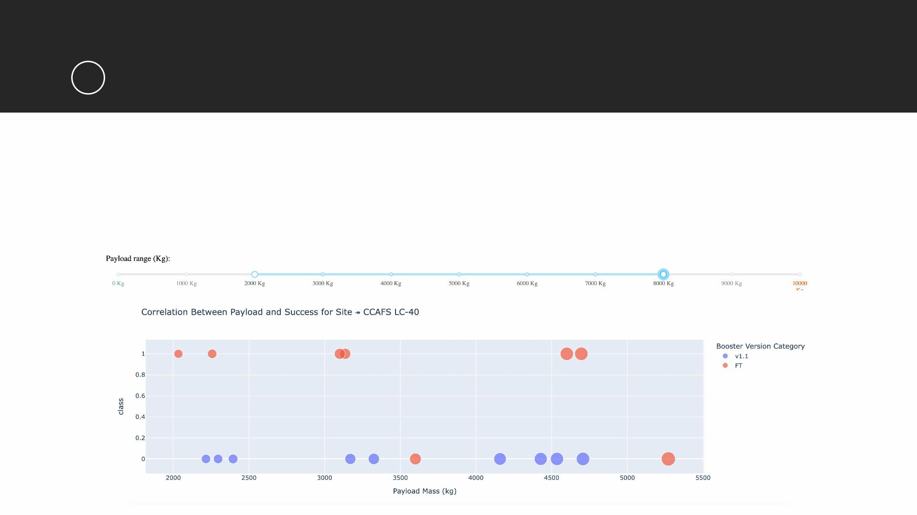
RESULTS
4
Dash
• The picture below shows a scatterplot when the payload mass range is set to be
from 2000kg to 8000kg.
• Class 0 represents failed launches while class 1 represents successful launches.

Slide 30
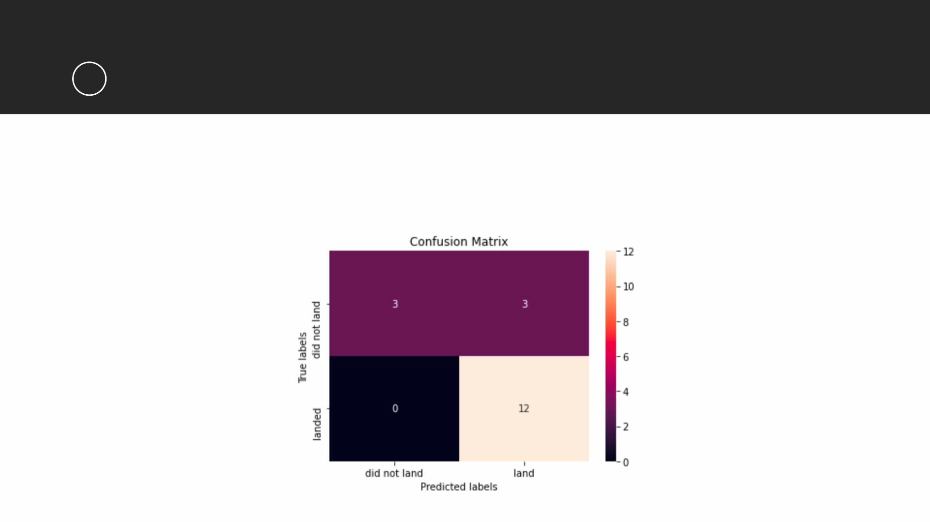
RESULTS
5
Predictive Analysis
• Logistic regression
• GridSearchCV best score: 0.8464285714285713
• Accuracy score on test set: 0.8333333333333334
• Confusion matrix:

Slide 31
RESULTS
5
Predictive Analysis
• Support vector machine (SVM)
• GridSearchCV best score: 0.8482142857142856
• Accuracy score on test set: 0.8333333333333334
• Confusion matrix:

Slide 32
RESULTS
5
Predictive Analysis
• Decision tree
• GridSearchCV best score: 0.8892857142857142
• Accuracy score on test set: 0.8333333333333334
• Confusion matrix:

Slide 33
RESULTS
5
Predictive Analysis
• K nearest neighbors (KNN)
• GridSearchCV best score: 0.8482142857142858
• Accuracy score on test set: 0.8333333333333334
• Confusion matrix:

Slide 34
RESULTS
5
Predictive Analysis
• Putting the results of all 4 models side by side, we can see that they all share the
same accuracy score and confusion matrix when tested on the test set.
• Therefore, their GridSearchCV best scores are used to rank them instead. Based
on the GridSearchCV best scores, the models are ranked in the following order
with the first being the best and the last one being the worst:
1. Decision tree (GridSearchCV best score: 0.8892857142857142)
2. K nearest neighbors, KNN (GridSearchCV best score: 0.8482142857142858)
3. Support vector machine, SVM (GridSearchCV best score: 0.8482142857142856)
4. Logistic regression (GridSearchCV best score: 0.8464285714285713)

Slide 35
DISCUSSION
• From the data visualization section, we can see that some features may have
correlation with the mission outcome in several ways. For example, with heavy
payloads the successful landing or positive landing rate are more for orbit types
Polar, LEO and ISS. However, for GTO, we cannot distinguish this well as both
positive landing rate and negative landing(unsuccessful mission) are both there
here.
• Therefore, each feature may have a certain impact on the final mission outcome.
The exact ways of how each of these features impact the mission outcome are
difficult to decipher. However, we can use some machine learning algorithms to
learn the pattern of the past data and predict whether a mission will be
successful or not based on the given features.

Slide 36
CONCLUSION
• In this project, we try to predict if the first stage of a given Falcon 9 launch will
land in order to determine the cost of a launch.
• Each feature of a Falcon 9 launch, such as its payload mass or orbit type, may
affect the mission outcome in a certain way.
• Several machine learning algorithms are employed to learn the patterns of past
Falcon 9 launch data to produce predictive models that can be used to predict the
outcome of a Falcon 9 launch.
• The predictive model produced by decision tree algorithm performed the best
among the 4 machine learning algorithms employed.

