Slide 1
Sentiment ANALYSIS ON IMDB MOVIE REVIEWS
Team 10
-Sai Krishna Movva Jaya(1002119758) -Suraj Kalyampudi (1002135272) -Karan Vasudevamurthy (1002164438)
Guidance
-Professor. Jesus A Gonzalez

Slide 2
The base paper
Sentiment Analysis from Movie Reviews Using LSTMs
Jyostna Devi Bodapati , N. Veeranjaneyulu , Shareef Shaik
The model leverages word embeddings created using the Word2Vec technique.
Preserves contextual information in the text.
These embeddings are passed into the LSTM layers.
With 100 LSTM units and 50 epochs, the model achieved an accuracy of 88.46%.

Slide 3
WHAT DID WE DO?

Slide 4
Getting the data ready
DATA COLLECTION
Collecting the data from the Kaggle website and we picked the same dataset as the one in the base paper so we could benchmark our results.
DATA ANALYSIS
Conducting Exploratory Data Analysis (EDA) on the initial dataset to gain insights into its structure, trends, and key features.
Data pre-processing
Applying data preprocessing steps to transform the dataset into the required format for model training and subsequent analysis.

Slide 5
What Did we learn from our eda?
The dataset is balanced.
The dataset contains equal number of semantics for reviews of both polarity.
The dataset contains redundant words and html syntaxes.
Punctuations/stopwords are present in a equal distribution in the dataset.

Slide 6
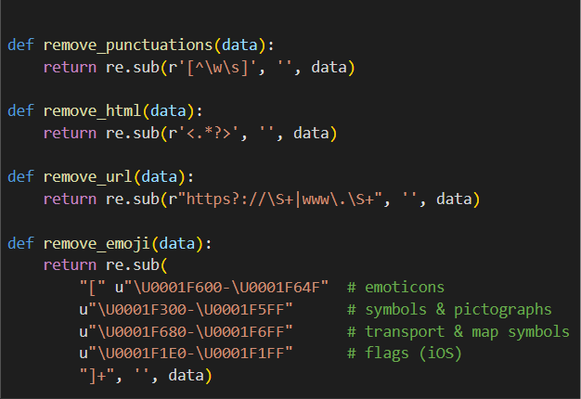
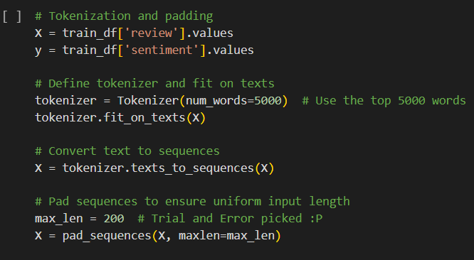
DATA PRE-PROCESSING
Cleaning Functions
Tokenization

Slide 7
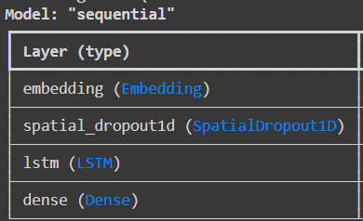
LSTM architecture
Embedding Layer
Converts tokens into dense vectors.
SpatialDropout1D
Added to prevent overfitting. Drops random maps along time.
LSTM
Added lstm layer with recurrent dropout
Dense
Added Dense layer for outputs with sigmoid function to achieve binary classification.

Slide 8
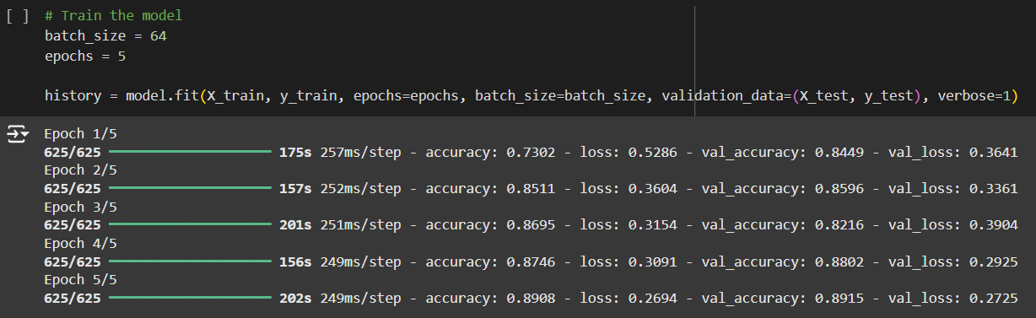
LSTM Training
Trained over 5 epochs with batch size of 64
So, 64 training examples processed together with each pass.

Slide 9
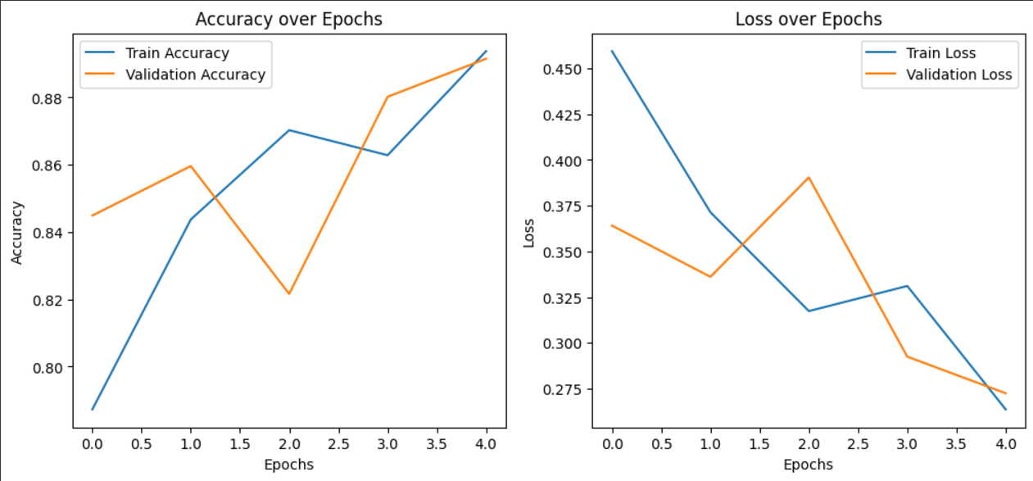
LSTM evaluation – Training data

Slide 10
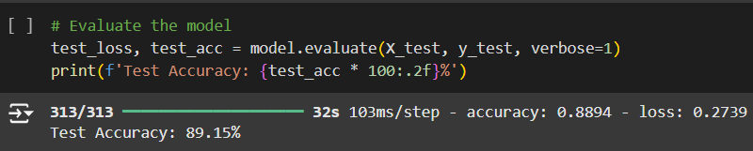
LSTM evaluation – test data
We got a test accuracy of 89.15%

Slide 11
WHY IS OUR LSTM AN IMPROVEMENT?
Higher Test Accuracy
Embedding Dimensions
The base paper had a best performance of 88.46% whereas we got 89.15% test accuracy.
We offer 128 embedding dimension compared to the base paper’s 32. So we have better representation of words.
FAST CONVERGENCE !!
The paper used 50 epochs whereas we used only 5 epochs.
LSTM units
Dropout Strategy
Our model employs 128 units, likely offering greater capacity to learn complex patterns compared to the paper's optimal configuration of 100 units.
The use of SpatialDropout1D helps regularize the embeddings, potentially reducing overfitting
Combined with recurrent dropout in the LSTM layer, this makes our model less prone to overfitting, which was a noted issue in the base paper when increasing LSTM units.

Slide 12
What did we do next?
We now have a model that outperforms the base paper’s model.
Our architecture can likely scale better to more complex datasets due to its richer embeddings and regularization.
Our model simplifies some of the tuning intricacies, making it more accessible for others to replicate or use in production.
We explored other NLP models and trends out of personal interest, drawing interest and ideas from various online sources.

Slide 13
BI-DIRECTIONAL LSTM

Slide 14
Why bidirectional lstms?
Better Context Understanding
BiLSTM processes sequences forwards and backwards, capture context from both past and future words, improving sentiment prediction.
Enhanced Feature Learning
In short, we just wanted to get a higher accuracy using an improved LSTM
Our two BiLSTM layers and a dense layer would extract more nuanced patterns from data.
Improved Regularization
Higher dropout rates and batch normalization reduce overfitting, boosting generalization.

Slide 15
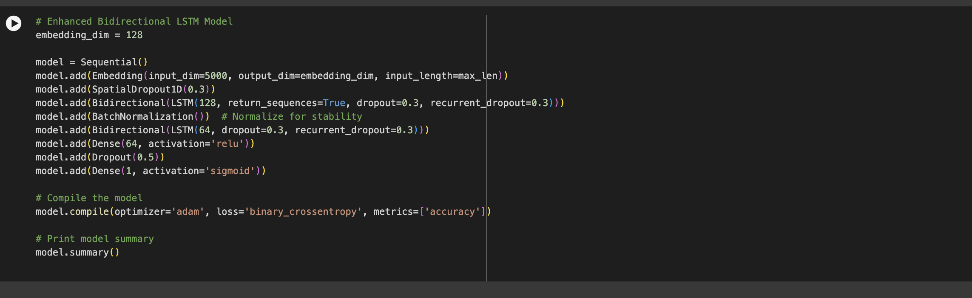
Bi-lstm architecture

Slide 16
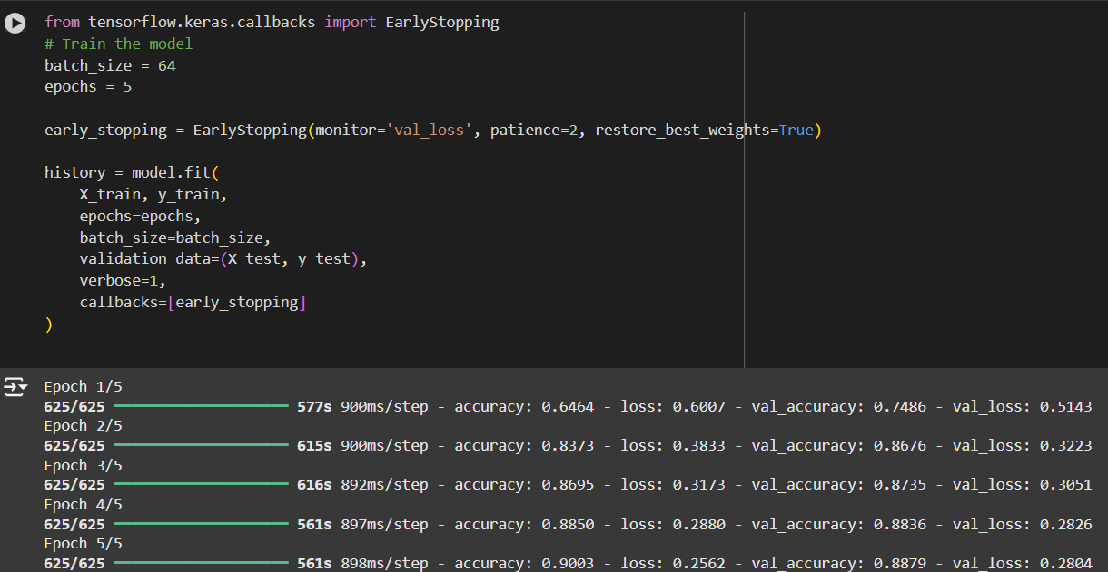
Bi-LSTM Training
Trained over 5 epochs with batch size of 64
Implemented early stopping to stop overfitting.

Slide 17
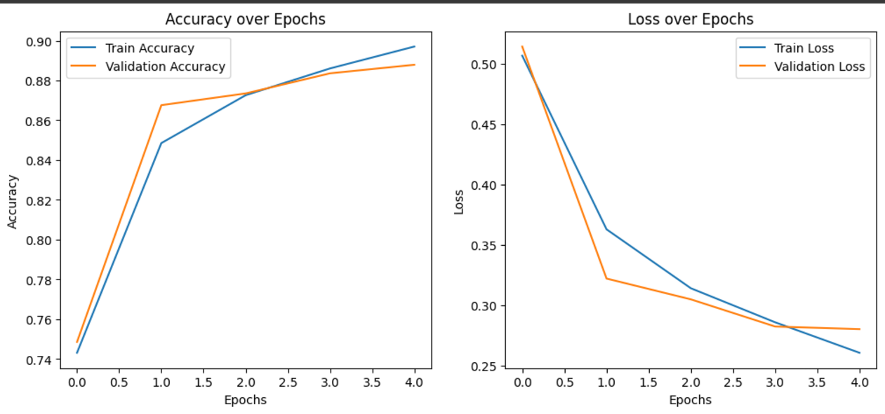
Bi-LSTM Evaluation
Training accuracy and loss

Slide 18
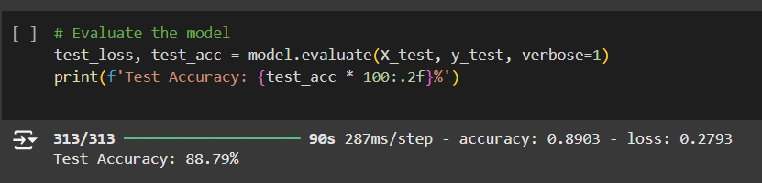
Bi-LSTM Evaluation

Slide 19
So what improvement do we have so far?
The fluctuations in both accuracy and loss for the LSTM model suggest that it might be struggling with stability and generalization.
The Bi-LSTM model shows a more stable learning pattern, with consistent improvement across epochs.
We did beat the paper’s accuracy
(Nearly)
But, we could not beat our evaluation accuracy of our own LSTM. ☹

Slide 20
ATTENTION IS ALL YOU NEED ☺

Slide 21
Why transformers? (bert)
Captures Long-Range Dependencies
Transformers use self-attention to relate words across the entire input sequence, regardless of distance.
Bidirectional Context Understanding
BERT reads text both forward and backward, capturing nuanced context like negations (e.g., "not good").
Pre-trained Knowledge
BERT comes with pre-trained language models, which can be fine-tuned on sentiment datasets for high accuracy with minimal training.

Slide 22
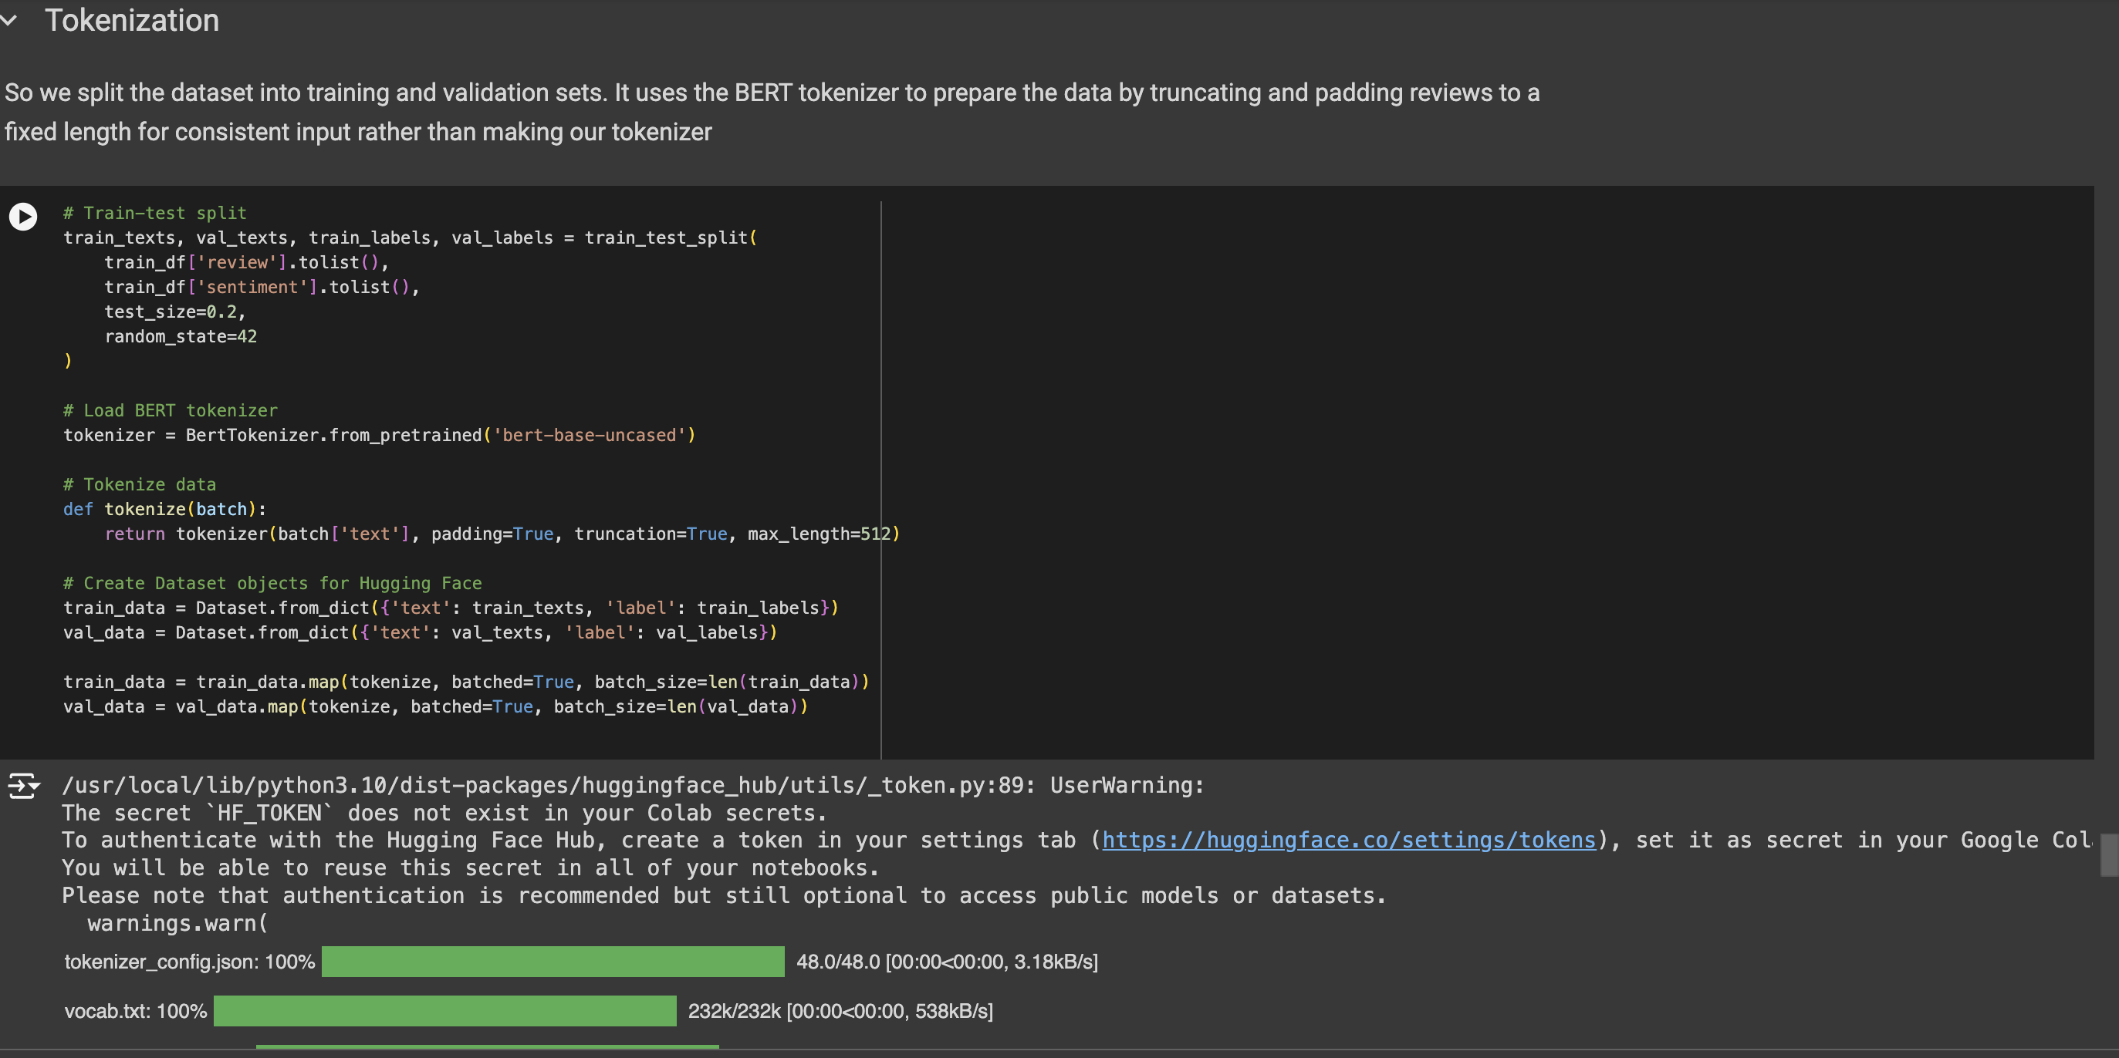
DATA PREPROCESSING
Different preprocessing for BERT

Slide 23
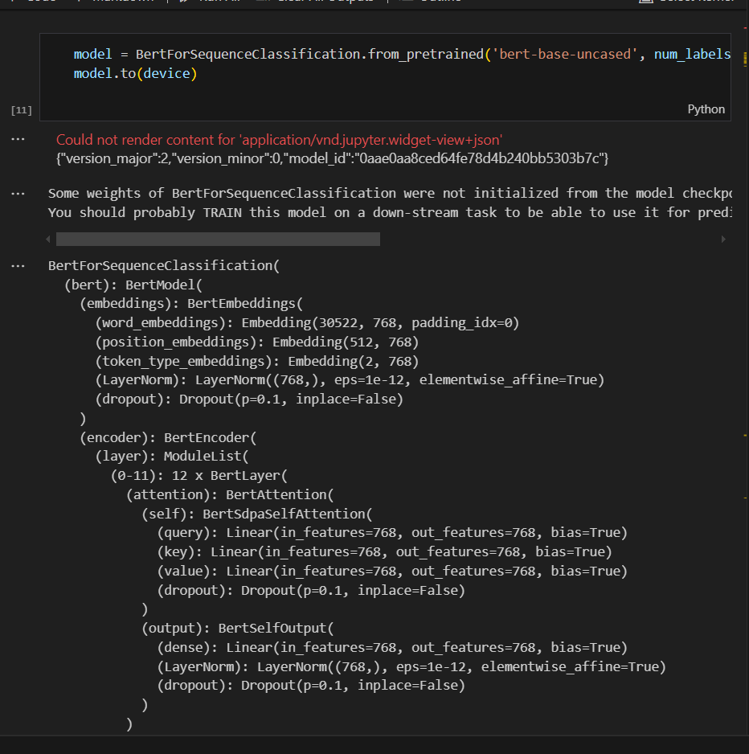
Loading bert

Slide 24
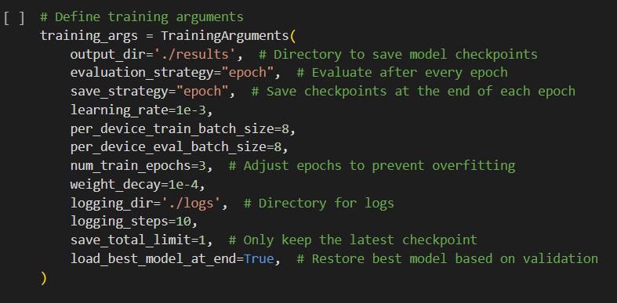
What were the training parameters?
We use huggingface’s trainer to train BERT

Slide 25
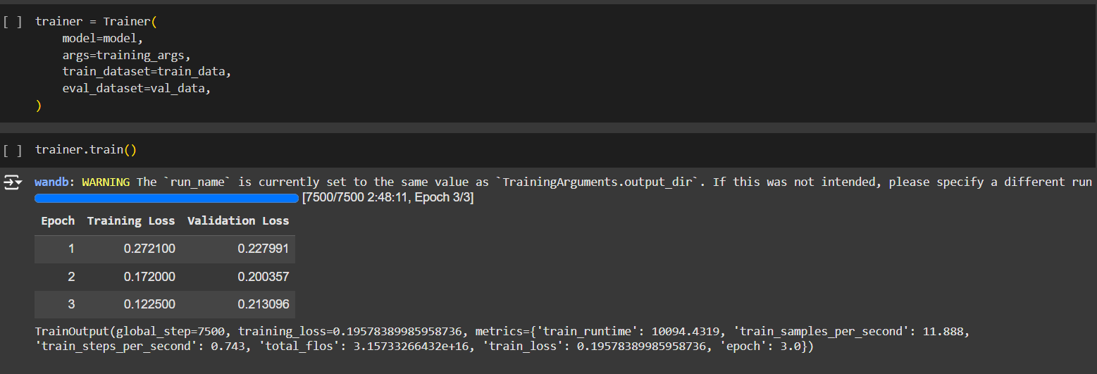
Training bert
We also unfreeze the last two encoder layers, which can help the model retain BERT's language understanding while also fine-tuning on our dataset (BertEncoder[10] and [11])

Slide 26
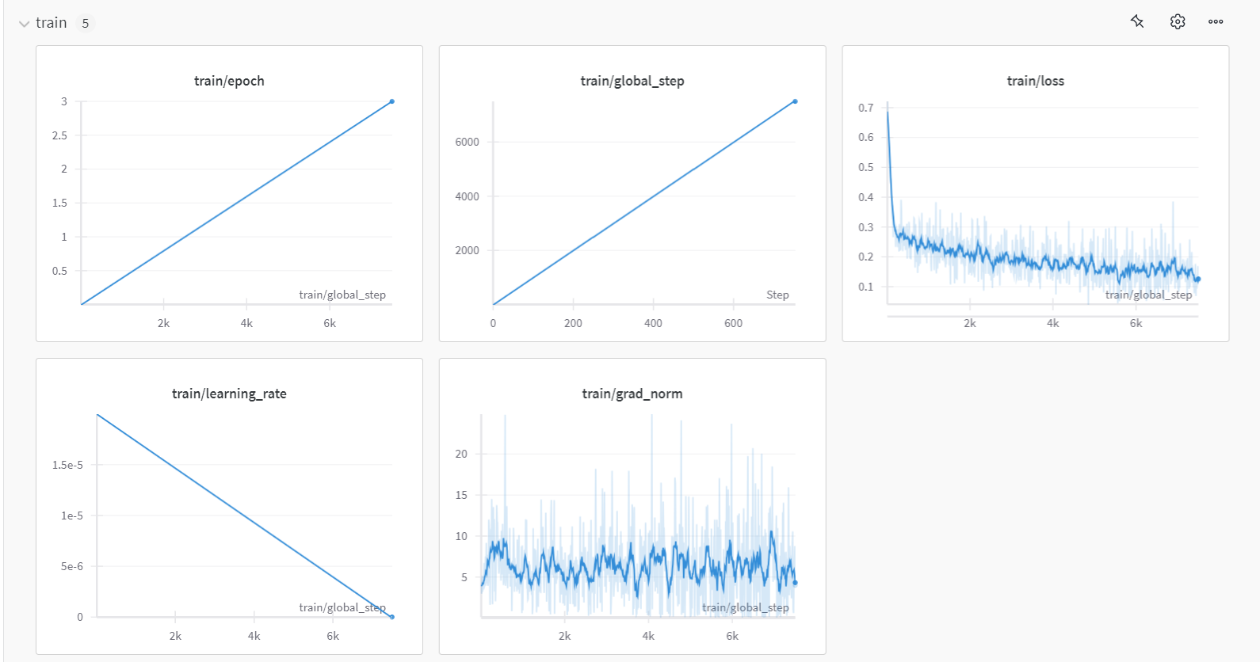
Results- Training
Running average smoothing has been applied on loss and grad_norm.

Slide 27
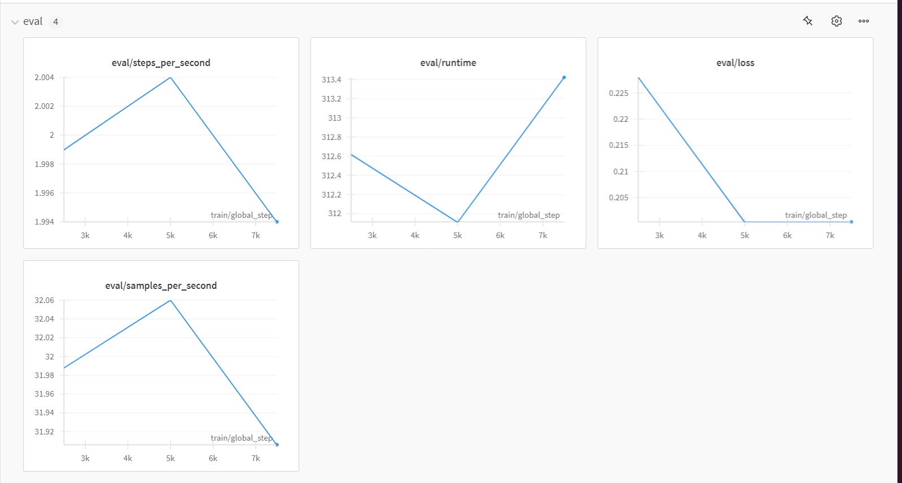
Results - Evaluation

Slide 28
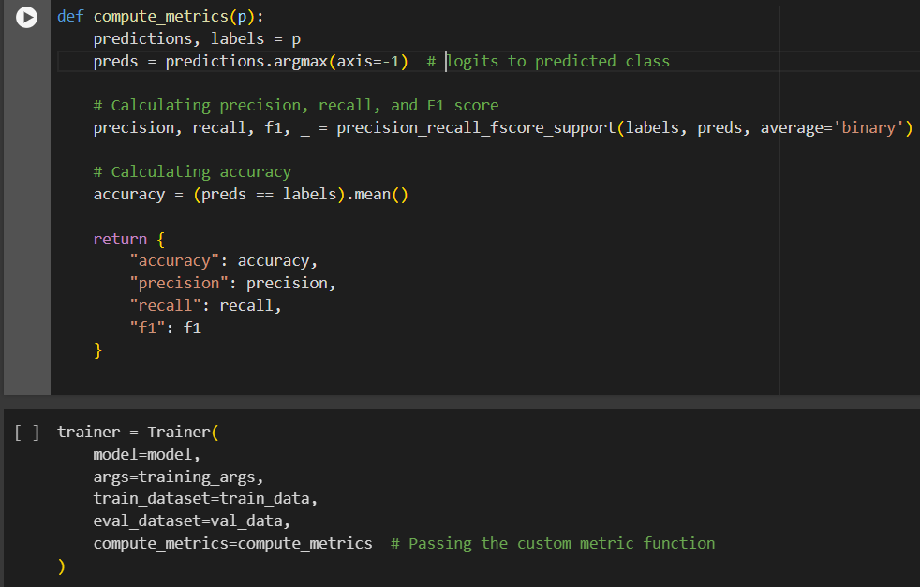
Results – Custom function

Slide 29
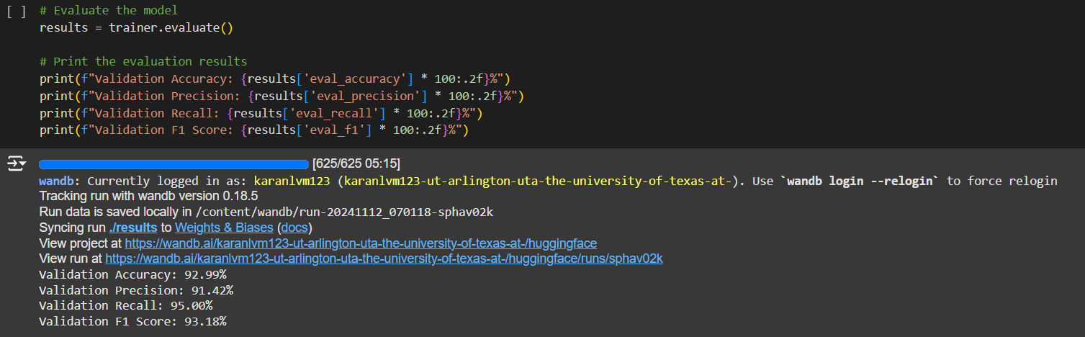
Results – Custom function

Slide 30
Summary
BERT outperforms both LSTM and Bi-LSTM models in all metrics.
Bi-LSTM shows better stability and accuracy than the LSTM model, with smoother learning curves
LSTM exhibits fluctuating accuracy and loss trends, indicating potential stability issues and lower generalization
Overall, BERT is the best choice if computational resources allow, as it captures complex patterns more effectively and consistently outperforms both LSTM-based models

Slide 31
Future work
DeBERTa improves upon BERT by using disentangled attention, which separates word content from word position. (SOTA performance for these monolingual tasks)
ALBERT: A lighter version of BERT designed for faster training and inference, making it suitable if you’re resource-constrained.

Slide 32
LINKS TO our works
LSTM and BiLSTM (Google Colab)
BERT (Google Colab)
Weights and Biases results
All of our models were trained using the Nvidia Tesla T4 GPU.

Slide 33
THANK YOU
Questions?

