Slide 1
NETWORK VIRUTALIZATION AND ITS SECURITY LOOPHOLES

Slide 2
OUTLINE
MOTIVATION/PRESENT DAY SCENARIO
NETWORK VIRTUALIZATION
NFV & SDN
PROBLEMS
SECURITY LOOPHOLES
FUTURE

Slide 3
PRESENT DAY SCENARIO
Internet the layered communication model for used throughout the world with a set of layered users
Problems faced by Network Operators
Ossification
Over the top service providers
Under utilization of resources
Scalability issues
Needs to be reframed

Slide 4
Network Virtualization
What is virtualization?
What is Network Virtualization?
Aggregation and subdivision of shared resources
Examples
Router Virtualization and LINP

Slide 5
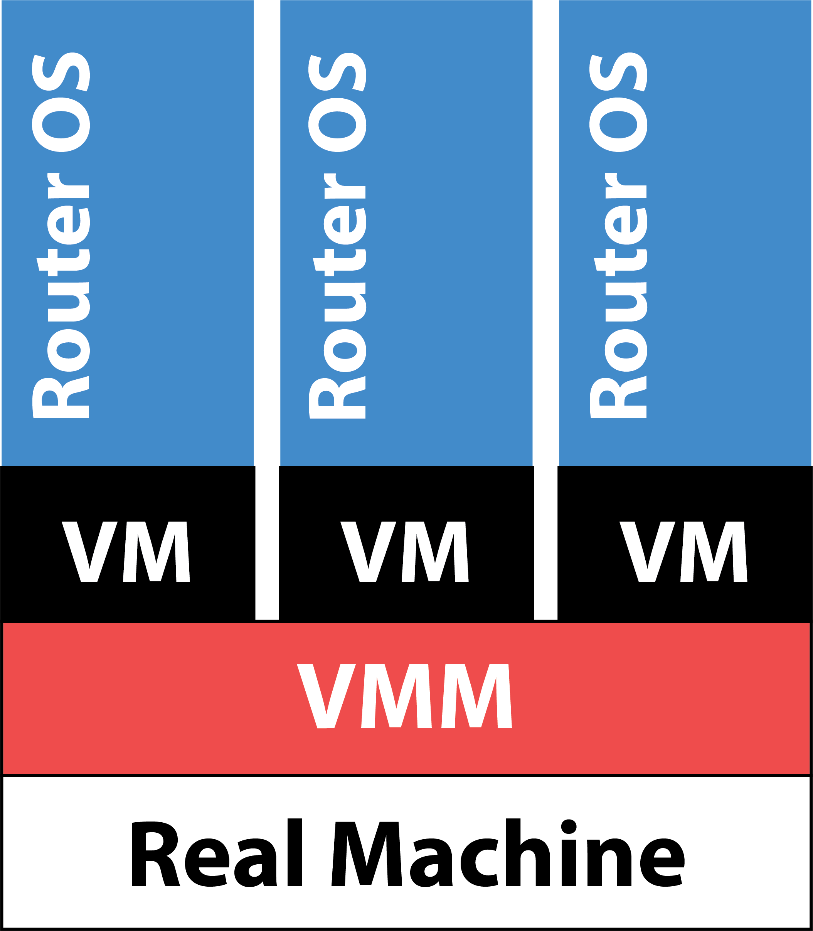
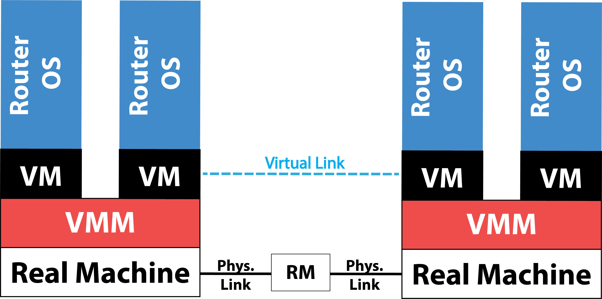
Figures showing Virtualization in Router

Slide 6
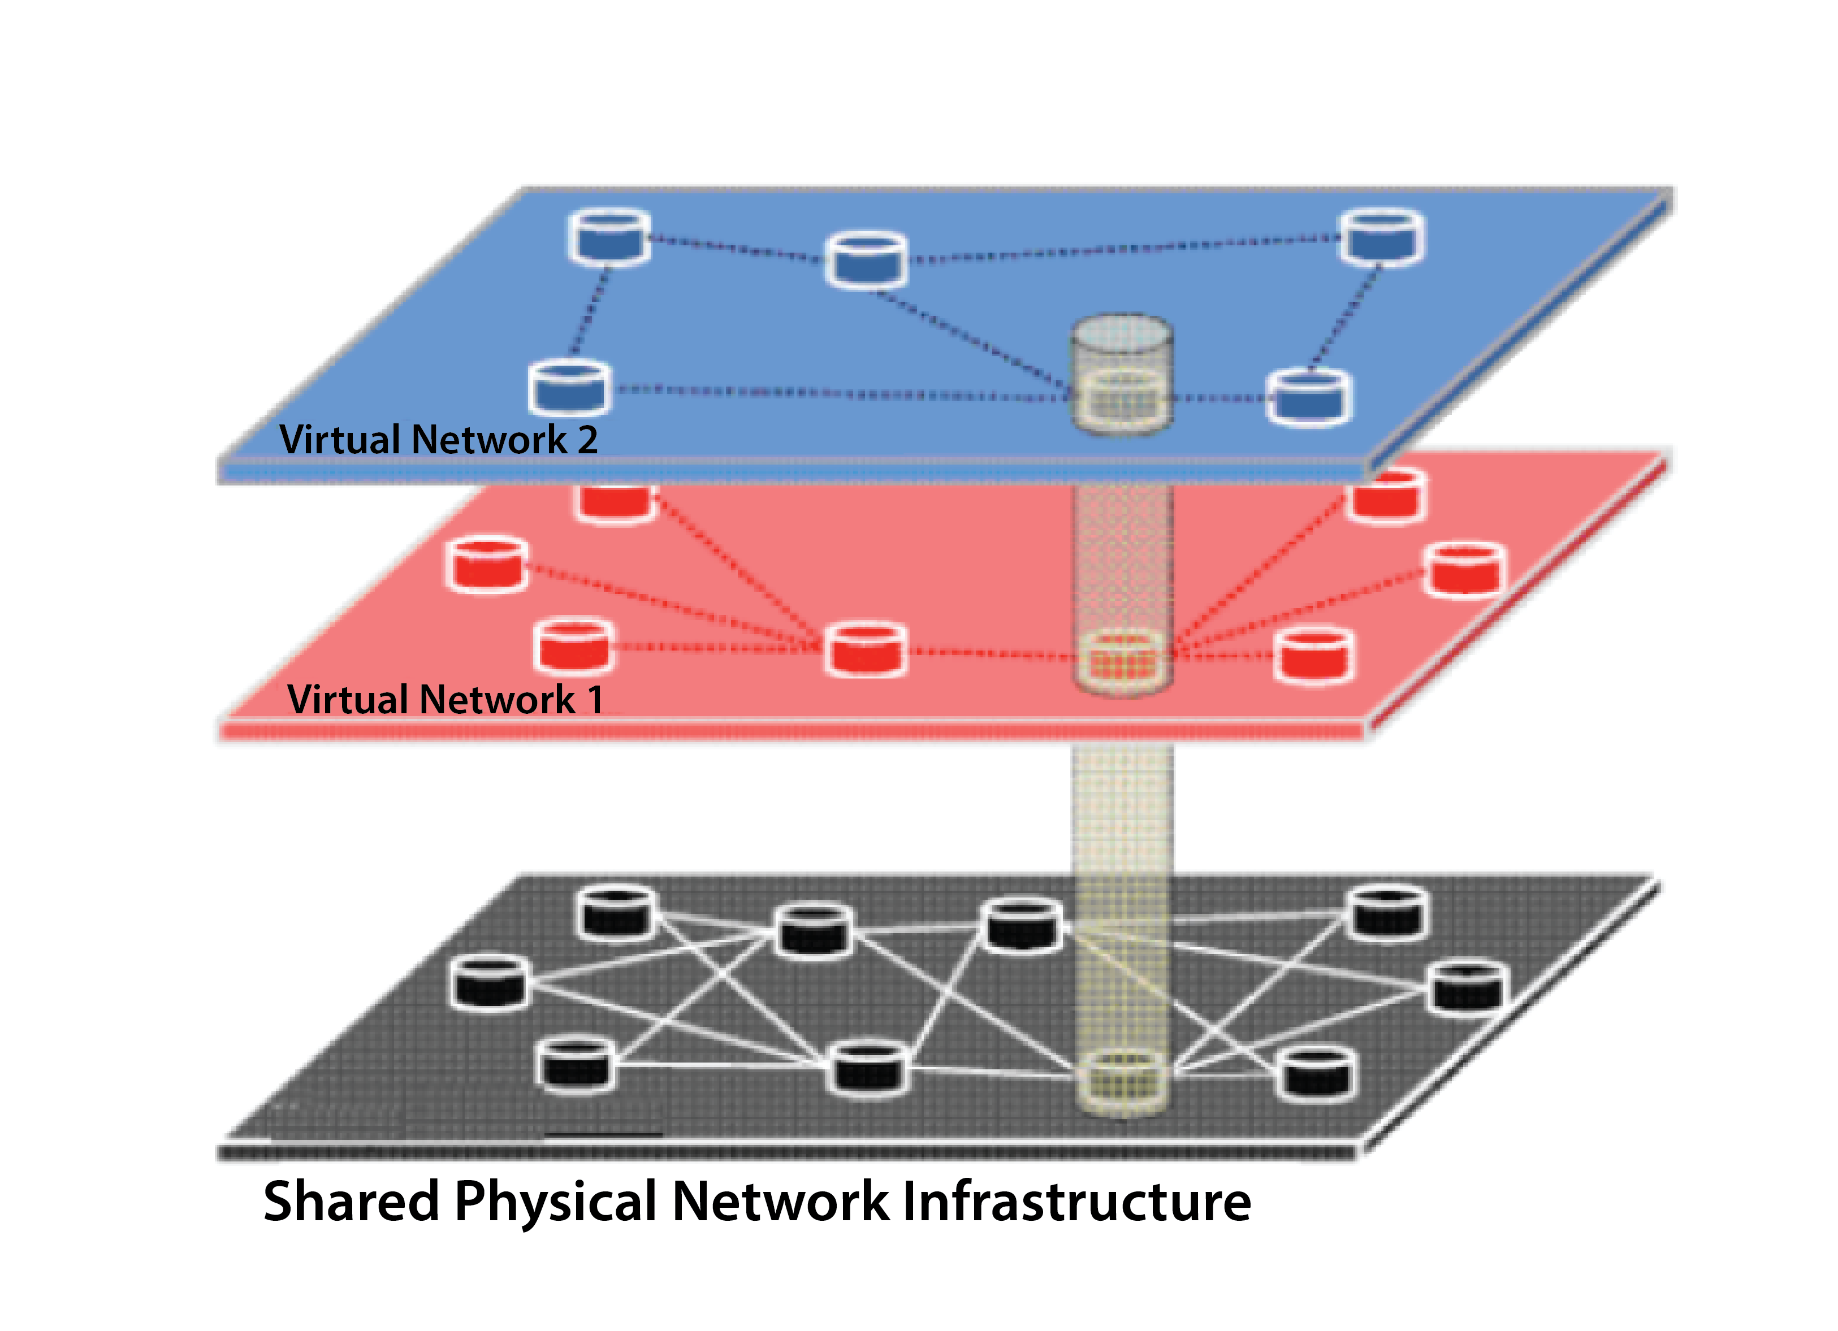
Figure showing Virtualized Networks

Slide 7
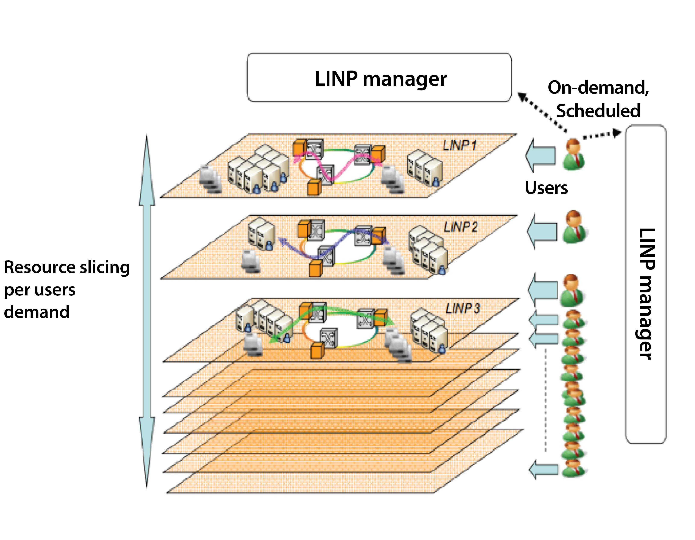
Figure showing Virtualized Networks

Slide 8
Network Function Virtualization
Data Plane and Control Plane
Idea of NFV
Role of Virtualization
Network Functions to be virtualized

Slide 9
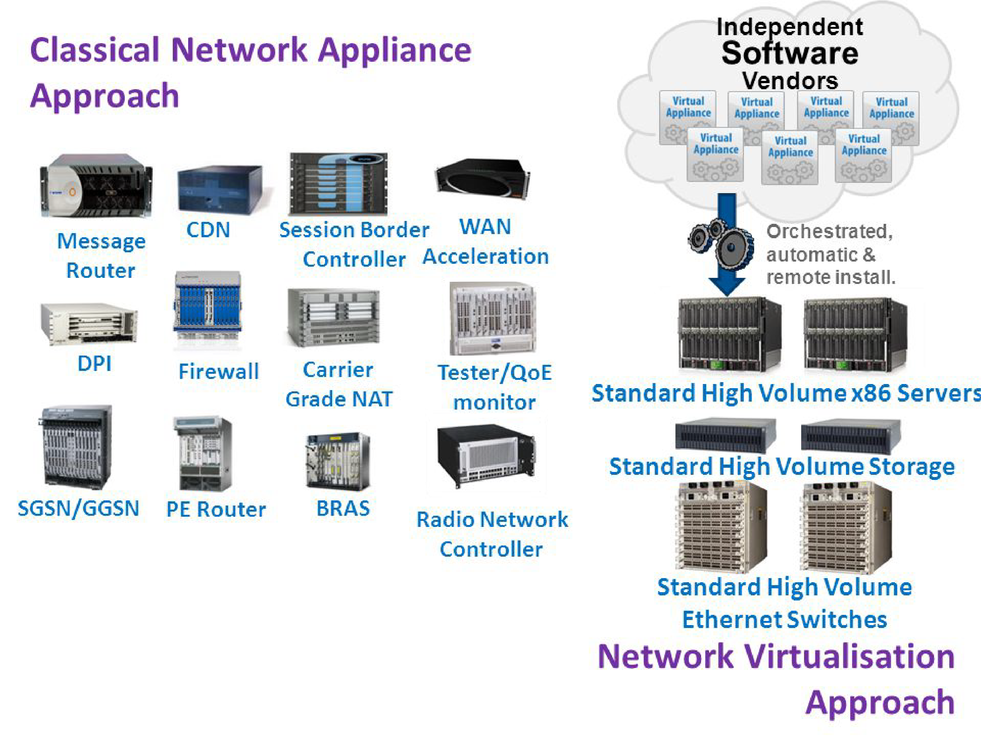
Figure showing Network Function Virtualization

Slide 10
NFV Issues
Areas of Concern
Management
Data Plane throughput issues
Role of automation
Impact on OSS/BSS
Security Loopholes
Type of attacks (internal and external)
Impact

Slide 11
Impact of Network Intrusion
Disruption
Usurpation
Disclosure
Deception

Slide 12
Security Loop Holes
Types of Internal Attacks
VN → User
VN → NI
VN → VN
NI → VN
NI → User
User → VN
User → NI
User → User

Slide 13
Conclusion
It can be summed up that with current computing advances we have been able to separate hardware and software this has a direct consequence in field of network virtualization by virtualizing the network functions. This research will help the ISPs and Network Infrastructure Provider.
3 major blockades exist on the road to implementation of Network Function Virtualization.
We have tabulated a list of all internal attacks which should be kept in mind when the virtualization policy framework is being designed

Slide 14
FUTURE
Artificial Intelligence and its role in OSS/BSS
Security problems being dealt by Machine Learning and Big Data, as real time network intrusion detection systems built over Hadoop using Spark

Slide 15
Acknowledgement
I would give my greatest regards and sincerely thank Dr. G. Viswanathan, Chancellor, Vellore Institute of Technology, for giving me such an opportunity and platform. Dr. C. Aswani Kumar, Session Chair, and Dr. Suneetha V for their support. I thank VIT University’s management and last but not the least, all the listeners present here for patiently listening.

Slide 16
References
Stallings W (2006) Cryptography and Network Security: Principles and Practice. Pearson/Prentice Hall, Upper Saddle River, New Jersey, USA
Cavalcanti E, Assis L, Gaudencio M, Cirne W, Brasileiro F (2006) Sandboxing for a free-to-join grid with support for secure site-wide storage area. In: International Workshop on Virtualization Technology in Distributed
Wolinsky DI, Agrawal A, Boykin PO, Davis JR, Ganguly A, Paramygin V, Sheng YP, Figueiredo RJ (2006) on the design of virtual machine sandboxes for distributed computing in wide-area overlays of virtual workstation
Andreas Fischer, Network Virtualization in the Future Internet Concepts, Applications, and Challenges.
Wu H et al (2010) Network security for virtual machine in cloud computing.
Shirey R (2000) RFC 2828: Internet Security Glossary
Nelson Gonzalez, Charles Miers (2015) A quantitative analysis of current security concerns and solutions for cloud computing.
Network Functions Virtualization – Introductory White Paper.
Leonardo Richter Bays. et al (2015) Virtual network security: threats, countermeasures, and challenges.

Slide 17
Questions
Kindly ask if you have any questions and doubts. Thank you.

