Slide 1
MEDbuddy.com Healing Hands, Caring Hearts. (Medicine Recommendation System)

Slide 2
Why this system?
Increasing Needs
Technological help
Role of patients
Uncertainty in health relating decisions
Access to correct information

Slide 3
Scope
Details of patient
Symptoms
Diseases
Prescribe effective medicines
Detailed information about medicine

Slide 4
Aims and Objectives
User friendly
Emergency conditions
Increase in the use of effective generic medicines
Effective health care delivery
Patients’ safety

Slide 5

Big Data

Slide 6
Introduction
Big Data may well be the Next Big Thing in the IT world.
The first organizations to embrace it were online and startup firms. Firms like Google, eBay, LinkedIn, and Facebook were built around big data from the beginning.
The three V’s of Big Data-
- Volume
- Velocity
- Variety

Slide 7
Role of Big Data
Constant supply of data.
Quick processing of data.
Precise Recommendation Systems.
High CPU consuming task.

Slide 8
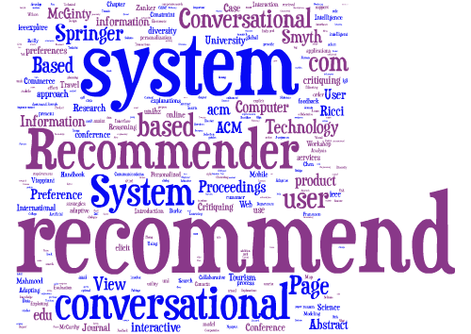
Recommendation Systems

Slide 9
Why Recommendation Systems?
Sayings-”Getting information from internet is like taking a drink from the fire hydrant”
User Benefit
Revenue
Precise Information

Slide 10
Recommendation System working
Data Collection - Collecting data from the user’s activities.
Rating - what a user feels about a product.
Filtering - filtering products based on ratings and other user data.

Slide 11
Project Design

Slide 12
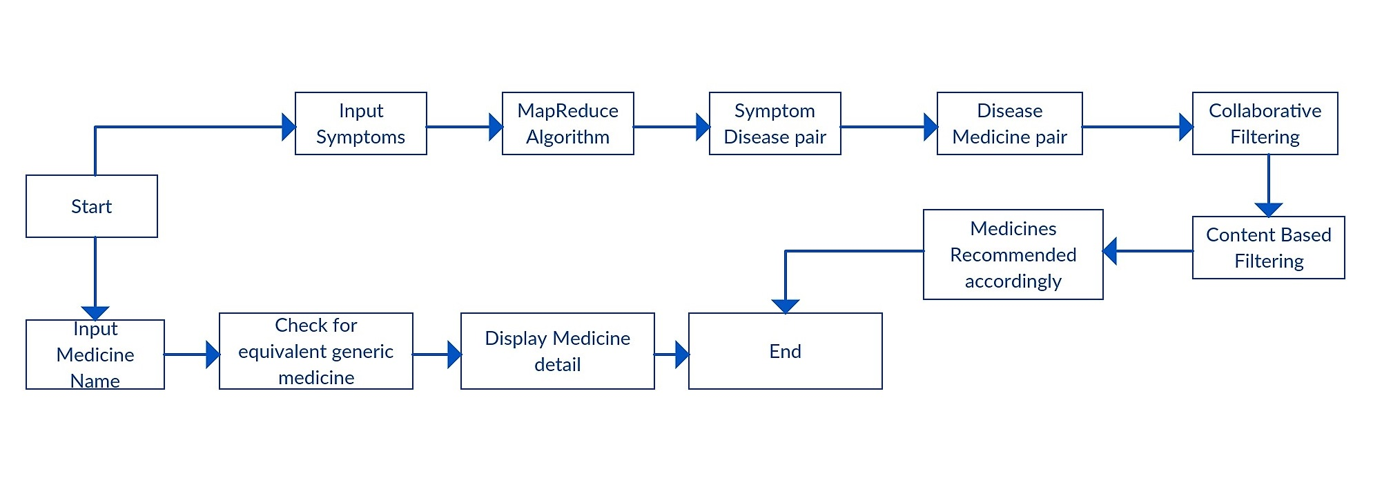
Block Diagram

Slide 13
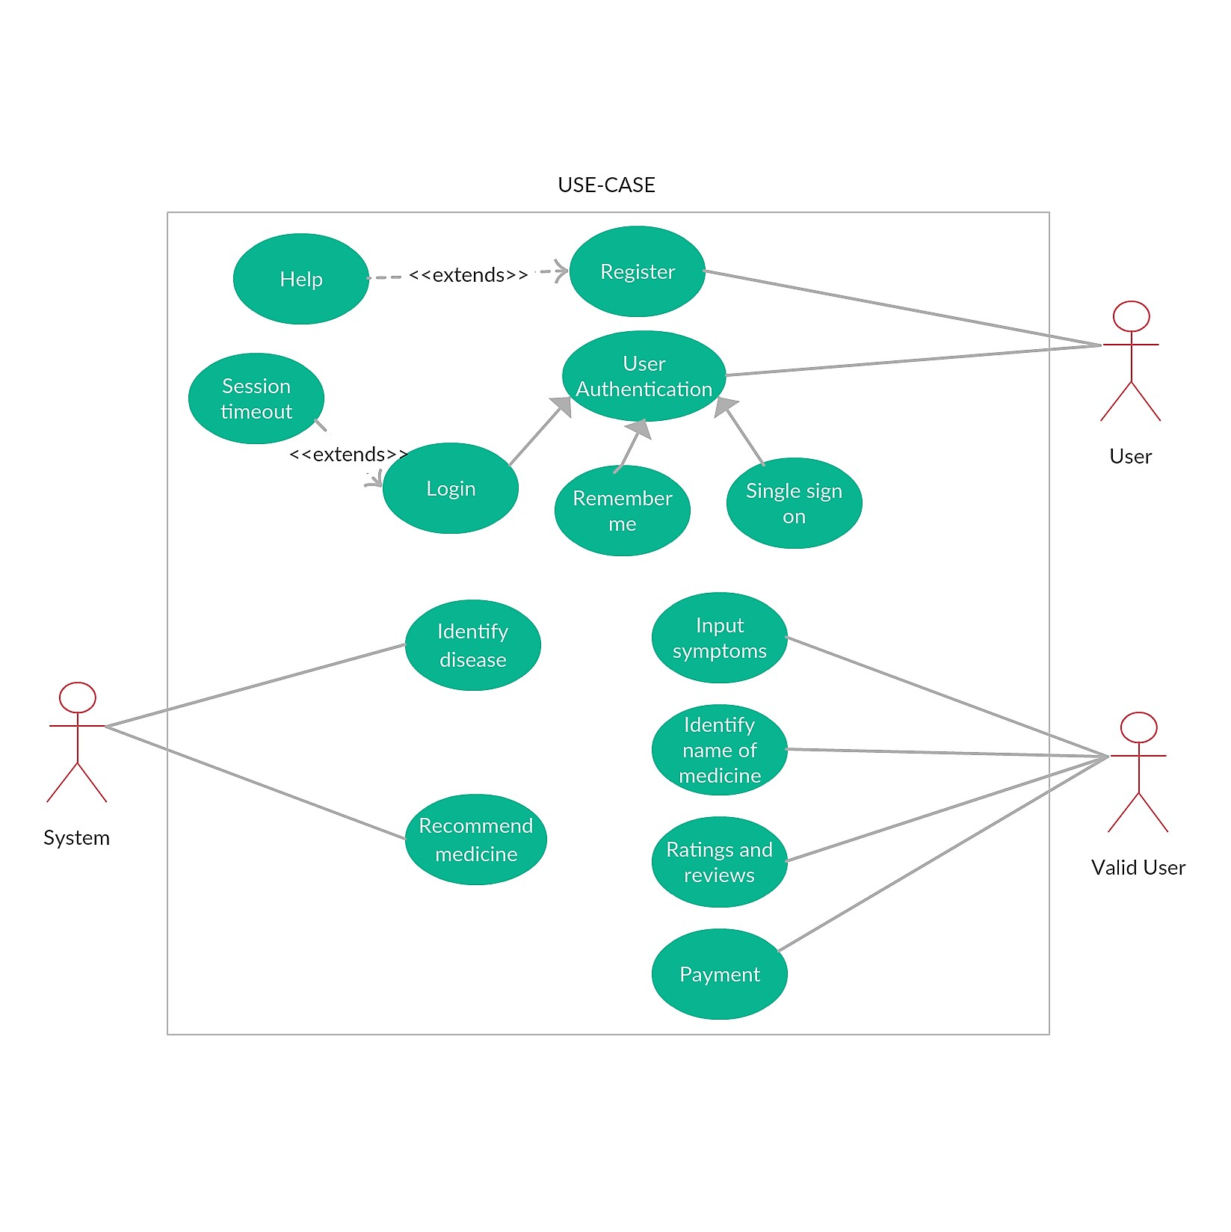
Use Case Diagram
Fig 4.1

Slide 14
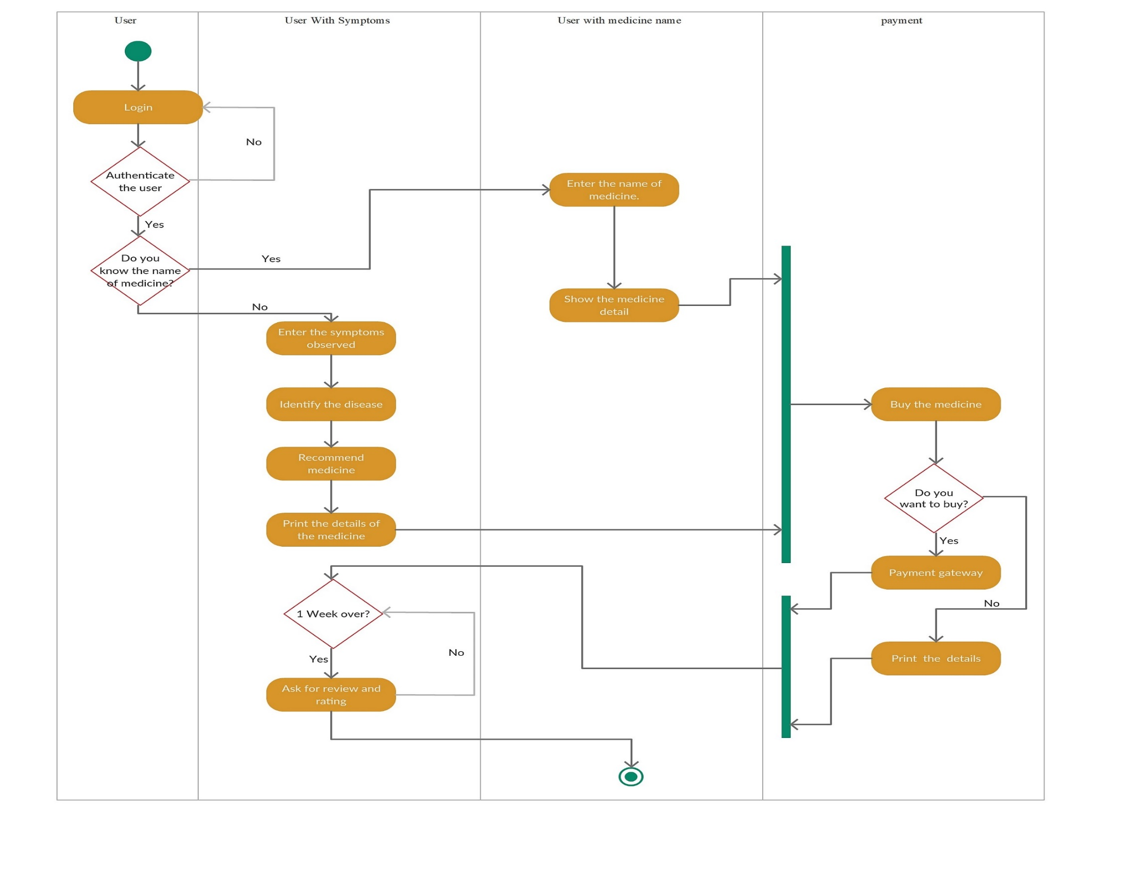
Activity Diagram for medicine recommendation system.
Fig 4.2

Slide 15
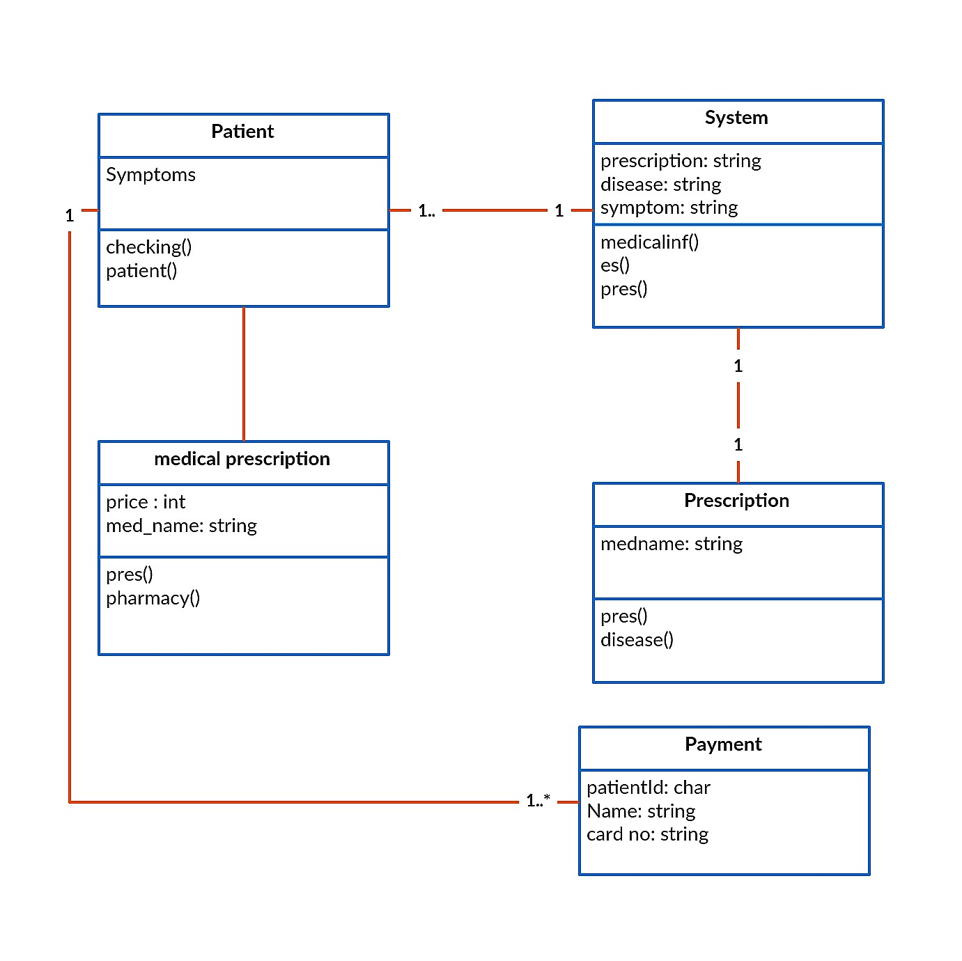
Class Diagram
Fig 4.3

Slide 16
Sequence Diagram for prediction of medicine with symptoms
Fig 4.4

Slide 17
Analysis
Functional Requirements
Non-Functional Requirements
Search medicine according to symptoms.
Search medicine according to medicine name.
Can view alternatives for noxious medicines.
Can view the dosage requirements of each medicine.
The recommender system will provide knowledge about medication with excellent efficiency and scalability.
Learnability
Reusability
Performance
Reliability
Correctness
Privacy

Slide 18
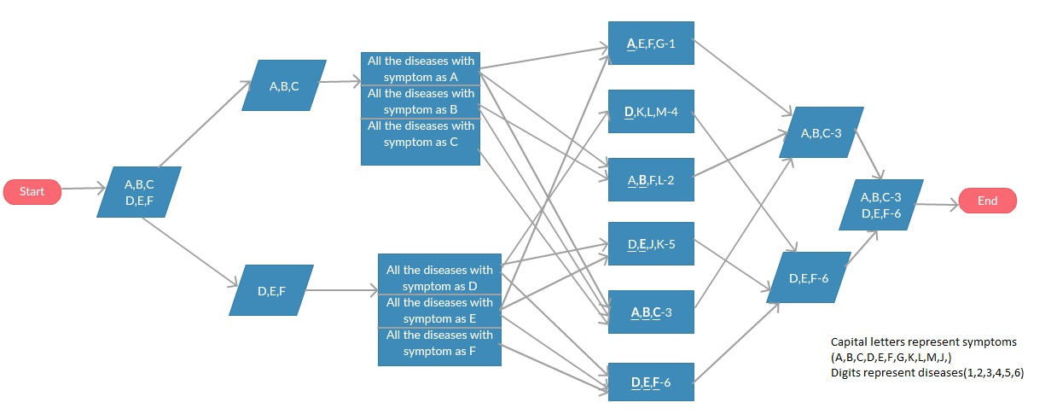
Map Reduce Algorithm for symptom-disease output(flowchart)

Slide 19
Filtering Techniques
Content based filtering
Collaborative filtering
 | MED1 | MED2 | MED3 | MED4 | MED5
Expensive | Yes | No | No | Yes | No
Generic | No | Yes | Yes | No | Yes
Highly concentrated | Yes | Yes | No | Yes | No
Syrup | Yes | No | No | Yes | No
Ayurvedic | Yes | Yes | Yes | No | NO
 | MED1 | MED2 | MED3 | MED4 | MED5
User1 | Yes | Yes | No | No | Yes
User2 | No | No | Yes | No | Yes
User3 | Yes | No | Yes | No | No
User4 | No | No | Yes | Yes | No
User5 | Yes | ?? | ?? | ?? | ??
If user1 Chooses MED1, We will count the properties that are same on other medicines .
So, similar no of properties with other medicines are
MED2 | MED3 | MED4 | MED5
2 | 1 | 3 | 0
So as MED5 is the one which is more similar to MED1 that med will be recommended afterwards.

Slide 20
