Slide 1
Using Auto Layout
Copyright © 2016 Apple Inc. All rights reserved.

Slide 2
Auto Layout
Dynamically calculates the size and position of all the views in your view hierarchy, based on constraints placed on those views.
constraint-based approach design allows dynamic response to changes:
  External:
    Device rotation, different screen sizes etc …
  Internal:
    Support dynamic types, internationalization etc …

Slide 3
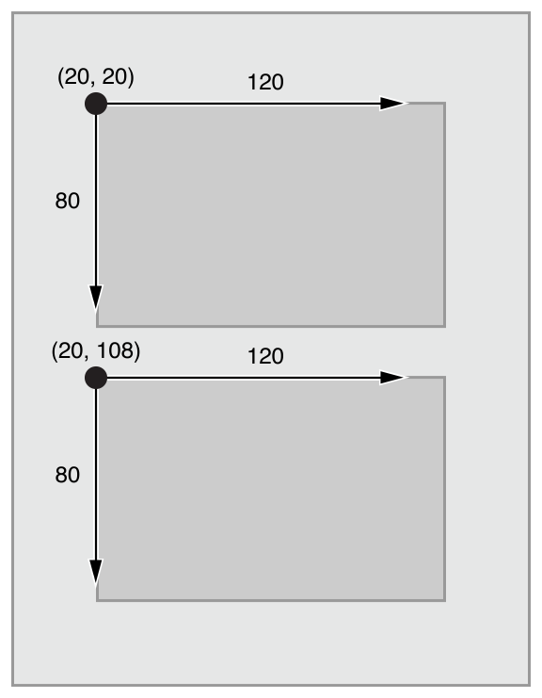
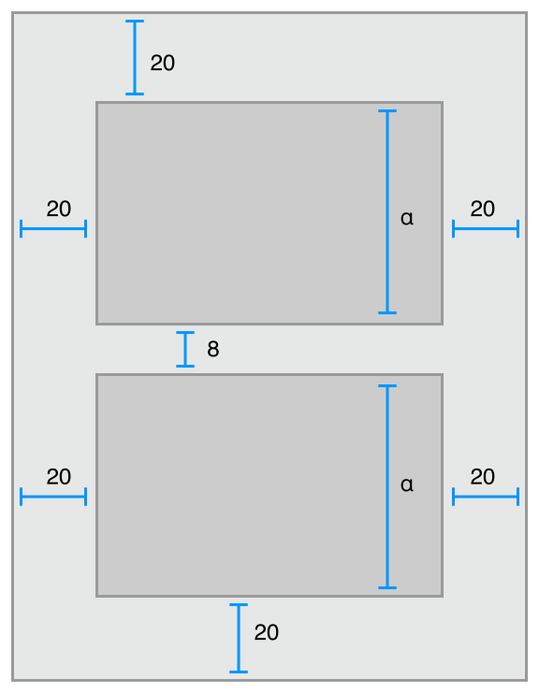
Frame-Based Layout
Auto Layout

Slide 4
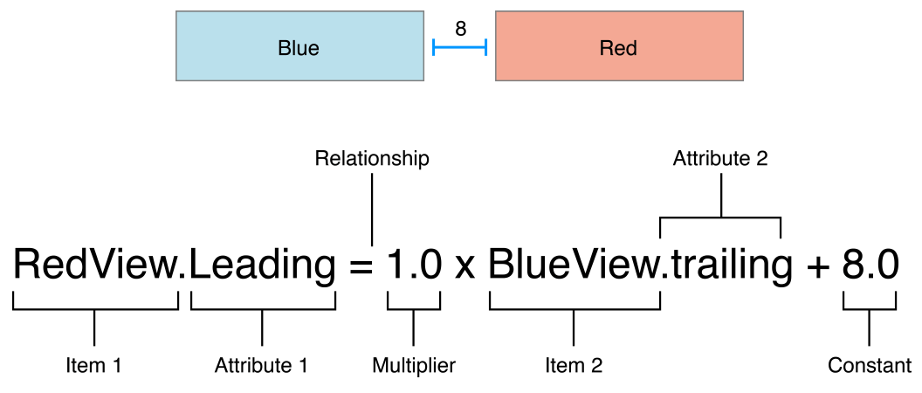
Anatomy of a Constraint
A constraint is a linear equation
A layout is defined as a series of constraints

Slide 5
Layout item:
  Views , layout guides
  two different attributes of a single item
  Item height or width
Layout attributes:
  The feature to be constrained:
    4 edges: leading, trailing, top, bottom
    Height and width
    Vertical and horizontal centers

Slide 6
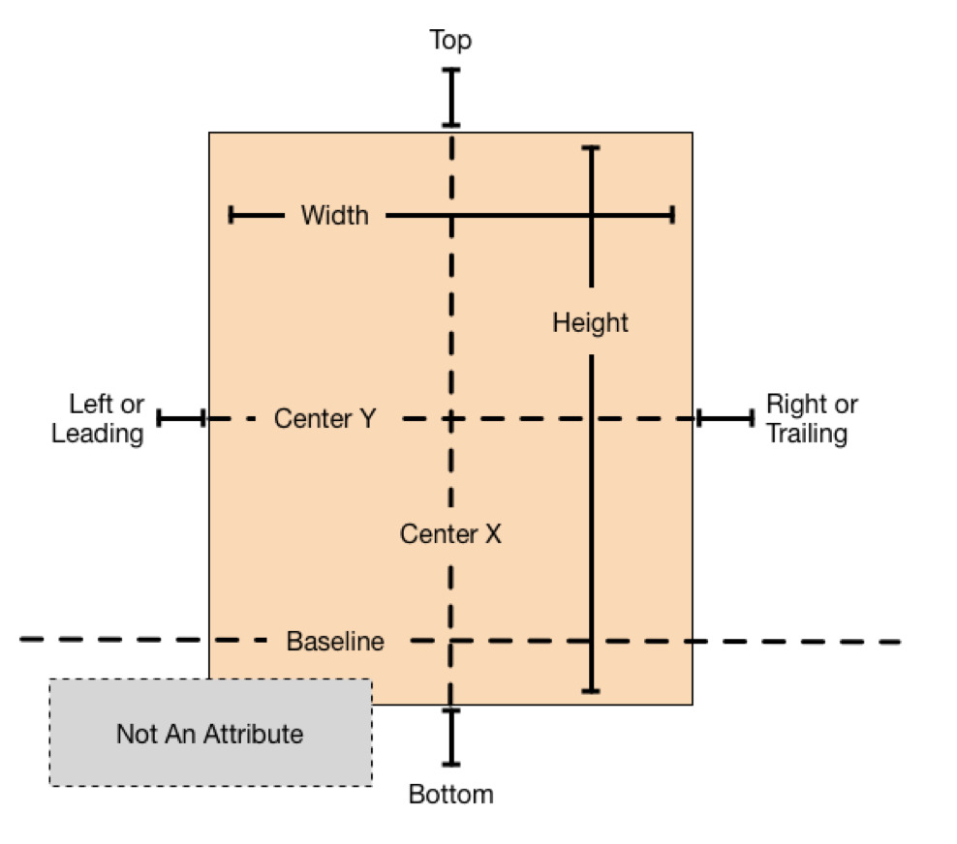
// Give two buttons the same width
Button_1.width = 1.0 * Button_2.width + 0.0
// Setting a constant height
View.height = 0.0 * NotAnAttribute + 40.0
// Setting the minimum width
View.width >= 0.0 * NotAnAttribute + 40.0

Slide 7
Constraints are required. ( by default)
If there is an error, Auto Layout prints information about the unsatisfiable constraints to the console
It chooses one of the constraints to break.
It then recalculates the solution without the broken constraint.
It keeps doing the above until it find a solution that satisfies all constraints
Constraints can be optional by setting their priority < 1000. ( 1 – 1000) where 1000 = required
Low(250), medium(500), high(750), required(1000)

Slide 8
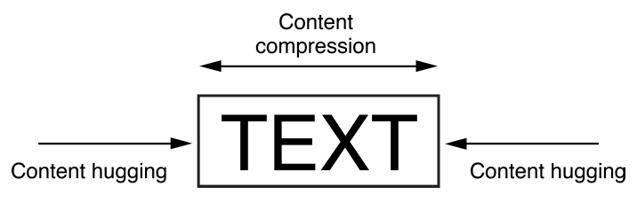
Intrinsic Content Size
Natural size given to the item content
A button’s intrinsic content size is the size of its title plus a small margin.
Intrinsic content size is based on the view’s current content
Auto Layout represents a view’s intrinsic content size using a pair of constraints for each dimension.
  The content hugging: pulls the view inward so that it fits snugly around the content.
  The compression resistance: pushes the view outward so that it does not clip the content.

Slide 9
// Compression Resistance
View.height >= 0.0 * NotAnAttribute + IntrinsicHeight
View.width >= 0.0 * NotAnAttribute + IntrinsicWidth
// Content Hugging
View.height <= 0.0 * NotAnAttribute + IntrinsicHeight
View.width <= 0.0 * NotAnAttribute + IntrinsicWidth
* Each of the above constraint can have its own priority
By default:
views use a 250 priority for their content hugging,
and a 750 priority for their compression resistance.
Fitting Size: output from the Auto Layout engine. It is the size calculated for a view based on the view’s constraints.

Slide 10
Setting Constraints in IB
Control-drag between views
Use Pin and Align tools
Let IB set up constraints ( prototyping constraints) and then edit
Once you create your first constraint, the system removes all the prototyping constraints from the views referred to by the constraint.
Without the prototyping constraints, the layout no longer has enough constraints to uniquely size and position all the views.
It becomes an ambiguous layout.
The affected constraints suddenly appear in red

Slide 11
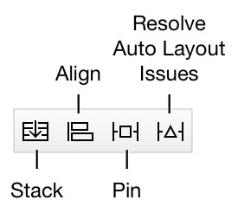
IB Auto Layout tools
Stack, Align, Pin, and Resolve Auto Layout Issues tools.

Slide 12
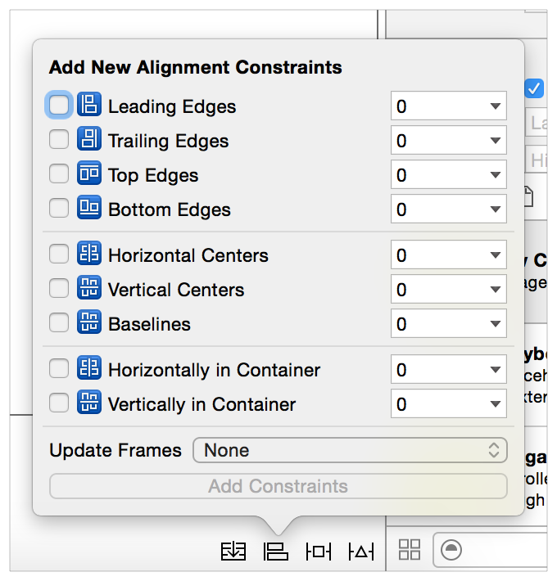
Align Tool

Slide 13
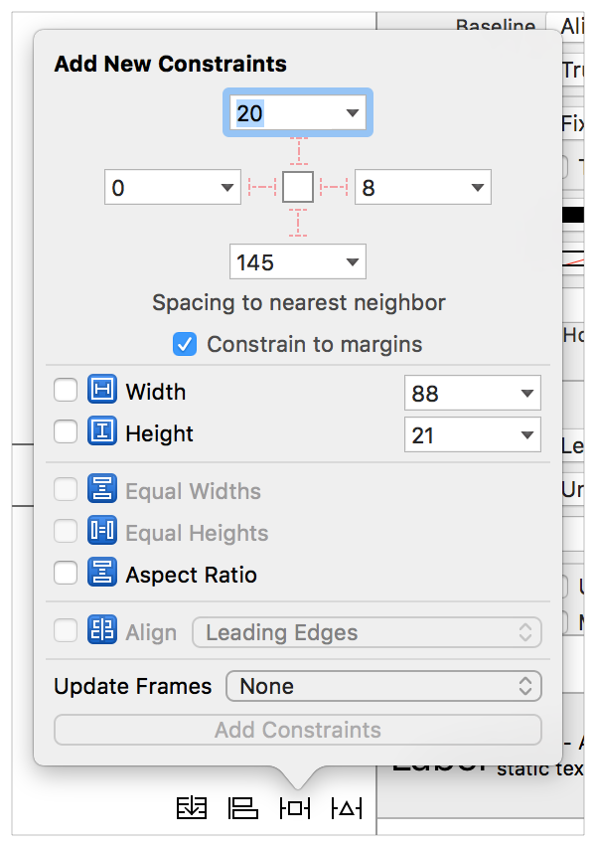
Pin Tool

Slide 14
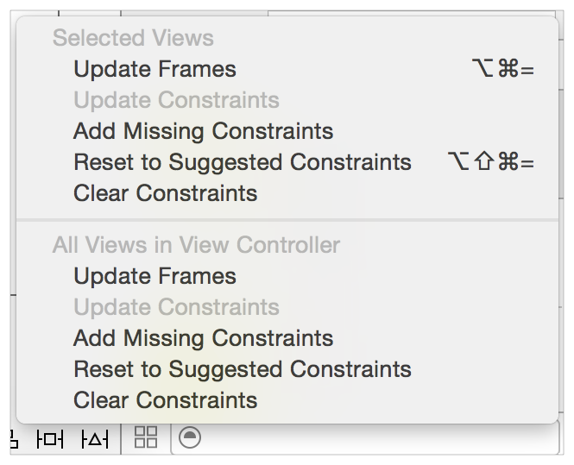
Resolve Auto Layout Issues Tool

Slide 15
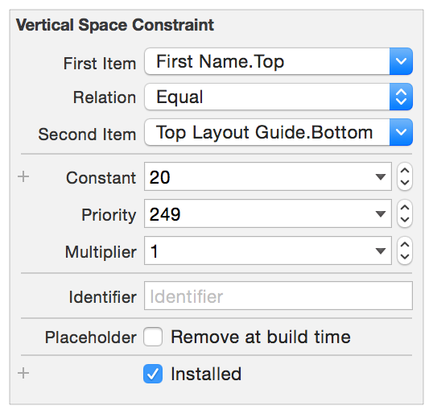
Constraints can be viewed:
  In the Canvas
  In the document outline
  In the size Inspector
Examining and Editing Constraints

Slide 16
Top and Bottom Layout Guides (Deprecated)
    the upper and lower edge of the visible content area for the currently active view controller.
    adopt the UILayoutSupport protocol ( length, topAnchor, bottomAnchor, heightAnchor)
Layout Margins
    describe the preferred spacing between the edge of the view and its subviews.
    Can be accessed using the layoutMargins layoutMarginsGuide property.
    Margins are set as UIEdgeInsets structure
    Default: 8 points
    Default for the root view of the viewController: 0 for top and bottom and 16/20 for sides ( cannot be changed)

Slide 17
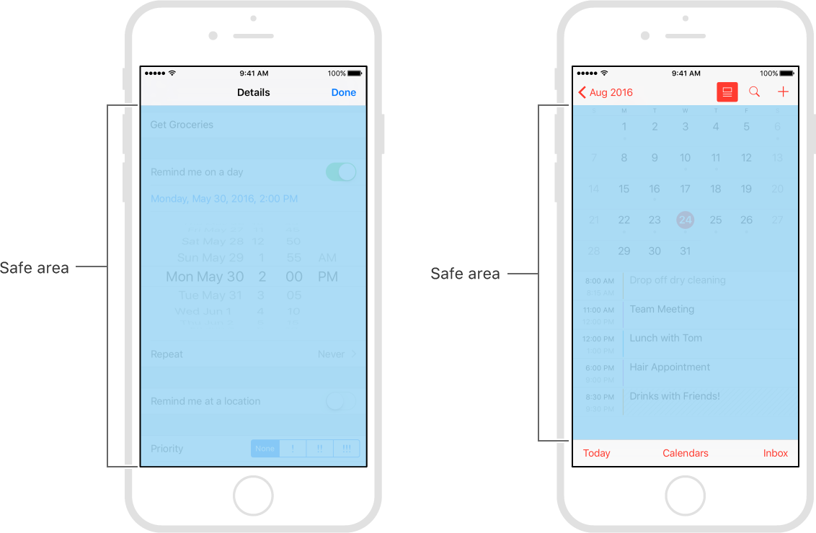
Use safe areas as an aid to laying out your content. (replace top and bottom layout guides)
Each view has its own layout guide (accessible from the safeAreaLayoutGuide property) that you can use to create constraints for items inside the view.

Slide 18
Readable Content Guides
    the maximum optimal width for text objects inside the view
    Obtained from the view’s readableContentGuide property
    In IB, you can set whether the view’s margins represent the layout margins or the readable content guide.
    Most of the time they are the same except in iPad in landscape orientation
Semantic Content
    The view’s semanticContentAttribute property determines whether the view’s content should flip when switching between left-to-right and right-to-left languages.

Slide 19
Size-Class-Specific Layout
Used by storyboard by default
Size classes provide rough indication on the element’s size
Then IB allows customizing layout features based on the current class size
The following features can be set :
  Install or uninstall a view or control
  Install or uninstall a constraint
  Set the value of select attributes ( font, layout margins)

Slide 20
Size Classes
Used to adapt to multiple screen sizes and orientation
Build the interface as it will look on most device, and then update only the objects that need to change when the available screen size changes.
A size class identifies a relative amount of display space for the height and width.
The size can be compact or regular for either height or width.
Compact: width of an iPhone screen in portrait and the height of the screen in landscape.
Regular: height of an iPhone in landscape, and both the width and height of an iPad screen.
size class: any: used to layout most of the interface elements for any width and height, and then layout any parts of the interface that change for a compact or regular size on either axis.
The specific number of points does not matter, only the relative amount of available space
Can preview the layout without running the app.

Slide 21
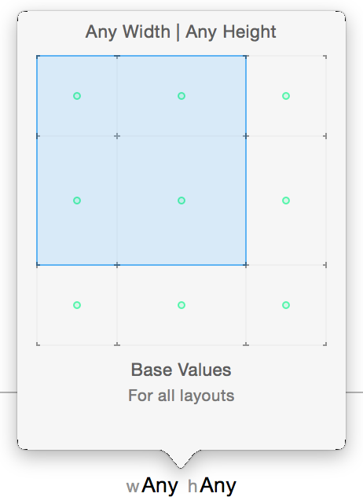

Slide 22
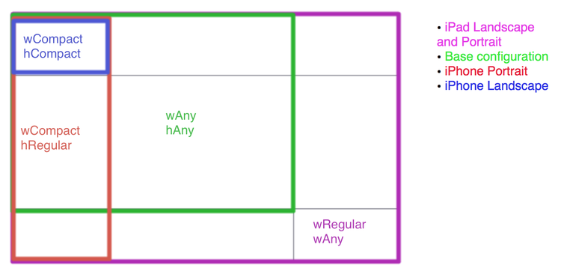

Slide 23
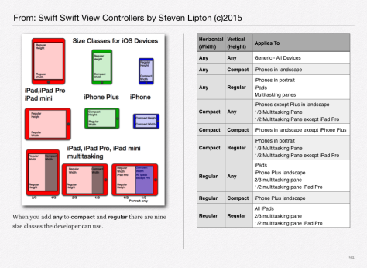

Slide 24
What can be changed?
The constant for a constraint
  Change size or position of a view
If a constraint is installed in the view hierarchy
  Add or remove sets of constraints
If a view is installed in the view hierarchy
  Add or remove a view
The font
  Change the font in labels, text views, and buttons

Slide 25
UITraitEnvironment
Provides iOS interface environment traits:
  horizontal and vertical size class: Regular/Compact
  display scale: 1.0 ( non Retina), 2.0 (Retina or greater)
  user interface idiom: unspecified, Phone, Pad
Protocol adopted by:
  UIScreen, UIWindow, UIViewController, UIPresentationController, and UIView.
traitCollection property: used to access the trait environment of an object

Slide 26
(void) traitCollectionDidChange: (UITraitCollection *) previousTraitCollection {
[super traitCollectionDidChange: previousTraitCollection];
if ((self.traitCollection.verticalSizeClass !=
previousTraitCollection.verticalSizeClass) ||
self.traitCollection.horizontalSizeClass !=
previousTraitCollection.horizontalSizeClass)) {
// your custom implementation here
}
}
func traitCollectionDidChange(_ previousTraitCollection: UITraitCollection?)
The system calls this method when the iOS interface environment changes.
(required) for UITraitEnvironment Protocol

Slide 27
Final and Base Size Classes
The Final size classes:
    The Final classes represent actual size classes displayed on devices)
        Compact-Compact,
        Compact-Regular,
        Regular-Compact,
        Regular-Regular
The Base size classes
        Compact-Any,
        Regular-Any,
        Any-Compact,
        Any-Regular,
        Any-Any

Slide 28
Auto Layout Without Constraints
Use Stack views
A single stack view defines a row or column of user interface elements.
The stack view arranges these elements based on its properties:
    axis: defines the stack view’s orientation, either vertical or horizontal.
    distribution: defines the layout of the views along the axis.
    alignment: defines the layout of the views perpendicular to the stack view’s axis
    spacing: defines the space between adjacent views.

