Slide 1
Using the Interface Builder

Slide 2
Building Interfaces
By hand using Objective-C or Swift
  Specify where each element appears onscreen and how it behaves.
Using Interface Builder,
  lay out those same elements using a visual editor.
  Save them in a nib file ( with .xib extension).
  Load the nib file using :`
  Bundle.main.loadNibNamed(name, owner: nil, options: nil)

Slide 3
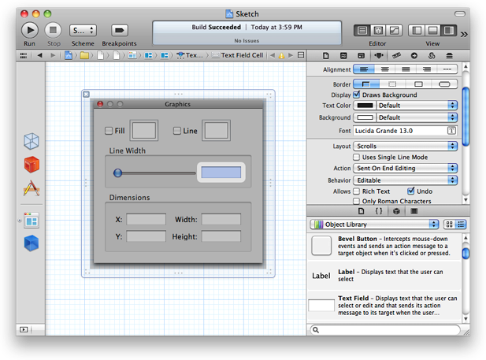
Interface Builder in the workspace window

Slide 4
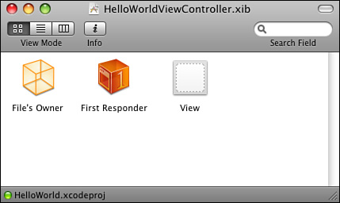
The Interface Builder window for a view controller .xib

Slide 5
View : The view is by default a member of the UIView class
File’s Owner represents the view controller.
  An abstract class, and it is a proxy because it plays a role in IB, but the object is not itself embedded in the .xib archive.
  View controllers don’t have a visual presentation. They manage views, but they don’t display anything of their own.
  Each view controller has an instance variable called “view” which is set to some UIView (in this case, the one at the right) that is responsible for providing the actual onscreen presentation.
  In the case of view controllers, the File’s Owner proxy represents the object that loads and owns the .xib.
First Responder: a proxy object. It represents the onscreen object that is currently responding to user touches.
  It changes during the lifetime of an application as users interact with the screen.
Outlets
  Instance variables ( in the IB-talk).

Slide 6
There are two kinds of objects displayed in the Interface Builder dock:
  Interface objects : objects are the objects that are actually created when the nib file is loaded and typically comprise the bulk of the objects.
  Placeholder objects: There are normally three placeholder objects in a nib file:
    File’s Owner:
      Represents the nib file’s controller object.
      It is the most commonly used placeholder object in nib files.
      It is the main bridge between your application and the contents of the nib file.
      You can designate any object in your application as the File’s Owner of a nib file.
    First responder
      represents the first object in the responder chain, which is determined dynamically at runtime by the UIKit frameworks.
    Application

Slide 7
Constraints
Auto Layout, available starting with Mac OS X v10.7 Lion, uses relationships called constraints to govern the layout of objects in the user interface.
This feature is a complete replacement for the autoresizing mask.
As you make changes to any view or control in Interface Builder (move it around, resize it, change an attribute, add a subview, and so forth), Interface Builder automatically adds and removes constraints based on the new layout.

Slide 8
Load a view from a nib file:
extension UIView { class func fromNib<T: UIView>() -> T {
return Bundle.main.loadNibNamed(String(describing: T.self), owner: self, options: nil)![0] as! T }
}
let myView = UIView.fromNib()
Or
var uiview :UIView? self.uiview =
Bundle.main.loadNibNamed("myXib", owner: self, options: nil)[0] as? UIView
The above is the same as:
let subviewArray = Bundle.main().loadNibNamed("myXib", owner: self, options: nil)
return subviewArray[0]

Slide 9
IBDesignable /IBInspectable
Marking a class IBDesignable tells interface builder to run the code from that view and render it instead of showing a simulated version.
  updates the view in realtime
Marking a property as IBInspectable tell interface builder to show a field for that property.
  exposes class properties in the interface builder Attribute Inspector

