Slide 1
Using the Storyboard
INFO 6350

Slide 2
Storyboard
Visual representation of the user interface of an iOS application
Shows screens of content and the connections between those screens
Composed of a sequence of scenes, connected by segue objects.
Scene:
  a single view controller and its views
Segue:
  represent a transition between two view controllers.

Slide 3
Using Storyboard
A scene represents an onscreen content area that is managed by a view controller.
You can think of a scene as a view controller and its associated view hierarchy.
Relationships are created between scenes in the same storyboard

Slide 4
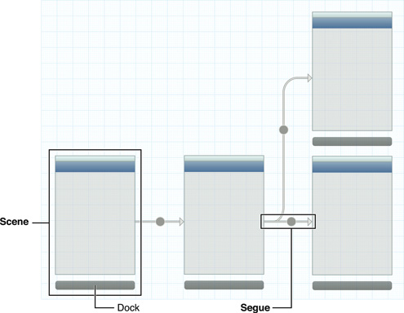

Slide 5
Containment
  represents a parent-child relationship between two scenes.
  View controllers contained in other view controllers are instantiated when their parent controller is instantiated.
  Ex, the first connection from a navigation controller to another scene defines the first view controller pushed onto the navigation stack. This controller is automatically instantiated when the navigation controller is.
  IB can adjust the appearance of the child view controller to reflect the presence of its ancestors.
A segue
  represents a visual transition from one scene to another.
  At runtime, segues can be triggered by various actions.
    Programatically : usually for segue that directly connect two view controllers
    By a third object such as a Button in the source view controller
  When a segue is triggered, it causes a new view controller to be instantiated and transitioned onscreen..

Slide 6
Kind of Segues
A push segue pushes the destination view controller onto a navigation controller’s stack.
A modal segue presents the destination view controller.
A popover segue displays the destination view controller in a popover.
A custom segue allows you to design your own transition to display the destination view controller.

Slide 7
func awakeFromNib() :
  used to finish initializing all objects loaded from a story board, including view controllers
  When an object receives an awakeFromNib message, it is guaranteed to have all its outlet and action connections already established.
Segue transitions:
  Push
  Modal
  Custom: subclass a segue object to implement a custom transition.
optional func prepare(for segue: NSStoryboardSegue, sender: Any?)
  Used to pass data between scenes.
  Invoked on the view controller when a segue is triggered.
optional func performSegue(withIdentifier identifier: NSStoryboardSegue.Identifier, sender: Any?):
  Used to programmatically force a transition on the view controller
optional func shouldPerformSegue(withIdentifier identifier: NSStoryboardSegue.Identifier, sender: Any?) -> Bool
  Called immediately prior to the performance of a storyboard segue.

Slide 8
UIStoryBoard Class
A UIStoryboard object encapsulates the view controller graph stored in an Interface Builder storyboard resource file.
View controllers in a storyboard are instantiated and created automatically in response to actions defined within the storyboard itself.
Can use a storyboard object to instantiate the initial view controller in a storyboard file or instantiate other view controllers to present them programmatically.
init(name: String, bundle storyboardBundleOrNil: Bundle?)
  Creates and returns a storyboard object for the specified storyboard resource file.
func instantiateInitialViewController() -> UIViewController?
  Instantiates and returns the initial view controller in the view controller graph
func instantiateViewController(withIdentifier identifier: String) -> UIViewController:
  Instantiates and returns the view controller with the specified identifier.

Slide 9
UIStoryboardSegue
Responsible for performing the visual transition between two view controllers.
Used to prepare for the transition from one view controller to another.
Contain information about the view controllers involved in a transition.
When a segue is triggered, but before the visual transition occurs, the storyboard runtime calls the current view controller’s prepareForSegue:sender: method so that it can pass any needed data to the view controller that is about to be displayed.
The storyboard runtime creates them when it must perform a segue between two view controllers.
Can be programmatically initiated using the :
open func performSegue(withIdentifier identifier: String, sender: Any?)
method of UIViewController
init(identifier: String?, source: UIViewController, destination: UIViewController, performHandler: @escaping () -> Swift.Void)
  Creates a custom segue that calls a block to perform the segue transition.
init(identifier: String?, source: UIViewController, destination: UIViewController)
  Initializes and returns a storyboard segue object for use in performing a segue.
  Used to initialize any variables in the custom segue subclass
open func perform()
  Performs the visual transition for the segue.
  Subclasses override this method and use it to perform the animations from the views in source ViewController to the views in destination ViewController.

Slide 10
Segue Attributes
var sourceController: Any { get }
  The source view controller for the segue. (read-only)
var destinationController: Any { get }
  The destination view controller for the segue. (read-only)
var identifier: NSStoryboardSegue.Identifier? { get }
  The identifier for the segue object. (read-only)

Slide 11
Instantiating a view controller from the storyboard
UIViewController *viewController = [[UIStoryboard
storyboardWithName:@"MainStoryboard" bundle:nil]
instantiateViewControllerWithIdentifier:
@"ViewController"];
let storyboard = UIStoryboard(name: "Main", bundle: nil)
let navController = storyboard.instantiateViewController(withIdentifier: "navigationController") as! UINavigationController

Slide 12
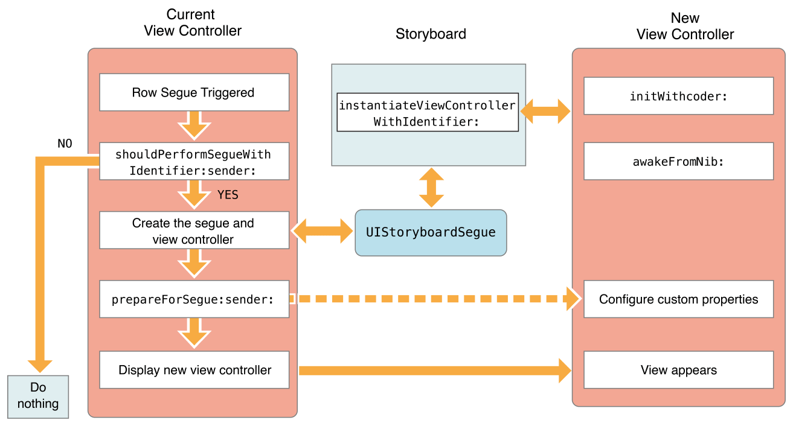
Displaying a view controller using a segue

Slide 13
New Changes
Refactor a single storyboard into multiple storyboards and link them visually via storyboard references.
Add supplementary views to a view controller using the scene dock.
Add multiple buttons to a navigation bar, right from the storyboard itself!

Slide 14
1. Show - Pushes the destination view controller onto the navigation stack, moving the source view controller out of the way (destination slides overtop from right to left), providing a back button to navigate back to the source - on all devices.
Example: Navigating inboxes/folders in Mail.
2. Show Detail - Replaces the detail/secondary view controller when in a UISplitViewController with no ability to navigate back to the previous view controller.
Example: In Mail on iPad in landscape, tapping an email in the sidebar replaces the view controller on the right to show the new email.
3. Present Modally - Presents a view controller in various different ways as defined by the Presentation option, covering up the previous view controller - most commonly used to present a view controller that animates up from the bottom and covers the entire screen on iPhone, but on iPad it's common to present it in a centered box format overtop that darkens the underlying view controller.
Example: Tapping the + button in Calendar on iPhone.
4. Popover Presentation - When run on iPad, the destination appears in a small popover, and tapping anywhere outside of this popover will dismiss it. On iPhone, popovers are supported as well but by default if it performs a Popover Presentation segue, it will present the destination view controller modally over the full screen.
Example: Tapping the + button in Calendar on iPad (or iPhone, realizing it is converted to a full screen presentation as opposed to an actual popover).
5. Custom - You may implement your own custom segue and have complete control over its appearance and transition.

Slide 15
Size Classes
Used to adapt to multiple screen sizes and orientation
Build the interface as it will look on most device, and then update only the objects that need to change when the available screen size changes.
A size class identifies a relative amount of display space for the height and width.
The size can be compact or regular for either height or width.
Compact: width of an iPhone screen in portrait and the height of the screen in landscape.
Regular: height of an iPhone in landscape, and both the width and height of an iPad screen.
size class: any: used to layout most of the interface elements for any width and height, and then layout any parts of the interface that change for a compact or regular size on either axis.
The specific number of points does not matter, only the relative amount of available space
Can preview the layout without running the app.

Slide 16
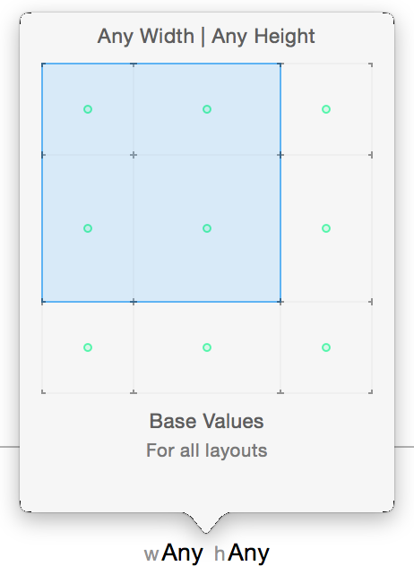

Slide 17
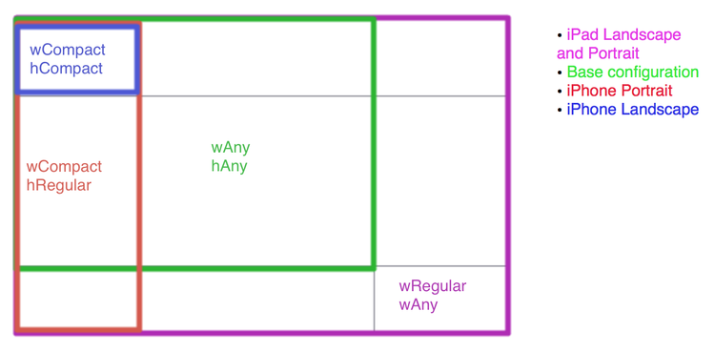

Slide 18
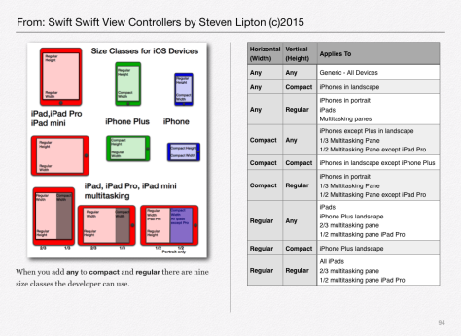

Slide 19
What can be changed?
The constant for a constraint
  Change size or position of a view
If a constraint is installed in the view hierarchy
  Add or remove sets of constraints
If a view is installed in the view hierarchy
  Add or remove a view
The font
  Change the font in labels, text views, and buttons

Slide 20
UITraitEnvironment
Provides iOS interface environment traits:
  horizontal and vertical size class: Regular/Compact
  display scale: 1.0 ( non Retina), 2.0 (Retina or greater)
  user interface idiom: unspecified, Phone, Pad
Protocol adopted by:
  UIScreen, UIWindow, UIViewController, UIPresentationController, and UIView.
traitCollection property: used to access the trait environment of an object

Slide 21
(void) traitCollectionDidChange: (UITraitCollection *) previousTraitCollection {
[super traitCollectionDidChange: previousTraitCollection];
if ((self.traitCollection.verticalSizeClass !=
previousTraitCollection.verticalSizeClass) ||
self.traitCollection.horizontalSizeClass !=
previousTraitCollection.horizontalSizeClass)) {
// your custom implementation here
}
}
func traitCollectionDidChange(_ previousTraitCollection: UITraitCollection?)
The system calls this method when the iOS interface environment changes.
(required) for UITraitEnvironment Protocol

Slide 22
Auto Layout Without Constraints
Use Stack views
A single stack view defines a row or column of user interface elements.
The stack view arranges these elements based on its properties:
    axis: defines the stack view’s orientation, either vertical or horizontal.
    distribution: defines the layout of the views along the axis.
    alignment: defines the layout of the views perpendicular to the stack view’s axis
    spacing: defines the space between adjacent views.

