Slide 1



MedConnect
-Bridging Patients and Safe Prescriptions.
CODEZEN 2026
Project Name: MedConnect
Team Name: Let’s Debug it
Team Members: Karan Sharma
Tracks Chosen: Healthcare

Slide 2
PROBLEM STATEMENT
SOLUTION
Disconnectivity in Health Care System
#MedConnect
Fragmented Data: Data on Internet is very scattered due to lack of comprehensive interoperable digital systems.
Medication Mistakes:
FDA reviews about 1,400 reports of medication errors per month (approximately 16,800+ annually).
The most common errors included wrong drug (30%), wrong strength (26%), and wrong directions (15%).
Accurate Information:
Providing user with right information and with good suggestions through blogs.
Managing complex medication schedules:
Providing user with proper managing system of scheduling there doses.
Medicine information:
Providing user with vital information about there medicine.

Slide 3
KEY FEATURES
Swasthya Jagarukta: This feature provide Medicine Scheduling, Smart Notifications, Missed Dose Tracker, Multiple Reminder, User-Friendly Interface.
Aarogya Mitra: This Mitra(friend) is a blog post in our project where we share some authentic and accurate information from official government websites which is helpful for everyone.
Why It’s Different
One Single Platform form Medicine Scheduling, Providing vital information about correct dose for different stages.
Target Users
Target Audience is people who have more complex medicine scheduling (old aged people) and as they often live with family this application help there Caretakers and for Health Conscious people.

Slide 4
Idea/Approach
Give friendly messages like “Get well soon” and “ Take Medicine properly”
Start App
Show Daily/Weekly Report
User Registration / Login
Set Notification Timer(with the use of Google Calendar)
End
Add Medicine Details
(Name, Dose, Time, Date(Duration)
Store Data In Database
(SQLite)

Slide 5

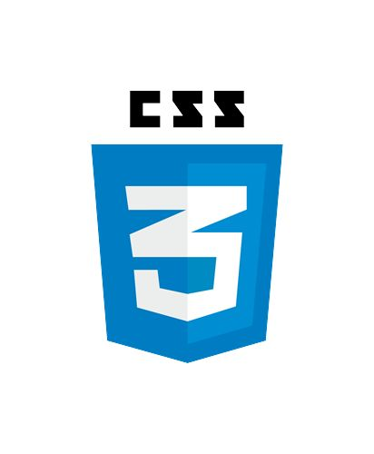


TECHNOLOGY STACK
FRONTEND HTML,CSS,JavaScript
Backend Node.js and Express.js
Notification Google Calendar API
Database SQLite

Slide 6
Feasibility and Showstoppers
The Tech Stack we are using is highly feasible to build project within time limit.
Swasthya Jagarukta and Aarogya Mitra are showstoppers. These features are quite helpful for users.
USP & BUSINESS MODEL
USP is its Managing complex medication schedules and guide them that they aren’t taking wrong dose of medicines.
This can be created as B2C where we interact directly with customers and sell them premium application with some more future advancements like daily protein trackers and daily calories intake.
This is software focused
THANK YOU

