Slide 1
Fake News detection on Twitter
-Karan Mankar

Slide 2




Introduction
Social media is a big part of our daily life.
Heavy reliance on microblogging sites
Present our views or opinions.
Follow influential personalities.
Problem of fake news to shape the public discourse is of growing concern
Exaggerated claims over the Hillary emails.
NHS bus that was roaming the streets of London (heavily publicized by the pro-Brexit camp using Twitter).

Slide 3
Business Understanding
Information quality over social media is of increasing concern as our reliance on the web platforms grows.
Widely used to undertake crucial tasks such as coordinating relief effort in times of disaster.
Influencers coordinating medicine and oxygen information in India during the recent Second wave.
Fake news during such trying times can lead to irreparable losses and so detecting Fake news before being widely disseminated is of paramount importance.
A system to detect fake news is presented in this project
The system will analyze:
Tweet content
Retweet data
Tweet source information
Sentiment of the tweet.

Slide 4
Literature Review
FakeBERT: Fake news detection in social media with a BERT-based deep learning approach
The FakeBERT system uses Deep Learning techniques like:
LSTM
Convolution Neural Networks
BERT transformer
Accuracy gain of approximately 90% using data acknowledged as fake news and from reputable tabloids like the New York Times and Washington Post.
Fake News Detection Using Machine Learning Ensemble Methods
Highlights the grave issue of lack of enough reliable open-sourced data
Has created a dataset MisInfoText.
Contribution for collecting data from various fact checking websites required.

Slide 5
Literature Review
Fake News Stance Detection Using Deep Learning Architecture (CNN-LSTM)
AI-powered analytic tools such as stance-classification
Determine whether the headline of the news matches the body
Text processing to analyze the author’s writing style
Image forensics to detect photoshop use.
Real time anomaly detection to detect anomalies in text indicating a pre-determined text that the owner of the handle just posted after being told to.

Slide 6
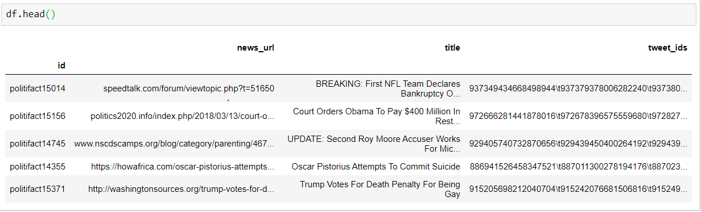
Data Understanding
Datasets used:
Politifact Dataset
Pheme RumourDataset
Politifact Dataset:
Consists of tweets, urls and
Retweet ids
Divided into two folders
Real
Fake

Slide 7
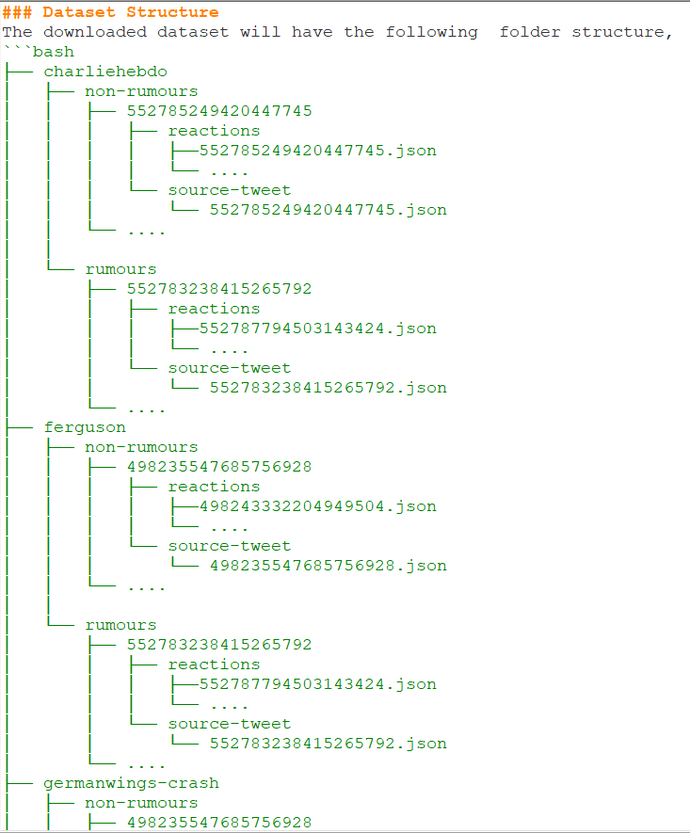
Data Understanding
Pheme Rumour Dataset:

Slide 8
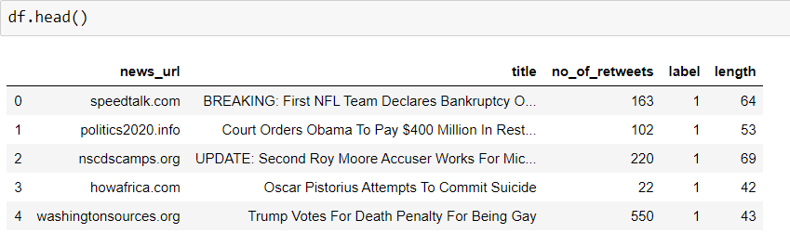
Data Preparation
Data preparation was done separately for both the datasets.
Python Script for Pheme Rumour Dataset
Sentiment Analysis using VaderSentiment Library
Removal of stopwords, URLs, emojis, @-mentions, hashtags from tweets
Conversion of tweet_ids to number of retweets

Slide 9
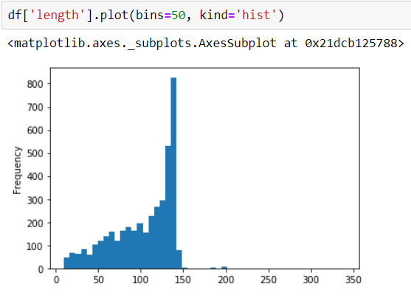
Exploratory Data Analysis
Length of all the tweets

Slide 10
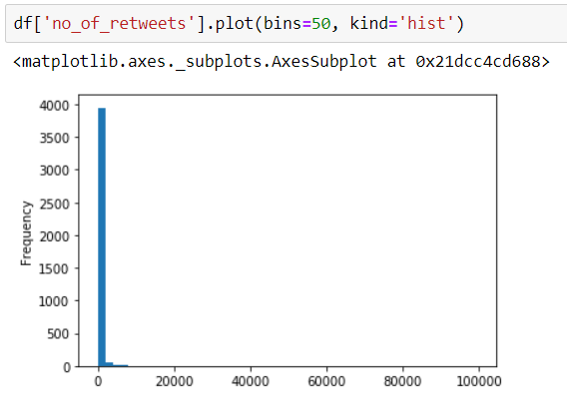
Exploratory Data Analysis Total number of retweets per news article

Slide 11
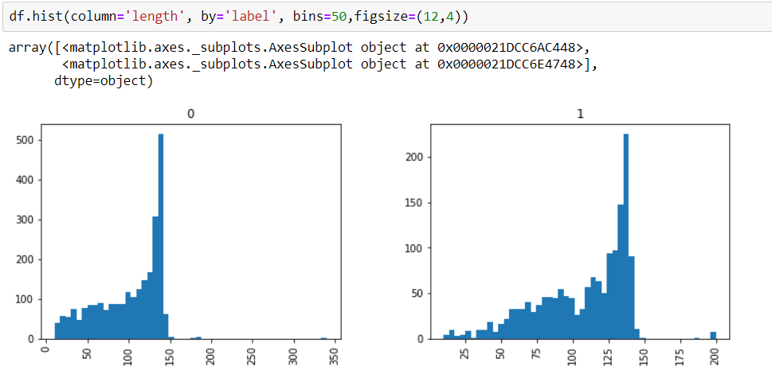
Exploratory Data Analysis Length vs Label

Slide 12
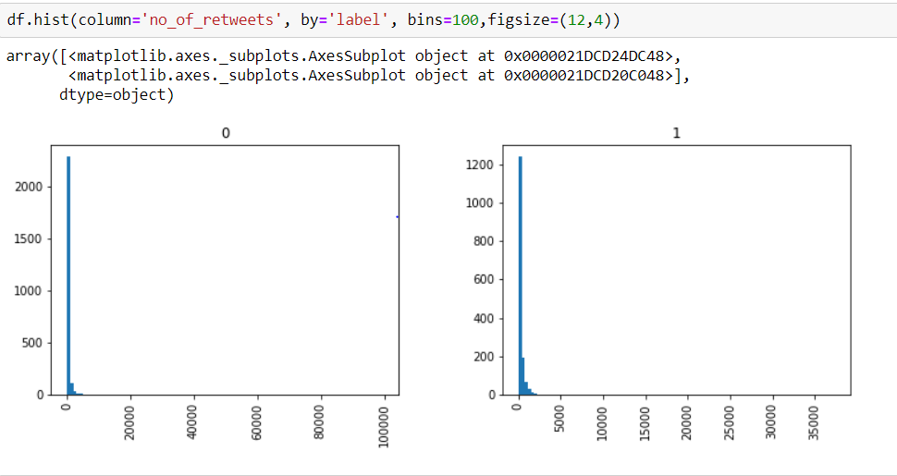
Exploratory Data Analysis
Number of retweets vs label

Slide 13
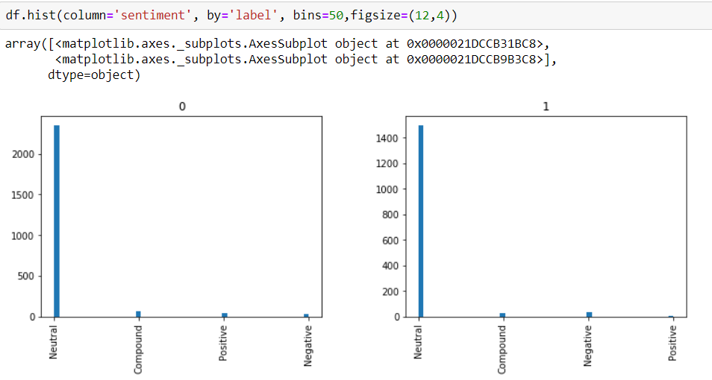
Exploratory Data Analysis
Sentiment vs Label

Slide 14
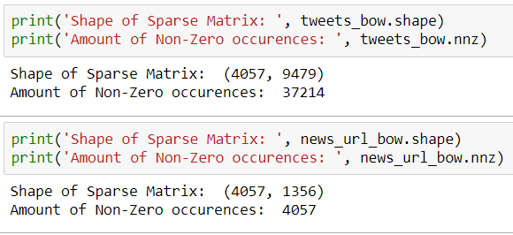
Vectorization
Bag of words transformation
Convert raw text data into vectors for modelling
Sparse Matrix of both tweet text and source URL
TF-IDF vectorization on tweet text and source URL

Slide 15
Modeling
Three models used:
Naïve Bayes
Support Vector Machines
K Means Clustering

Slide 16
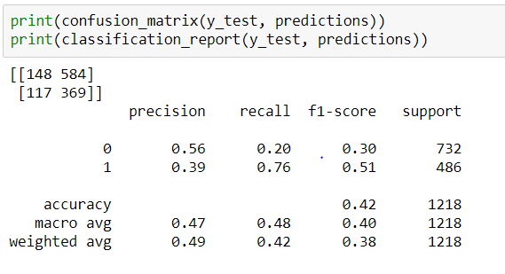
Naïve Bayes
 | Accuracy | Precision | Recall | F1-Score
Naïve Bayes | 0.42 | 0.47 | 0.48 | 0.40

Slide 17
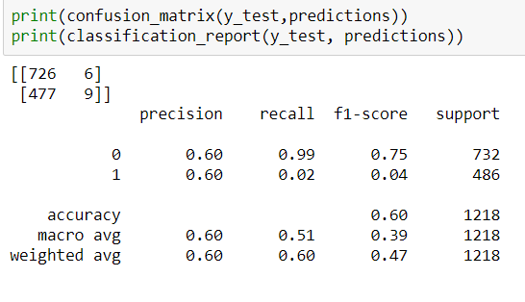
Support Vector Machines
 | Accuracy | Precision | Recall | F1-Score
SVM | 0.60 | 0.60 | 0.51 | 0.39

Slide 18
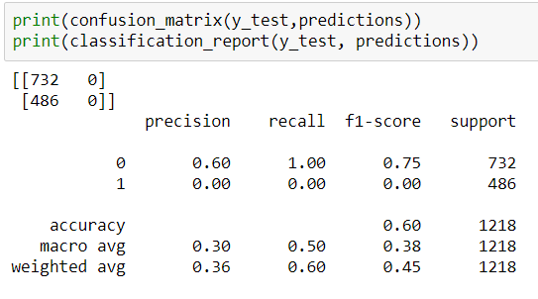
K Means Clustering
 | Accuracy | Precision | Recall | F1-Score
K Means | 0.60 | 0.30 | 0.50 | 0.38

Slide 19
Evaluation
 | Accuracy | Precision | Recall | F1-Score
Naïve Bayes | 0.42 | 0.47 | 0.48 | 0.40
SVM | 0.60 | 0.60 | 0.51 | 0.39
K Means | 0.60 | 0.30 | 0.50 | 0.38

Slide 20
The End

