Slide 1
GShard: Scaling Giant Models with Conditional Computation and Automatic Sharding
BITS F382 – Reading Course on LLMs, [Link]

Slide 2
Motivation –
Lack of Architecture-specific model parallelism support → Naïve methods are sequential, wrt to TensorFlow and PyTorch and/or require migrating code to different frameworks
Super-linear scaling of computation cost vs model size → Straight-forward increase in model depth/width => linear increase in step-size time OR straight-forward graph partitioning leads to network overheads.
Problems with scalability of large model representation → inter-op OR intra-op distribution across D devices of the model leads to O(D²) graph size and compilation-time .
Challenges with implementing partitioning strategies → graph-level partitioning => sophisticated algorithms and operator level partitioning => semantically inspired communication patterns.
Solution & Abstract –
GShard is an innovative module that helps with massive distributed training across multiple devices across multiple use-cases along with minimal changes to existing code (like an extension to XLA) and beats previous SOTA. Uses Sparsely-Gated Mixture-of-Experts (MoEs). The paper’s primary focus is on Multi-lingual transfer and translation. Concretely they have tried to scale beyond 600B parameters and trained them efficiently using appropriate distribution of resources, “We demonstrate that such a giant model can efficienctly be trained on 2048 TPU v3 accelerators in 4 days to achieve far superior quality for translation from 100 languages to English compared to the prior art”.
BITS F382 – Reading Course on LLMs
Notes:
Naïve methods – Graph Partitioning (It involves dividing the computational graph representing the model into smaller subgraphs, which are then assigned to different computing nodes (such as GPUs or machines) for parallel execution), different frameworks like XLA.
For 2nd point, Device under-utilization stems from imbalanced assignment and sequential dependencies of the underlying neural network and cannot be resolved by simply using more devices.
For 4th point, semantics, e.g., whether it needs to accumulate partial results, or to rearrange data shards

Slide 3
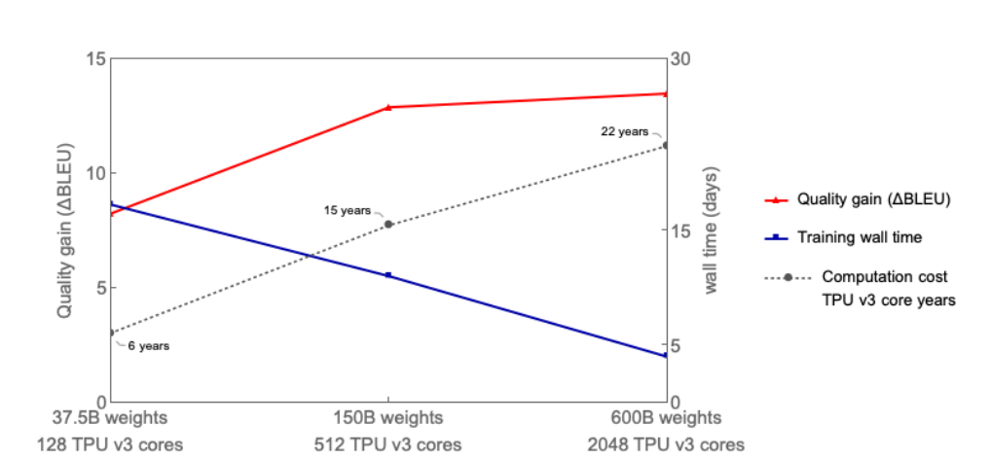
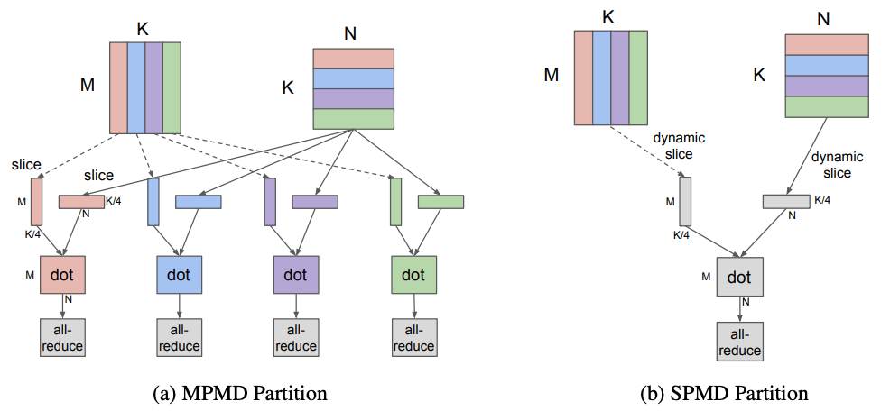
Goals –
“In this paper, we demonstrate how to overcome these challenges by building a 600 billion parameter sequence-to-sequence Transformer model with Sparsely-Gated Mixture-of-Experts layers, which enjoys sub-linear computation cost and O(1) compilation time.”
Design Principles –
Sub-Linear Scaling → Use Conditional computation because enables training and inference efficiency by having a sub-network activated on the per-input basis.
*Abstraction → The model description should be separated from the partitioning implementation and optimization. Major motivation.
Scalable Compilers → developed a innovative compiler technique for SPMD (Single Program Multiple Data) transformation that generates a single program to run on all devices, keeping the compilation time constant independent of the number of devices.
BITS F382 – Reading Course on LLMs
Notes:
For Goals, “trained this model with 2048 TPU v3 devices for 4 days on a multilingual machine translation task and achieved far superior translation quality compared to prior art when translating 100 languages to English with a single non-ensemble model”.
For 1. Conditional Computation means only a sub-part of the network is active based on input, they also had already tried Position-wise Sparsely gated MoEs with RNNs and achieved good results (SOTA) with sublinear computation cost.
For 2. This separation of concerns let model developers focus on the network architecture and flexibly change the partitioning strategy, while the underlying system applies semantic-preserving transformations and implements efficient parallel execution. GShard consists of a set of simple APIs for annotations, and a compiler extension in XLA [28] for automatic parallelization. Model developers write models as if there is a single device with huge memory and computation capacity, and the compiler automatically partitions the computation for the target based on the annotations and their own heuristics.
For last design principle, Notice that with the usual MPMD (Multiple Program Multiple Data) approach in Figure 2a scaling becomes more challenging since the number of nodes in the graph increases linearly with the number of devices

Slide 4
MODEL DETAILS
BITS F382 – Reading Course on LLMs

Slide 5
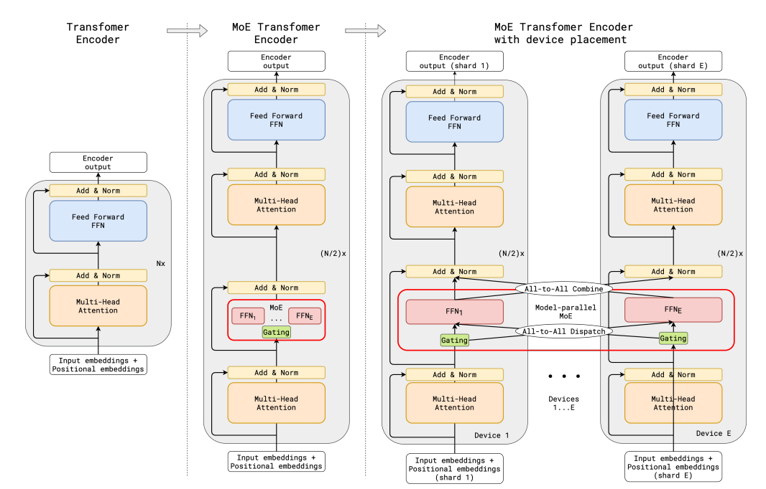
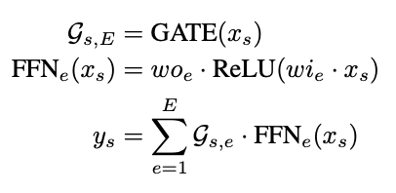
Model –
This cut through arrow is just a mistake, nothing special is going on!
BITS F382 – Reading Course on LLMs

Slide 6
“We sparsely scale Transformer with conditional computation by replacing every other feed-forward layer with a Position-wise Mixture of Experts (MoE) layer with a variant of top-2 gating in both the encoder and the decoder”
An expert → This is just a FFN.
The GATE(.) → The most important aspect of the pipeline, uses SoftMax and has top-2 gating, i.e. the token is dispatched to only two experts (NOT the top-2 experts). It must have the following properties in addition –
Balanced Load → Naïvely choosing top-k experts would over-burden a few experts and leave others untrained.
Efficiency at Scale → Gating cannot be done sequentially, otherwise O(N*E) {N – Number of tokens ~ 10⁶ and E – Number of experts ~ 10²} and most resources would be idle.
The Gate(.), Details → In line with the two requirements, the paper makes the following design choices –
Expert capacity → Ensures (1), by setting a threshold on number of tokens processes by an expert.
Local group dispatching → Ensures (1) & (2), G groups are made from N tokens and all are processed in parallel (S = N/G tokens per group). Grouping also limits the number of tokens an expert can attend to from a group.
Auxiliary Loss → Again Ensures (1), another term is added to the loss function m_{e}*(c_{e}/S) to ensure differentiability and capture this goal of distributing load. ( m_{e} = mean tokens per expert)
Random Routing → (I believe this is very similar to dropout) If the weight of the 2nd expert is very low, it’s just dropped.
BITS F382 – Reading Course on LLMs
Notes:
Top-2 gating => the top-2 experts are selected, no pun xD
FFN – Feed Forward Network.
For expert capacity, Assuming that the total number of tokens in a training batch is N, and each token is dispatched to at most two experts, then the expert capacity is set to be O(N/E). GATE(·) keeps a running counter ce for how many tokens are dispatched to an expert. When both experts selected by a token already exceed their capacity, the token is considered as an overflowed token, where Gs,E degenerates into a zero vector. Such tokens have their representation xs passed on to the next layer via residual connections.

Slide 7
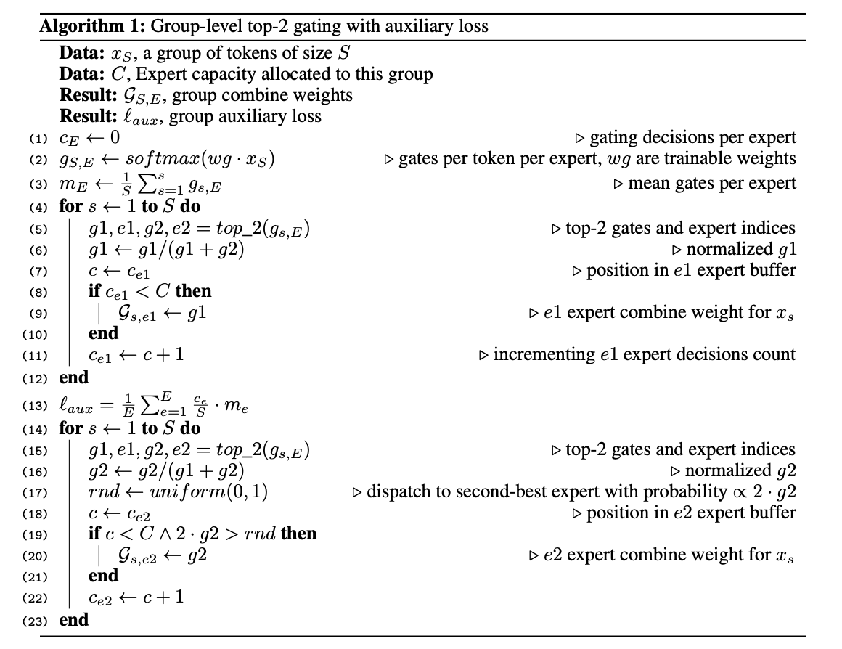
Highly Parallel Implementation of Gshard –
BITS F382 – Reading Course on LLMs

Slide 8
IMPLEMENTATION DETAILS
BITS F382 – Reading Course on LLMs

Slide 9
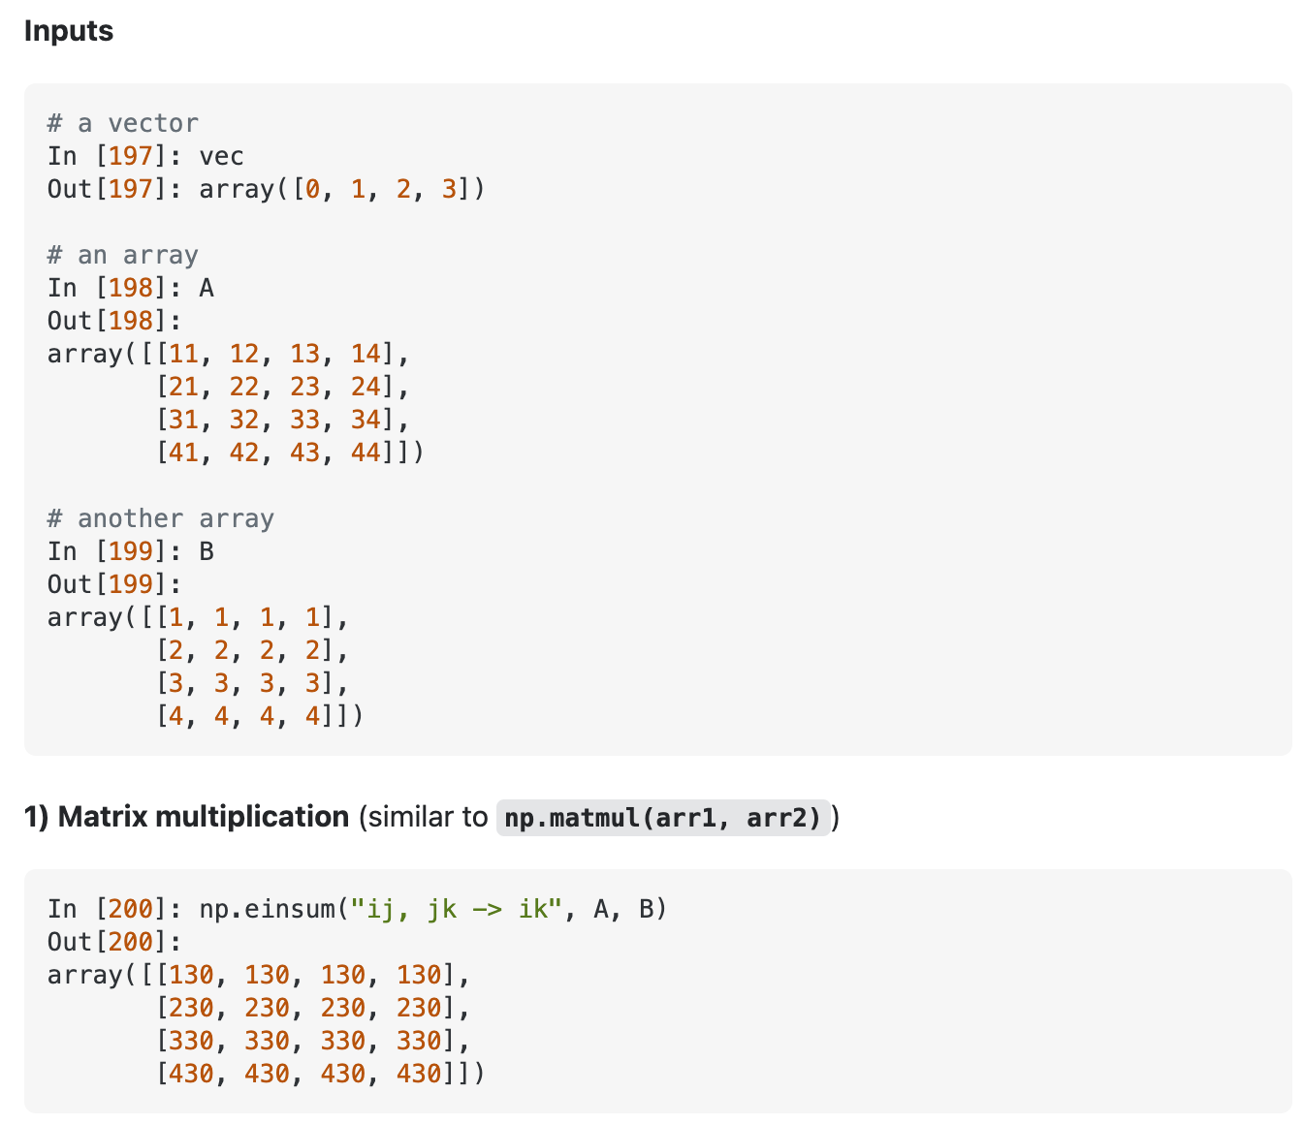
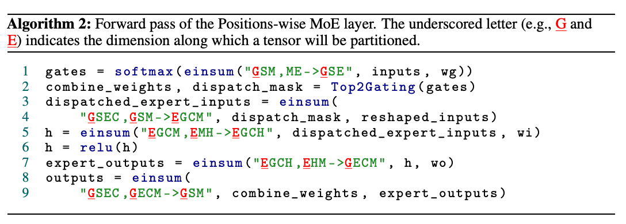
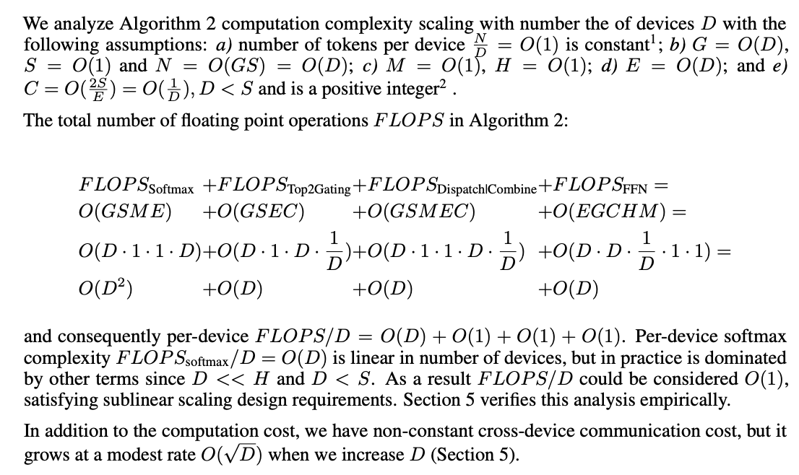
Positions-wise MoE Layer Expressed in Linear Algebra –
First, Why Linear Algebra? Because our software stack (TensorFlow and/or PyTorch) and our hardware (GPUs and/or TPUs) are both optimized for that!
(A VERY) Brief introduction to einsum
Have the same shape, same everything, just that, dispatch_mask is one-hot and combine_weights is like a probability map.
BITS F382 – Reading Course on LLMs
Notes:
Top2Gating in Algorithm 2 computes the union of all group-local GS,E described in Algorithm 1. combine_weights is a 4-D tensor with shape [G, S, E, C]. The value combine_weights[g, s, e, c] is non-zero when the input token s in group g is sent to the input buffer of expert e at buffer position c (2-hot vector of dimension C). For a specific g and s, a slice combine_weight[g, s, :, :] contains at most two non-zero vaules. Binary dispatch_mask is produced from combine_weights by simply setting all non-zero values to 1.
Ideally we assign one group to one expert.

Slide 10
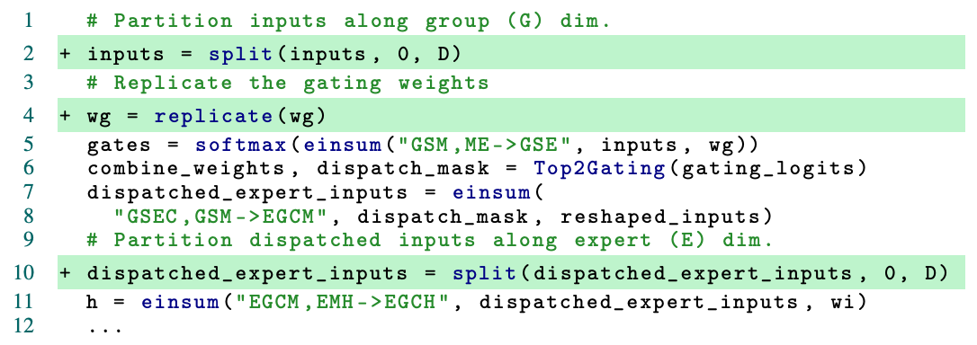
GShard Annotation API for Parallel Execution –
To Shard and Distribute tensors efficiently, Gshard introduces a sharding API which allows us to decide how tensors should be partitioned, this information is also propagated to the compiler to facilitate automatic application of these transformations. 3 Major API calls (for TensorFlow) are –
replicate(tensor) → Annotates tensor to be replicated along partitions (this is like setting requires_grad=True), returns annotated tensor.
split(tensor, split_dimension, num_partitions) → Annotates tensor to be partitioned along split_dimesnsion. Partition i is placed on the ith device.
shard(tensor, device_assignment) → generalizes split to allow partitions along multiple dimensions and specifying the placement of each partition.
Note : it is NOT required to annotate every tensor by it’s sharding dimension, the compiler can automatically infer that. And, “it is recommended to annotate the initial input and final output tensors of the computation”.
BITS F382 – Reading Course on LLMs
Notes:
the invocations to split or shard only adds annotations and does not change the logical shape in the user program. The user still works with full shapes and does not need to worry about issues like uneven partitioning.
The sharded dimensions could include batch (data-parallelism), feature, expert, and even spatial dimensions in image models, depending on the use cases. Because sharding annotation is per tensor, we can partition different parts of models in different ways (MoE vs non-MoE layers).
Sharding API also allows a mix between manual and automatic sharding.

Slide 11
RESULTS
BITS F382 – Reading Course on LLMs
Notes:
There is another (detailed and full of innovations) section on the specifics of the compiler they have developed, I don’t think that was very relevant to this discussion and so I did not include it.

Slide 12
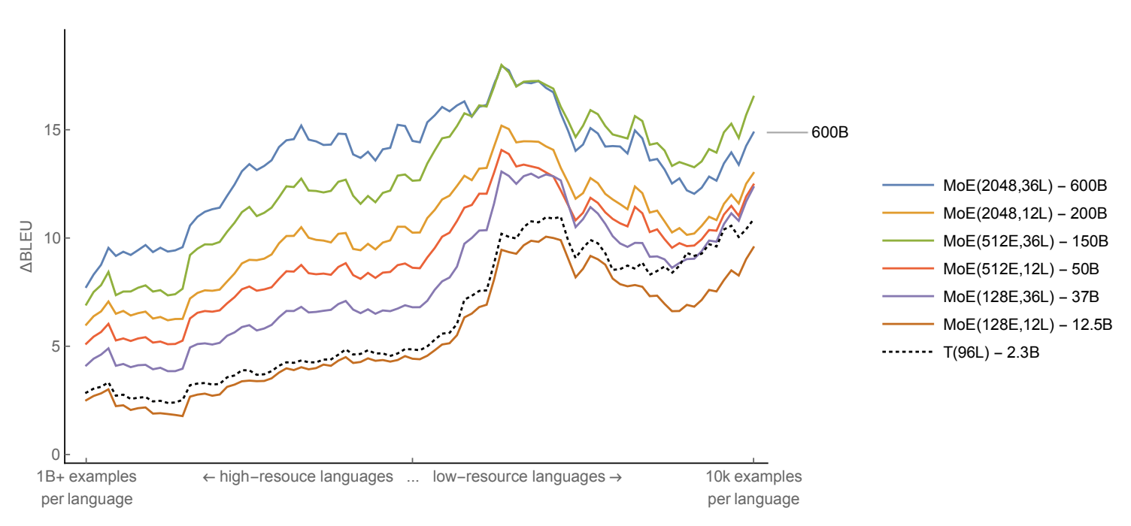
Gshard bridges the gap for a transformer model between being able to excel on low-resource languages with positive language transfer vs not being able to perform comparably on a high-resource language as a model trained on just that language, by increasing the scale immensely, to break the bottleneck capacity.
Conditional Computation speeds up training and sparse gating allows for scale.
BITS F382 – Reading Course on LLMs
Notes:
After this they have more experiments amongst their own model sizes, i.e., no comparison with a non-sharded transformer, which I again think is irrelevant here so I have not included that. Apart from that, this paper is pretty dense and has another section where they compare their per-operator compilation time against micro benchmarks for the same task!

