Slide 1
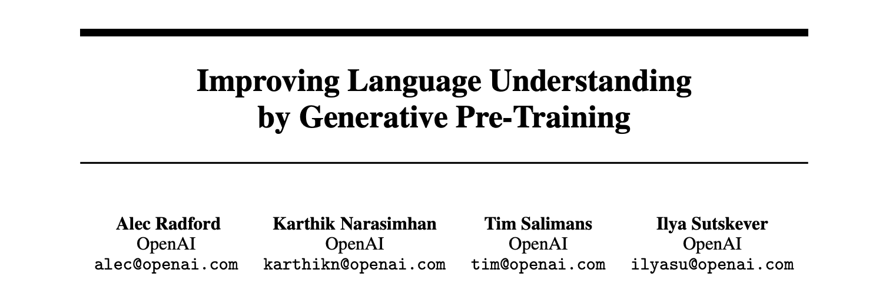
BITS F382, Reading Course on LLMs, [Link]

Slide 2
Goals and Contributions
BITS F382, Reading Course on LLMs

Slide 3
Goal(s) –
Learn better representations of the text that are task-agonistic and generalize to a wide variety of tasks in a few-shot manner.
Compare with other architectures and methods, i.e., unsupervised pre-training supervised fine-tuning. Back then people used “making task-specific changes to the model architecture, using intricate learning schemes and adding auxiliary learning objectives”.
Contributions –
Provide a pre-training framework that can train extremely generalizable models, i.e., can sort of try to understand language at a more finer level which does not depend on the task.
Provided a strong base-line for new models across variety of tasks back then, like natural language inference, paraphrase detection and story completion.
Introduced this notion of two-stage training.
BITS F382, Reading Course on LLMs
Notes:
Main Motivations - Most deep learning methods require substantial amounts of manually labeled data, which restricts their applicability in many domains that suffer from a dearth of annotated resources. In these situations, models that can leverage linguistic information from unlabeled data provide a valuable alternative to gathering more annotation, which can be time-consuming and expensive. Further, even in cases where considerable supervision is available, learning good representations in an unsupervised fashion can provide a significant performance boost.

Slide 4
Pre-training framework : Details
BITS F382, Reading Course on LLMs

Slide 5

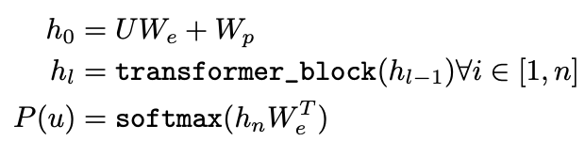



1. Unsupervised pre-training –
Unsupervised corpus of tokens, U = {u₁, . . . , u_{n}}. The innovation for this part is that they have chosen to use a multi-layer decoder transformer architecture. where U = (u_{-k}, . . . , u₋₁) is the context vector of tokens, n is the number of layers, W_{e} is the token embedding matrix, and W_{p} is the position embedding matrix.
2. Supervised fine-tuning –
Labelled dataset C, which has input-sequence-tokes-output-ys pairs + Auxiliary loss!
Auxilliary loss is just the language modelling loss, which they found increased generalization and accelerated convergence.
BITS F382, Reading Course on LLMs

Slide 6
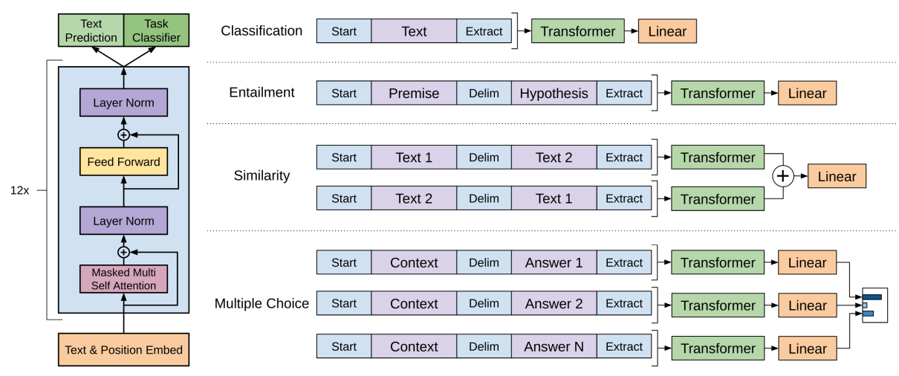
3. Task specific input transformations –
“For some tasks, like text classification, we can directly fine-tune our model as described above. Certain other tasks, like question answering or textual entailment, have structured inputs such as ordered sentence pairs….”
Entailment – add randomly initialized <s> start and <e> end tokens (?) and $ as delimiter.
Similarity – add sequences in both “directions” and then a linear layer.
MCQ – process [z; q; $; a_{k}] independently for all k and then SoftMax. (z – Context Doc., q – Question, $ - delimiter, a_{k} – kth answer choice)
BITS F382, Reading Course on LLMs
Notes:
So because our goal is to adapt as quickly as possible and as well as possible, we just add modifications in the input, like a <start> and <end> token and <delimiter> tokens

Slide 7
Experiments
BITS F382, Reading Course on LLMs

Slide 8
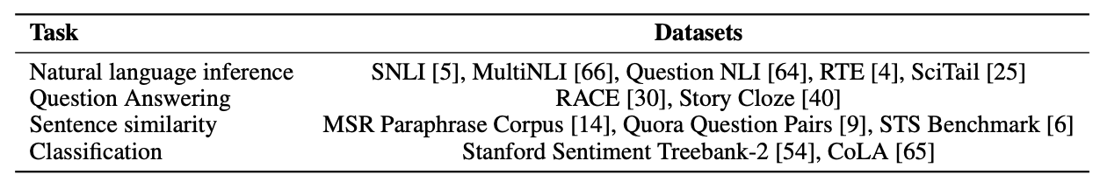
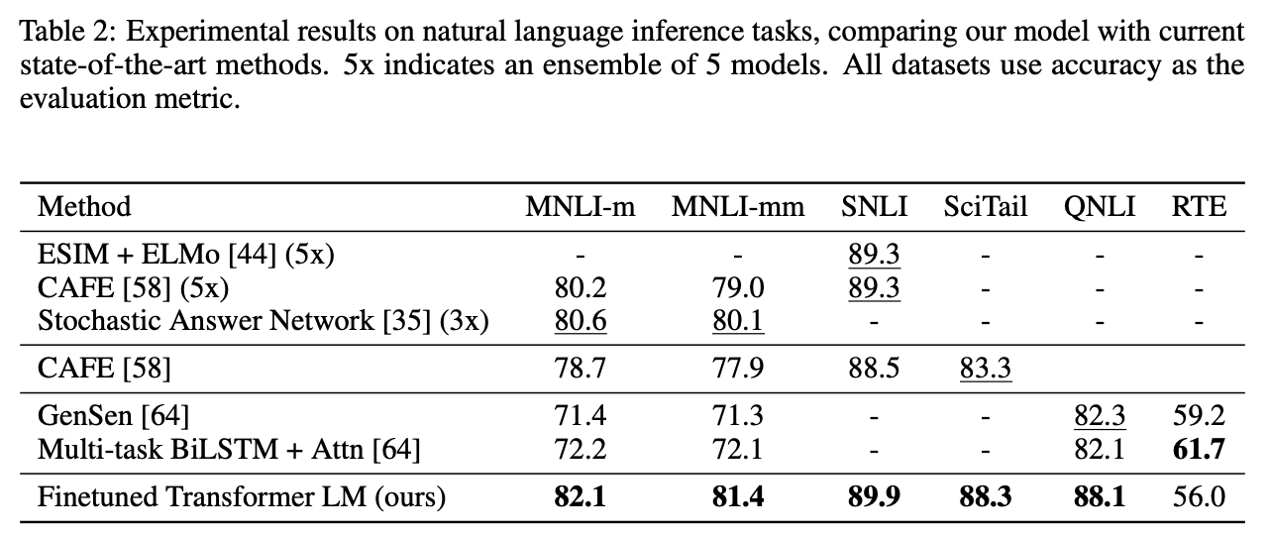
1. Unsupervised pre-training – (Sufficient explanation + experiment)
Used the BookCorpus dataset to sufficiently capture long-range structure.
2. Supervised Fine-tuning –
Datasets and corresponding tasks –
1. Natural Language Inference –
Involves reading a pair of sentences and judging the relationship between them from one of entailment, contradiction or neutral. (Sufficient variety of datasets and scenarios considered)
Results -
BITS F382, Reading Course on LLMs
Notes:
Fine-tuning details Unless specified, we reuse the hyperparameter settings from unsupervised pre-training. We add dropout to the classifier with a rate of 0.1. For most tasks, we use a learning rate of 6.25e-5 and a batchsize of 32. Our model finetunes quickly and 3 epochs of training was sufficient for most cases. On RTE, one of the smaller datasets we evaluate on (2490 examples), we achieve an accuracy of 56%, which is below the 61.7% reported by a multi-task biLSTM model????

Slide 9
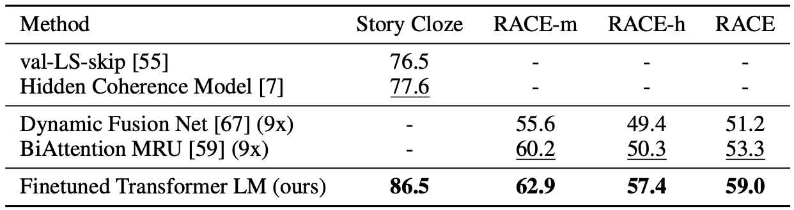
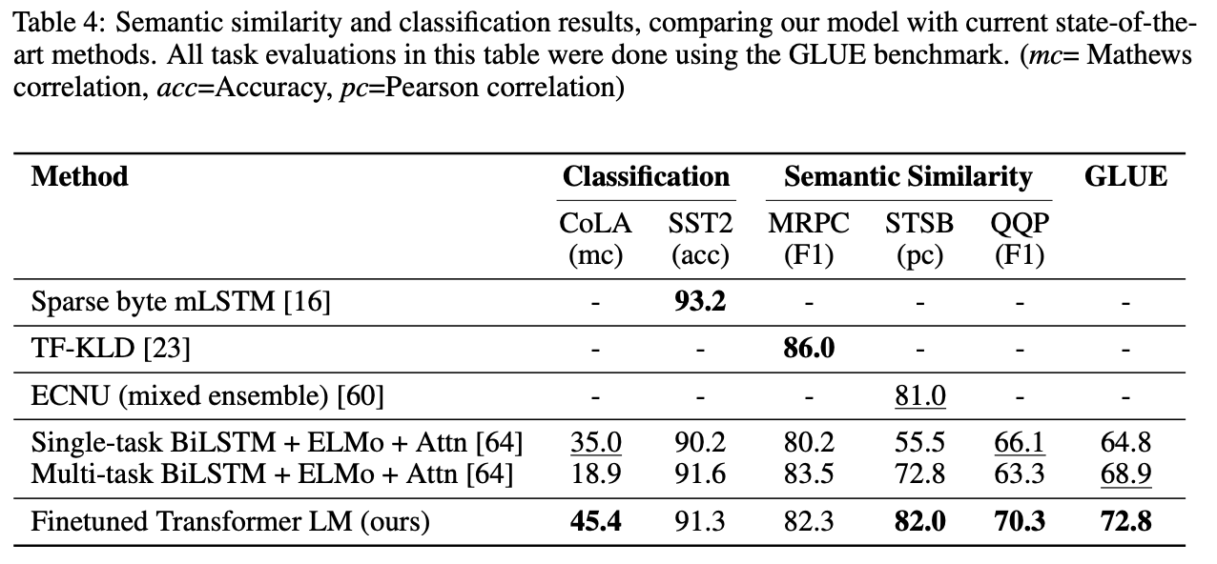
2. Question Answering –
Reasoning over paragraphs, Used the RACE dataset which is consisting of English passages with associated questions from middle and high school exams and on StoryCloze which involves selection among only two. (Only evaluated for long-range accuracy, i.e., no test for model brevity)
Results –
3. Semantic Similarity –
Involves predicting if two sentences are semantically equivalent. Uses wide variety of datasets and benchmarks. SOTA performance.
4. Classification –
The task is pretty obvious, and has considered a sort of wide range of Benchmarks and Datasets.
BITS F382, Reading Course on LLMs
Notes:
Mention GILL’s dependency on long-range texts and how PaLM 540B looses Brevity but the 84B parameter model maintains that.

Slide 10
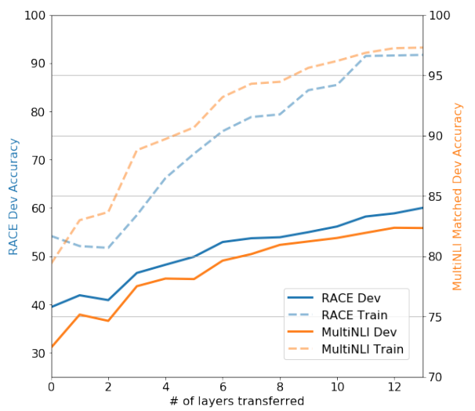
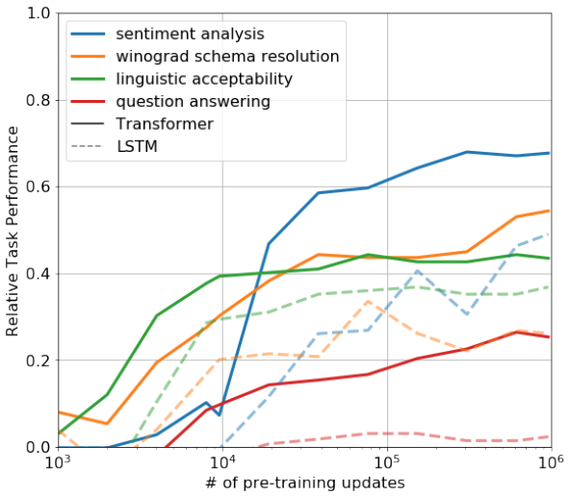
3. Extra Analysis – (Sufficient + demonstrate model’s achievements boldly)
Effect of number of layers transferred, positive results as expected. (left)
Zero-shot behavior tests, basically used models with different amount of pre-training and analyzed generalizability vs LSTMs. (right)
BITS F382, Reading Course on LLMs

Slide 11
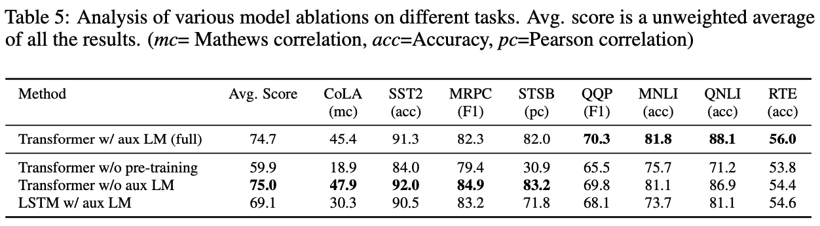
4. Ablation Study – (No justification for the trend observed with no LM, otherwise sufficient)
BITS F382, Reading Course on LLMs

Slide 12
Research Gaps
BITS F382, Reading Course on LLMs

Slide 13
This was a pretty complete paper, but I noticed these two blatant points –
Maybe could’ve also tried a encoder-decoder type architecture of the transformer, more parameters, more learning?
A line from the paper – “Given the strong performance of our approach on larger NLI datasets, it is likely our model will benefit from multi-task training as well but we have not explored this currently.” What does multi-task mean here?
BITS F382, Reading Course on LLMs

