Slide 1
Amdocs Training Project Mingle box
Made By – Karan Phatnani
Employee ID - 200607

Slide 2

Project Overview
The project involves the development of a prototype for the MingleBox Marketplace, a console-based application. The aim is to create a platform where coders and buyers can interact for job postings, bids, payments, and messaging.

Slide 3

Purpose of the Document
The purpose of this document is to provide a detailed overview of the MingleBox Marketplace project. It outlines the concept, functionality, architecture, and technologies used in the development of the prototype.

Slide 4

MingleBox Marketplace
MingleBox Marketplace is a console-based prototype developed as part of an Amdocs training project. It simulates a marketplace where coders can offer their services, and buyers can post jobs, place bids, and make payments.

Slide 5

Scope of the Project
The scope of the project includes the development of a console-based prototype for the MingleBox Marketplace. Key features include user authentication, job posting, bidding, messaging, payment processing, and user management.

Slide 6
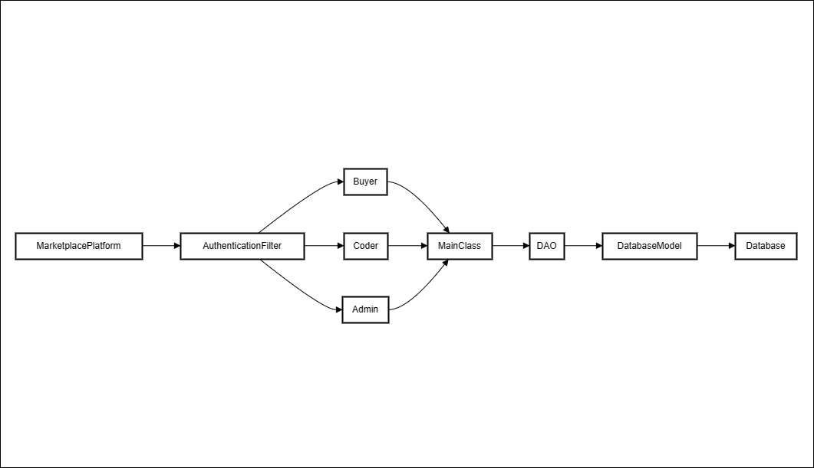
High level architecture

Slide 7
Functional Requirements
The functional requirements of the MingleBox Marketplace prototype include:
- User registration and authentication
- Job posting and browsing
- Bidding and bid management
- Messaging between users
- Payment processing
- User profile management
- Admin functionality for user and job management

Slide 8

High-Level Architecture
The architecture of the MingleBox Marketplace consists of three main components:
- User Interface: Console-based interface for user interaction
- Business Logic: Core logic for user management, job posting, bidding, messaging, and payment processing
- Database: H2 database for storing user data, job posts, bids, messages, and payments

Slide 9
Technologies Used
The MingleBox Marketplace prototype is developed using the following technologies:
- Java: Core programming language for application logic
- H2 Database: Lightweight in-memory database for data storage
- JDBC: Java Database Connectivity for database interaction
- Object-Oriented Design: Design principles for modular and maintainable code

Slide 10
Future work Testing and Unit Testing
Testing plays a crucial role in ensuring the reliability and functionality of the MingleBox Marketplace prototype. Unit testing will be performed on individual components, and integration testing will validate the interactions between modules.

Slide 11

Future work(Cont.) User Interface
The user interface of the MingleBox Marketplace is console-based, providing a command-line interaction for users. Users can navigate through menus, post jobs, place bids, send messages, and manage their profiles using text commands.

Slide 12
Thank you

