Slide 1

SYSTEM MONITERING : Centralized System Monitoring for Hardware Components
CONTRIBUTED BY
KARAN DHARRA 23MCA1102
GUIDED BY
Dr. L. Mary Shamala

Slide 2
Table of Contents
Problem Statement
Introduction
Objective
Architectural Model
Flow Chart
Unique Features of this System Compared to the Existing System

Slide 3
Problem Statement
SUDDEN BREAKDOWN AND SLOWDOWN IN SYSTEM IN AN ORGANSIZATION.
CHANCES OF LOOSING WORKFORCE ENVIRONMENT IN AN ORGANIZATION.

Slide 4
Introduction to System Monitor
Client-server model to collect system information from multiple nodes over a network. To implement the connection between client and server the concepts of socket programming and then using those concepts the system information is being sent periodically to a server to update about its current working state with following parameters:
RAM usage
CPU utilization
Disk utilization
Processor Information
Number of CPU
These parameters are then periodically sent from the server to the database by establishing the database connection. If the user wants he/she can access the desired system information by selecting the options from a menu driven program which is displayed on the client side.

Slide 5
OBJECTIVE
FOR MAINTANANCE OF HARDWARE AND OVERALL SYSTEM LIFE.
AVOID SYSTEM TO STUCK IN BOTTLENECK.
FOR MAINTAINING AND ENHANCING THE SYSTEM WORKFORCE ENVIRONMENT IN AN ORGANISATION.

Slide 6
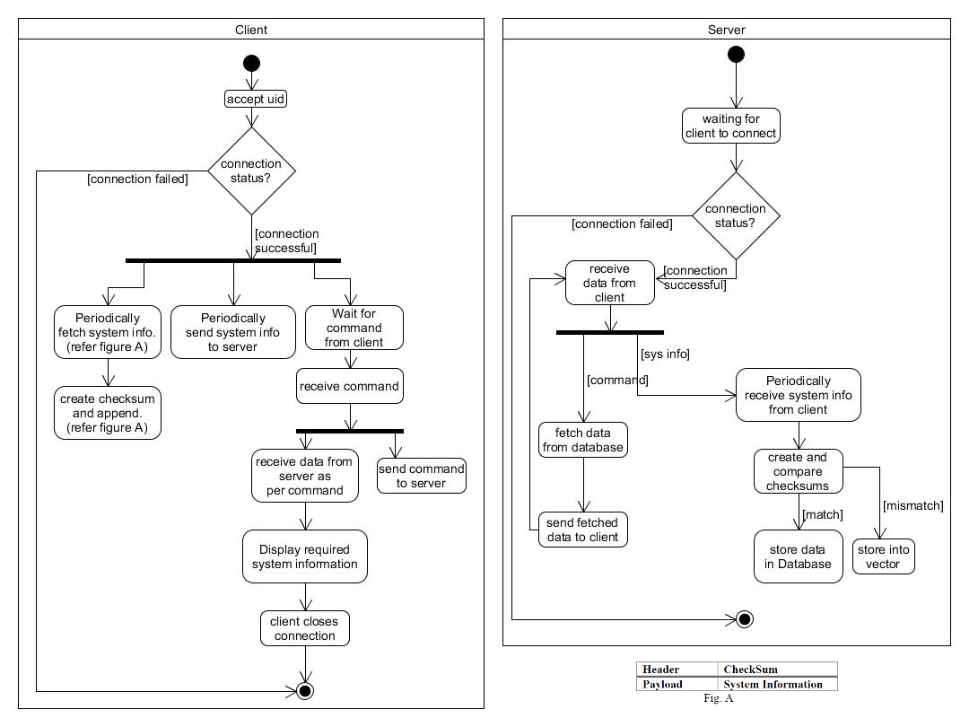
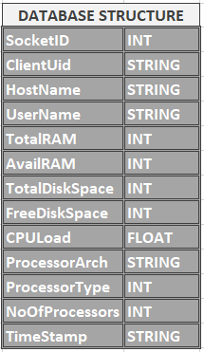
ARCHITECTURAL MODEL

Slide 7
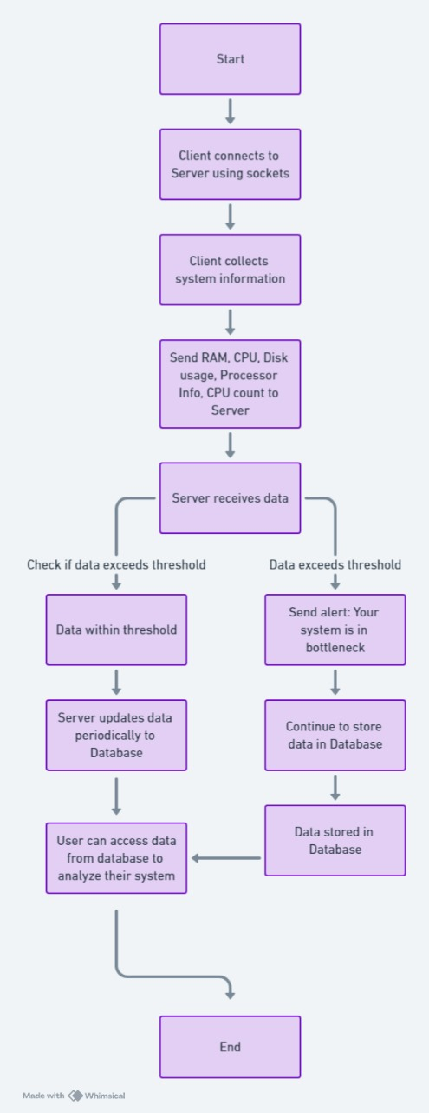
FLOW CHART

Slide 8

Unique Features of this System Compared to the Existing System
Send Alert messages to the client.
Determine the BOTTLENECK PERIOD of a particular system .
Work on both local and remote network.

Slide 9
THANKYOU

