Slide 1
ADTA 5940 — ANALYTICS CAPSTONE · SPRING 2026
Remote Work and
Federal Employee Satisfaction
A view from 646,000 federal employees
Karan Parekh · Chau Le
University of North Texas · Dr. Denise Philpot

Slide 2
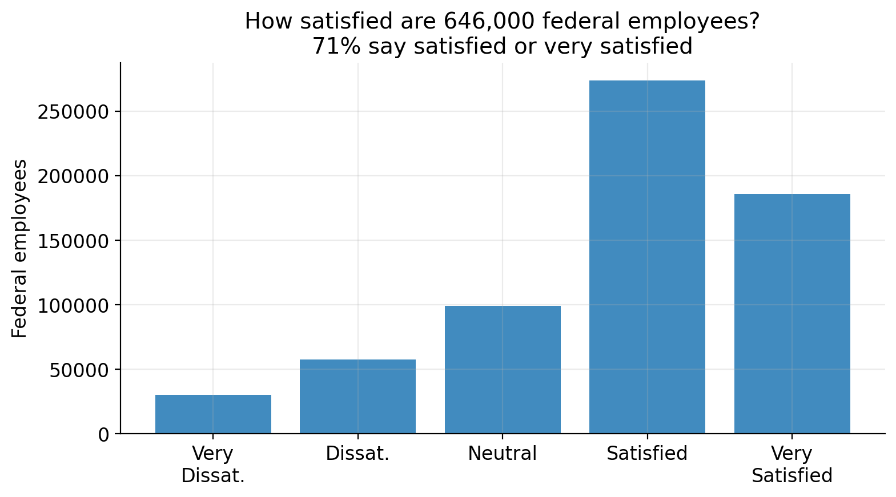
THE STARTING POINT
71%
of federal employees say they're satisfied
Today's question: why those, and not the other 187,000?
Source: 2024 OPM Federal Employee Viewpoint Survey · n = 646,545

Slide 3
OUR RESEARCH QUESTION
Does where you work — remote, hybrid, or on-site —
actually change how satisfied you are?

Slide 4
WHAT WE WORKED WITH
The data
646K
36
96
respondents
agencies
questions
Every federal employee who responded
to the 2024 viewpoint survey.
From cabinet departments to small
independent agencies.
Job satisfaction, engagement,
work-life balance, demographics.
Source: U.S. Office of Personnel Management — Public Release Data File

Slide 5
APPROACH
We built the model in four steps
Each step adds one ingredient and shows how much more it explains.
1
2
3
4
Telework only
+ Work-life balance
+ Engagement
+ Demographics
Where you work.
Do you have time for life?
Are you energized by your work?
Age, gender, tenure, supervisor.

Slide 6
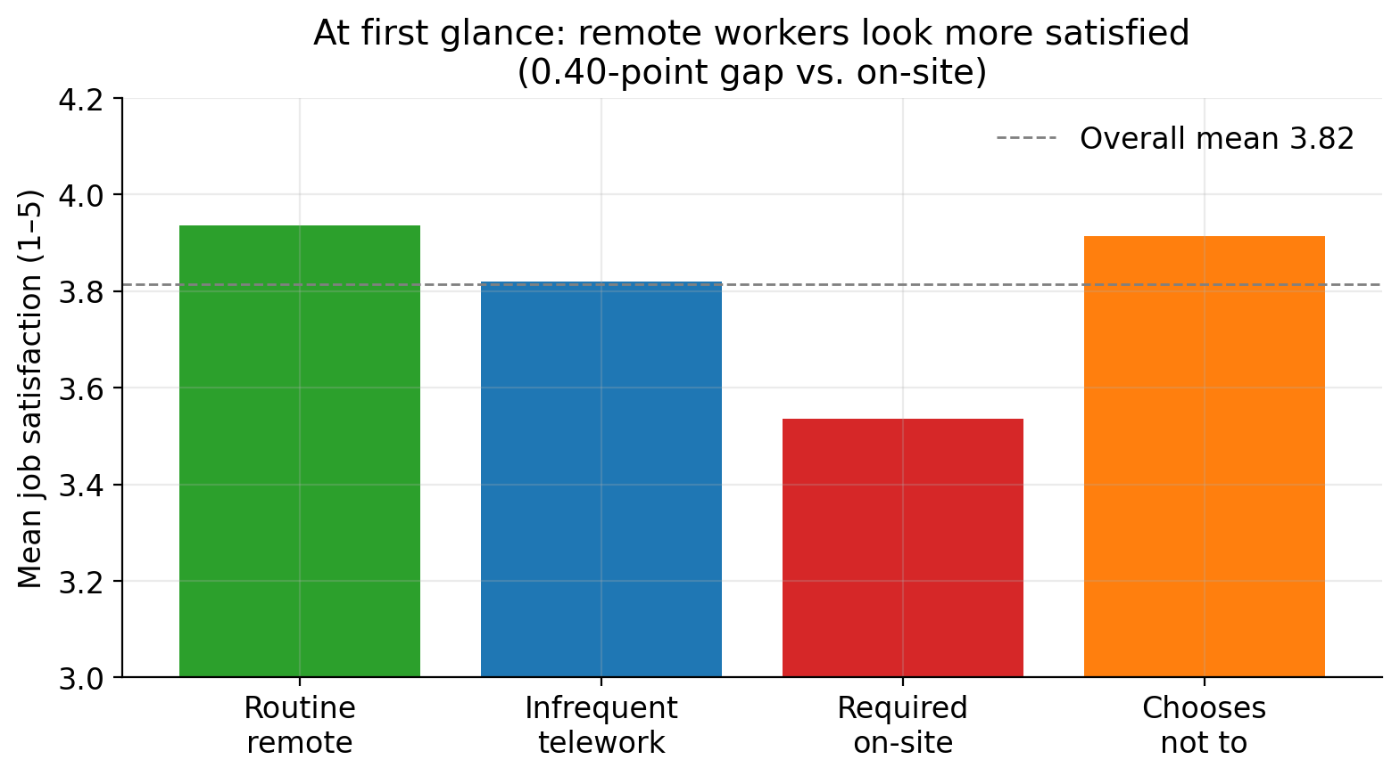
FINDING 1 — SURFACE
At first glance, remote workers look more satisfied
THE GAP
0.40
points on the 5-point
satisfaction scale
Routine remote (3.94)
vs. required on-site (3.54)

Slide 7
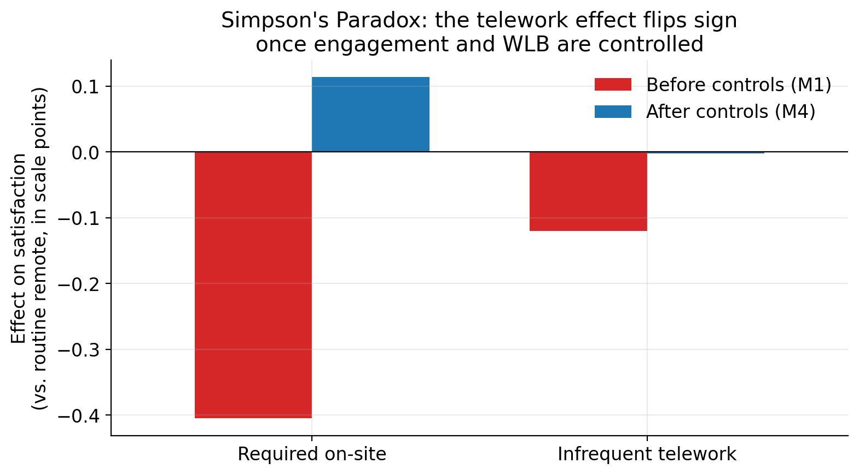
FINDING 1 — THE TWIST
…but that's not the whole story
WHAT HAPPENED
The telework
effect flipped
sign.
Once we account for engagement
and work-life balance, being
required on-site goes from
−0.40 to slightly positive.
The original gap wasn't really
about where people work.

Slide 8
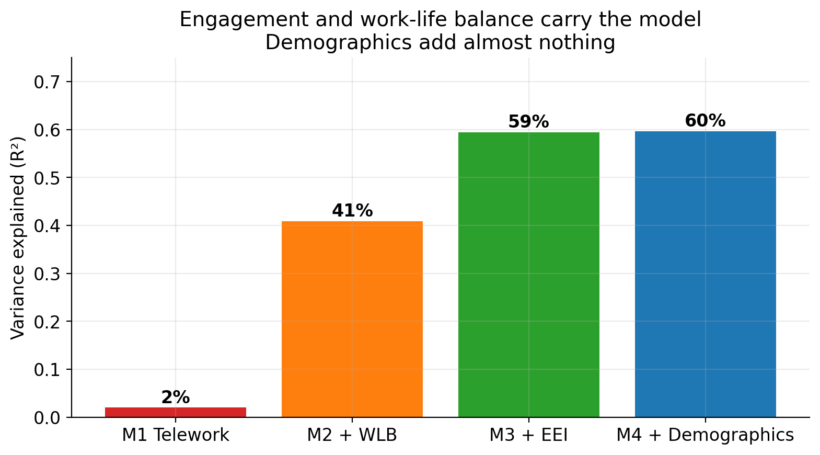
FINDING 2 — WHAT ACTUALLY MATTERS
Engagement explains the variation, not telework
2%
Telework alone
41%
+ Work-life balance
60%
+ Engagement

Slide 9
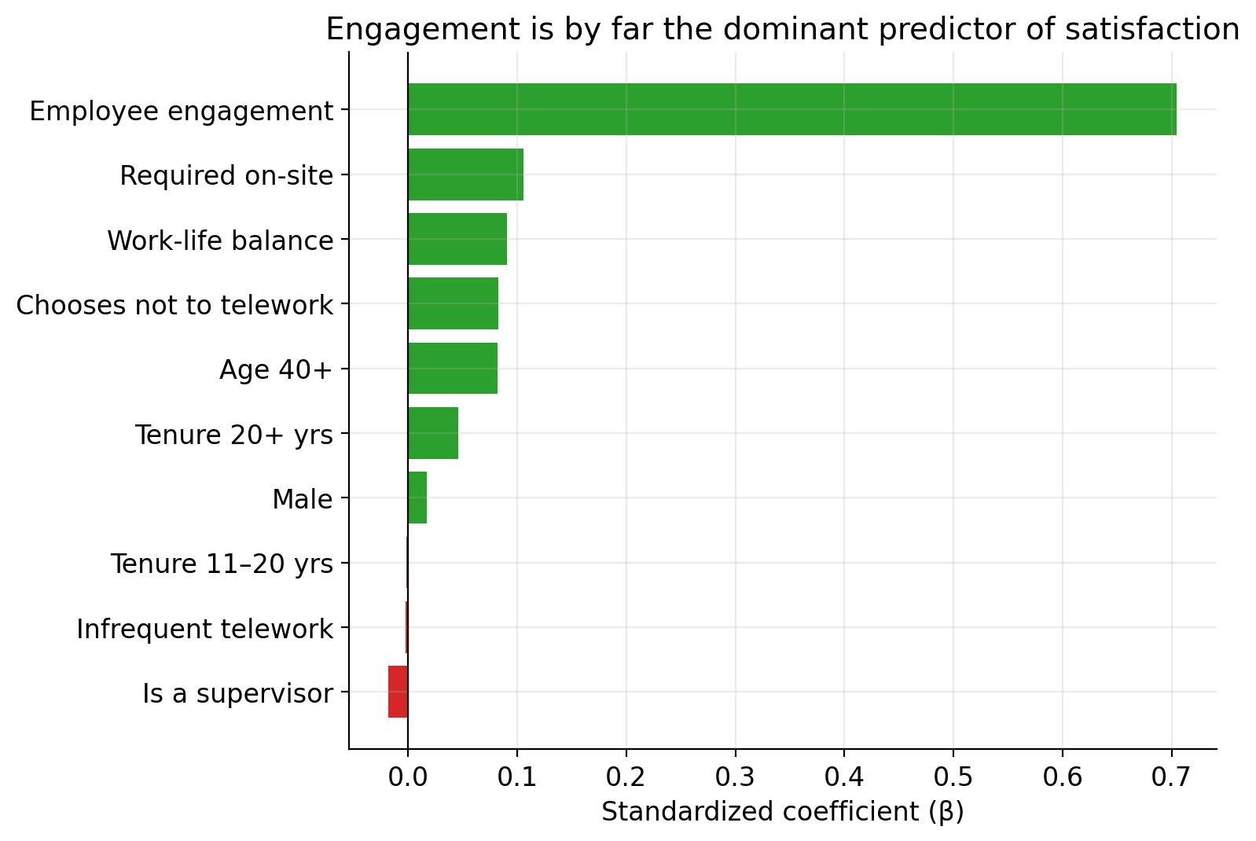
FINDING 2 — RANKED DRIVERS
Engagement is ~7× larger than the next thing
READING THIS CHART
Each bar is the standardized effect on satisfaction.
Engagement: β = 0.71
Next closest: β = 0.10
Where you work, gender, age, tenure — barely register.

Slide 10
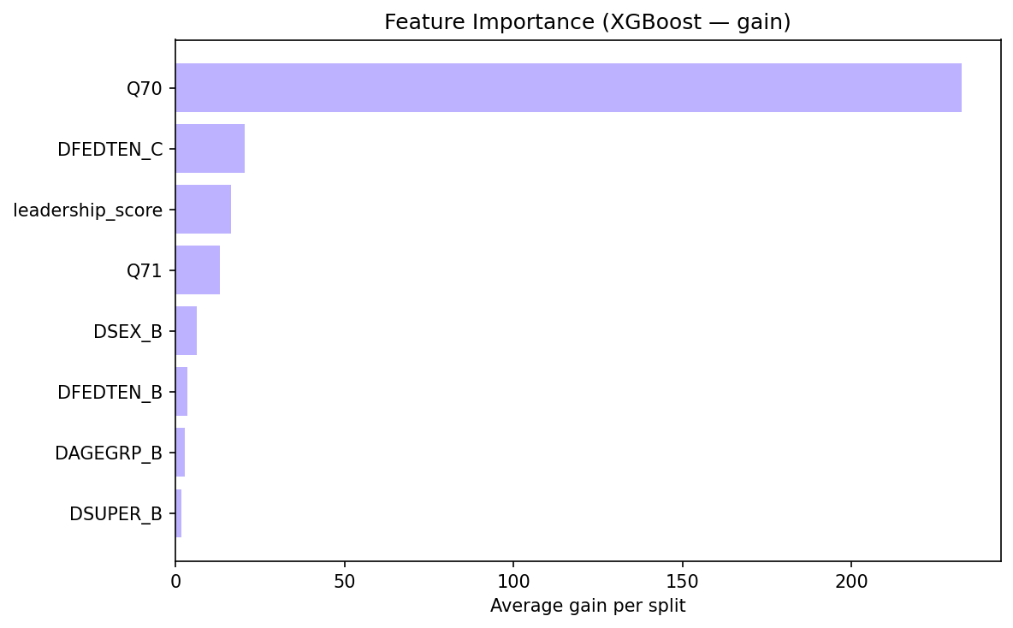
BONUS — SECONDARY ANALYSIS
Side question: who's likely to leave?
33%
of federal employees are considering leaving
AUC 0.77
XGBoost classifier (recall 64% on leavers)
Top 3 drivers: Job satisfaction (Q70), Leadership (Q57–Q65 mean), Pay satisfaction (Q71).
Demographics (DFEDTEN_C = tenure 20+, DSEX_B = female, etc.) barely register.

Slide 11
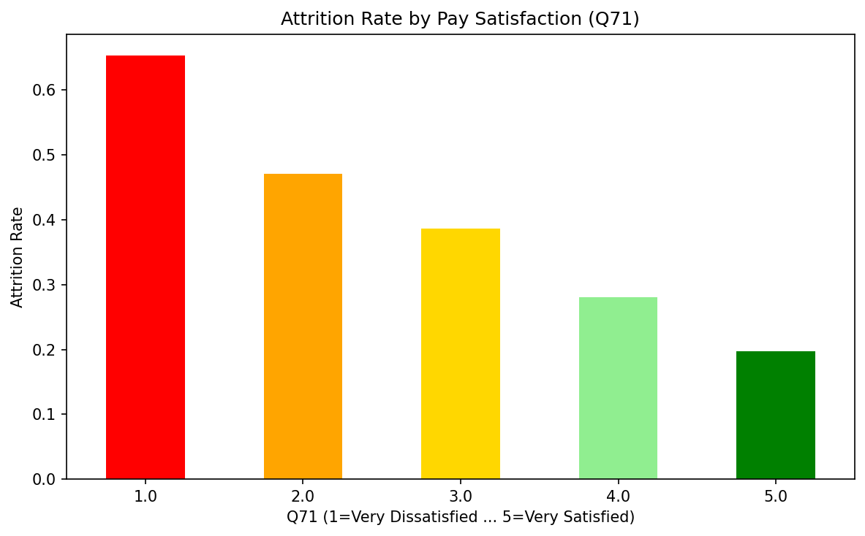
BONUS — THE PAY GRADIENT
And the relationship is monotonic
FROM RED TO GREEN
65%
attrition rate among employees very dissatisfied with pay
20%
attrition rate among those very satisfied with pay

Slide 12
SO WHAT
Three takeaways for federal agencies
1. Don't fight over telework policy.
It's a small lever. Engagement is the big one.
2. Invest in engagement.
Manager quality, mission clarity, recognition — that's the 60%.
3. Watch attrition signals.
Low pay satisfaction × low engagement = high flight risk.

Slide 13
LIMITATIONS & WHAT WE'D DO NEXT
Cross-sectional
We see association, not causation.
Self-reported
Same person rates engagement and satisfaction.
Single year
2024 only. Replicate across 2022–24 next.
Telework gets the headlines.
Engagement gets the results.

Slide 14
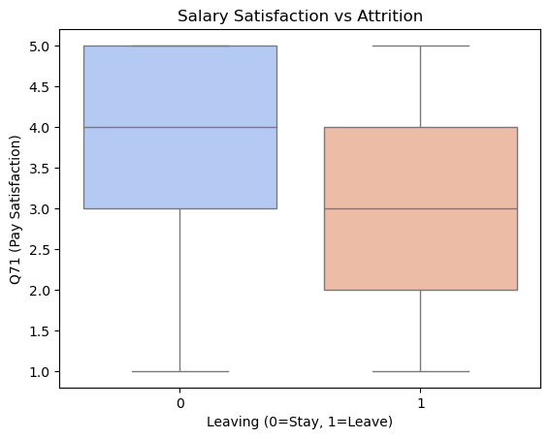
BACKUP 1 / 5 — Q71 BOXPLOT
Pay satisfaction vs. leaving (boxplot)
Stayers (0): median pay
satisfaction = 4.
Leavers (1): median pay
satisfaction = 3.
The full distribution
shifts down a full point
for those considering
leaving.

Slide 15
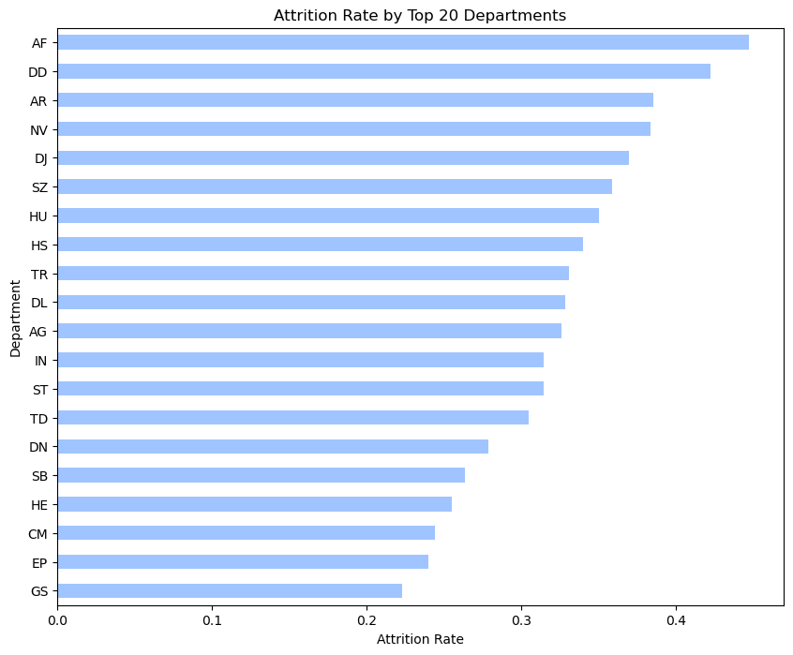
BACKUP 2 / 5 — TOP 20 AGENCIES
Attrition varies a lot by agency
Highest attrition: AF, DD,
AR (~40-45%).
Lowest: GS, EP, CM
(~22-25%).
Two-fold variation
suggests agency-level
culture matters — not
just individual factors.

Slide 16
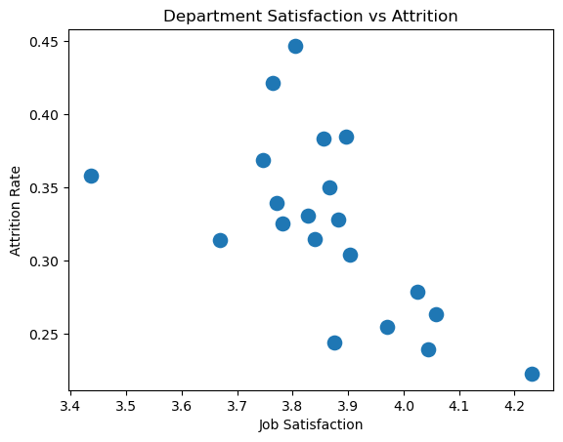
BACKUP 3 / 5 — AGENCY SCATTER
Less satisfied agencies have higher attrition
Each dot is one agency.
Clear inverse pattern:
higher mean job
satisfaction ↔ lower
attrition rate.
The outlier in the
upper-left is a small,
low-satisfaction agency
with high churn.

Slide 17
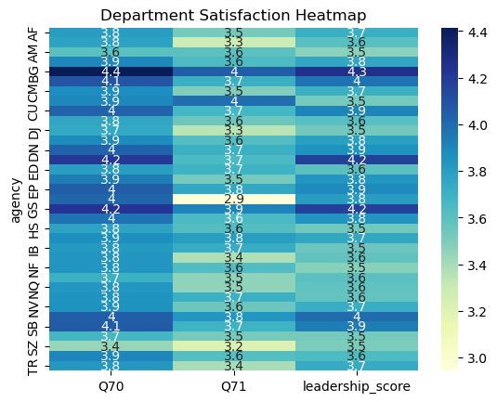
BACKUP 4 / 5 — Q70 / Q71 / LEADERSHIP BY AGENCY
Department satisfaction heatmap
Mean scores across
36 agencies for:
• Job satisfaction (Q70)
• Pay satisfaction (Q71)
• Leadership composite
Darker = higher score.
Most agencies cluster
around 3.7-4.0 on the
5-point scale.

Slide 18
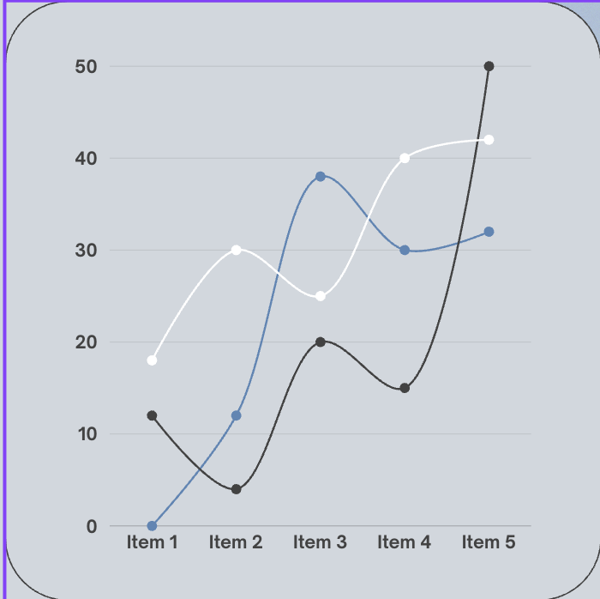
MODELING
Logistic Regression
XGBoost

Slide 19
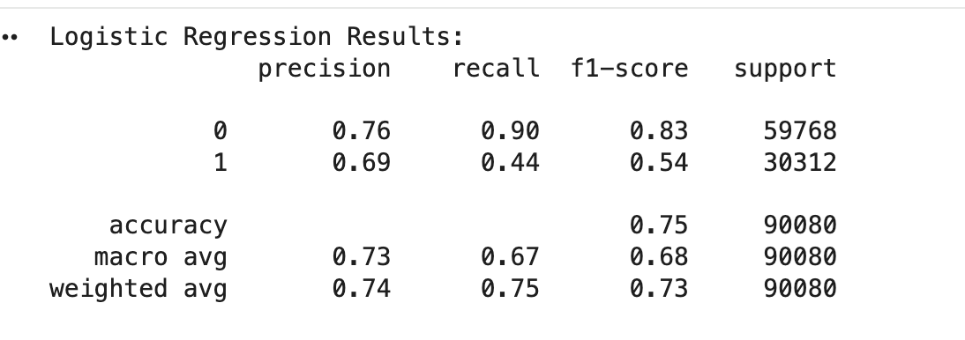
Logistic Regression
The model is better at predicting people who stay than people who leave.
The recall for attrition is relatively low, meaning many at-risk employees are not being captured by the model

Slide 20
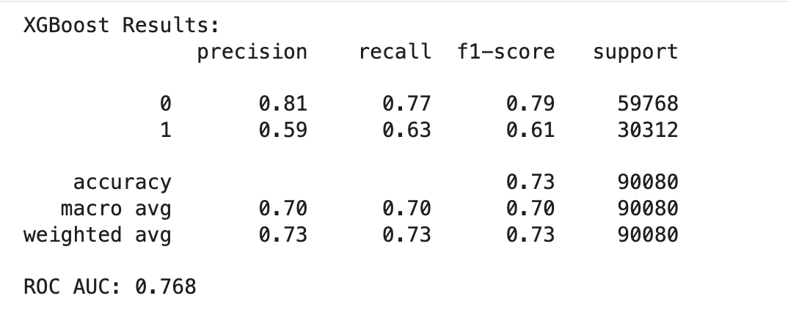
XGBoost
XGBoost performs slightly worse on accuracy but much better at identifying employees who leave.
The recall for attrition improves significantly, which makes it a better model for predicting attrition risk.

Slide 21
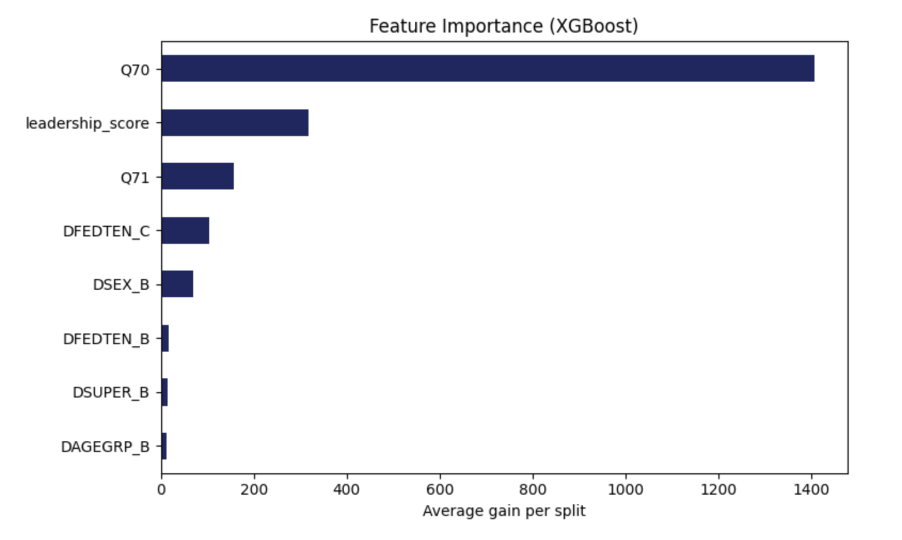
Feature Importance
Q70 is the most important feature according to the graph, this aligns with the EDA.

Slide 22
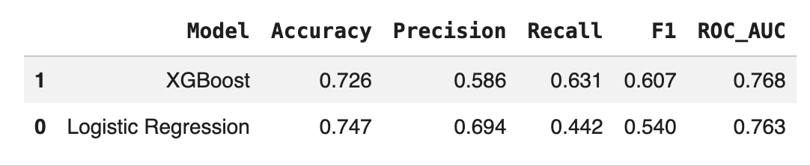
Model Comparison
XGBoost is the better model for attrition prediction, even though its accuracy is slightly lower.
In addition, XGBoost, significantly improves recall and F1 score, making it more effective for attrition risk prediction compared to Logistic Regression.

Slide 23
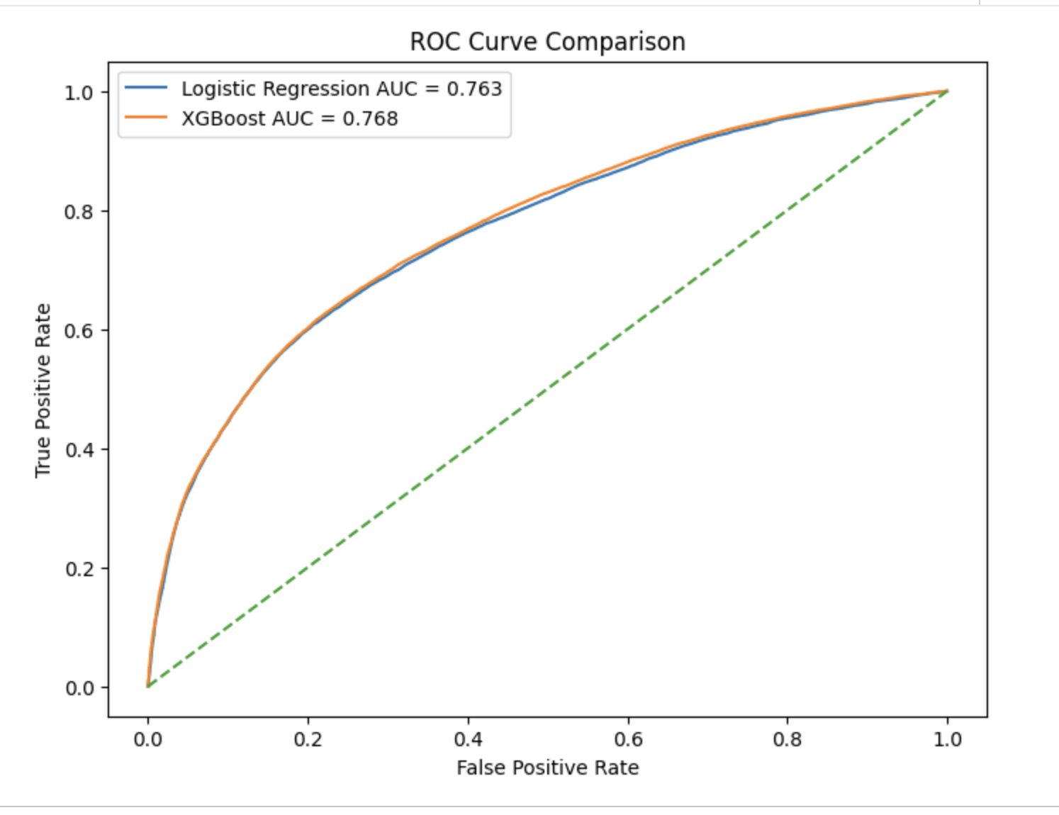
ROC Curve Comparison
Both models perform similarly, with XGBoost slightly outperforming Logistic Regression.
The AUC scores around 0.76 indicate the models are reasonably good at distinguishing between employees who stay and those who leave.

Slide 24
Takeaways
XGBoost captures better predictions due to ability to model nonlinear relationships and feature interactions, resulting in slightly improved recall and overall performance compared to Logistic Regression .
Key predictors (XGBoost): job satisfaction (Q70), leadership composite (mean of Q57–Q65), and pay satisfaction (Q71) dominate.
Recommendation: to reduce attrition risk, agencies should focus on job satisfaction, leadership quality, and pay satisfaction — not on demographic targeting.

Slide 25
Thank you

