Slide 1
Group 38
Book Recommender System
Presenters:
Sarthak Dixit (2020574)
Shivanshu Kumar (2019476)
Rishav (2020569)
Harsh Kashyap (2020434)
D Likhith (2019038)
Karan Prasad Gupta (2020439)

Slide 2
Problem Statement
We're addressing the inefficiency of current book recommendation systems, which often fail to deliver personalized suggestions or cater to individual reading preferences. This disconnect leaves users dissatisfied and disengaged. Our goal is to introduce a novel approach using advanced algorithms and user-centric design to enhance the user experience with tailored recommendations.

Slide 3
Motivation
Online book availability has surged in the digital age, offering users a plethora of options. However, sifting through countless titles to find personalized recommendations is challenging.Traditional recommendation systems often use simplistic algorithms, providing inadequate suggestions.These systems fail to capture the nuances of individual reading preferences, leading to frustration and disengagement.

Slide 4
Literature review
https://ieeexplore.ieee.org/document/9579647
The authors have found machine learning techniques such as K-nearest neighbors, Pearson’s R Correlation Coefficient, and Cosine Similarity within collaborative filtering to be effective in determining the most suitable books for users based on the input query provided to their system.
https://cs.carleton.edu/cs_comps/1617/book_rec/final-results/paper.pdf
The book recommendation system project utilizes data gathered from various sources across the web, including Amazon Books and Google Reads. It employs machine learning classifier models such as the Naive Bayes Classifier and the Maximum Entropy Classifier for its content-based approach. Additionally, it utilizes the K-nearest neighbor algorithm and UV decomposition for its collaborative filtering-based approach to determine suitable book recommendations based on user queries.
Book Recommendation System using Association Rule Mining & Collaborative Filtering
The research paper explores various collaborative filtering algorithms, including the Jaccard Distance and Pearson’s Coefficient, alongside a novel technique called Association Mining.

Slide 5
Proposed Solution
Hybrid Model:
Combines functionalities of Content-based and Collaborative-filtering recommender systems.
Extracts best features from processed datasets (Books, Ratings, Users)
Personalized User Interface:
Users provide feedback on recommendation relevance.
Recommendations dynamically adjust based on user preference.
Algorithm adapts recommendations by altering similarity matrix values.
Enhances recommendation accuracy and user satisfaction.

Slide 6
Methodology
Hybrid recommender system combining Content-based and Collaborative Filtering.
Collaborative Filtering:
Identifies active users (>200 ratings) and popular books (>50 ratings).
Constructs user-item matrix for collaborative filtering.
Similarity techniques tested:
Cosine Similarity:
Computes similarity between pairs of books.
Recommends top 5 similar books based on cosine similarity.
Pearson's Coefficient:
Calculates correlation coefficients between books.
Recommends 5 books based on correlation.

Slide 7
Methodology
Content-Based Recommendation (using TF-IDF model):
Preprocesses text data (lowercasing, punctuation removal, stop-word removal, stemming).
Concatenates 'Book-Title,' 'Book-Author,' and 'Publisher' columns.
Applies TF-IDF model for vector representations and Cosine Similarity for similarity detection.
Hybrid Recommendation Method:
Integrates Singular Value Decomposition (SVD) for dimensionality reduction.
Utilizes Collaborative Filtering for user-item interactions and content-based filtering for textual similarities.
Combines both approaches through weighted averaging.
Employs SVD for dimension reduction, analyzes textual content for similar books, and combines scores for personalized suggestions.
Evaluation using book datasets and user interactions demonstrates effectiveness with metrics like precision, recall, and user satisfaction indicating superior performance.

Slide 8
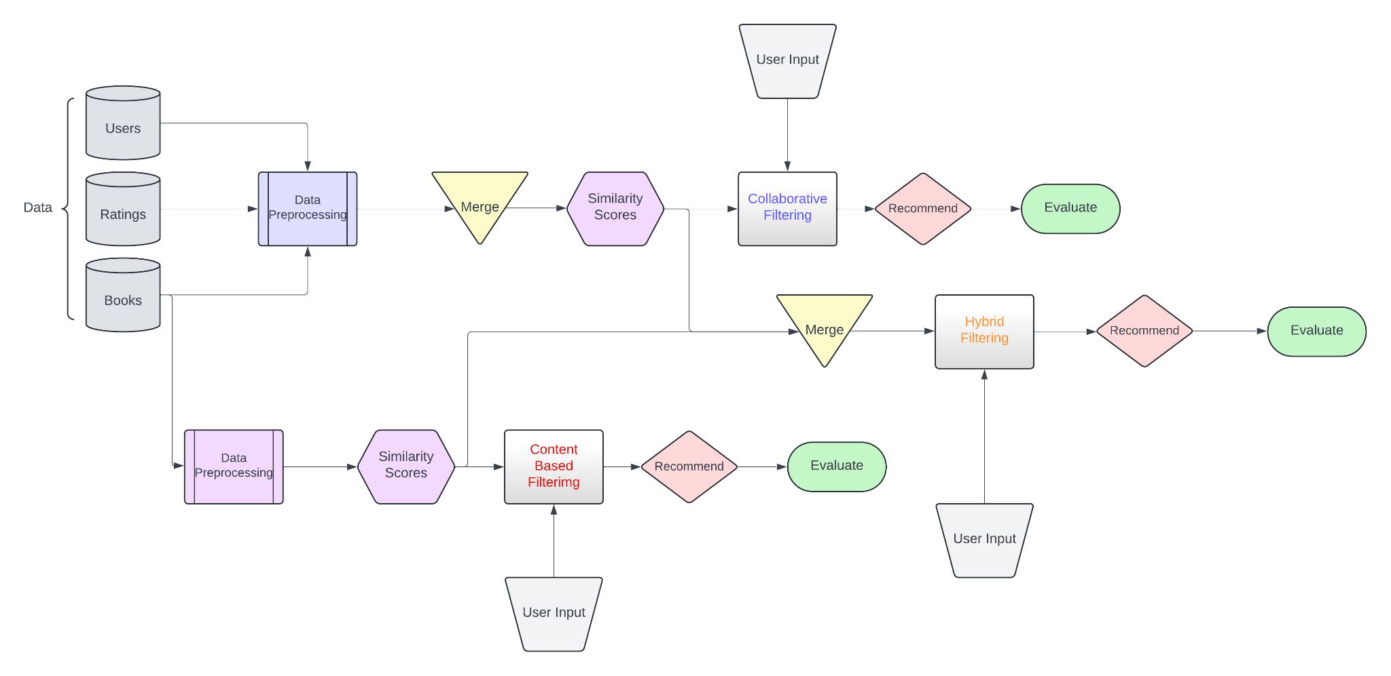
Model Pipeline

Slide 9



Results
Evaluation Metrics
We’ve used three evaluation metrics : Average Precision, Average Recall and Average F1-Score (each on 20% of the Data)
For Content Based Recommendations:
For Collaborative Filtering Based Recommendations:
Hybrid Recommendations:

Slide 10
THANK YOU
Our Github Handle: https://github.com/sarthak20574/Book_Recommendation_System

