Slide 1

Data Management for Analytics – IE6700 Project Topic: Database for a Vehicle insurance company
NORTHEASTERN UNIVERSITY
Boston, Massachusetts
Spring 2021
TEAM MEMBERs:
Karan Paresh
Rashmi Nambiar Pappinisseri Puthenveettil

Slide 2
Topics
Introduction
Problem definition
EER model
UML model
Relational model
Implementation Demo – MySQL, NoSQL, R
Conclusion

Slide 3
Introduction
Auto insurance is a contract between a customer who owns one or more vehicles and an insurance company which protects the customer against financial loss in the event of an accident or theft of the vehicle(s).
The insurance company agrees to pay part or whole of losses as stated in the insurance policy in exchange for a premium amount from the customer.
A claim analyst analyses the damage to a vehicle involved in an accident and makes an initial estimate of the payment to be made. This is conveyed to the underwriter.
A cost assessment by underwriter reveals how frequently the customer makes claims, the vehicle type for which damages occur frequently and location where accidents with most vehicle damage occurs (based on claimed amount). This is further used to analyze if the customer creates loss and conveyed to sales department of the insurance company.

Slide 4
Problem Definition
The problem is based on vehicle insurance covered in the event of an accident involving one or more vehicles.
The primary objective of the case study is to implement a database model for a vehicle insurance company. Vehicle insurance company requires information on their customers, vehicles owned by them, insurance policy details like premium and validity, claims made in case of accidents and payment made by the company to the customers.

Slide 5
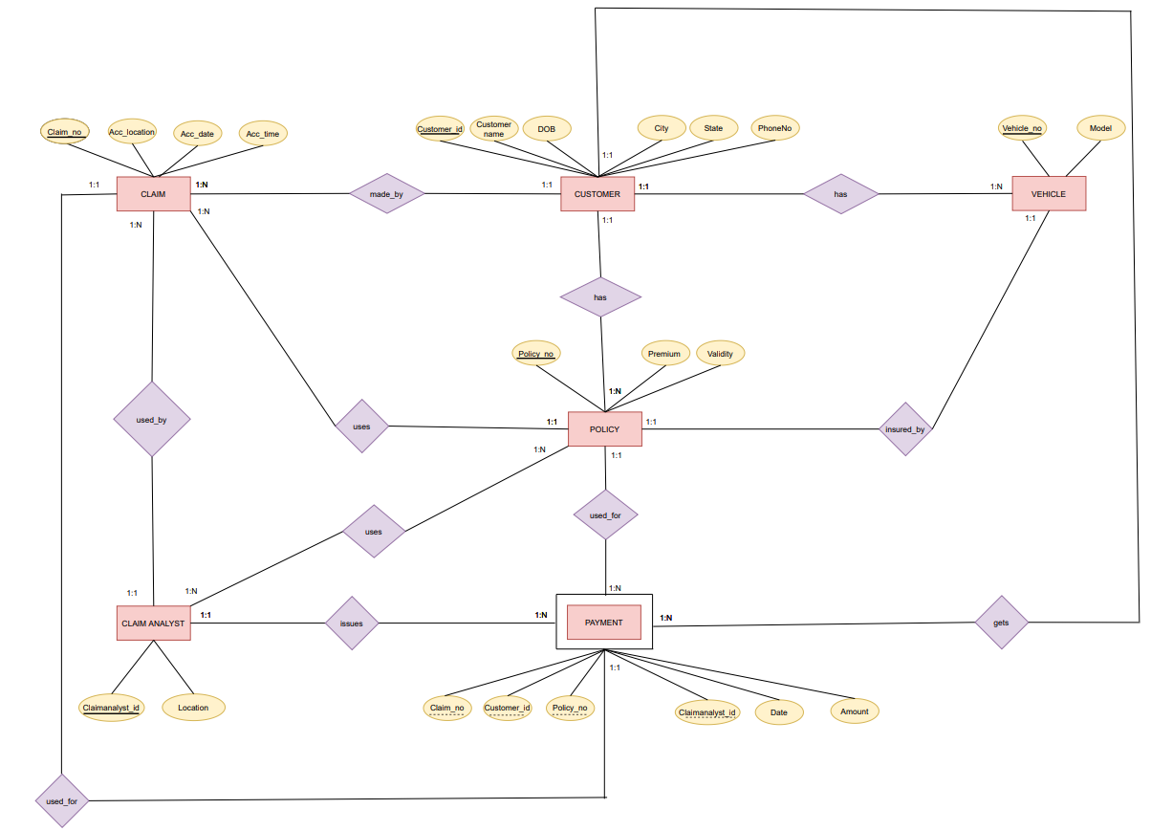
EER model

Slide 6
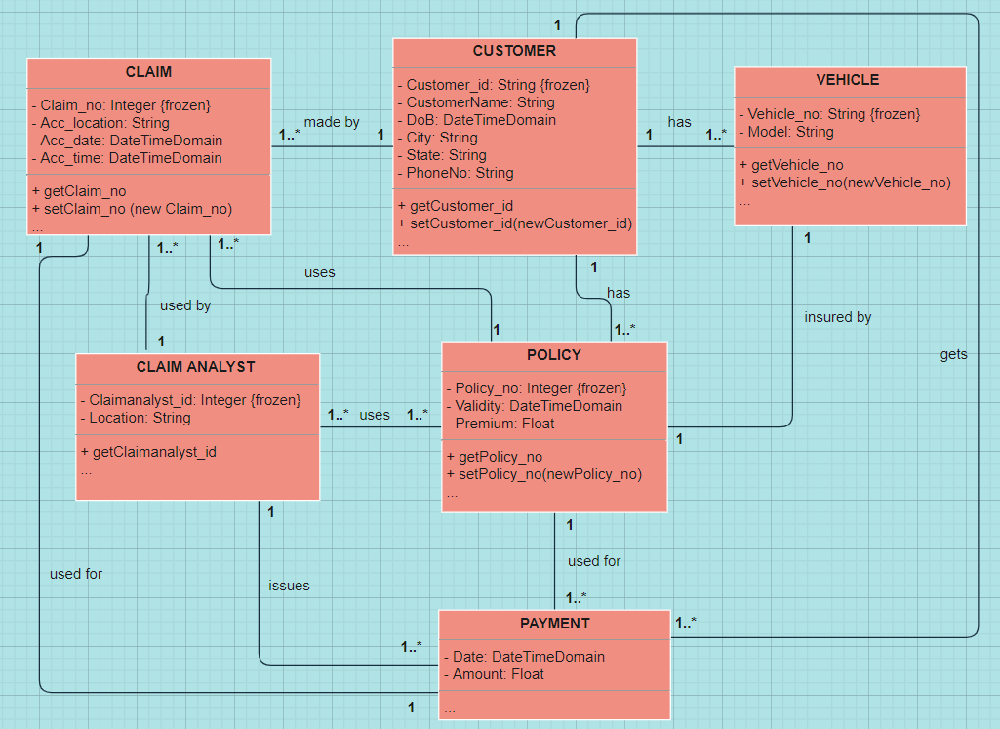
UML model

Slide 7
Relational model
Primary key – Underlined; Foreign key – Italicized
Customer (CustomerID, CustomerName, DoB, City, State,PhoneNo)
Vehicle (VehicleNo, Model, CustomerID)
CustomerID foreign key refers to CustomerID in Customer; NULL NOT ALLOWED
Policy (PolicyNo, Premium, Validity, CustomerID, VehicleNo)
CustomerID foreign key refers to CustomerID in Customer; NULL NOT ALLOWED
VehicleNo foreign key refers to VehicleNo in Vehicle; NULL NOT ALLOWED
Claim (ClaimNo, Acc_location, Acc_date, Acc_time, CustomerID, PolicyNo, CID)
CustomerID foreign key refers to CustomerID in Customer; NULL NOT ALLOWED
PolicyNo foreign key refers to PolicyNo in Customer; NULL NOT ALLOWED
CID foreign key refers to CID in ClaimAnalyst; NULL NOT ALLOWED

Slide 8
Relational model (contd.)
Primary key – Underlined; Foreign key – Italicized
ClaimAnalyst(ClaimAnalystID, Location)
Uses (CID, PolicyNo)
CID foreign key refers to ClaimAnalystID in ClaimAnalyst; NULL NOT ALLOWED
PolicyNo foreign key refers to PolicyNo in Policy; NULL NOT ALLOWED
Payment (ClaimNo, PolicyNo, CID,CustomerID, Payment_date, Amount)
CID foreign key refers to ClaimAnalystID in ClaimAnalyst; NULL NOT ALLOWED
PolicyNo foreign key refers to PolicyNo in Policy; NULL NOT ALLOWED
CustomerID foreign key refers to CustomerID in Customer; NULL NOT ALLOWED
ClaimNo foreign key refers to ClaimNo in Claim; NULL NOT ALLOWED

Slide 9
Implementation
MySQL
NoSQL – using Neo4j Cypher
Database access with R

Slide 10
Conclusion
The database for a vehicle insurance company designed on MySQL is one that can be implemented in the industry. It could result in easier access of customer information and useful insights to the same, thereby proving to be valuable to the underwriter of the company who can decide the risk of insuring a customer (his/her vehicles) and loss incurred over a certain period.
In this study, the focus is primarily on those vehicles involved in accidents. More attribute types can be added to the model, for instance, customer can have his/her driving license number, registration details, vehicle-specific details like engine number and chassis number.

