Slide 1
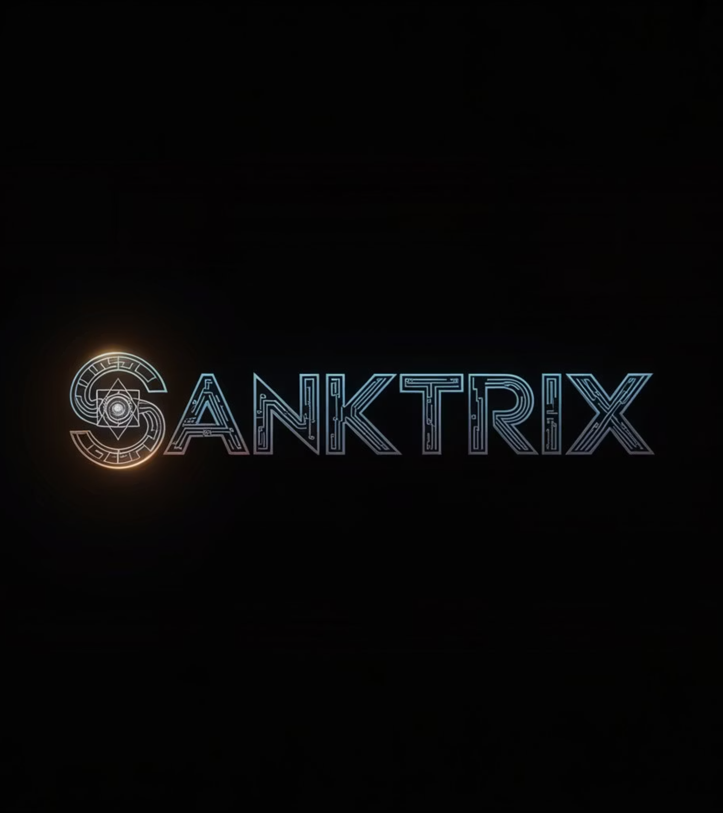
SANKTRIX
Autonomous Computational Intelligence Platform
"An AI-native operating system for strategic business intelligence."
Built by Karan A Sharma

Slide 2
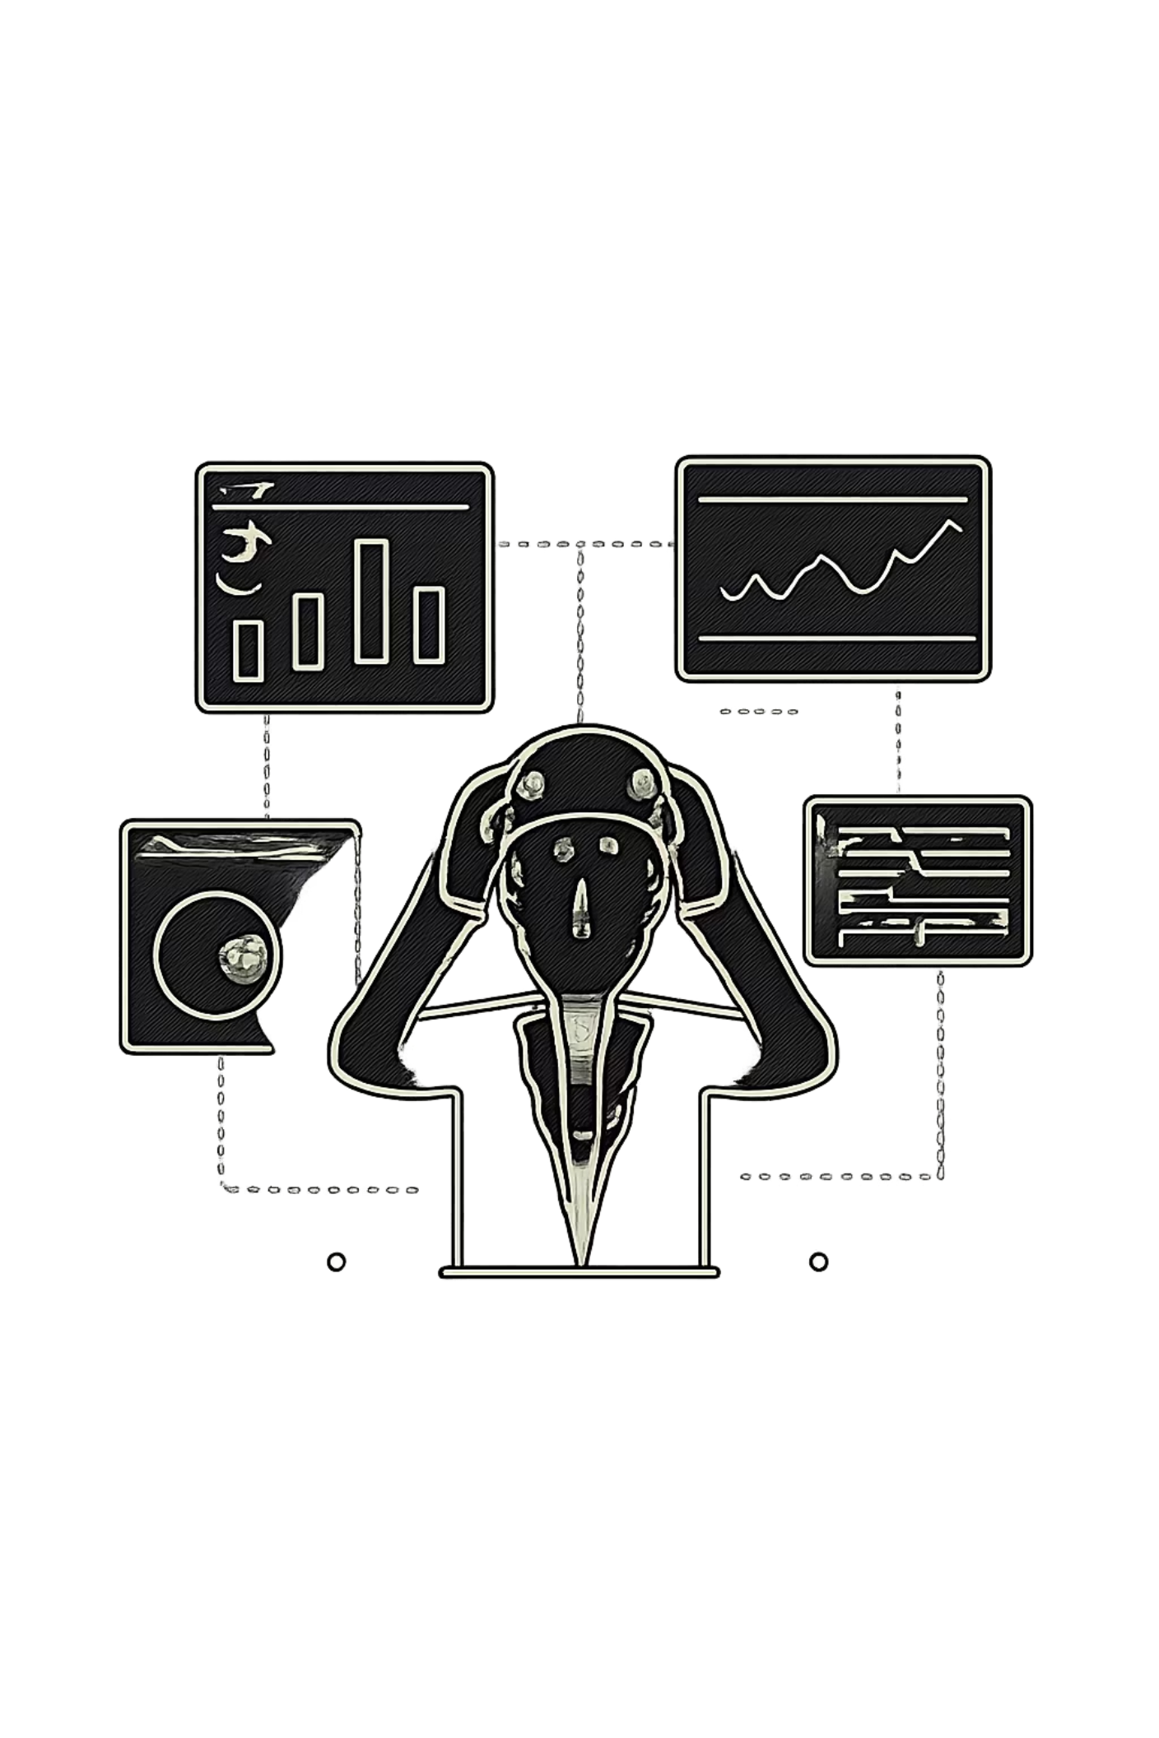
Businesses Have Data. But They Lack Intelligence.
Modern enterprises drown in tools yet starve for strategic reasoning. Traditional BI visualizes — it does not think.
Fragmented Tools
Siloed SaaS platforms with no shared intelligence layer
Delayed Decisions
Static reports arrive too late to prevent costly mistakes
Reactive Analytics
Traditional BI shows what happened — never what's coming
No Autonomous Reasoning
No software truly thinks strategically on behalf of executives
"Current business software shows information. It does not think."

Slide 3



Meet Sanktrix
An autonomous computational intelligence system that continuously thinks, predicts, simulates, optimizes, and recommends — in real time.
Autonomous Business Agents
Self-directed AI teams that reason, delegate, and execute
Realtime Strategic Intelligence
Live anomaly detection, forecasting, and operational optimization
Business Simulations
Wolfram-powered predictive modeling and scenario analysis
Enterprise Workflow Automation
Event-driven pipelines that trigger autonomous actions

Slide 4
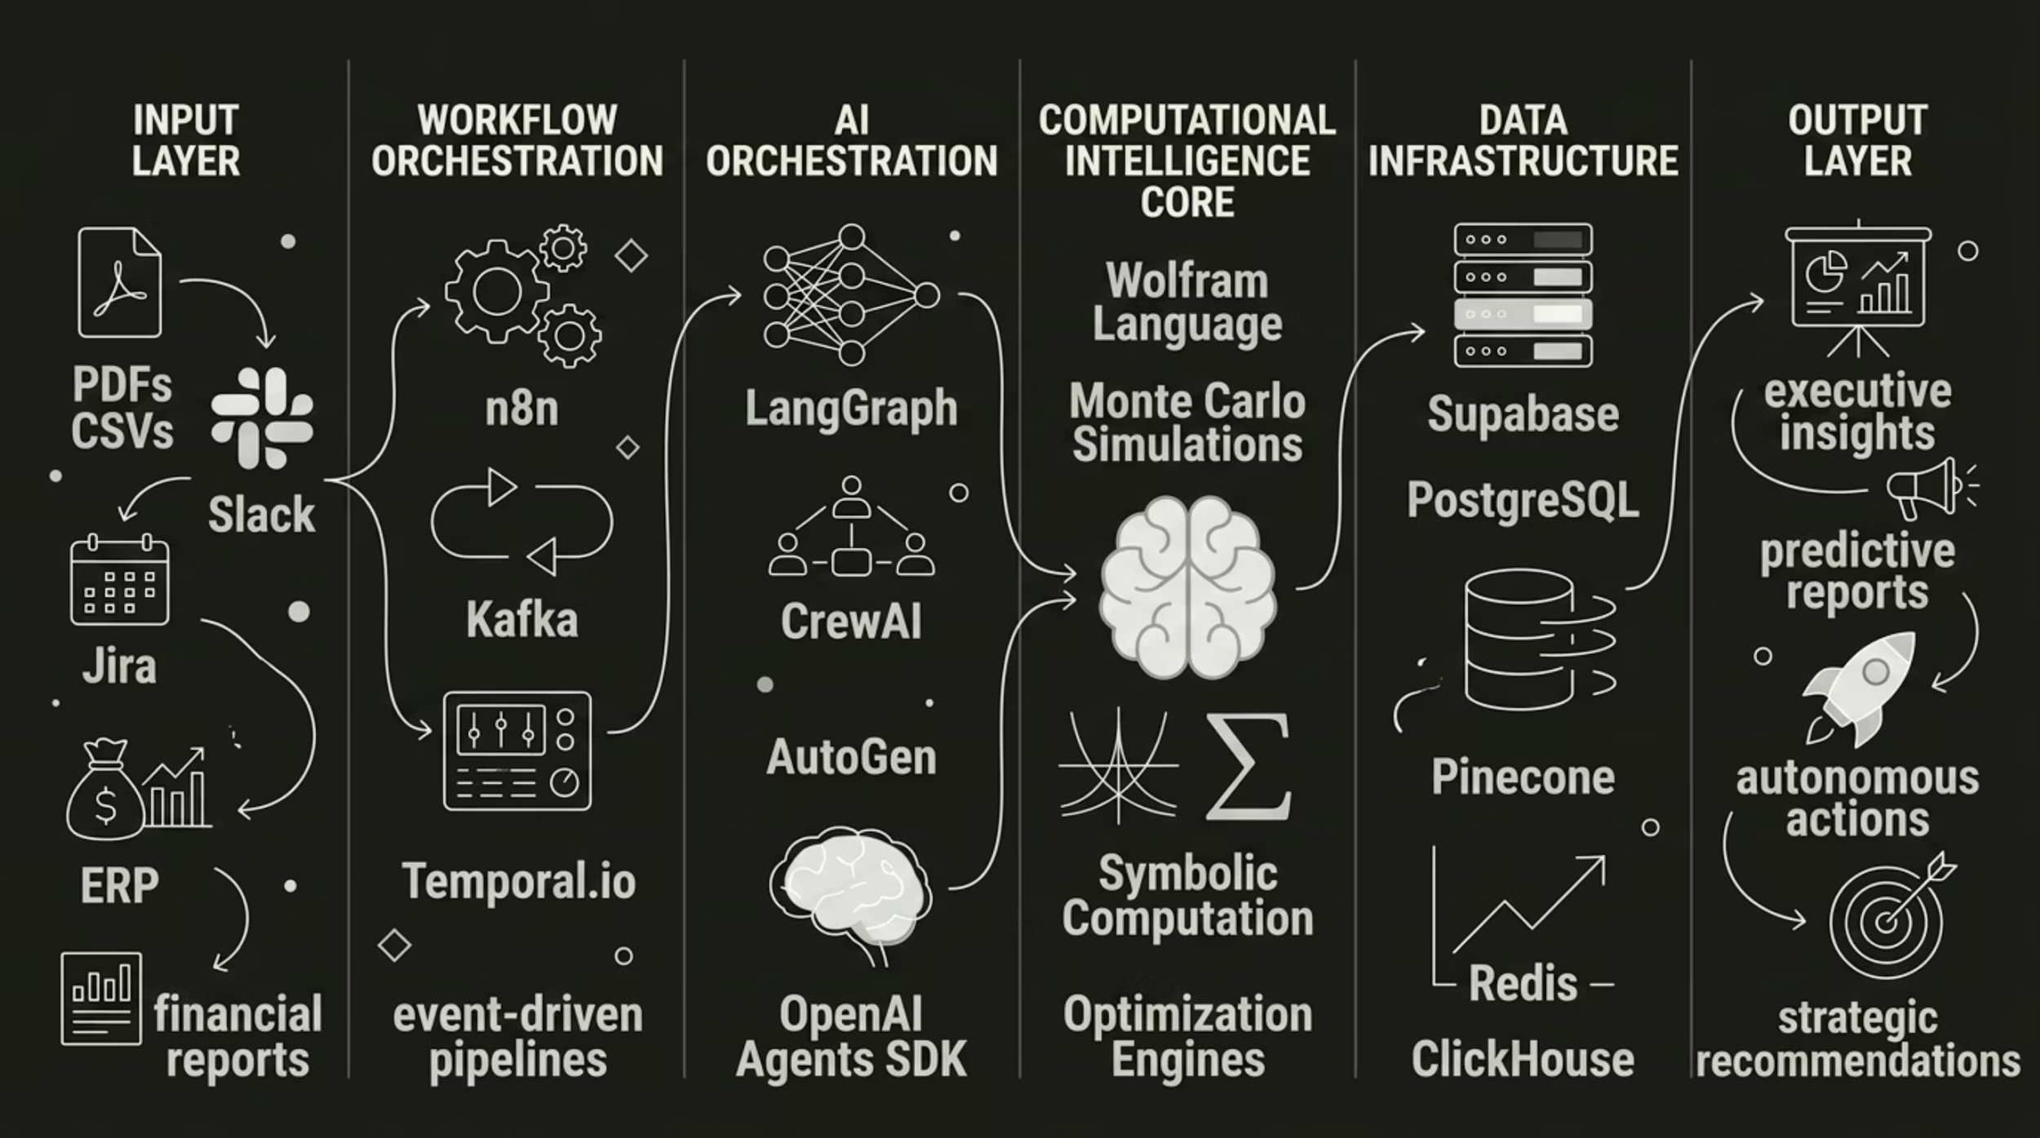

Distributed Autonomous Intelligence Architecture
Not a backend. A distributed intelligence operating system — with Wolfram computational intelligence at its core.
Every layer operates autonomously — ingesting, reasoning, simulating, and acting without human intervention.

Slide 5

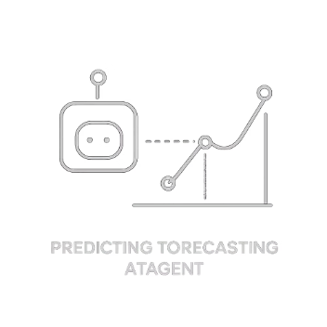
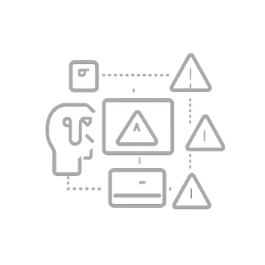

AI Agents That Operate Like Enterprise Teams
From passive dashboards to autonomous enterprise reasoning. Agents communicate, delegate, and execute in concert.
Finance Analyst Agent
Forecasting Agent
Risk Prediction Agent
Executive Strategy Agent
Runs probabilistic projections and scenario modeling autonomously
Detects operational and financial risk before it materializes
Monitors burn rate, margins, and financial anomalies in real time
Synthesizes cross-domain intelligence into strategic recommendations

Slide 6
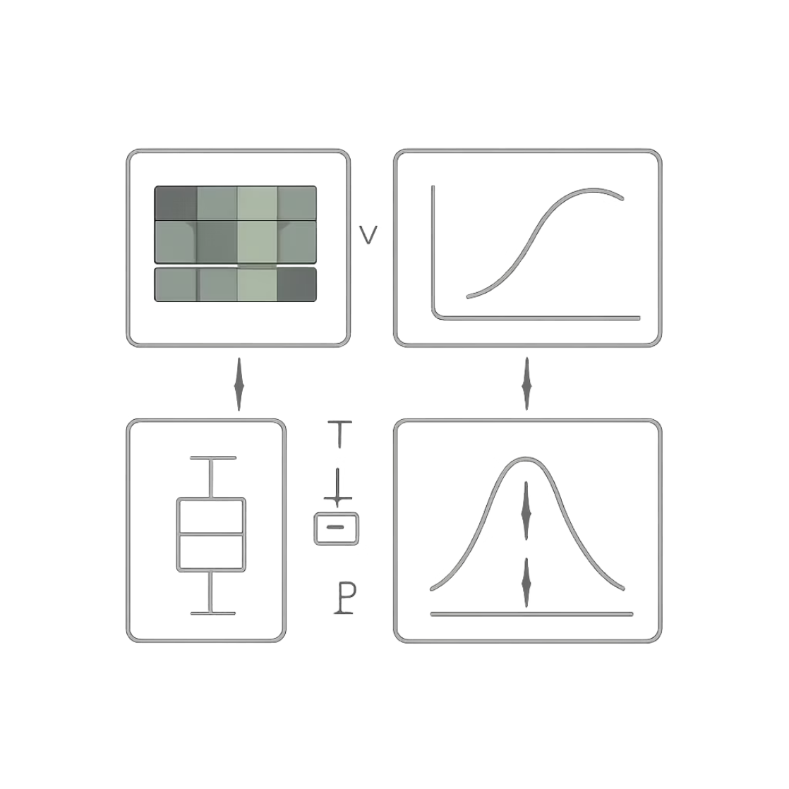
Wolfram-Powered Business Simulation Engine
Businesses no longer guess. They simulate. Sanktrix autonomously computes projections, models outcomes, and estimates probabilities using Wolfram's computational intelligence.
Powered by Wolfram Language, Monte Carlo simulations, symbolic computation, and probabilistic reasoning.
"What if CAC increases 25%?"
"How will hiring affect runway?"
"What happens if churn spikes next quarter?"

Slide 7
Why Sanktrix Is Different
Not analytics software. Autonomous computational intelligence infrastructure.
Capability
Power BI
Tableau
ChatGPT
Notion AI
Palantir
Sanktrix
Autonomous AI Agents
❌
❌
❌
❌
⚠️
✅
Realtime Orchestration
❌
❌
❌
❌
⚠️
✅
Workflow Automation
❌
❌
❌
❌
⚠️
✅
Predictive Intelligence
⚠️
⚠️
❌
❌
✅
✅
Business Simulations
❌
❌
❌
❌
⚠️
✅
Computational Reasoning
❌
❌
❌
❌
✅
✅
Wolfram Integration
❌
❌
❌
❌
❌
✅
Autonomous Execution
❌
❌
❌
❌
⚠️
✅

Slide 8
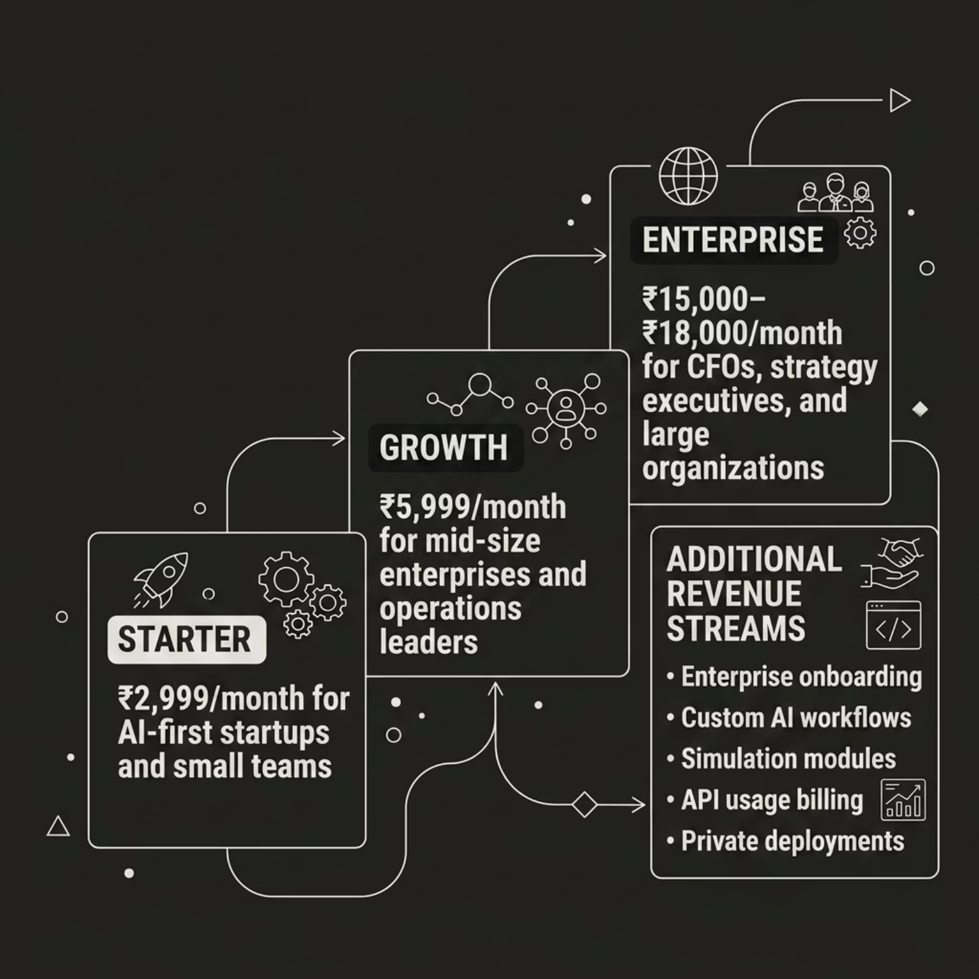

Business Model & Revenue
Customer Segments
Mid-size enterprises & AI-first startups
CFOs, finance teams & operations leaders
Strategy executives & enterprise consulting firms
Manufacturing & logistics enterprises
Key Partners
Wolfram, OpenAI, Supabase
n8n, Cloudflare, Vercel
Go-to-Market
Enterprise sales, LinkedIn outreach, tech conferences
Startup incubators & strategic partnerships
API ecosystem integrations

Slide 9






Built for Enterprise-Scale Autonomous Intelligence
A production-grade, composable stack engineered for reliability, scale, and computational depth.
Frontend
AI Orchestration
Next.js 15 · Tailwind CSS · Framer Motion · Tremor Charts
LangGraph · CrewAI · AutoGen · OpenAI Agents SDK
Automation Layer
Computational Core
n8n · Trigger.dev · Temporal.io · Kafka · BullMQ
Wolfram Language · Monte Carlo Engines · Symbolic AI
Data Infrastructure
Deployment & Observability
Supabase · PostgreSQL · Redis · Pinecone · ClickHouse
Vercel · Docker · Grafana · LangSmith · PostHog

Slide 10

The Future of Enterprise Intelligence
Businesses evolved from spreadsheets → dashboards → analytics. The next frontier is autonomous intelligence systems.
AI-Native Operations
Realtime Strategic Reasoning
Intelligence embedded in every workflow
Decisions powered by live computation
Autonomous Infrastructure
Systems that think, act, and optimize
"While most AI systems generate answers, Sanktrix computes strategic intelligence. We are building the operating system for autonomous enterprises."
Karan A Sharma · Sanktrix

