Slide 1

Summer Training Presentation on Automatic Fare Collection
Guided By:
Anil Sharma
Durgesh Meena
Made By:
Ritwik Bhowmick
Vinay Pokharna

Slide 2
Automatic Fare Collection

Slide 3
Introduction
Access Control: It is the term associated with physical security and information security. It is the selective restriction of access to a place or other resource.
Full Access Control: Restricting the entry and exit to a resource.
Full Access Controlled Ticketing.

Slide 4

Introduction (Cont..)

Slide 5
Types of Ticketing
Tokens
Paper tickets
Magnetic stripe ticket
Contact-based smartcards
Contactless Cards
Mobile ticketing

Slide 6
Tokens
Generally they are single journey tokens that are valid only for a one way journey.
Value depends on destination.
Delhi Metro tokens have an NFC (Near Field Communication) tag inside which allows the exit machines to read/write data on it.

Slide 7
Paper tickets
They may have bar codes which can be read by a bar code reader.
They can be manually checked by a ticket collector.

Slide 8
Magnetic stripe ticket
capable of storing data by modifying the magnetism of tiny iron-based magnetic particles on a band of magnetic material on the card. Each particle is really a very tiny bar magnet .
Read by swiping past a magnetic reading head
Data encoding-Tracks with different bit densities

Slide 9
Contact-based smartcards
Contact smart cards have a contact area of approximately 1 square centimetre , comprising several gold-plated contact pads. These pads provide electrical connectivity when inserted into a reader, which is used as a communications medium between the smart card and a host (e.g., a computer, a point of sale terminal). Cards do not contain batteries; power is supplied by the card reader.
Communication protocols for contact smart cards

Slide 10
Contactless Cards
A second card type is the contactless smart card, in which the card communicates with and is powered by the reader through RF induction technology (at data rates of 106–848 kbit/s). These cards require only proximity to an antenna to communicate. Like smart cards with contacts, contactless cards do not have an internal power source. Instead, they use an inductor to capture some of the incident radio-frequency interrogation signal, rectify it, and use it to power the card's electronics. They use RFID technology for communication.

Slide 11
Advantages of Full Access Controlled Ticketing
Authorized personnel gets entry.
Time saving.
No need of manual ticket checking.
Diverse Sales channels
Transparency
Undesired reselling prevention
Extras on tickets-like discount, etc.
Better Customer satisfaction

Slide 12
Technology
Near Field Communication (NFC)
Jointly developed by Philips and Sony, Near Field Communication (NFC) is a wireless connectivity technology that enables convenient short-range communication between electronic devices.
Range is 4inch or 10 cm.
NFC device can work in three modes:
NFC card emulation.
NFC reader/Writer.
NFC peer to peer.

Slide 13
Contd…
NFC Card Emulation:
Enables devices to act like smart card. Ex: smart phone.
NFC reader/Writer:
Enables NFC device to read information stored on NFC tag.
NFC peer to peer:
Enables NFC devices to communicate in an adhoc fashion

Slide 14
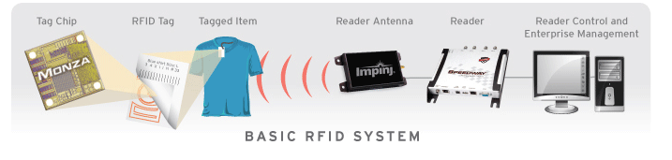
Technology (Cont….)
Radio Frequency Identification (RFID):

Slide 15
Technology (Cont…)
RFID Components:
Tag Chip
Tag Antenna
Reader antenna
Reader Control and application software (Middleware).

Slide 16
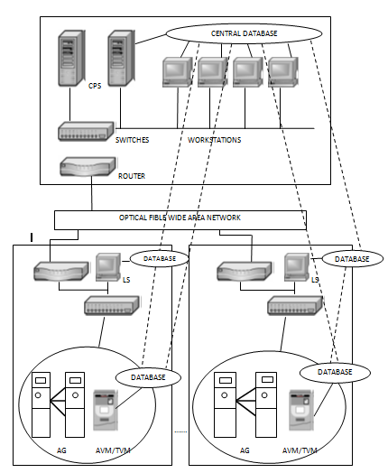
Architecture
LS : Local server
AVM : Automatic Vending Machine
TVM : Ticket Vending Machine
AG : Automatic Gates
CPS : Central Processing Server

Slide 17
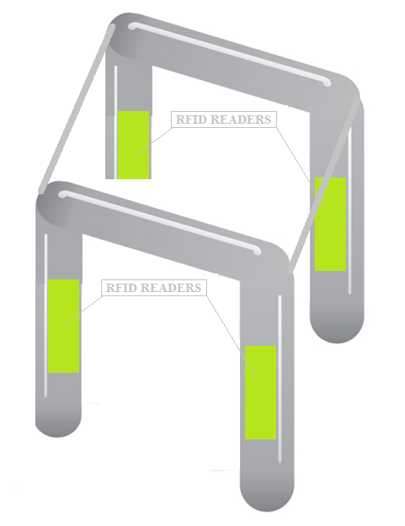
For entry/exist checks use of RFID tags reader gates.
Single gate for both IN and OUT.
A single gate contain two gates internally to decide IN and OUT action.

Slide 18
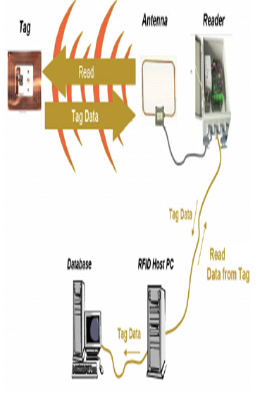
Gate working principal:

Slide 19
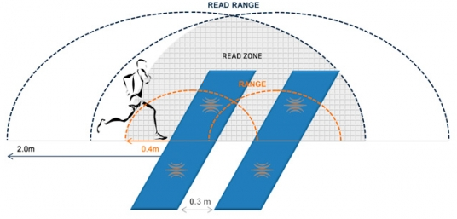
Tag read Zone:
Tags will be read only when it is in range of read Zone.

Slide 20
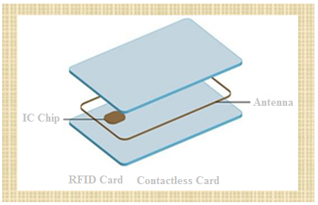
Use of RFID smartcards
Smart card/Tag (Passive):
Contains encrypted data
Card has 16 digits unique card no
An a/c will be opened for each passenger and a card will be issued.
Card can be recharged online / through counter / bank a/c automatically.

Slide 21
Architecture and data flow
Station B computer
Station C Computer
Station A computer
Station D Compute
Station Z Computer
Central computer
Station E Computer
Station F Computer
Station I Computer
Station H Computer
Station G Computer

Slide 22

Data SYNC:
Detail of all passengers who is in this train.
Detail of all passengers newly ‘IN’ or left train here who were in this train before.
Train data transfer to station computer
Train data transfer to station computer
Platform
Train
Track
Train
Central computer data of a particular passenger will be updated, when passenger left that particular train by which journey was performed.

Slide 23
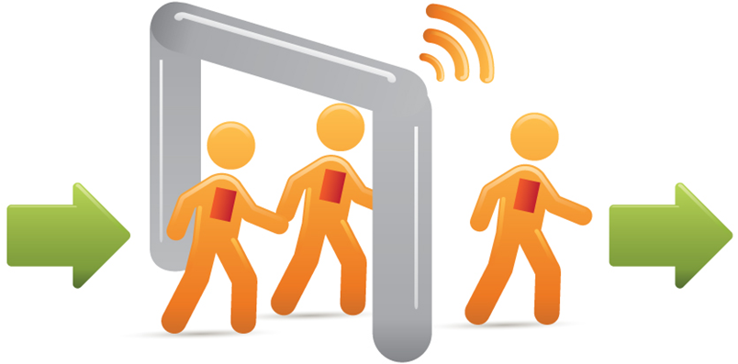
Data Flow:
Sending Info to Station Computer

Slide 24
This System Yields
Full access controlled ticketing.
No Queue for getting tickets.
No need to book unreserved tickets.
No need of manual examine tickets.
With W/L e-ticket passengers can travel.
No need of manual filing TDR.
Physical security increases.
Each and every traveling person is being monitor.
User friendly system.
One system for entire ticketing.

Slide 25
Common security attacks and countermeasures
Eavesdropping
Data Corruption
Data Modification
Man-in-the-Middle Attack
Solutions and Recommendations
Data security and Security devices
Notes:
1 Eavesdropping Because NFC is a wireless communication interface it is obvious that eavesdropping is an important issue. When two devices communicate via NFC they use RF waves to talk to each other. An attacker can of course use an antenna to also receive the transmitted signals. Either by experimenting or by literature research the attacker can have the required knowledge on how to extract the transmitted data out of the received RF signal. Also the equipment required to receive the RF signal as well as the equipment to decode the RF signal must be assumed to be available to an attacker as there is no special equipment necessary. The NFC communication is usually done between two devices in close proximity. This means they are not more than 10 cm (typically less) away from each other. The main question is how close an attacker needs to be to be able to retrieve a usable RF signal. Unfortunately, there is no correct answer to this question. The reason for that is the huge number of parameters which determine the answer. For example the distance depends on the following parameters, and there are many more. • RF filed characteristic of the given sender device (i.e. antenna geometry, shielding effect of the case, the PCB, the environment) • Characteristic of the attacker’s antenna (i.e. antenna geometry, possibility to change the position in all 3 dimensions) • Quality of the attacker’s receiver • Quality of the attacker’s RF signal decoder • Setup of the location where the attack is performed (e.g. barriers like walls or metal, noise floor level) • Power sent out by the NFC device Therefore any exact number given would only be valid for a certain set of the above given parameters and cannot be used to derive general security guidelines. 5. Additionally, it is of major importance in which mode the sender of the data is operating. This means whether the sender is generating it’s own RF field (active mode) or whether the sender is using the RF field generated by another device (passive mode). Both cases use a different way of transmitting the data and it is much harder to eavesdrop on devices sending data in passive mode. In order to not leave the reader without any idea on how big the eavesdropping distances are, we give the following numbers, which as stated above are not valid in general at all, but can only serve to give a rough idea about these distances. When a device is sending data in active mode, eavesdropping can be done up to a distance of about 10 m, whereas when the sending device is in passive mode, this distance is significantly reduced to about 1 m.
2 Data Corruption Instead of just listening an attacker can also try to modify the data which is transmitted via the NFC interface. In the simplest case the attacker just wants to disturb the communication such that the receiver is not able to understand the data sent by the other device. Data corruption can be achieved by transmitting valid frequencies of the data spectrum at a correct time. The correct time can be calculated if the attacker has a good understanding of the used modulation scheme and coding. This attack is not too complicated, but it does not allow the attacker to manipulate the actual data. It is basically a Denial of Service attack.
3 Data Modification In data modification the attacker wants the receiving device to actually receive some valid, but manipulated data. This is very different from just data corruption. The feasibility of this attack highly depends on the applied strength of the amplitude modulation.
4 Data Insertion This means that the attacker inserts messages into the data exchange between two devices. But this is only possible, in case the answering device needs a very long time to answer. The attacker could then send his data earlier than the valid receiver. The insertion will be successful, only, if the inserted data can be transmitted, before the original device starts with the answer. If both data streams overlap, the data will be corrupted.
5
In the classical Man-in-the-Middle Attack, two parties which want to talk to each other, called Alice and Bob, are tricked into a three party conversation by an attacker Eve. Man-in-the-Middle Setup Alice Bob Eve Alice and Bob must not be aware of the fact that they are not talking to each other, but that they are both sending and receiving data from Eve. Such a setup is the classical threat in unauthenticated key agreement protocols like Diffie-Hellmann protocol. Alice and Bob want to agree on a secret key, which they then use for a secure channel. However, as Eve is in the middle, it is possible for Eve to establish a key with Alice and another key with Bob. When Alice and Bob later use their key to secure data, Eve is able to eavesdrop on the communication and also to manipulate data being transferred. How would that work when the link between Alice and Bob is an NFC link? Assuming that Alice uses active mode and Bob would be in passive mode, we have the following situation. Alice generates the RF field and sends data to Bob. In case Eve is close enough, she can eavesdrop the data sent by Alice. Additionally she must actively disturb the transmission of Alice to make sure that Bob doesn’t receive the data. This is possible for Eve, but this can also be detected by Alice. In case Alice detects the disturbance, Alice can stop the key agreement protocol. Let’s assume Alice does not check 7. for active disturbance and so the protocol can continue. In the next step Eve needs to send data to Bob. That’s already a problem, because the RF field generated by Alice is still there, so Eve has to generate a second RF field. This however, causes two RF fields to be active at the same time. It is practically impossible to perfectly align these two RF fields. Thus, it is practically impossible for Bob to understand data sent by Eve. Because of this and the possibility of Alice to detect the attack much earlier we conclude that in this setup a Man-in-the-Middle attack is practically impossible. The only other possible setup is that Alice uses active mode and Bob uses active mode, too. In this case Alice sends some data to Bob. Eve can list and Eve again must disturb the transmission of Alice to make sure that Bob does not receive the data. At this point Alice could already detect the disturbance done by Eve and stop the protocol. Again, let us assume that Alice does not do this check and the protocol continues. In the next step Eve would need to send data to Bob. At first sight this looks better now, because of the active-active communication Alice has turned off the RF field. Now Eve turns on the RF field and can send the data. The problem here now is that also Alice is listening as she is expecting an answer from Bob. Instead she will receive the data sent by Eve and can again detect a problem in the protocol and stop the protocol. It is impossible in this setup for Eve to send data either to Alice or Bob and making sure that this data is not received by Bob or Alice, respectively. We claim that due to the above given reasons it is practically infeasible to mount a Man-in-the-Middle attack in a real-word scenario.
Solutions and Recommendations
1 Eavesdropping As described in section 3.1, NFC by itself cannot protect against eavesdropping. It is important to note that data transmitted in passive mode is significantly harder to be eavesdropped on, but just using the passive mode is probably not sufficient for most applications which transmit sensitive data. The only real solution to eavesdropping is to establish a secure channel as outlined in section 4.6.
2 Data Corruption NFC devices can counter this attack because they can check the RF field, while they are transmitting data. If an NFC devices does this, it will be able to detect the attack. The power which is needed to corrupt the data is significantly bigger, than the power which can be detected by the NFC device. Thus, every such attack should be detectable.
3 Data Modification Protection against data modification can be achieved in various ways. By using 106k Baud in active mode it gets impossible for an attacker to modify all the data transmitted via the RF link as described in section 3.3. This means that for both directions active mode would be needed to protect against data modification. While this is possible, this has the major drawback, that this mode is most vulnerable to eavesdrop- 8. ping. Also, the protection against modification is not perfect, as even at 106k Baud some bits can be modified. The two other options might therefore be preferred. NFC devices can check the RF field while sending. This means the sending device could continuously check for such an attack and could stop the data transmission when an attack is detected. The third and probably best solution would be a secure channel
4 Data Insertion There are three possible countermeasures. One is that the answering device answers with no delay. In this case the attacker cannot be faster than the correct device. The attacker can be as fast as the correct device, but if two devices answer at the same time no correct data is received. The second possible countermeasure is listening by the answering device to the channel during the time, it is open and the staring point of the transmission. The device could then detect an attacker, who wants to insert data. The third option again is a secure channel between the two devices. 4.5 Man-in-the-Middle-Attack As already outlined in section
5 it is practically impossible to do a Man-in-the-Middle-Attack on an NFC link. The recommendation is to use active-passive communication mode such that the RF field is continuously generated by one of the valid parties. Additionally, the active party should listen to the RF filed while sending data to be able to detect any disturbances caused by a potential attacker.
4.6 Secure Channel for NFC Establishing a secure channel between two NFC devices is clearly the best approach to protect against eavesdropping and any kind of data modification attack. Due to the inherent protection of NFC against Man-in-the-Middle-Attacks it is rather easy and straightforward to setup a secure channel. A standard key agreement protocol like Diffie-Hellmann based on RSA [4] or Elliptic Curves could be applied to establish a shared secret between two devices. Because Man-in-the-Middle is no threat, the standard, unauthenticated version of Diffie-Hellman works perfectly. The shared secret can then be used to derive a symmetric key like 3DES or AES, which is then used for the secure channel providing confidentiality, integrity, and authenticity of the transmitted data. Various modes of operation for 3DES and AES could be used for such a secure channel and can be found in literature

Slide 26
Intrusion Prevention System
An Intrusion Prevention System is a network security device that monitors network and/or system activities for malicious or unwanted behavior and can react, in real-time, to block or prevent those activities IPS can detect and block: OS, Web and database attacks Spyware / Malware Worm propagation Critical outbound data loss (data leakage)

Slide 27
Thank You

