Slide 1

Project Report

Slide 2
Acknowledgement

Slide 3
Contents
1. Definition of signalling
2. Objective of Signalling
3. Gauge system
4. Train Control and signalling system
5. ATP
6. ATO
7. ATS
8. CBI
9. OCC
10. System architecture
11. System standards
12. Modes of train operation
13. Signal
14.Interlocking
15. Point Machine
16. Track circuit
17. Depot Signalling
18. Train Radio
19. Signalling Equipment's

Slide 4
WHAT IS SIGNALLING?
An indication given to a metro operator for controlling the movement of the train in a safe manner. On railways all over the world, signals are used to indicate to the driver of a train how he should proceed. The driver using his knowledge and experience will decide about the speed the metro can safely travel at.

Slide 5
OBJECTIVES OF SIGNALLING -
To ensure the overall safety.
Increase line capacity.
Ensure timely arrival of the metro.
To run metro in an economic and profitable manner.

Slide 6
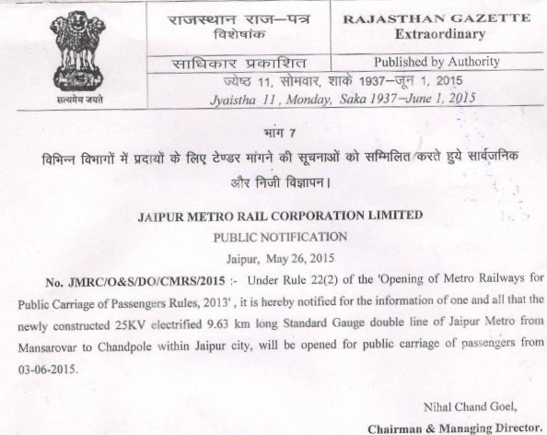
Gauge system
Based on the suggestions from Delhi Metro rail corporation, Jaipur metro follows the standard gauge(SG) of four feet eight and a half inches over the broad gauge(BG) of five feet six inches.
The choice of the gauge for the metro depends on topographical conditions and legal allowance from the ministry.

Slide 7
Train control And Signaling System
The Train Control and Signaling system should consist of following sub-system for all gauges -
1. Automatic Train Protection (ATP) System with Cab Signaling.
2. Automatic Train Operation (ATO) System.
3. Automatic Train Supervision (ATS) System with Automatic Route Setting(ARS) and Automatic Train Regulation (ATR).
4. Computer based Interlocking (CBI), both for main line and depos.
The system shall be designed for a Headway of 120 seconds.

Slide 8
ATP - (Automatic Train Protection System)
The main function of ATP system is to ensure safe Train Separation and safe Train movement. The ATP'S intelligent and safe Decision Making process shall be mainly on the On- board ATP equipment.
It has in its store the needed Rolling stock characteristics. Safety Information in respect of field entities shall be provided by the Computer based Interlocking for the track circuit occupancy and by the way-side ATP equipment for the track profile like curves, gradients, location/Position of Signals and Points, Location of stopping point, and permanent and temporary speed restrictions etc.
The communication between the Track and Train-borne equipment shall be through coded AFTCs, in the form of ATP telegrams. The telegrams shall be received by the train through a pair of pick-ups Coils mounted on both side of the first Bogie of the driving car.

Slide 9
ATP - (Automatic Train Protection System continued….
The train-borne equipment shall act as a driver does. It shall receive Information from the track, calculate the speed versus Location Profile and deduce Orders such as 'Stop at this point‘ or 'Reduce the Speed to this level at this Point' etc.
The communication link between the Track and Train shall also be used to transit the train ID and Alarms and Messages to the Track side ATP equipment.

Slide 10
ATO - (Automatic Train Operation System)
The main function of ATO system shall be to run the Trains in between the stations automatically without the intervention of the Train driver.
The ATO System shall generate Speed Control to the Traction and Braking System of the Train with respect to the Computed Speed profile. The ATO System shall ensure that the train achieves timely, accurate and smooth Station stops or stopping ahead of restrictive point.
The ATO system shall also control the Train doors during station stops under the supervision of the ATP System without the intervention of the Train Driver.

Slide 11
ATS - (Automatic Train Supervision System)
The main function of the ATS system shall be automatic management of the Train movement with due interfacing with the ATP/ATO/CBI systems for Automatic Route Setting and Automatic Train Regulation -
The ATS System shall supervise:
The train movement continuously and optimize the train movements in case of abnormalities. This shall be achieved by assigning Train Identification Numbers(TIDs), monitoring the operation of each Train, modifying the Dwell times at each Station, if required, Modifying Train operations to optimize Headways, Power consumptions or run-time and also provide outputs to the Passenger Information Display System (PIDS) Units at each station.

Slide 12
CBI - (Computer based Interlocking)
The main function of Interlocking System shall be to provide the requisite Interlocking, Control and Indication functions as also support all the feasible Train movements in the Yard. The CBI shall be based on Entry-Exit System and shall have separate Controls, upon operation of which the trains will be allowed to operate in reverse direction except at Terminals and Turn back stations. The system shall interface with CATC Systems.
The interlocking ensures that:
Conflicting routes can not be set.
Points are only moved, when all the safety conditions are met.
Signals only clear to a proceed aspect, when all the safety conditions are fulfilled.
The system is Fail-safe and failures shall not provoke an unsafe situation. Under failure conditions, signals shall remain in their last operated position.

Slide 13
CBI - (Computer based Interlocking) continued……
In normal operation, the route shall be released by the train movement, if the route is not set in the fleet mode. However, it shall be possible for an operator to release the route with a specific Local/Remote Control, as per the requirements of Operations as also to meet the emergent situations. The interlocking System, on receipt of a Route Remote Control from the Local ATS ( The command either originated from the Central ATS (CATS) or the Local ATS itself),shall permit to:
Control and Lock the points to the position required by the route.
Set up the Route.
Lock the Sub-routes of the Route.
Lock the Route.
Set direction of Traffic (DOT).
Authorize the Route.
Set the Aspect of the Signal, at the origin of the route, to 'PROCEED' Aspect.
Control cum- Indication Panel (Domino type) with Panel Processor having standby processor and/or a control terminal with VDU Display consisting of a Color VDU Monitor, a keyboard and Mouse or digitizer be provided to allow Trains to be controlled on the Section, in case of failure of the ATS System.

Slide 14
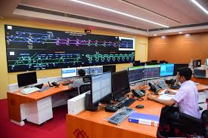
OCC – (Operation Control Centre)
Like the control tower at the airport, Metro has control centers that tell trains where to go. The Operations Control Center (OCC), the brain of Metro’s rail network, has three "desks, "each of which controls a different part of the system. On a normal day, Rail Traffic Controllers will talk with train operators a number times. For example, the RTC may need to tell the operator to hold at stations if they’re too close to the train ahead.

Slide 15
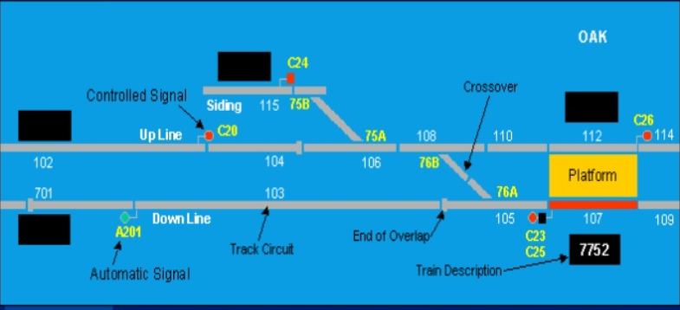
Signalman’s Display at OCC

Slide 16
System Architecture -
The train Control and Signaling system shall be based on Fail- Safe Computers and Safety-critical Software.
The system shall be configured with Fiber optic Transmission System (FOTS) based on backbone of transmission of both vital and non-vital information between CBIs and Trackside ATP Equipment's.
The trackside Systems shall be connected to the central ATS (CATS) System at the Operation Control Centre (OCC) again through the FOTS for performing the function of supervision and regulation on traffic on the line.

Slide 17
Safety Standards -
Safety shall be the primary consideration in the Design and Performance requirements for the system. To meet these requirements:
All Safety-critical equipment's shall be designed to Conform to Fail-safe principle in respect of Reliability, Availability, Maintainability and Safety(RAMS),Manufactured and validated to meet the Safety Integrity Level-4 (SIL-4),as defined in the CENELAC Standards EN50126,EN50128 and EN50129.
The CBI and ATP System shall conform to SIL-4 in accordance with CENELAC Standard EN50129 for the safety-related Electronics System for Signaling and with CENELAC Standards EN50128 for software for Control and Protection System.

Slide 18
Modes for train operation -
1. ATO Mode –
The normal mode of Operation for the lines provided with ATO shall be the ATO Mode. In this mode, the trains should operate automatically between the stations while remaining within the safety envelope calculated and enforced by the ATP and Open/Close its doors at the next station.

Slide 19
Modes for train operation -
2. ATP Mode –
The normal mode of Operation for the lines not provided with ATO shall be ATP mode. In this mode, the Train Driver shall operate the Train manually. Indications shall be provided in the Cab of the train with on-board displays for Maximum Safe Speed (MSS),current speed, target distance(Distance to Go) and Target speed. The braking curve shall be computed continuously along the line, so as to enable maintaining a minimum Safely Distance between the train and the danger point. The maximum speed shown in the cab shall be enforced by the ATP equipment. ATP equipment shall also indicate which side Doors may be opened when a train enters a Station. The ATP equipment shall not allow the Doors to be opened when train enters a station. The ATP equipment shall not allow the doors to be opened on wrong side, unless an emergency override control is activated.

Slide 20
Modes for train operation -
3. Cut-out Mode:
The cut-out mode shall be used when the On-Board ATP equipment fails. In this mode, Line side signals shall be used to provide information to the Train Driver that the Route is clear to the next interlocking or to enter the depot connecting track. Accordingly, the Train Driver shall operate the Train from interlocking to Interlocking, following the Aspects of Line side signals. In this Mode, the Train Driver shall operate the train at a maximum of 25 kmph and this speed limit enforcement shall be ensured by the On-board Rolling Stock equipment.

Slide 21
Modes for train operation -
4. Restricted Manual (RM) Mode:
RM Mode shall be used to drive the Trains in the absence of any Cab Signal Input. In this Mode, the speed shall be limited to 25kmph by the On-board ATP equipment.
5. Run On Sight:
This mode shall be used
1. For Depot Entry/Exit
2. For driving on main line in absence of cab signal
This mode automatically changes to ATP on reception of ATP signal from trackside.

Slide 22
Signals and It’s Types -
It is an indication given to the train operator for controlling train movement.
Signal
Cab
Signal
Fixed
Signal
Hand Signal

Slide 23
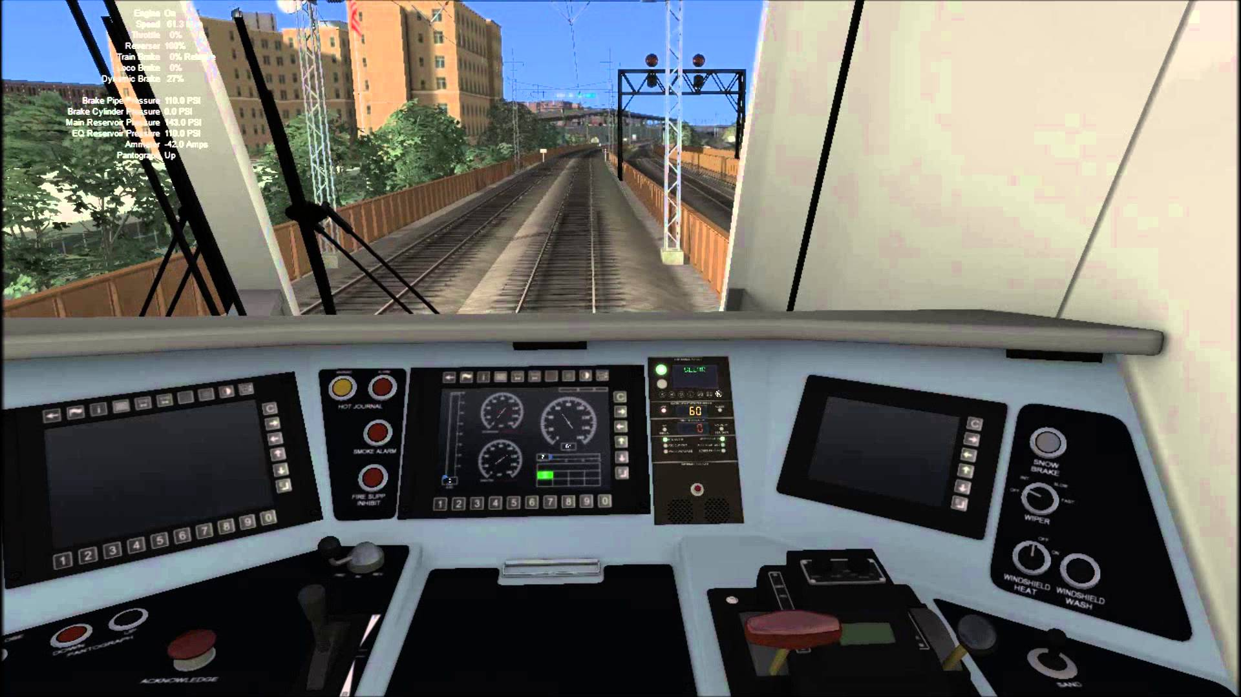
Cab Signal
It is a signal displayed as a speed code on the train operator’s console granting him the authority to proceed.

Slide 24
Fixed Signal
Line side fixed signals, with route indicators where required, shall be installed on the Main Lines at the entry and exit to all interlocking for bi-directional working. The location of Fixed Signals shall be such that Trains will stop at a safe distance from any Fouling movement or location.
Line Side signals can be of 3 aspects –
RED
VIOLET
GREEN

Slide 25
Fixed Signal
RED –
A train must be brought to Stop short of the signal. RED aspect shall indicate that either Route is not set and locked or the first track circuit after the signal is occupied.
VIOLET –
(Conditional Proceed) Violet aspect shall indicate that route is set and locked but not fully clear. The first Track circuit after the signal is clear or the GREEN aspect has failed. A train operating under cab signal may proceed under the authority of the cab signals but a Train operating on the sole authority of Line side signals must stop.

Slide 26
Fixed Signal
GREEN –
(Proceed) Route is set and locked and the track circuits up to the next Fixed Signals are clear. A train may proceed as far as the next Fixed Signal.
In ATP mode, VIOLET shall be interpreted by the driver in accordance with the Target Speed/Distance displayed.
In RM or ROS or CO modes, drivers shall never pass a signal showing RED or VIOLET aspect, until the Driver obtains a formal authorization from the Central Operator.

Slide 27
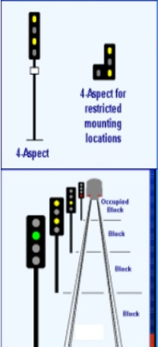
4 Aspect Fixed Signal
The 4-aspect concept is a development of multi aspect signals. In addition of a RED signal at bottom, this signal shows a single violet signal to indicate one block ahead is clear, a double violet(one above the other) to indicate that two blocks ahead is clear, and a GREEN signal to indicate that at least 3 blocks ahead are clear. The signals are shown without overlaps.

Slide 28
HAND SIGNAL
It is a manual signal used for shunting of work train in depot or at the site of work or in extreme emergency in case of failure of cab signal or fixed signal.
Flag, Lamps and flashes can be used as a means of hand signal.

Slide 29
Bi-Directional Signalling
Many metros are equipped with bi direction signalling. We will often see a boundary with two signals, one facing in each direction. The signals operates exactly the same, regardless of the direction of running.

Slide 30
Importance of Signalling
We can control actual speed of Train.
The maximum permitted speed of the train at a point of travel can be maintained.
Controlling the maximum distance metro is allowed to travel at a time.
Active System alarms.
Smooth flow of messages from OCC to operator of the metro.

Slide 31
Interlocking
A system arrangement of signals, points and other appliances, operated from a panel, so interconnected by mechanical or electronic locking or both that their operation must take place in proper sequence to ensure safety.

Slide 32
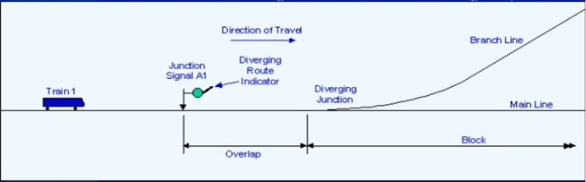
Junctions
Signals are provided at a junction for 2 reasons: first to inform the driver that the route is set for his train and second to ensure that no conflicting or unsafe moves are made through the junction. Some junctions show Green aspect for main route and Violet aspect for a diverging route, so that driver is given a warning for reduction of speed of the train.

Slide 33
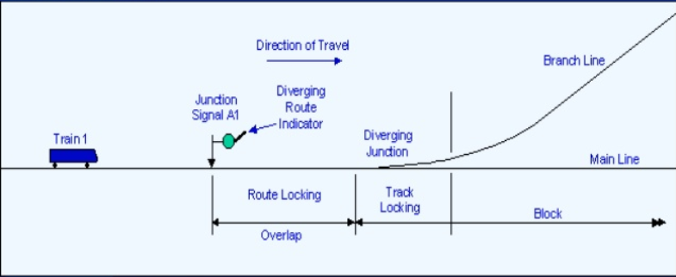
Route And Track Locking
Once track circuit is occupied the point control is locked and the points cannot be moved.

Slide 34
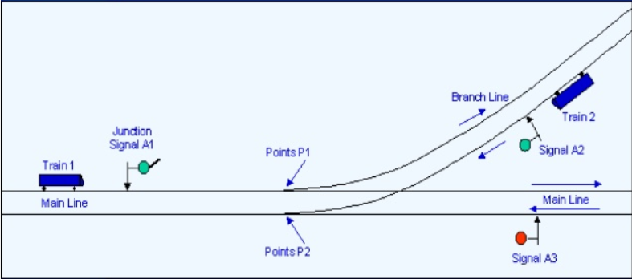
Signals at Junction

Slide 35
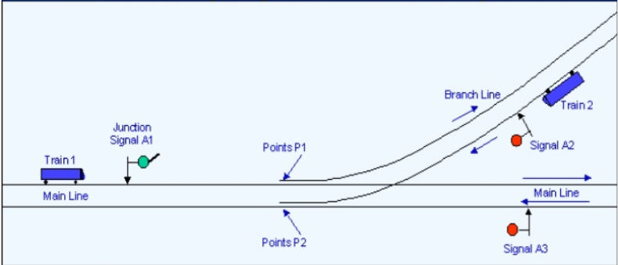
Interlocking
Points and Signals at junction must operate in harmony to ensure that no unsafe moves are set up. The process is known as “interlocking”.

Slide 36
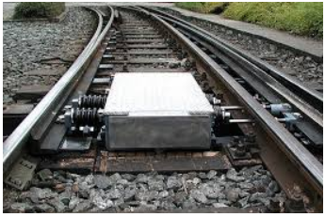
Electric Point Machines
Point machines shall be of Electrical type, operating on either 380V 3-phase AC or 110V DC. Point Machines shall be used in conjunction with external locks and shall provide Detection.
Point Machines provided on Main Running Lines shall be of external Lock type and Non-Trailaible and those provided in the Depot shall preferably be of Trailable type.
It is provided near the points for operating them electrically to the required position for train movement.

Slide 37
Track Circuits
Joint less coded Audio Frequency Track Circuits(AFTC) shall be used for Train detection purposes. Separate sets of frequencies shall be used for up and down or even or odd tracks. Frequency differentiation between up or down and odd or even tracks should neutralise the effect of Cross Talk.
The track circuit frequencies shall be Frequency Modulated by means of different Bit Patterns, to ensure a clear assignment of Transmitters to receivers.
The track circuit vacancy detection Procedure shall, accordingly, encompass Amplitude Assessment of the Signal and Frequency Check is a minimum.

Slide 38
Track Circuits
The AFTC Configuration shall also be used for transmission of Telegrams for ATP System. The transmission of Telegram Signals for ATP shall commence when the track circuit is occupied. The change-over from Normal Code transmission for Track circuit Vacancy Detection to ATP Code Transmission for controlling the movement of Trains, shall be controlled via sensing of the ‘Level Decrease’, when the level of the track circuit Signal in the receiver shall fall below a certain level. When a ‘Level Increase’ is registered, the ATP Code transmission shall cease and Normal transmission shall commence.

Slide 39
Depots
Signalling Facilities to be provided in the Depots shall be as under:
Signalling for movement of Rakes for various Maintenance facilities within the depots. Movements within the Depots beyond the entrance Interlocking, shall be controlled by Line side Shunt Signals and Stop Signals.
ATS link preferably having a separate duplicated ATS Server System. The ATS System, at depot shall continuously present Dynamic and Static overview of Train Movement and Signalling Information within the Depot Control Area and for the connecting Tracks to Main line.
Transfer tracks or cut-in/ cut-out Tracks, of suitable lengths in between the Depot and Main line, for switching in to and out of RM/ROS Mode from Normal Operation Modes, while entering or leaving the Depot.
Test Track to dynamically test the Train-borne ATC System. The Test Track shall be equipped with full Trackside ATP/ATO Systems for Train tests to be conducted within the limitations od the Test Track Length.

Slide 40
Train Radio System
Mobile Train Radio System shall be provided to enable the train driver to contact OCC/SCR in case of Emergency. Train Radio System shall, interlock, interface with Train Control and Signalling System to enable it to report the Alarm and Status of the Train-borne Signalling Equipment to the OCC and for dynamic registration of Train Identification Number (TIN) with the system.

Slide 41
Signalling Equipment's
The signalling equipment's for the Jaipur Metro have been installed and manufactured by ALSTOM.
LATS MMI – Man Machine Interface
CCIP – Control Cum Indication Panel
ESP – Emergency Stop Plunger
EKT – Electrical Key Transmitter

