Slide 1
KARAN RAJ S
Nmid: 2FF58D3A991E4E68357416BC90CE43BB
Madras Institute of Technology campus, Anna University
Final Project

Slide 2
PROJECT TITLE
Emotion Detection
3/21/2024 Annual Review

Slide 3


AGENDA
This project aims to develop a real-time system for detecting human emotions using OpenCV and deep learning techniques. The system will utilize a webcam to capture video frames, identify faces within those frames, and predict the emotional state of the person based on facial expressions. The detected emotion will be displayed as text overlaid on the video stream.
3/21/2024 Annual Review

Slide 4
PROBLEM STATEMENT
The ability to recognize human emotions from facial expressions holds significant value in various applications. It can enhance human-computer interaction, improve customer service experiences, and provide valuable insights in fields like market research and psychology. However, accurately detecting emotions can be challenging due to factors like cultural differences, subtle expressions, and variations in lighting conditions.
3/21/2024 Annual Review

Slide 5
PROJECT OVERVIEW
Data Acquisition: Compile a dataset of labeled images containing faces with corresponding emotional expressions.
Preprocessing: Develop functions to preprocess images, including grayscale conversion, face detection using OpenCV's Haar Cascade classifier, and image resizing to match the model's input requirements.
Model Development: Train a deep learning model, potentially a Convolutional Neural Network (CNN), to classify facial expressions into different emotion categories (e.g., happy, sad, angry). Keras and TensorFlow are popular libraries for this task.
Integration and Testing: Integrate the pre-processing steps, model prediction, and result visualization into a real-time application using OpenCV. Test the system with various individuals and lighting conditions to assess its accuracy and robustness.
Evaluation and Refinement: Evaluate the system's performance and identify areas for improvement. This might involve fine-tuning the model, exploring different preprocessing techniques, or incorporating additional data.
3/21/2024 Annual Review

Slide 6

WHO ARE THE END USERS?
Human-Computer Interaction (HCI) Developers: These developers can integrate emotion detection into software or hardware products to create more natural and engaging user experiences.
Customer Service Representatives: Call centers and other customer service environments could utilize emotion detection to tailor their approaches based on customer sentiment.
Market Researchers: By analyzing emotional responses, researchers can gain insights into consumer preferences and improve marketing effectiveness.
Psychologists and Neuroscientists: Researchers in these fields can leverage emotion detection technology to study human emotions in a more objective and controlled manner. Gamers and Entertainment Industry Professionals: Emotion detection can be integrated into games or other interactive experiences to create more immersive and personalized engagement.
Security and Law Enforcement: In controlled environments, emotion detection might be used to identify potential threats or suspicious behavior. However, ethical considerations and privacy concerns need to be carefully addressed in such applications.
3/21/2024 Annual Review

Slide 7
YOUR SOLUTION AND ITS VALUE PROPOSITION
Enhance Human-Computer Interaction (HCI): Software and hardware can respond more naturally to user emotions, creating a more engaging experience.
Improve Customer Service: Customer service representatives can tailor their approach based on a customer's emotional state, leading to more empathetic and effective interactions.
Provide Market Research Insights: By analyzing emotional responses to products or marketing campaigns, researchers can gain valuable insights into consumer preferences.
Advance Scientific Research: Psychologists and neuroscientists can use this technology to study human emotions objectively, potentially leading to breakthroughs in understanding emotional expression and processing.
Create Immersive Entertainment: Games and other interactive experiences can become more personalized and engaging by adapting to the player's emotional state.
3/21/2024 Annual Review

Slide 8
THE WOW IN YOUR SOLUTION
Real-time Emotion Mirroring: Imagine a virtual assistant or chatbot that not only detects your emotions but also responds by mirroring your emotional state through its voice or on-screen avatar.
Adaptive User Interfaces: An interface that changes its layout, color scheme, or even content based on the user's emotional state. Level of personalization could create a more engaging and responsive user experience.
Emotion-Driven Content Curation: Imagine a music streaming service that recommends songs based on your current mood, detected through your webcam. This would create a more personalized and emotionally aware content experience.
Collaborative Emotion Regulation: A system that not only detects emotions but also offers suggestions for regulating them.
Emotion-Based Security Systems: While ethical considerations are paramount, a future scenario might involve workplaces where access control systems consider not just facial recognition but also emotional state.
3/21/2024 Annual Review

Slide 9
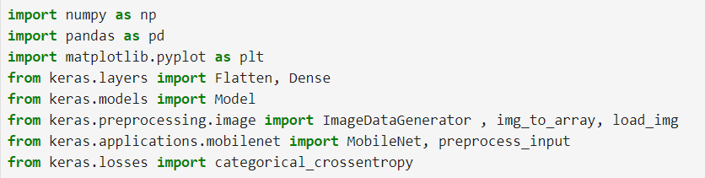
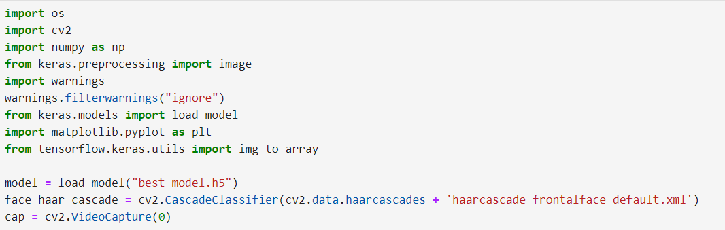
MODELLING
EMOTION_DETECTION LIBRARIES
3/21/2024 Annual Review

Slide 10
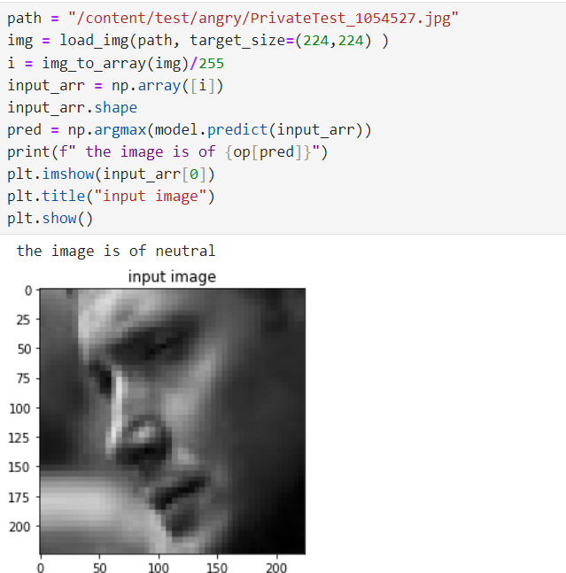

Slide 11
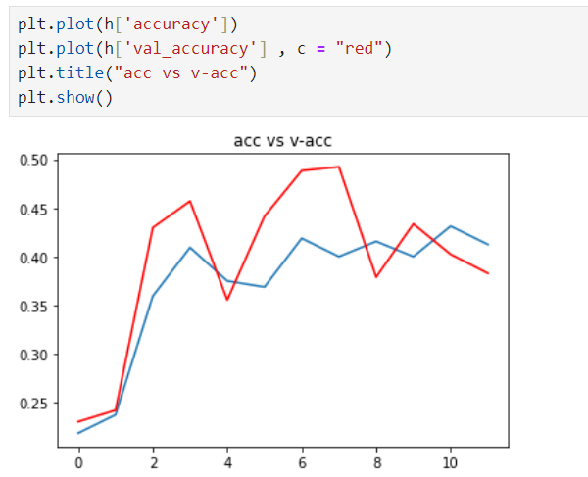
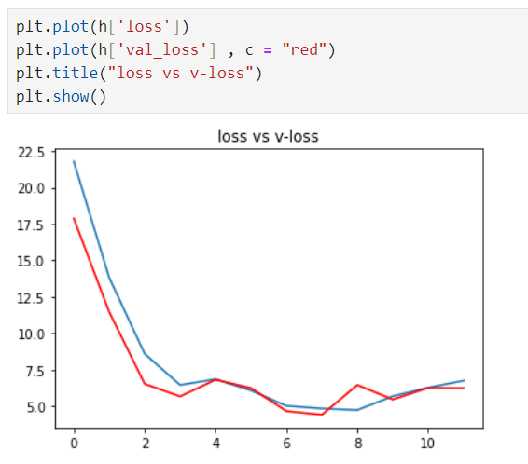
ACCURACY OF THE MODEL

Slide 12
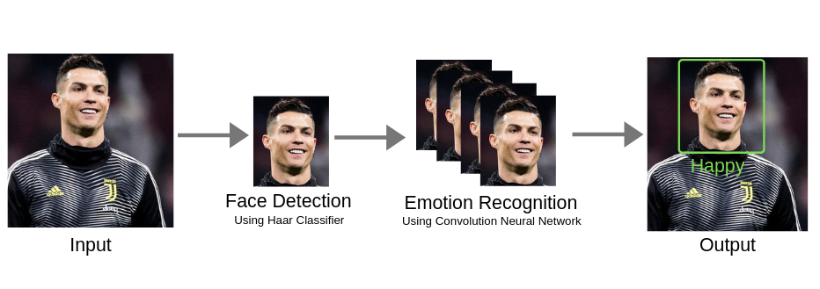
RESULTS
3/21/2024 Annual Review

