Slide 1
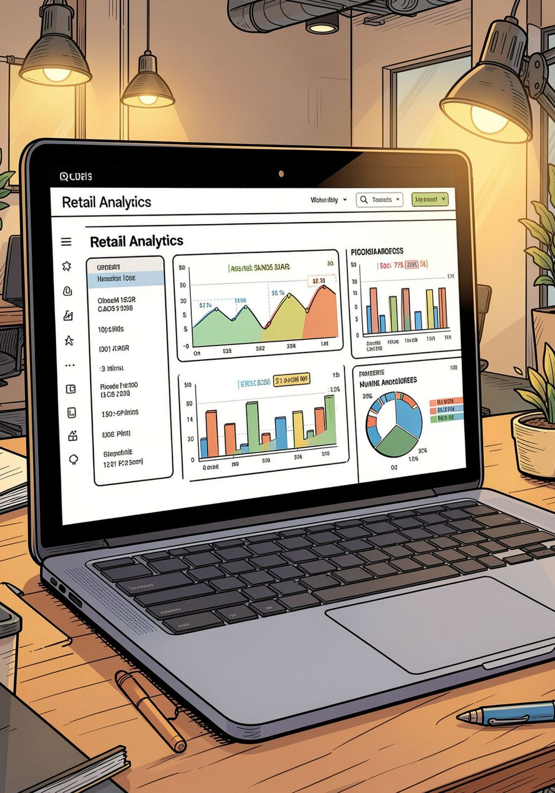
Customer Shopping Behavior — Overview
Analysis of 3,900 purchases to uncover spending patterns, segments, preferences, and subscription behavior.

Slide 2
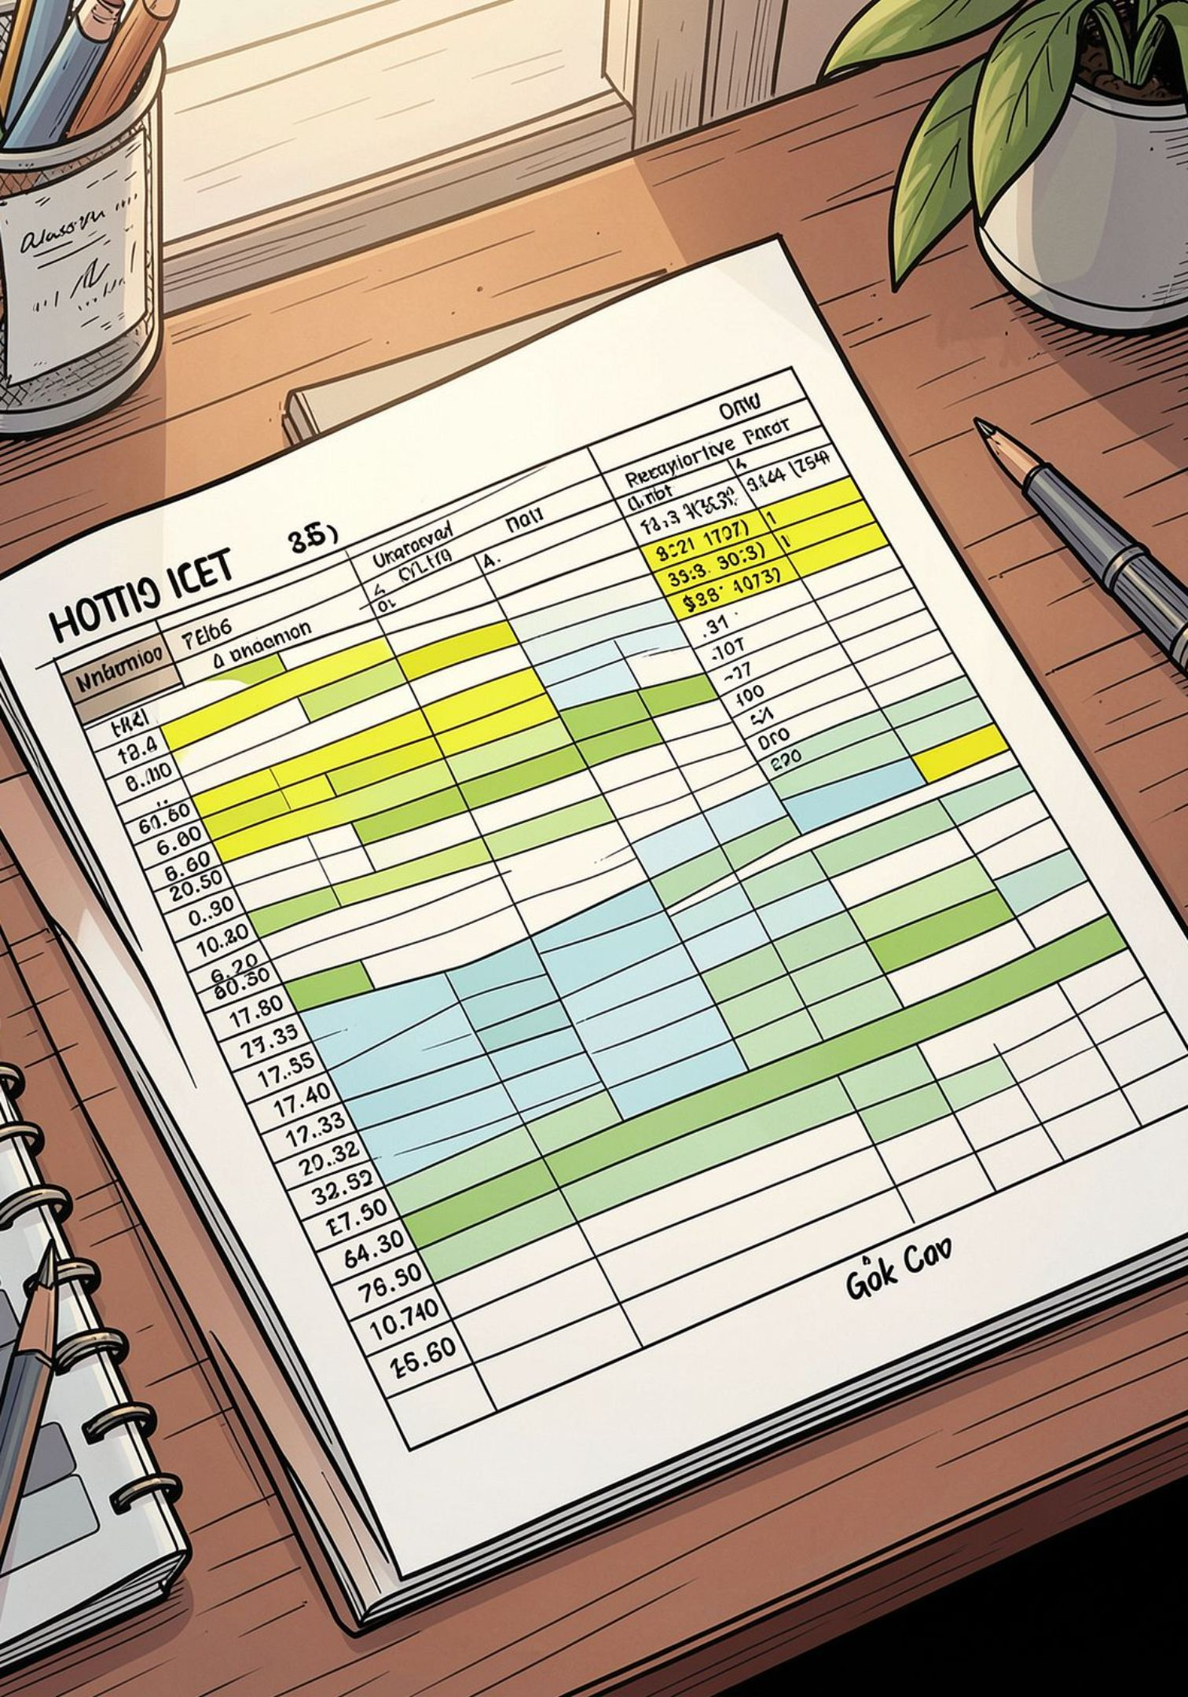
Dataset Snapshot
Rows & Columns
Key Features
Missing Data
Demographics, purchase details, behavior, shipping, discounts
37 missing values in Review Rating
3,900 rows · 18 columns

Slide 3

Data Prep & Feature Engineering
01
Cleaning
Loaded with pandas; checked structure and summary stats
02
Imputation
Imputed Review Rating by category median
03
Engineering
Added age_group and purchase_frequency_days
04
Standardize
Renamed columns to snake_case

Slide 4




Database & SQL Analysis
Revenue by Gender
Male: 157,890 · Female: 75,191
High-Spending Discount Users
839 rows: users who used discounts but spent above average
Top Rated Items
Gloves, Sandals, Boots, Hat, Skirt (avg ratings ~3.78–3.86)

Slide 5
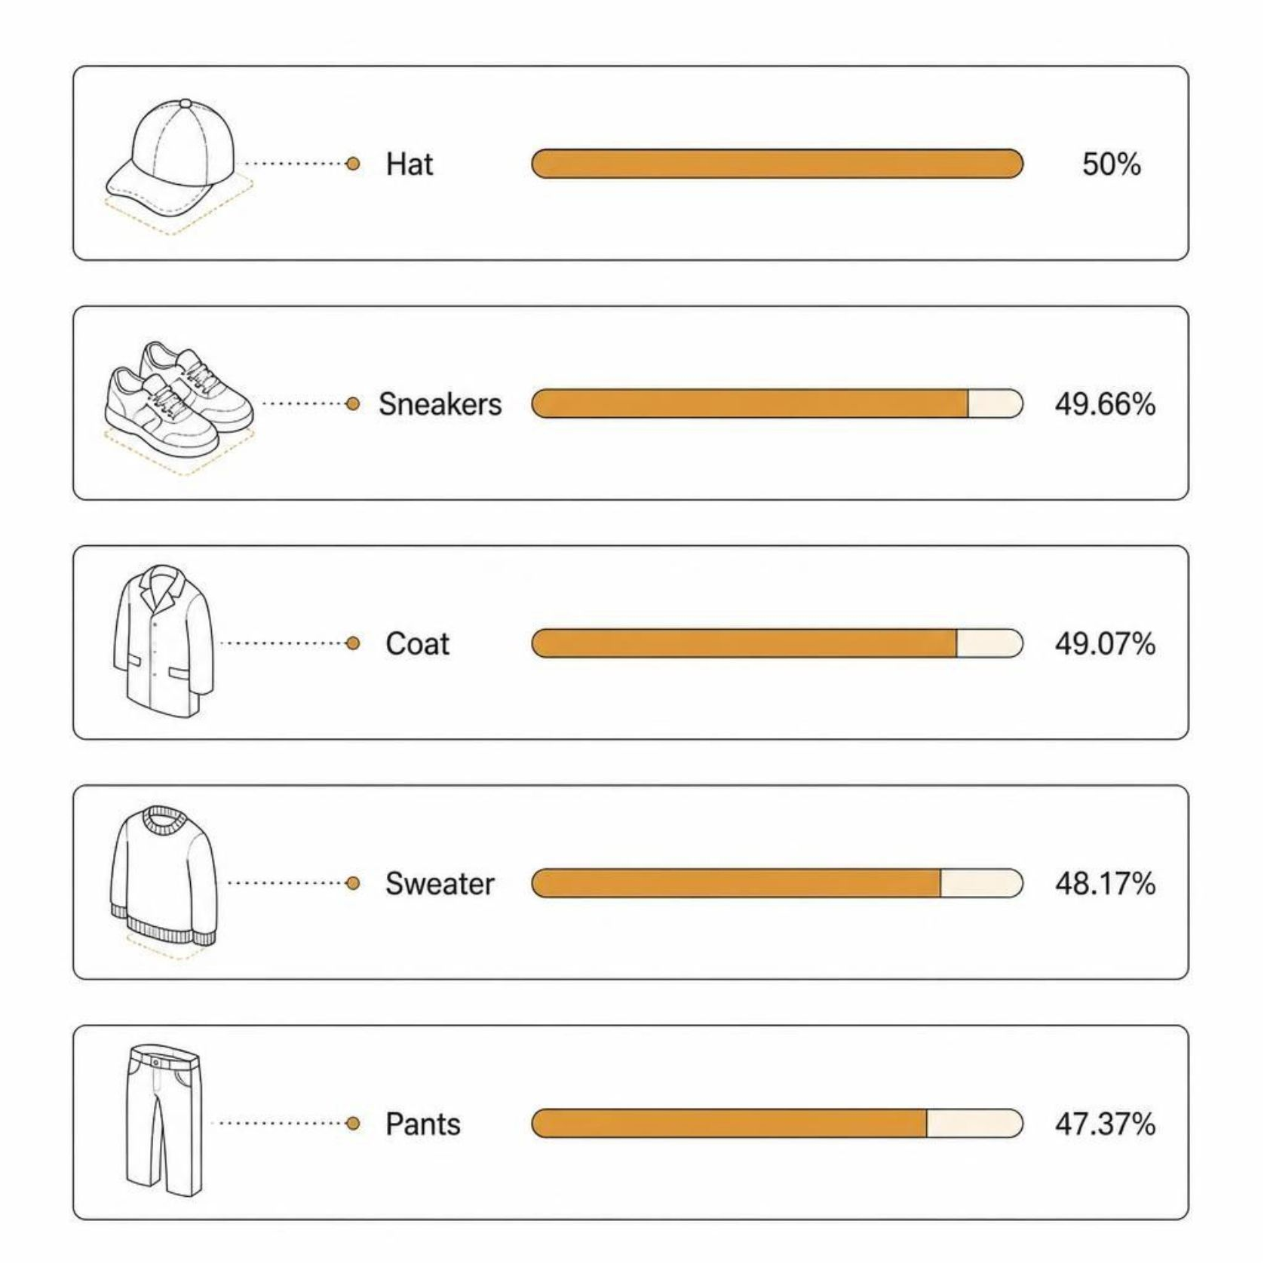
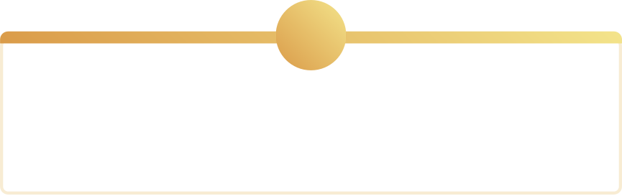
Product & Discount Insights
Discount-dependent products identified — review policy to protect margins.
1
2
Top 5 Discounted
Action
Hat · Sneakers · Coat · Sweater · Pants
Balance promotions vs. margin

Slide 6

Customer Segments & Loyalty
Subscribers vs Non
Subscribers: 1,053 — Avg spend $59.49 — Revenue 62,645
Returning701
Loyal3,116
Non-Subscribers
2,847 — Avg spend $59.87 — Revenue 170,436
New83
Repeat Buyers
Repeat buyers (>5): more likely non-subscribers (2,518 No vs 958 Yes)

Slide 7
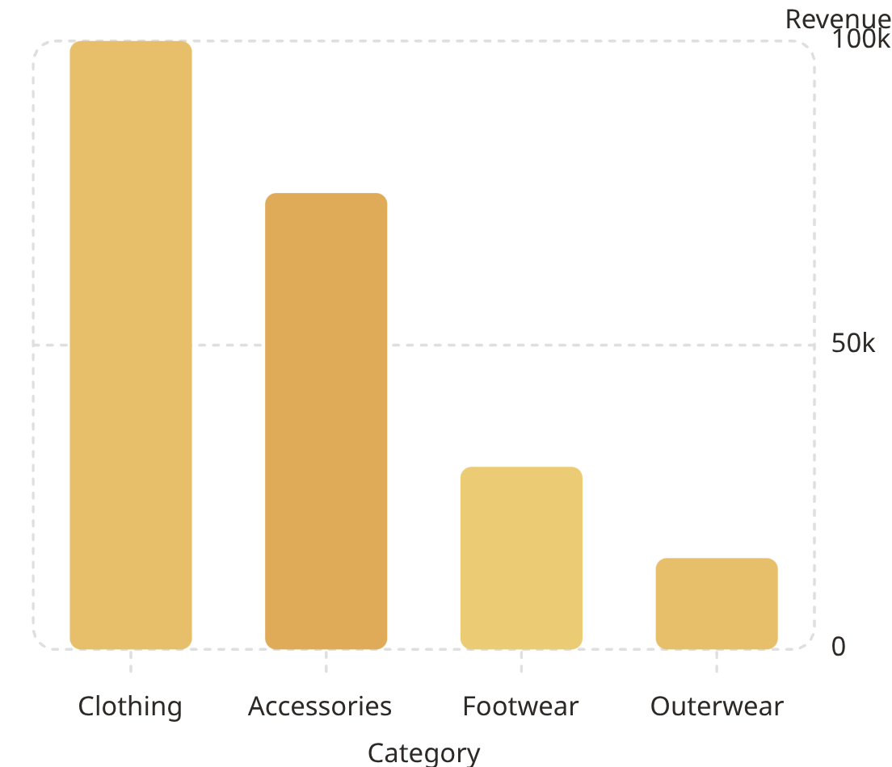
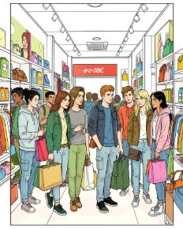

Sales & Revenue Highlights
Revenue by Age Group
Shipping
Avg purchase: Standard $58.46 · Express $60.48
Young Adult 62,143 · Middle-aged 59,197 · Adult 55,978 · Senior 55,763

Slide 8
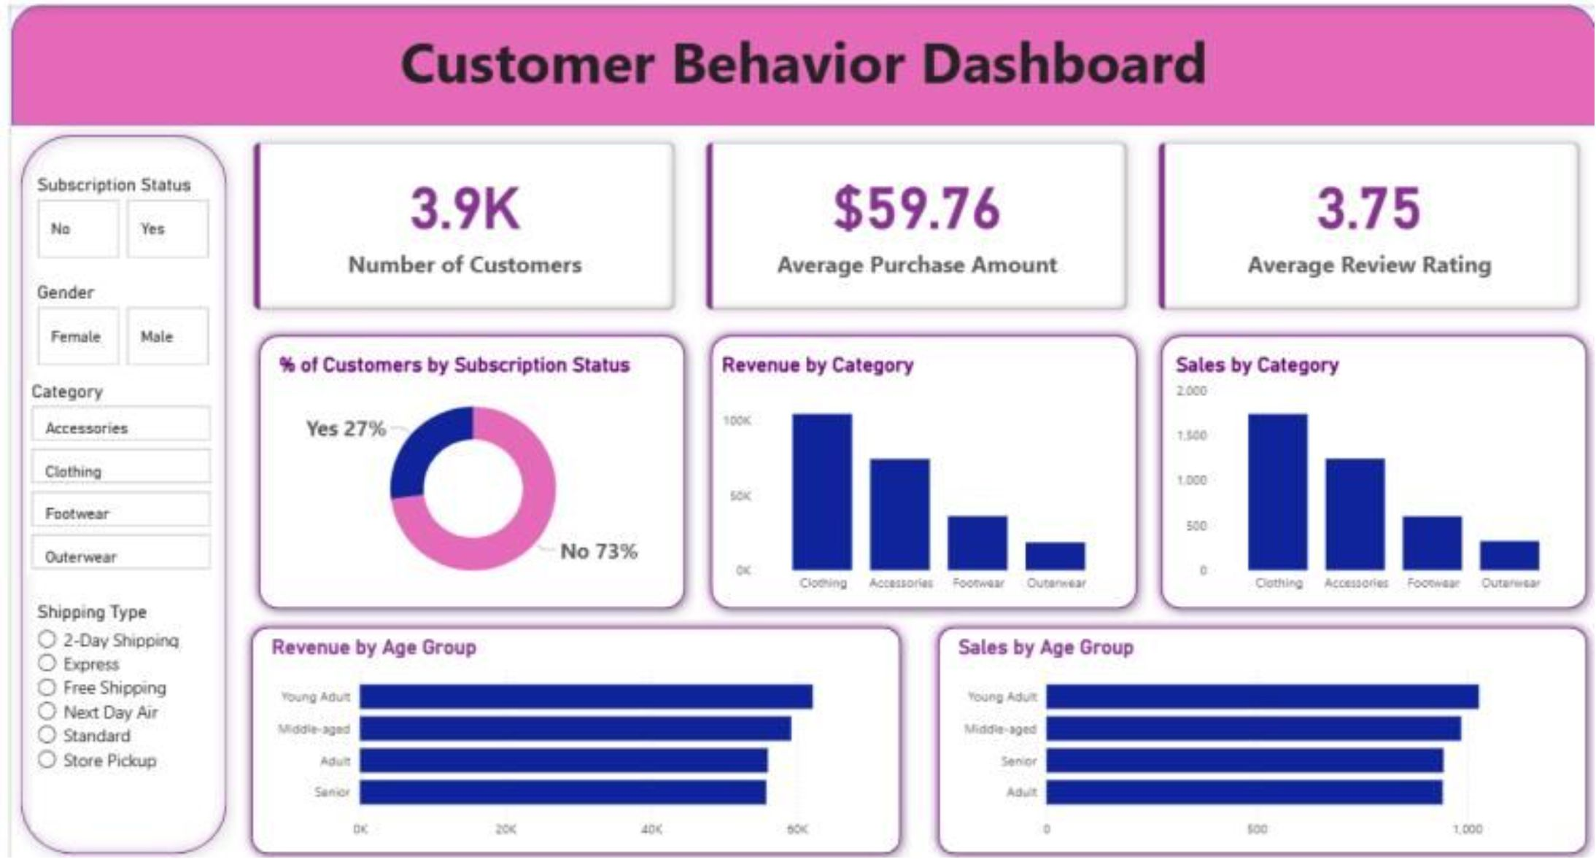
Dashboard & Recommendations
Boost Subscriptions
Promote exclusive subscriber benefits
Loyalty Programs
Reward repeat buyers to increase loyalty
Review Discounts
Adjust discount strategy to protect margins
Product Positioning
Promote top-rated & best-selling items
Targeted Marketing
Focus on high-revenue age groups and express-shipping users

