Slide 1

Moving Domestic Robotics Control Method Based on Creating and Sharing Maps with Shortest Path Findings and Obstacle Avoidance
Presented by –
Karan Bhakuni(M22RM003)
Soham Padhye(M22RM007)
IIT Jodhpur
Author: Kohei Arai
Graduate School of Science and Engineering Saga University Saga City, Japan

Slide 2
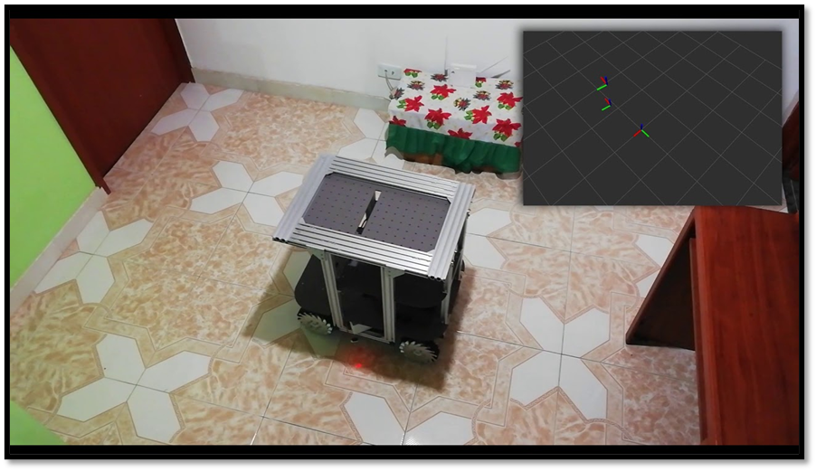

Agenda
Introduction and Application of mobile robot
Experiments on Path Planning and control of unicycle robot
Simulation on MATLAB

Slide 3
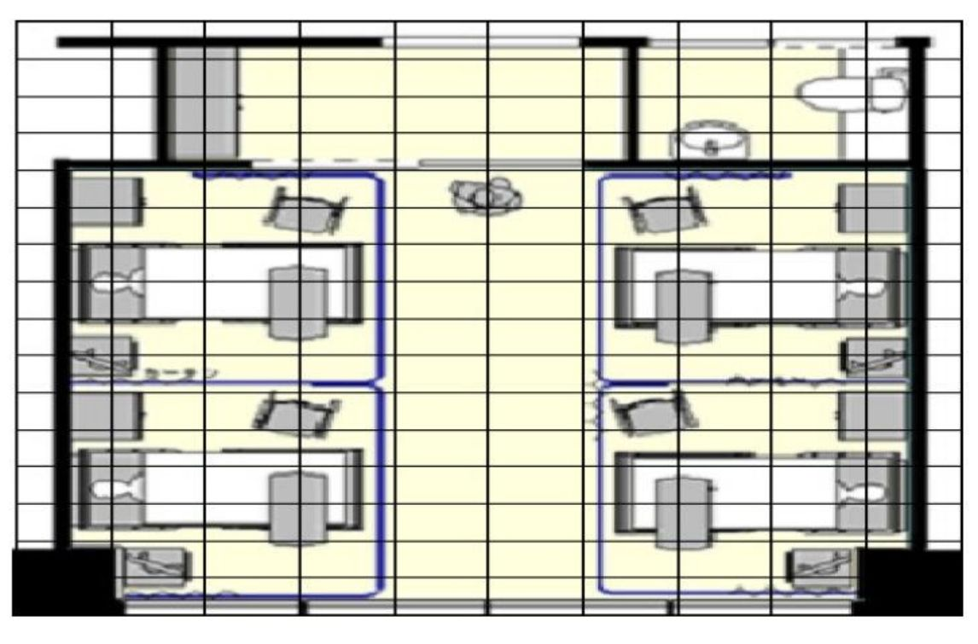
Abstract
Room Layout with mobile robot
This paper deals with the methods for obstacle avoidance, and finding a shortest pass based on Dijkstra algorithm.
Place Identifier: Places are identified by using identifiers placed outside the rooms.
A control method for moving robotic in closed areas is proposed.
The method is based on creating and sharing maps using shortest path techniques and obstacle avoidance.
The proposed method is validated through a simulation study.
The effect of map sharing among multiple robotics is confirmed.
The effectiveness of obstacle avoidance using cameras and ultrasonic sensors is also confirmed.

Slide 4
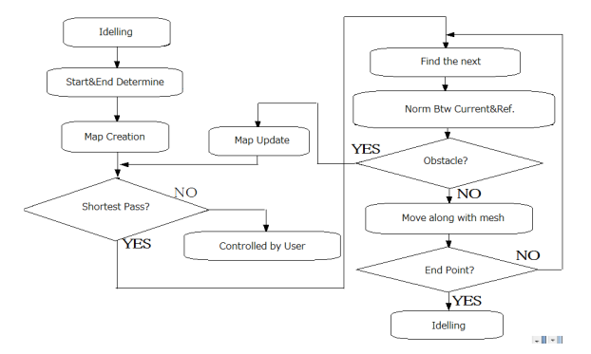
Process Flow of the Robot
Divided into four parts:
Finding Shortest Path.
Update according to obstacle.
Control the mobile robot.
Map update and sharing.
Reference: Research Paper

Slide 5
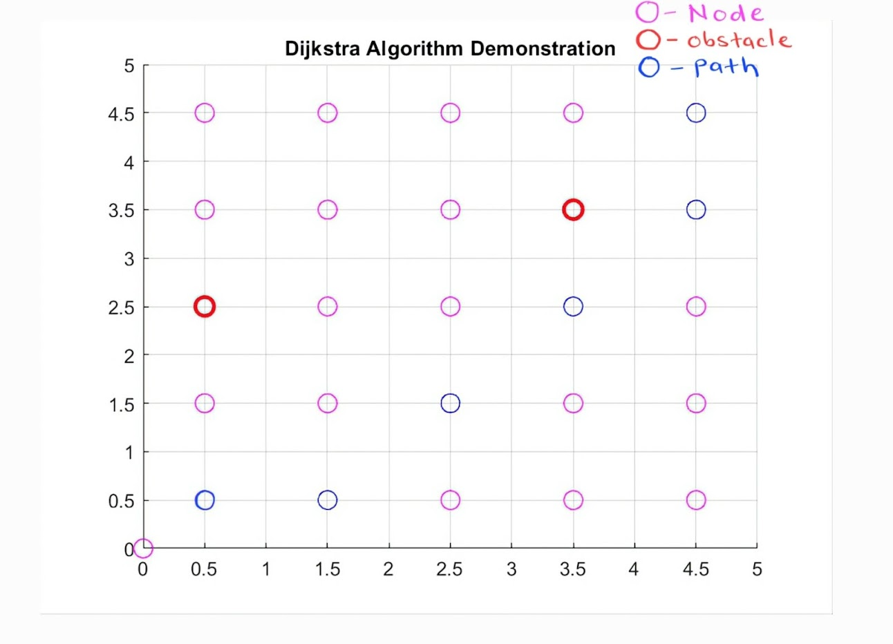
Dijkstra Algorithm for Shortest Path Finding between Start and Goal point
MATLAB Simulation Results
To find the shortest path between two points(initial and goal), Dijkstra Algorithm is used.
We can easily apply it where the nodes and distances between them are provided.
But how to use it in a room to traverse from one point to other with shortest distance?
To understand this we have done a simulation by dividing a room in 5x5 grid. This is similar to what is there in Research Paper.

Slide 6
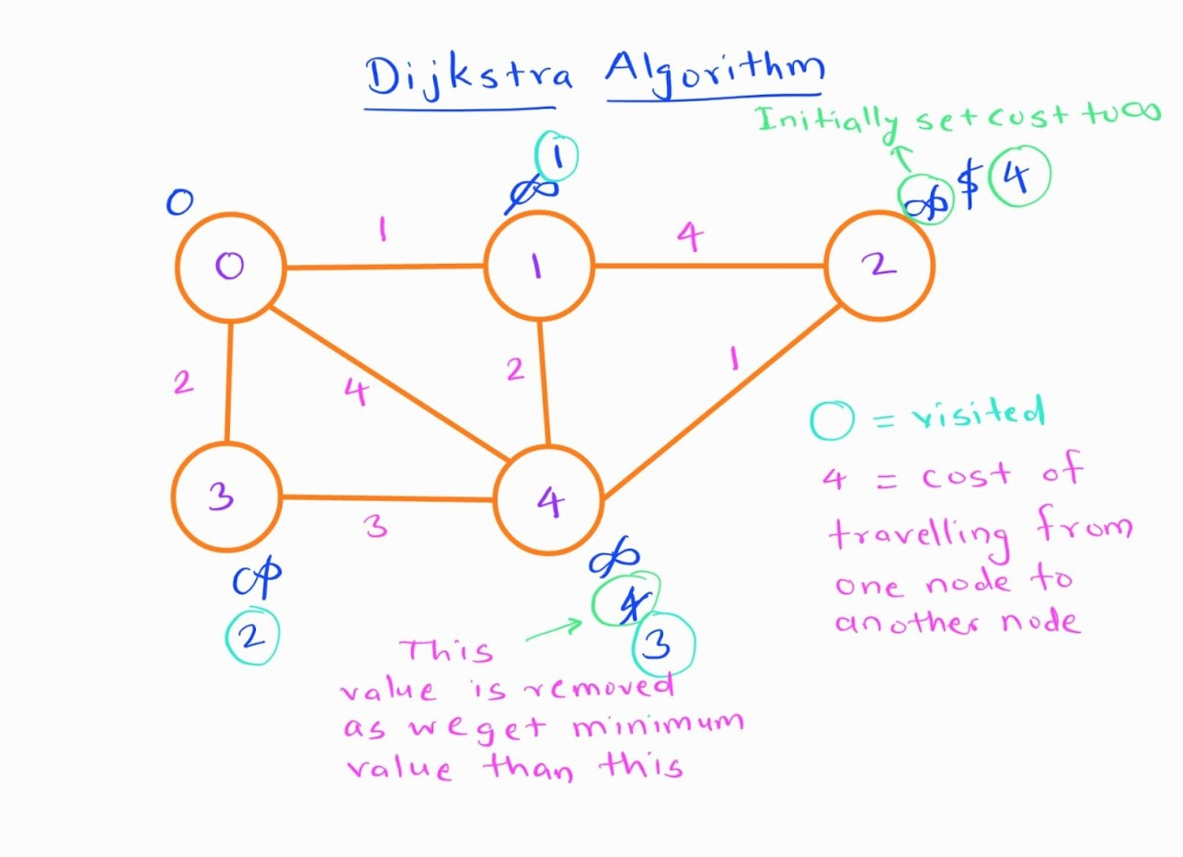
Steps for Dijkstra algorithm
Divide the room into a grid of cells, where each cell represents a valid location that can be reached without intersecting an obstacle.
Identify which cells are occupied by obstacles and mark them as unreachable.
Place the nodes of the graph at the centers of the cells that are reachable and free of obstacles.
Create edges between adjacent cells that are both reachable and not blocked by an obstacle.
Determine the weight of each edge, typically based on the distance between the two cells.
Construct the graph based on the nodes and edges created.
Find distance between any two nodes.
Start by selecting the node with the smallest distance from the start node.
Update the distances of its neighbors based on the edge weights.
Repeat steps 8-9 until the destination node is reached or all nodes have been explored.
Ensure that the chosen nodes accurately represent the reachable and obstacle-free locations in the room and that the edges reflect the cost of moving between them.
Solved the example shown in research paper and getting the same answer.

Slide 7
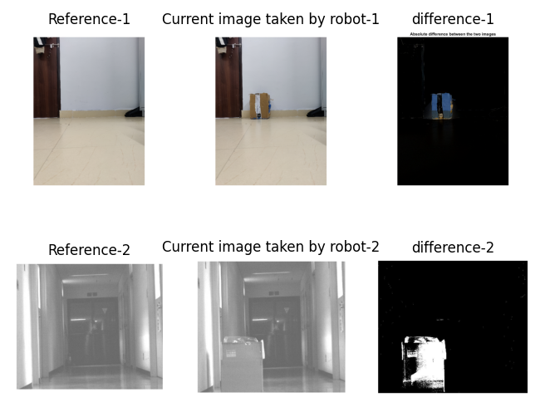
Norm of Images for Obstacle Detection
We have taken two images from same view point:
With Obstacle
Without Obstacle
After finding norm(difference) between the two images, we will detect the obstacle continuously as the robot moves in the space.
What if we take the images from two different viewpoints?
Norm of Images for Obstacle Avoidance

Slide 8
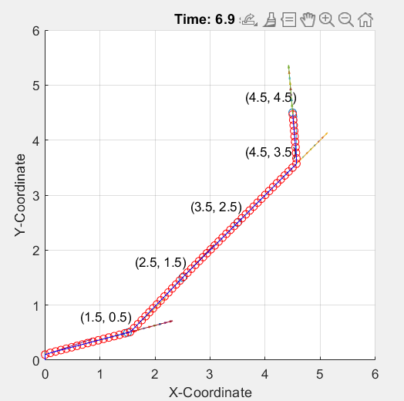
Control Algorithm
Simulation Result for K=10
1.We got the coordinate of points by applying Dijkstra algorithm.
2.Now using kinematics of unicycle robot we will control the robot to move through these points.
3. We tried to simulate the mobile robot to traverse through these points.
Now we will move to the MATLAB simulation and understand how this is working.

Slide 9
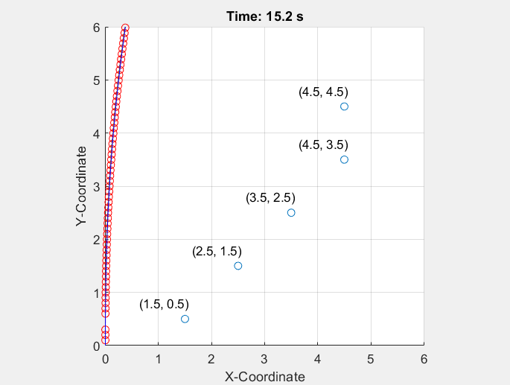
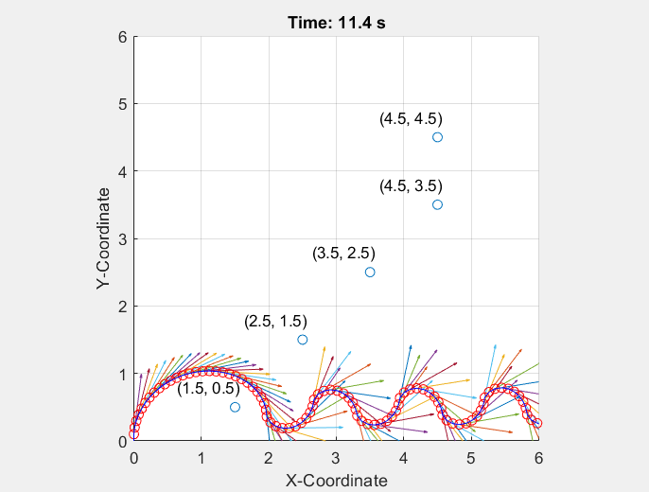
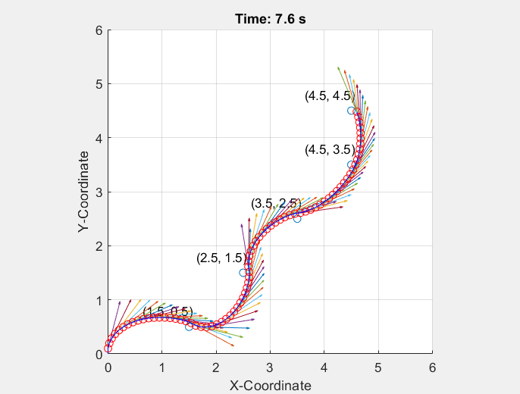
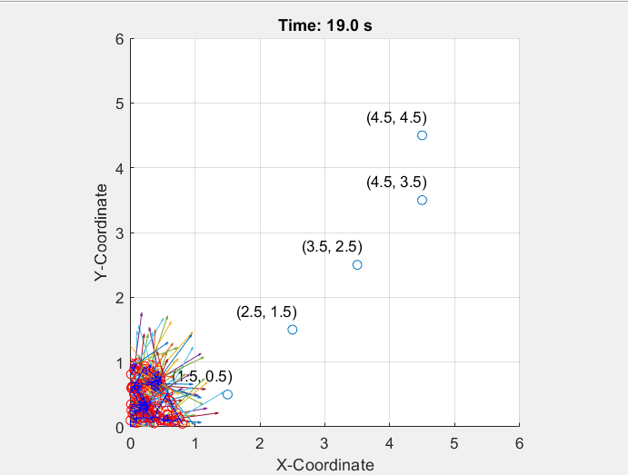
What happens if we change the value of K?
K=0.01
K=1
K=2
K=30

Slide 10
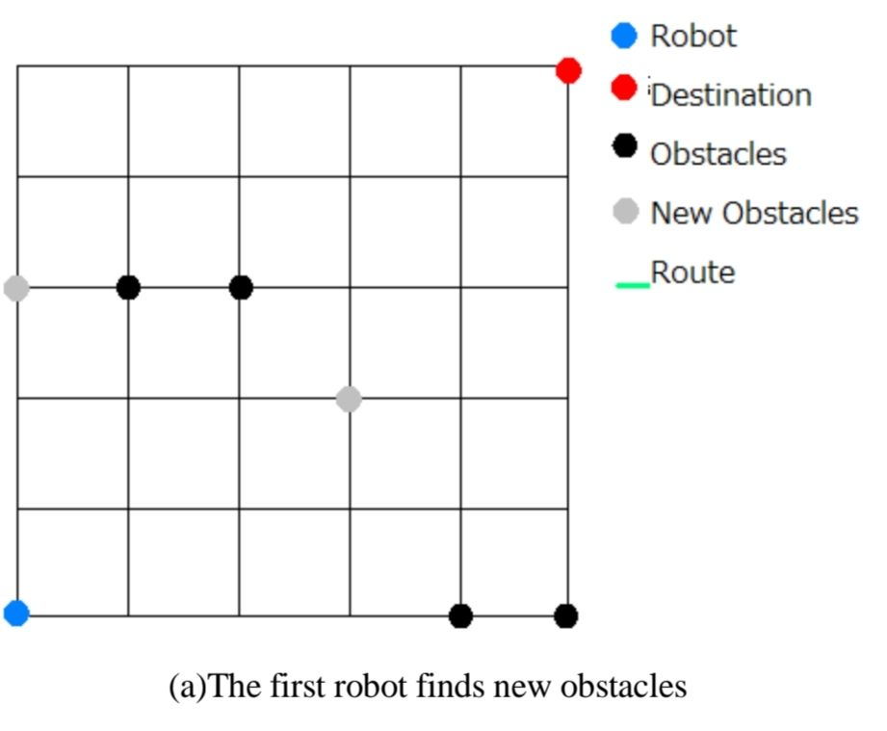
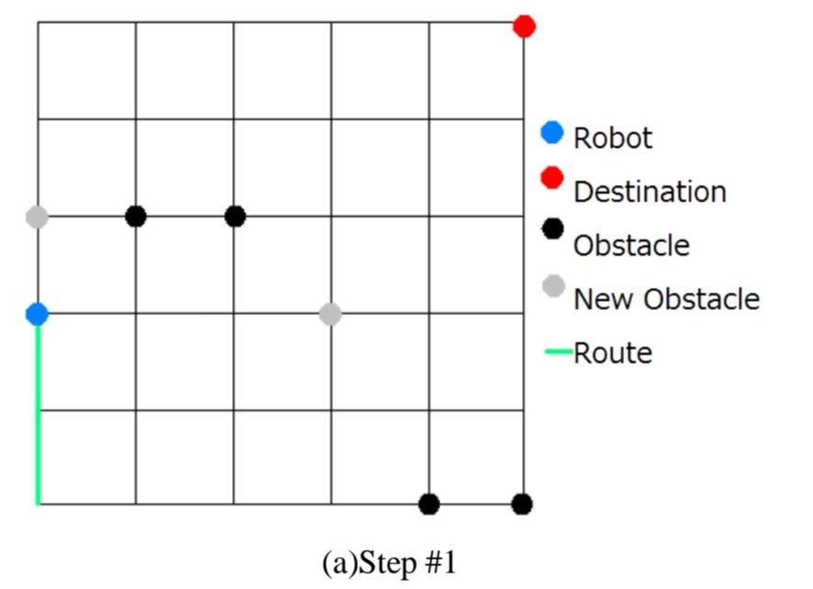
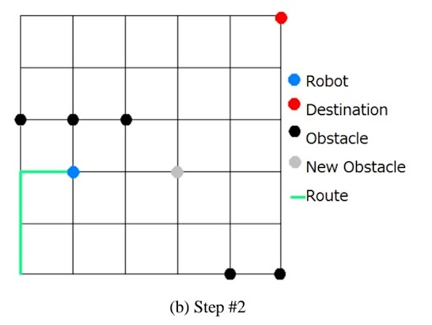
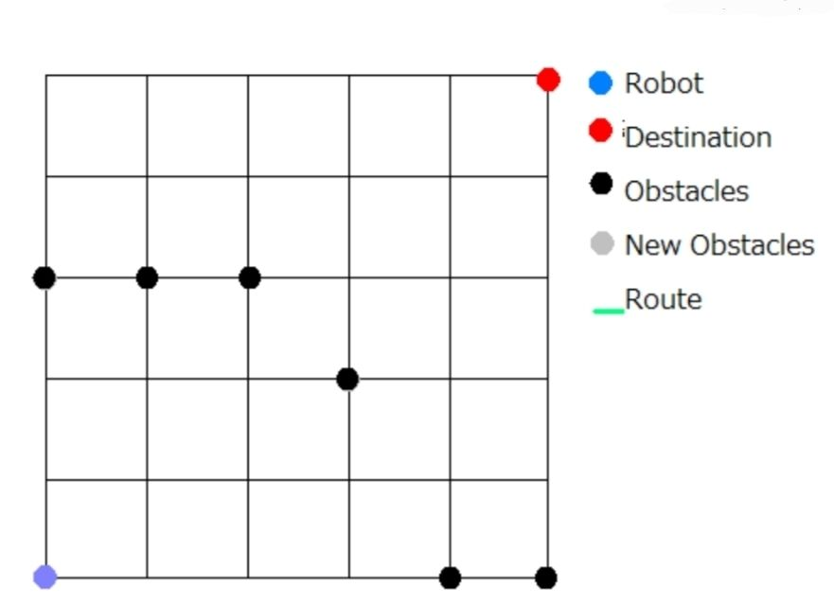
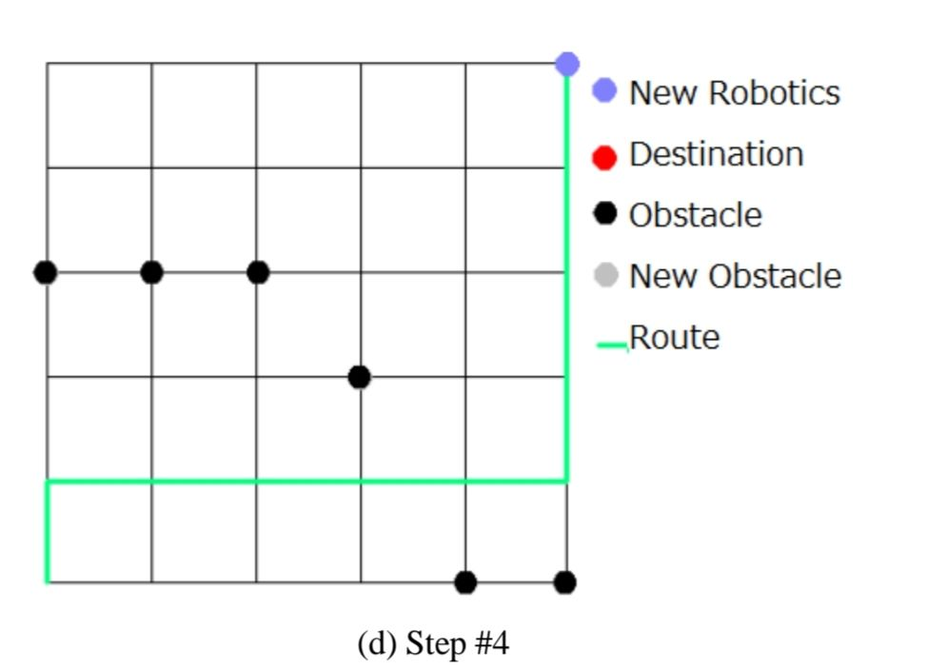
MAP SHARING
Above Three images shows the path followed by first robot.
It then updates the map and shared it with second robot.
Images on both sides shows that second robot has traversed the path easily.

Slide 11
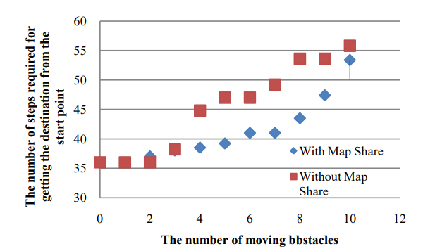
Map sharing
Map sharing is very helpful in case of multi robot system. As one robot encounters an obstacle it can update the map and share with others, such that other robots can plan the path efficiently.
The effect of the map sharing is saturated when number of moving obstacles crosses a certain threshold value.
What may be the possible reason for that?
Ref: Research Paper

Slide 12
Improvements and Future scope
We are unable to do the simulation of the MAP SHARING concept proposed in the research paper.
Also we have not tested/implemented obstacle avoidance using ultrasonic sensor.
Value for proportional gain is chosen by trial and error method.
We have developed only Proportional controller, we can go for more advanced controller like MPC .

Slide 13
Contribution
We both have done all parts of the project, but main contributions are
Karan-
Concept of Dijkstra algorithm and implementation in MATLAB
Obstacle finding using Norm images
Soham-
Control of unicycle robot and implementation in MATLAB
Map sharing algorithm explanation

Slide 14
THANK YOU

