Slide 1

Case Study on Prediction of Cancer Mortality Rates for US counties.
Karan Trehan
18BCS6033
18AITAIML-1 GROUP B

Slide 2
Problem Definition
Prediction of Cancer Mortality Rates for US Counties based on given dataset.
How it has to be performed :
To Identify the Features affecting TARGET_deathRate.
To create a Multi-Variate Linear Regression Model using Ordinary Least Squares Method that quantitatively relates TARGET_deathRate with given Features.
To know the Accuracy of the model, i.e. how well these variables can predict house prices.

Slide 3
Data Collection
The first and foremost step taken in the procedure was acquiring the Data.
It was acquired from the website, https://query.data.world/s/xlh353wvypzveoxm7h4u4c6hnucftk.
The Data contains information about Cancer Patients from different US Counties collected from numerous sources, namely the American Community Survey (census.gov), clinicaltrials.gov, and cancer.gov

Slide 4
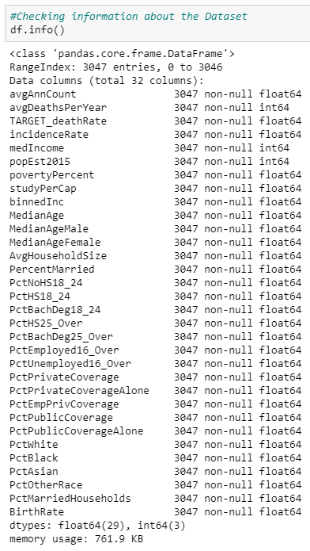
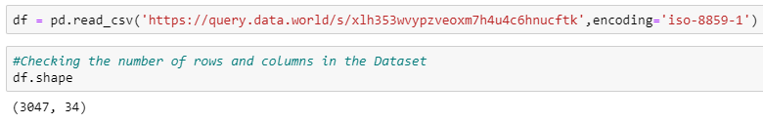
Basic Information on Dataset
We can infer that we have a Dataset having 94.11% of Numerical Data (32 Numeric Columns) and 5.89% of Categorical Data (2 Object Columns)
Also, we have 3047 records, i.e. information from 3047 US Counties
Plus the Dataset contains some Missing Values for certain Features.

Slide 5
Data Cleaning
Feature ‘binnedInc’ contained numeric value as a String, for example : ‘(61494.5, 125635]’
All the values in this form were converted to Numeric form by removing ‘(‘ , ‘[‘ , ‘]’ from the string and the averaging the two values (i.e the Upper Bound and the Lower Bound).
Feature ‘Geography’ had 3047 unique values of string type, since it would have been redundant to create 3046 Dummy Variables, this feature was dropped.

Slide 6
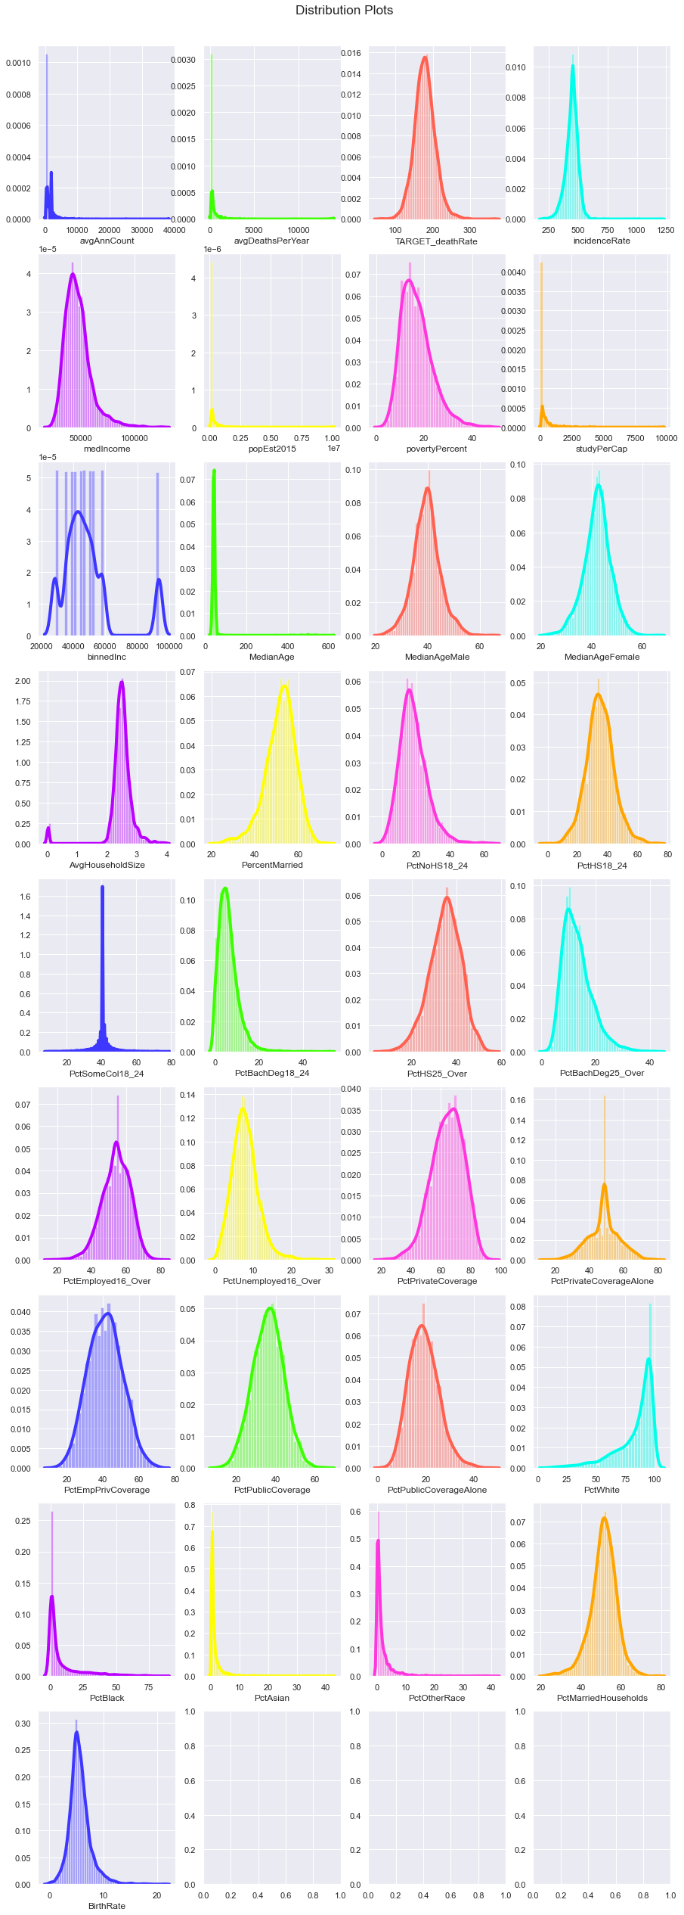
Data Exploration and Visualization
Univariate Analysis :
Distribution Plots: Firstly, we plotted the Distribution Graphs of all the Features to check their normal behaviour.

Slide 7
Inferences :
Many Features were found to be Skewed, they will be needing treatment later on.

Slide 8
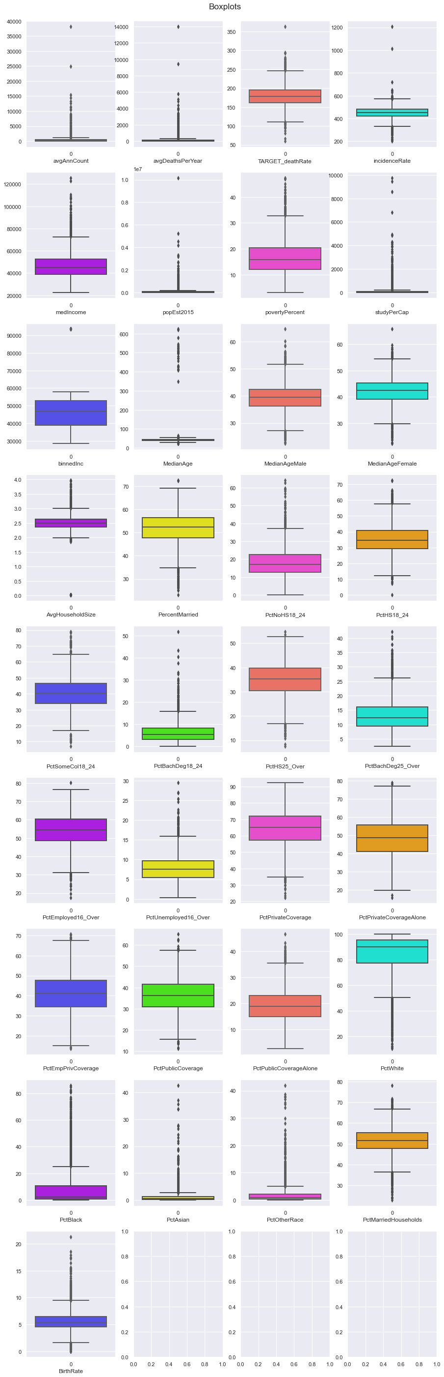
Box Plots: Then we plotted the Boxplot Graphs of all the Features to check the presence of Outliers.

Slide 9
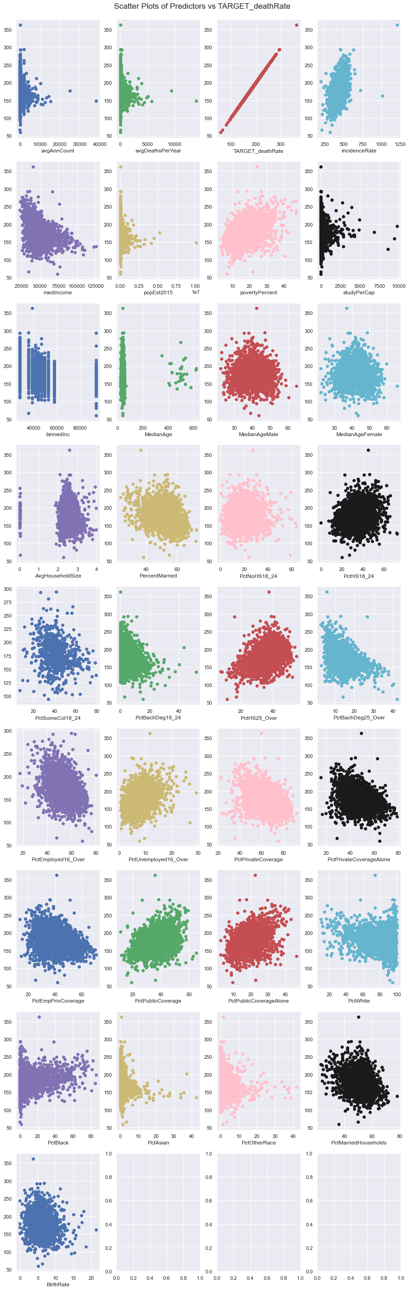
Inferences :
Many Features were found to have Outliers. Even the Target variable has Outliers
Bivariate Analysis :
Scatter Plots: Graphs were plotted between predictor variables and Target Variable to see if any pattern exists.

Slide 10
Inferences :
No Feature was found to be Highly Correlated

Slide 11
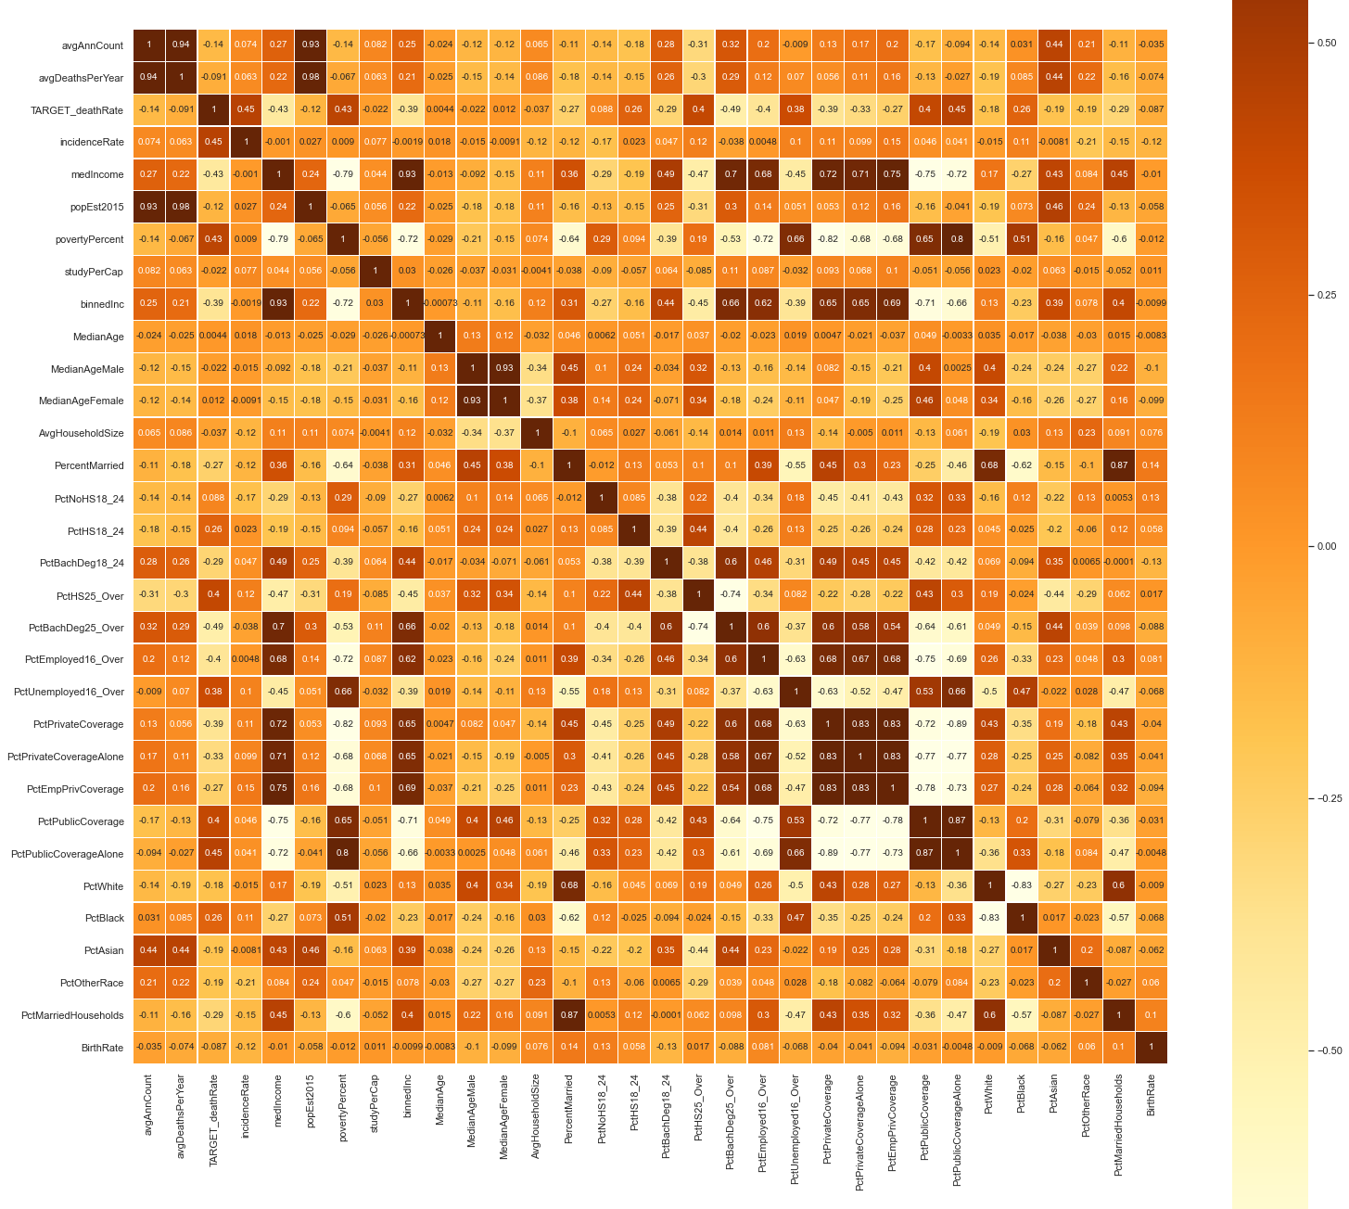
Correlation Map : To find correlation among Features and Target Variable
Inferences :
Many Features were found to have High Correlation amongst them signifying that the Data has High Multicollinearity.

Slide 12
Data Preparation and Pre-processing
Duplicate values were checked, none was found.
Features with Missing Values of more than 74% was dropped, namely ‘PctSomeCol18_24’
The other two columns, namely ‘PctEmployed16_Over’ and ‘PctPrivateCoverageAlone’ were imputed by their Median Values

Slide 13
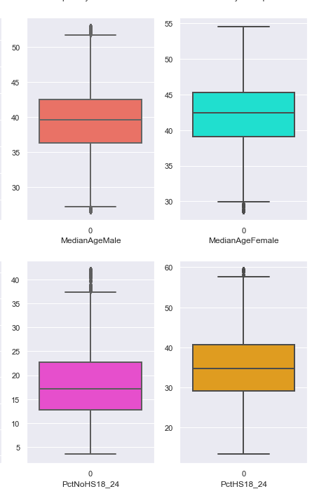
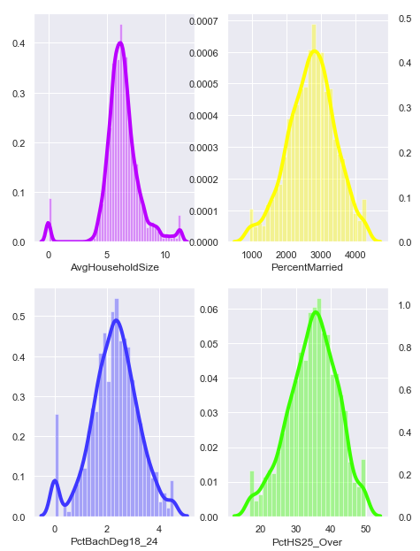
Outlier Treatment and Skewness Removal
Outliers were capped and Skewed Variables were transformed

Slide 14
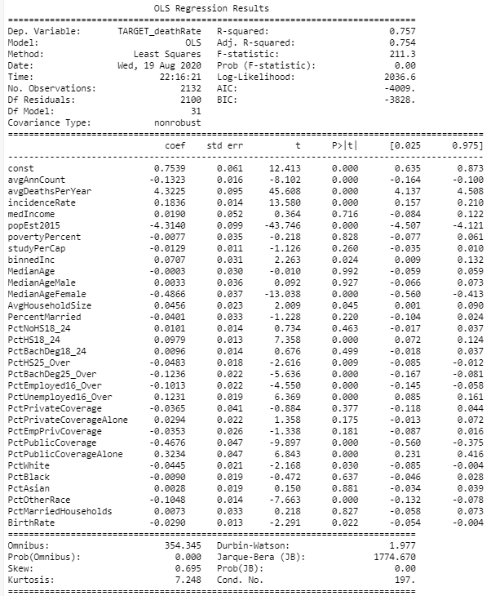
Model Building
Firstly the Dataset was split into Training and Testing Data and then the first model was built.
Model-1 : All Features

Slide 15
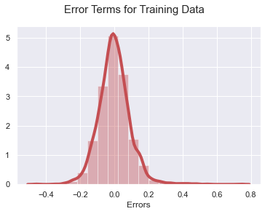
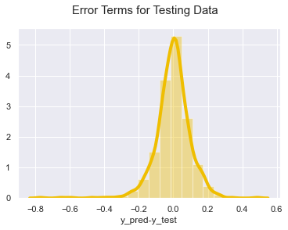
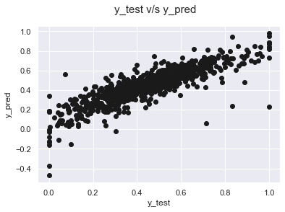
Inferences :
y_test v/s y_pred graph seems to have linear relationship
Inferences :
Model 1 may have High Multicollinearity and maybe Overfitted

Slide 16
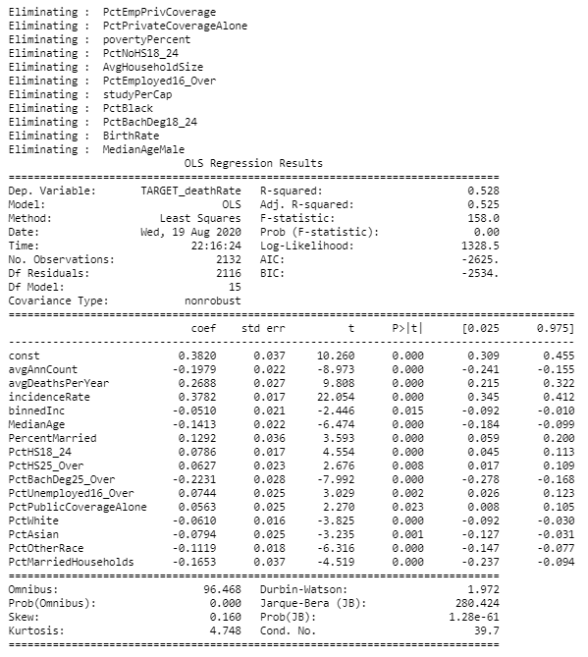
Model-2: Checking for High VIF values and Insignificant Features and performing Backward Elimination in OLS Model

Slide 17
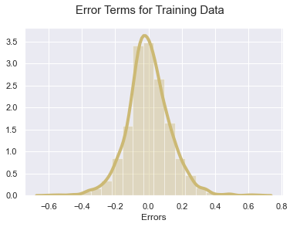
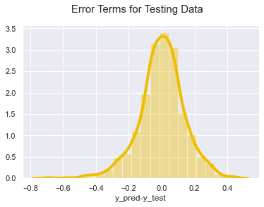
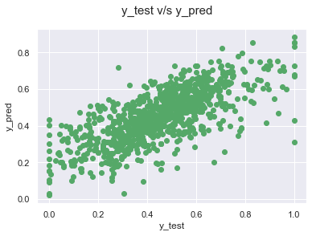
Inferences :
y_test v/s y_pred graph seems to have scattered relationship
Inferences :
Model 2 is a good fit model

Slide 18
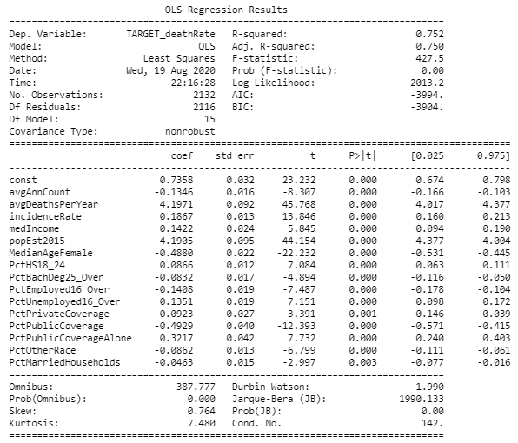
Model-3: Using Recursive Feature Elimination for Feature Selection and Model Building

Slide 19
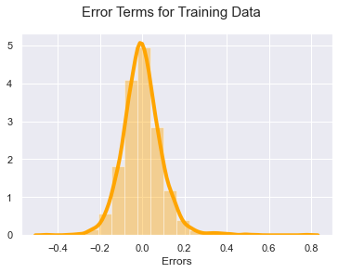
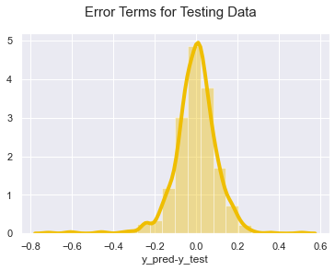
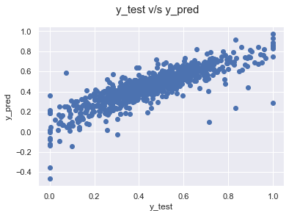
Inferences :
y_test v/s y_pred graph seems to have linear relationship.
Inferences :
Model 3 may have Multicollinearity and may also be Overfitted

Slide 20
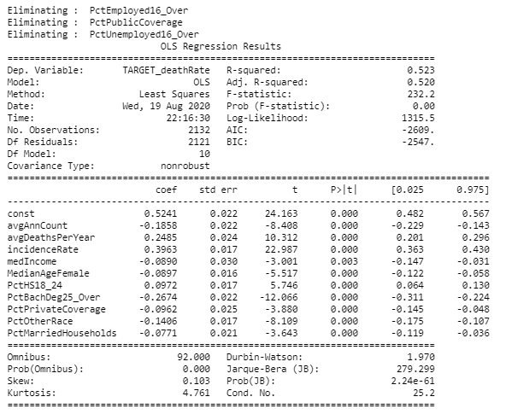
Model-4: Removing High VIF and High P valued Columns from Model-3, RFE Model

Slide 21
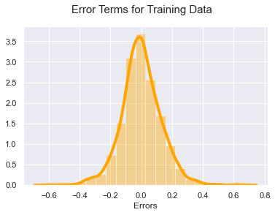
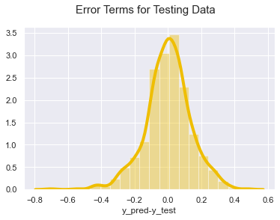
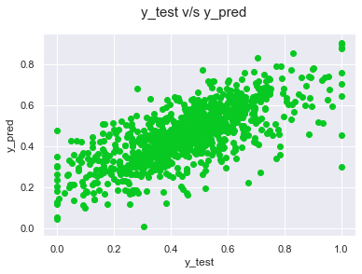
Inferences :
y_test v/s y_pred graph seems to have scattered relationship
Inferences :
Model 4 is the best fit model

Slide 22
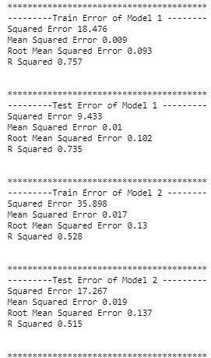
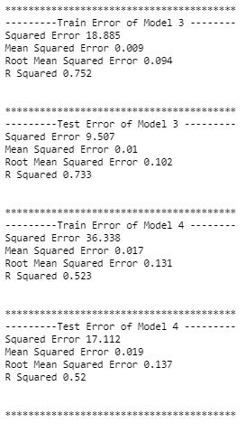
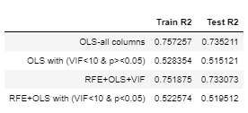
Best Model Selection
Comparing the Errors and Adjusted R² Of all the Models

Slide 23
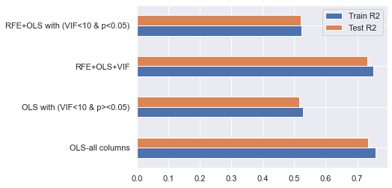
We can finally observe that Model-1 and Model-3 have high Adjusted R2 values for both Test and Train Data but we will not choose them because:
Model 1 contains all the Columns and has high Multicollinearity
Model 3 contains half the Columns but still has high Multicollinearity.
Also there is a possibility that both of these have been overfitted as the y_test vs y_pred graph follows a Linear Relationship and is not Spread all over as it should have.
We can choose any one of Model-2 and Model-4 because they both have a better spread in the y_test vs y_pred graph and they both don't have Multicollinearity or any Insignificant Features

Slide 24
Equation of Model - 2
TARGET_deathRate = const * 0.382 + avgAnnCount * -0.198 + avgDeathsPerYear * 0.269 + incidenceRate * 0.378 + binnedInc * -0.051 + MedianAge * -0.141 + PercentMarried * 0.129 + PctHS18_24 * 0.079 + PctHS25_Over * 0.063 + PctBachDeg25_Over * -0.223 + PctUnemployed16_Over * 0.074 + PctPublicCoverageAlone * 0.056 + PctWhite * -0.061 + PctAsian * -0.079 + PctOtherRace * -0.112 + PctMarriedHouseholds * -0.165

Slide 25
Equation of Model - 4
TARGET_deathRate = const * 0.524 + avgAnnCount * -0.186 + avgDeathsPerYear * 0.248 + incidenceRate * 0.396 + medIncome * -0.089 + MedianAgeFemale * -0.09 + PctHS18_24 * 0.097 + PctBachDeg25_Over * -0.267 + PctPrivateCoverage * -0.096 + PctOtherRace * -0.141 + PctMarriedHouseholds * -0.077
I'll personally choose Model 4 because it has the fewest yet most efficient predictor variables.

Slide 26
THANK YOU!

