Slide 1
Mutual Funds Analytics: A Comprehensive Data Platform
End-to-End ETL, Quantitative Modeling, and Interactive Visualization
Karan Veer Singh
[LinkedIn Profile] | [GitHub Repository] | [Live Project]

Slide 2
Executive Summary
Transforming raw financial data into actionable investment intelligence.
The Challenge: Retail investors lack institutional-grade analytics to evaluate Indian mutual funds.
The Solution: An automated ETL pipeline and interactive dashboard offering deep risk-return analysis.
Key Capabilities:
Automated daily NAV ingestion via AMFI.
Factor-weighted scoring models (Alpha, Sharpe, Drawdown).
Advanced quantitative projections (Monte Carlo, Markowitz).
Business Impact: Empowers data-driven portfolio allocation and identifies at-risk investor segments.

Slide 3
The Market Opportunity
The Indian Mutual Fund industry is experiencing exponential growth, demanding sophisticated tracking.
AUM Surge: Industry AUM has crossed massive milestones, driven by retail participation.
The SIP Revolution: Systematic Investment Plans (SIP) form the backbone of retail inflows.
Data Fragmentation: Despite the growth, performance data remains scattered across multiple AMC domains and regulatory bodies.
Need for Centralization: A unified data warehouse is critical for comparative analysis across 40+ bluechip and midcap schemes.

Slide 4
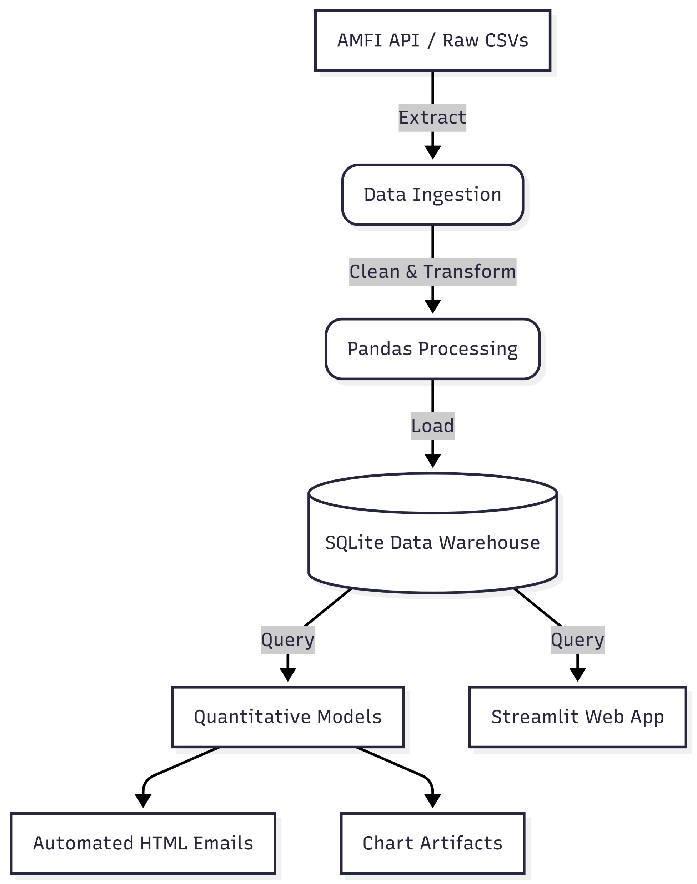
Architecture & Technology Stack
A robust, automated, and scalable Python-based data infrastructure.
Languages & Core: Python, SQL
ETL & Processing: Pandas, NumPy, SQLite3, Schedule
Visualization: Plotly, Seaborn, Matplotlib, Streamlit
Automation: Windows Batch scripting, Smtplib (HTML Emails)

Slide 5
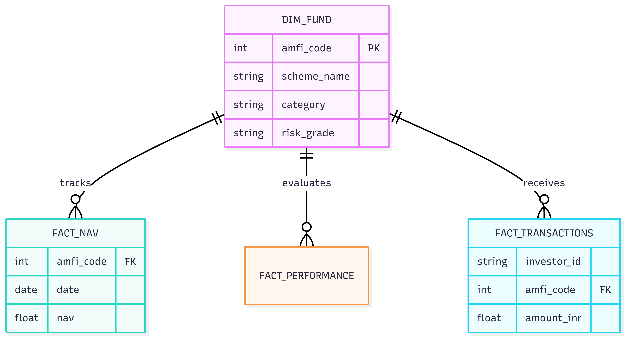
Data Modeling & Schema
A normalized Star Schema designed for high-performance analytical queries.

Slide 6
Core Analytics - Risk vs. Return
Moving beyond simple CAGR to true risk-adjusted performance evaluation.
Sharpe Ratio Calculation: Measuring excess return per unit of volatility.
Alpha & Beta: Tracking fund manager skill against benchmark indices (Nifty 50, Nifty Midcap 150).
Maximum Drawdown: Stress-testing funds by evaluating historical peak-to-trough declines.
The Bluestock Composite Score: A proprietary 0-100 ranking system weighting returns against expense ratios and risk metrics.

Slide 7
Investor Behavioral Analytics
Decoding retail transaction patterns to optimize client retention.
Geographic Distribution: Identifying high-growth Tier 2 and Tier 3 cities driving AUM expansion.
Cohort Analysis: Grouping investors by acquisition year to track lifetime value and average ticket size.
SIP Continuity Flagging:
Algorithmic detection of "at-risk" investors.
Flags accounts with inter-transaction gaps exceeding 35 days.

Slide 8
Advanced Modeling - Monte Carlo Simulations
Key Message: Projecting future NAVs utilizing Geometric Brownian Motion.
Methodology:
Extracted historical daily log returns, drift, and volatility.
Simulated 1,000 unique market paths spanning 1,260 trading days (5 years).
Outputs:
Uncertainty bands at the 5th, 50th, and 95th percentiles.
Allows risk-averse investors to visualize "worst-case" scenario baselines.

Slide 9
Modern Portfolio Theory (Markowitz)
Key Message: Mathematically optimizing asset allocation across a diversified basket of funds.
The Approach: Simulated 10,000 distinct portfolio weightings across Large Cap, Mid Cap, Small Cap, and Debt funds.
Efficient Frontier Construction: Plotted Expected Risk against Expected Return.
Key Deliverables:
Identified the absolute Maximum Sharpe Ratio portfolio.
Identified the Minimum Volatility portfolio for conservative clients.

Slide 10
The Streamlit Interactive Dashboard
Delivering the analytics engine directly to the user through a premium interface.
Apple-Inspired Aesthetics: Clean layout, Sans-Serif typography, and minimalist metrics.
Dynamic Filtering: Real-time cross-filtering by AMC and Fund Category.
Key Modules:
Macro Industry Overview
Fund Performance Scatter Plots
Investor Demographics Breakdown
Systematic Investment (SIP) Trends

Slide 11
Pipeline Automation & Reporting
A zero-touch operational ecosystem.
Daemonized Scheduling: ETL pipeline programmed to auto-execute via Python schedulers.
HTML Email Engine:
Automatically parses the top 5 funds from the newest Composite Scorecard.
Generates a styled HTML newsletter.
Transmits silently via SMTP for weekly stakeholder updates.

Slide 12
Business Value & Strategic Impact
How this platform serves stakeholders.
For Retail Investors: Democratizes access to institutional metrics like Alpha, Beta, and Efficient Frontiers.
For AMCs / Brokers: Predicts churn via SIP continuity analysis and highlights geographic hotspots.
For Fund Analysts: Fully automates the tedious daily task of NAV data cleaning and benchmark alignment.

Slide 13
Technical Challenges Conquered
Overcoming real-world data engineering hurdles.
Missing Weekend NAVs: Solved using forward-fill algorithms to ensure accurate daily compounding.
Column Naming Collisions: Resolved `_x` and `_y` merge conflicts through strict schema definitions.
Headless Matplotlib Generation: Engineered the pipeline to use non-interactive backends to prevent GUI crashes during automated cron execution.

Slide 14
Conclusion & Future Scope
A highly capable V1 platform with room to scale.
Current State: A fully functioning, end-to-end Python financial data product.
Future Scope:
Cloud migration (AWS RDS for database, Lambda for ETL).
Integration of predictive Machine Learning models for NAV forecasting.
Live order execution APIs via broker gateways.

Slide 15
Q&A
Thank You
Developer: Karan Veer Singh
Repository: [github.com/karanveersingh05/MutualFundsAnalytics]
LinkedIn: [linkedin.com/in/karanveersingh05]
Live Project Streamlit.app
Open for Questions.

