Slide 1
Restaurants Ratings KM Team

Slide 2
Outline
Problem Definition
Why it is Important
Data Exploration & Statistical Analysis
Business Statistical Insights
Approach
Limitations
Further Work

Slide 3

Problem Definition
Building a model to predict users’ ratings for restaurants given:
User Id
Restaurant Id
Discounted (Boolean)
Restaurant Area
Restaurant Offered Cuisines (List)
Restaurant Features (List)
Notes:
user_uuid - an anonymous id unique to a given user
restaurant_uuid - an anonymous id unique to a given Restaurant
discounted - 1 if user had discounts upon past ordering
area - Area where Restaurant is located
cuisine - Tag of Food provided by the Restaurant
restaurant_features - Features of a given Restaurant

Slide 4

Why it is Important
Building a Recommendation System
Making Business Decisions
Providing Improvement Suggestions for Business Owners
Notes:
Drawing Useful Insights (for both the company and the restaurants)

Slide 5



Data Exploration & Statistical Analysis
Number of unique restaurants = 493
Number of unique users = 34235
Data Description
Combining Data Features
Cuisines
Area
Restaurant Features
Notes:
Drawing Useful Insights (for both the company and the restaurants)

Slide 6
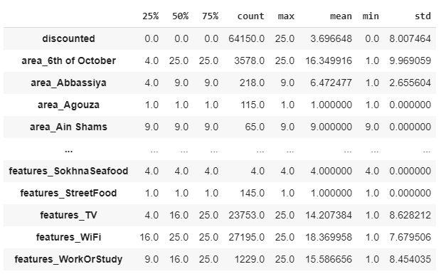
Data Exploration & Statistical Analysis
Notes:
Drawing Useful Insights (for both the company and the restaurants)

Slide 7
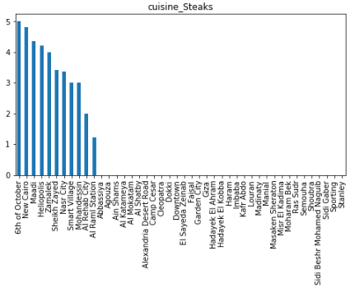
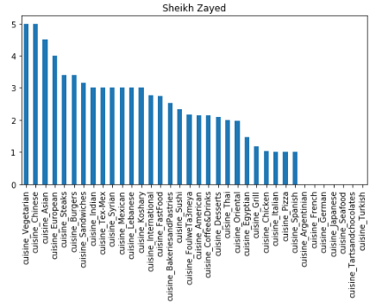
Data Exploration & Statistical Analysis
Notes:
Drawing Useful Insights (for both the company and the restaurants)

Slide 8
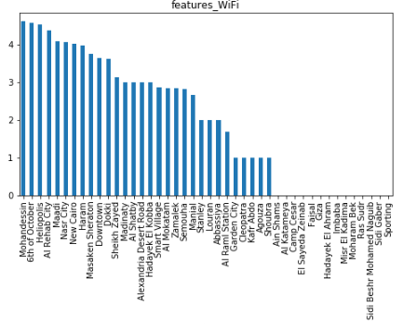
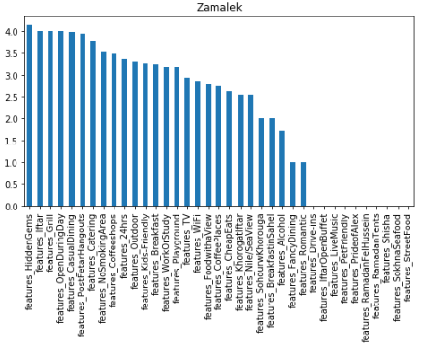
Data Exploration & Statistical Analysis
Notes:
Drawing Useful Insights (for both the company and the restaurants)

Slide 9
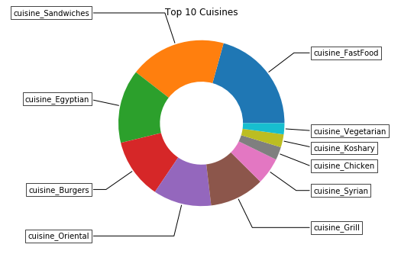
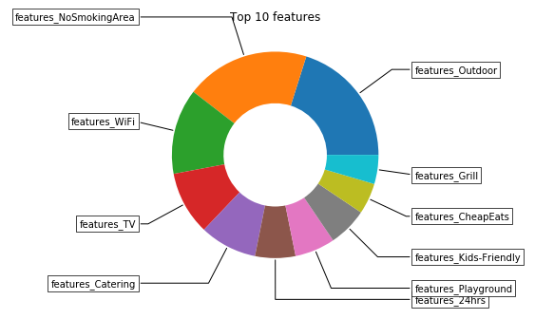
Business Statistical Insights
Notes:
Drawing Useful Insights (for both the company and the restaurants)

Slide 10

Approach
Data Cleaning
Data Analysis
Feature Engineering
Machine Learning Models (using scikit-learn library)

Slide 11
Data Cleaning
Cuisines and features string lists to list data structure
Eliminating Special Characters
Filling null values

Slide 12
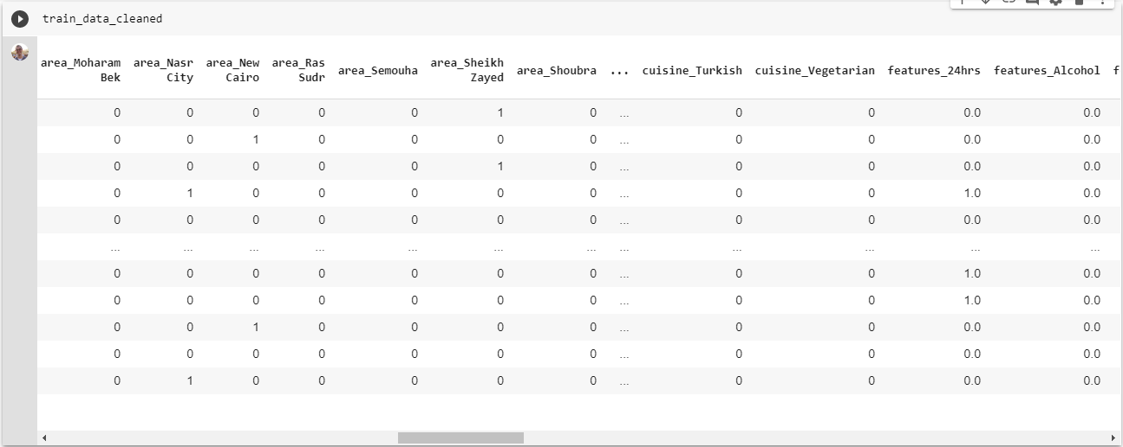
Feature Engineering
Notes:
(one hot encoding, numerical values)

Slide 13
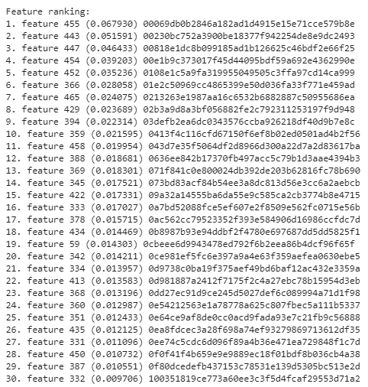
Feature Engineering
Feature Importance:
Using ExtraTreesClassifier
F1 Score: 0.997693
Notes:
(Opening hours, Price level, ..etc) AND users’ personal data
(restrictions to include user’s ids)

Slide 14
Machine Learning Models
Including Restaurant ID
(MLP)
0.999141
Excluding Restaurant ID
(MLP)
0.997139
Notes:
#mlp without restId: 0.9971393554366641
mlp with restId: 0.9991412771653729

Slide 15
Machine Learning Models
Gradient Boosting Classifier (GBC) | 0.884926
Support Vector Classification (SVC) | 0.995441
K-Nearest Neighbors (KNN) | 0.996320
Random Forest Classifier (RF) | 0.997139
Multi-Layer Perceptron (MLP) | 0.999141
MLP (3 Layers) | 0.999189
MLP (2 Layers) | 0.999064
Pipeline (Feature Selection , RF) | 0.999189
MLP (1 Layer = 308) | 0.999313
Notes:
gbc: 0.8849262570339861
svc: 0.9954410759680231
knn: 0.9963200335728487
#mlp 308 sgd: 0.9969430577708414
random forest classifier: 0.9971393554366641
#mlp without restId: 0.9971393554366641
mlp with restId: 0.9991412771653729
mlp 462, 308, 154: 0.99918911
mlp 406, 203: 0.9990643
pipeline :0.9991891861161399
mlp 308 :0.999313886983954

Slide 16
Limitations
Dataset Size
Features Variations
Random Fluctuations in Food Quality at the Restaurant Handling (Outliers)
Notes:
(Opening hours, Price level, ..etc) AND users’ personal data
(restrictions to include user’s ids)

Slide 17

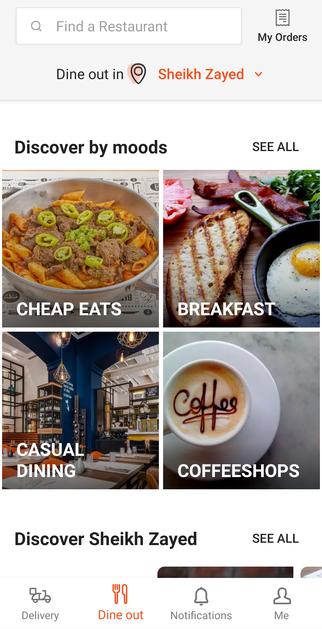
Further Work
Users’ Personal Information
Users’ Reviews (NLP, Sentiment Analysis)
Gathering More Data (Taste, Waiting Time, Servers, ..etc)
Larger Dataset (Retrain & Apply Content Based and Collaborative Filtering )
Notes:
Users’ Personal Information (Age, Gender, Location, History, Payment Method, Delivery/Dine Out, ..etc)
Users’ Reviews (NLP, Sentiment Analysis for ratings validation, correlations between hidden aspects in reviews and numeric ratings, discover hidden aspects and to suggest improvements

Slide 18
References
Gao, Yifan, et al. “A Restaurant Recommendation System by Analyzing Ratings and Aspects in Reviews.” Database Systems for Advanced Applications Lecture Notes in Computer Science, 2015, pp. 526–530., doi:10.1007/978-3-319-18123-3_33.
Guo Yiwen, et al. “Predicting Restaurants’ Rating And Popularity Based On Yelp Dataset ” Department of Economics, Stanford University, 2017
Srivats, Anmol. “Recommending Restaurants: Collaborative Filtering and Model Stacking Using Deep Learning.” Medium. Towards Data Science, July 9, 2019. https://towardsdatascience.com/recommending-restaurants-collaborative-filtering-and-model-stacking-using-deep-learning-70cbac0f8e89.

Slide 19
Thank You!

