Slide 1
OIP
Overview

Slide 2
Background Information

Slide 3
OIP sprung from the idea that data needs to be captured from an Excel spreadsheet to a SharePoint site collection. The data represents inspections coordinated by target stackholders on their units and organizations. The data represents a three-dimensional view that will be captured on a SharePoint 2010 calendar, document libraries, and lists.

Slide 4
Abstraction (User Interface Will Represent Abstraction at this Development Stage)

Slide 5
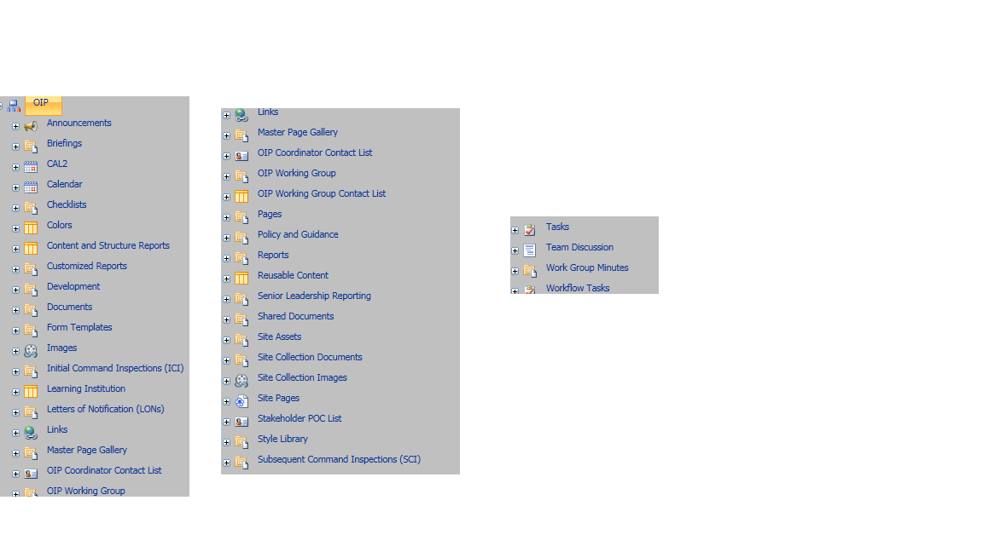

Slide 6
Requirements Gathering (Main Points After Visualization)
Capture three-dimensional data on SharePoint 2010 calendar.
Implement document library hierarchy and structure.
Implement permission set.
Implement calendar color coding.
Use incremental requirements gathering based on customer needs(Agile Approach).

Slide 7
Visualization
Customer understands product and views/approves product versions using communication and visualization.

Slide 8
Demo

Slide 9
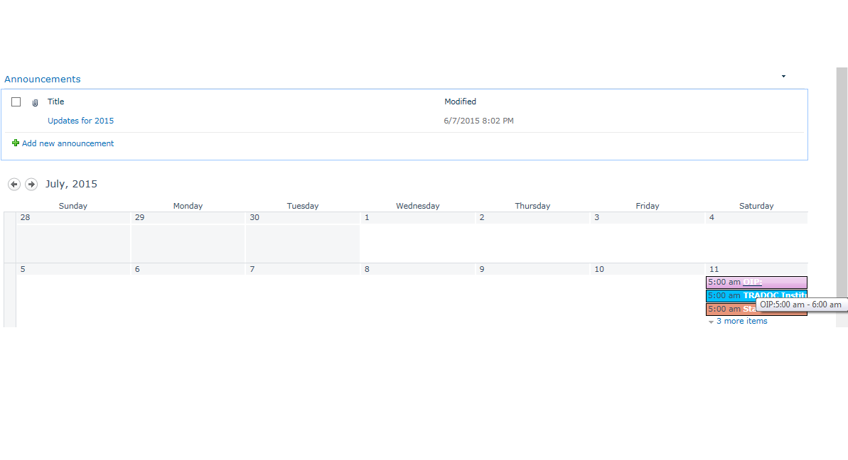
Color Coding Calendar webpart using
SharePoint Client Side Object Model via JavaScript(Look and Feel).
https://hq.tradoc.army.mil/sites/OIP/Pages/Calendar.aspx

Slide 10
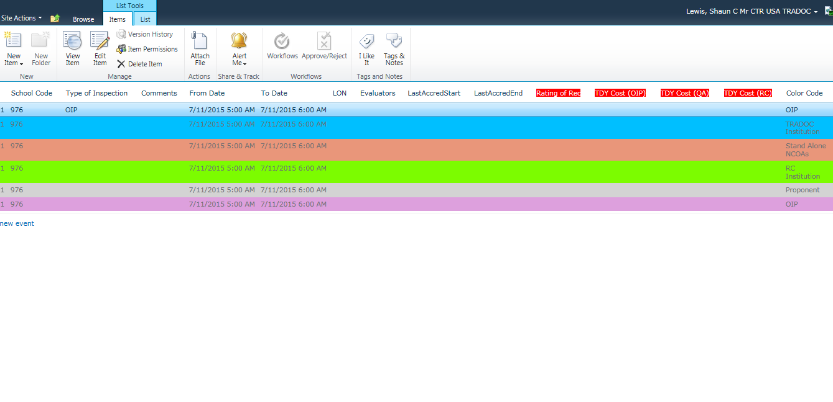
Calendar personal/list view using SharePoint Client Side Object Model
JavaScript and core CSS for the red labels(Look and Feel).

Slide 11
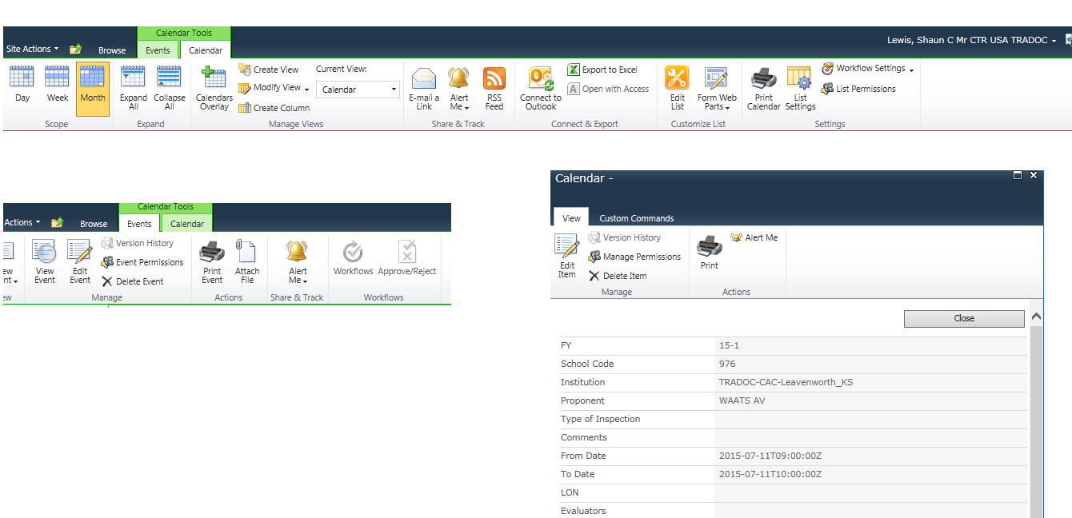
Improved printing options and capability for calendar:
Calendar Ribbon(Far Top),
Events[Display View](Above),
Item View(Left)
Printing enhance implemented using SharePoint Designer.

