Slide 1

EDA Project King County Real estate (Buyer case)
E. Karçahan Eldeş

Slide 2

Outlıne
Introduction
Data Source
Client and Requests
Research Questions and Hypotheses
Methodology
Visualizations (Feature vs. Price)
RQ1 (Bathrooms)
RQ2 (Living Space)
RQ3 (Golf Court)
RQ4 (Historic)
Recommendations
Q&A
Resources

Slide 3
Introduction
The real estate industry is one of the major parts of economy in any country and buying or selling houses is a significant commitment (or source of income) for many.
Therefore, accurate and realistic predictions play a crucial role in the process of making an informed decision while buying or selling.

Slide 4
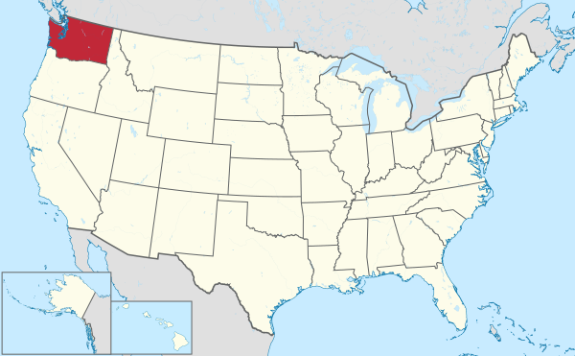
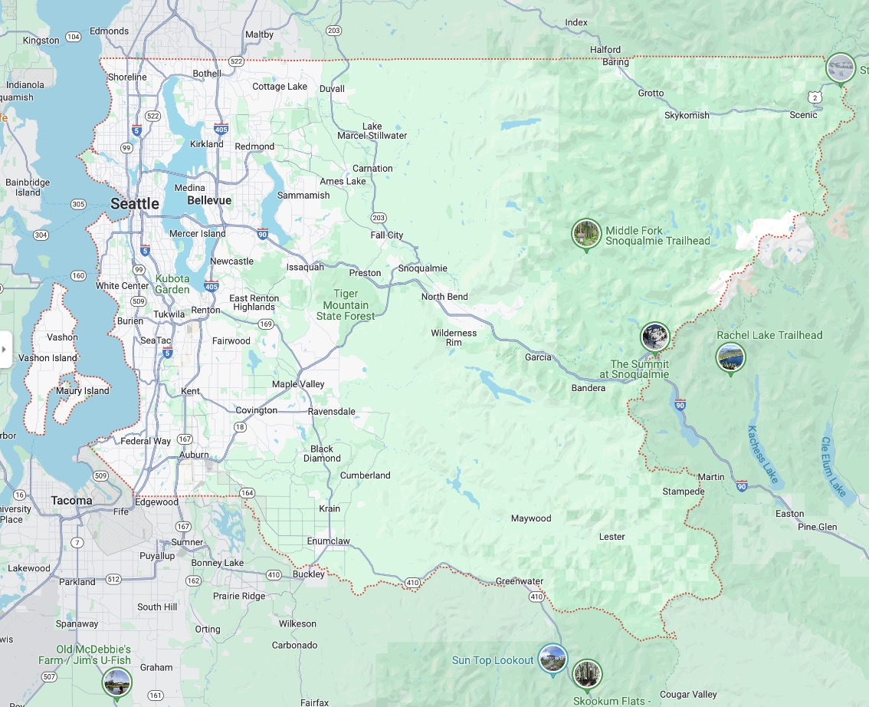
Data Source
King County, Washington, USA
21,597 listings between 2014 – 2015

Slide 5

Client and Requests
Jacob Philips, Buyer, Unlimited Budget
Wants:
At least 4 bathrooms (or smaller house nearby)
Big lot (enough for a tennis court and a pool)
Golf course nearby
Historic
No waterfront

Slide 6
Research Questions and Hypotheses
Does the number of bathrooms affect the price?
- The more the bathrooms, the higher the price
Does a ”big lot” affect the price?
- The larger the square foot, the higher the price
Does location affect the price?
- If there is a nearby golf court, the price is higher
Is the age of the house an important feature to consider?
- The newer the house, the higher the price
- If the house is renovated, the price is higher

Slide 7
Methodology
Insights
Assumptions
Performed EDA to understand the raw dataset
Filtered and sorted the data frame based on my client’s requests
Plotted graphs (both with unfiltered and filtered data frames) to make observations and recommendations
Filtered out houses with waterfront
Investigated nearby house living space
A standard tennis court and pool are taken as 7200 and 800 ft² respectively
Recommended tennis court / living space and pool / living space ratios are set as 20% and 10% respectively
Historic = age > 50, renovations are assumed to be done properly to maintain historic status
In case of two houses nearby, only first house needs to satisfy client’s needs
”NaN” values in ‘yr_renovated’ are assumed to represent no renovation

Slide 8
Visualizations

Slide 9
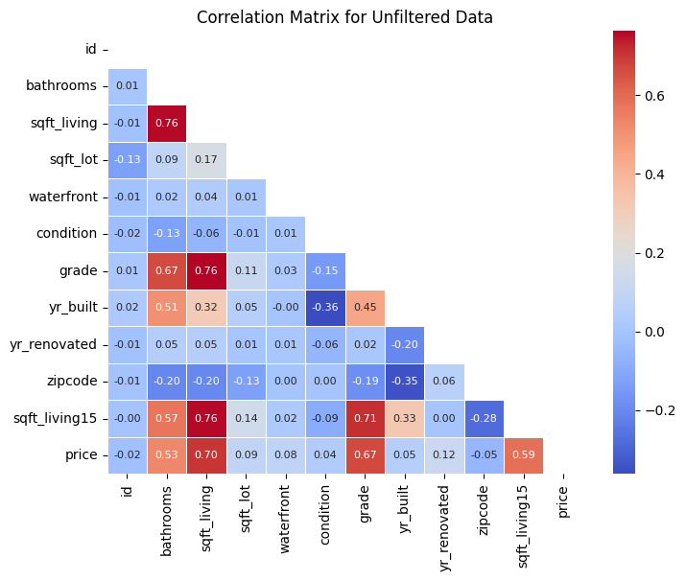
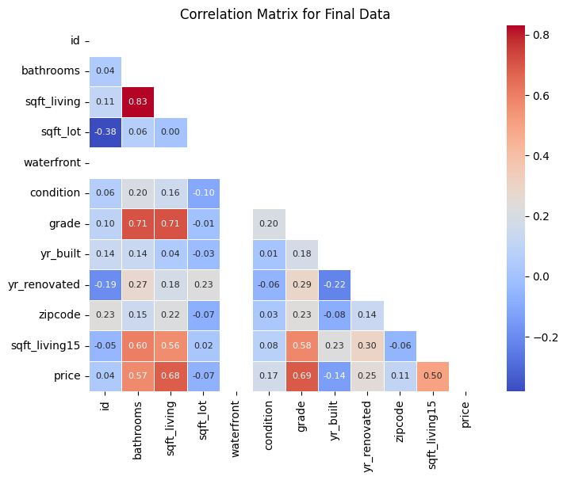
Correlation matrices
(strong negative linear) -1 0 1 (strong positive linear)
(no linear relationship)

Slide 10
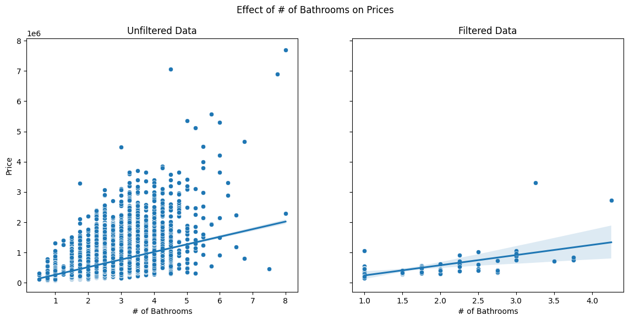
Rq - 1
Does the number of bathrooms affect the price?
”The more the bathrooms, the higher the price”

Slide 11
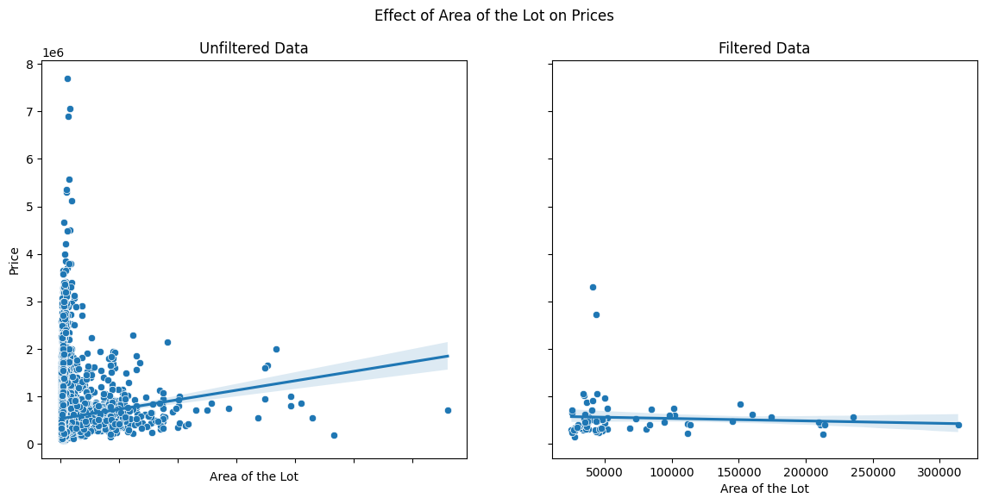
Rq - 2
Does a ”big lot” affect the price?
"the larger the square foot, the higher the price”

Slide 12
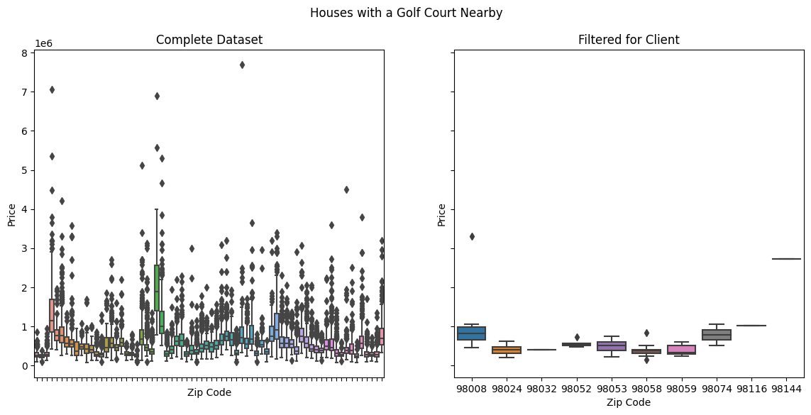
Rq - 3
Does location affect the price?
“if there is a nearby golf court, the price is higher”

Slide 13
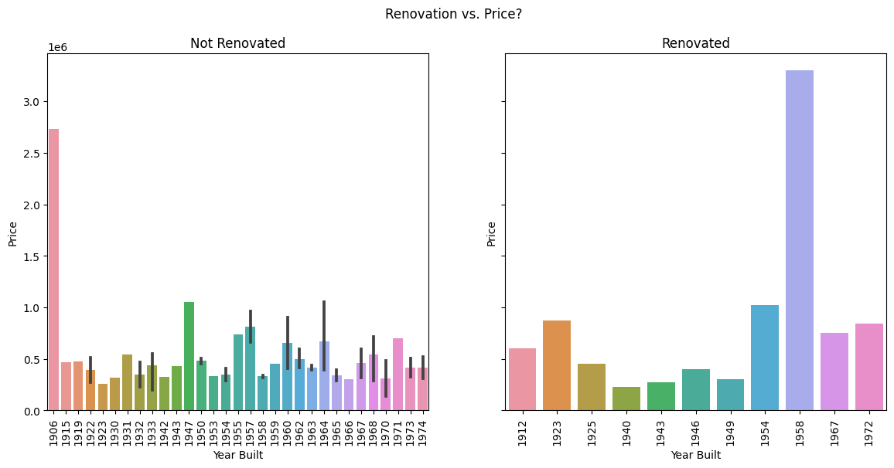
Rq - 4
Is the age of the house an important feature to consider?
“the newer the house, the higher the price”
“if the house is renovated, the price is higher”

Slide 14
Recommendations and observations
More bathrooms doesn’t necessarily mean higher price
There are houses with same number of bathrooms but different prices
More bathrooms increase the square foot value and indirectly the value of the property, but it shouldn’t justify unreasonable prices
Larger living space or lot doesn’t automatically translate into higher price
There is a general saturation around the smaller lot size, but prices aren’t necessarily low
A nearby golf court doesn’t have a significant effect on the price
Raw data has a lot of outliers
When data is filtered by nearby golf courts, price variation isn’t significant neither in filtered nor in raw data
Age of the house shouldn’t be a deciding factor on the price
House prices don’t increase or decrease by year
Renovations don’t change the price in a pattern

Slide 15
Q & A

Slide 16
Thank you!

Slide 17


References
https://www.talbottennis.com/blog/dimensions-of-tennis-courts/
https://www.tennisdepartment.com/tennis-court-dimensions/
https://scottpaynecustompools.com/what-size-pool-is-right-for-my-backyard/#:~:text=The%20average%20pool%20is%20between,1200%20and%203200%20square%20feet.
https://en.wikipedia.org/wiki/Historic_house
https://www.rocketmortgage.com/learn/buying-a-historic-home
https://savingplaces.org
https://info.kingcounty.gov/assessor/esales/Glossary.aspx?type=r
DS Course Material and ChatGPT for technical help <3

