Slide 1
Mobile-PIRL: Mobile Versions of Pretext-Invariant Representation Learning
İzzet Emre Küçükkaya – Berkcan Üstün

Slide 2
Outline
Brief description of the project
Pretext Invariant Representation Learning
Mobile Networks (Lightweight CNNs)
What we have done so far
Future work

Slide 3
Purpose of Mobile-PIRL
Self supervised learning and fine tuning
Performance of mobile networks on SSL domain
Performance of combination of pretext tasks

Slide 4
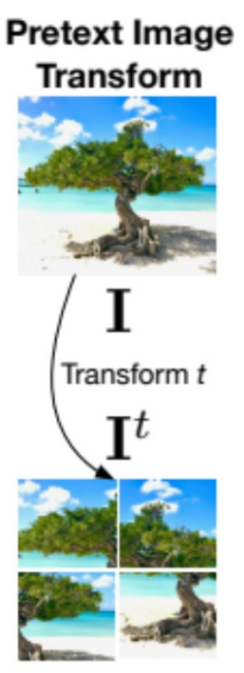
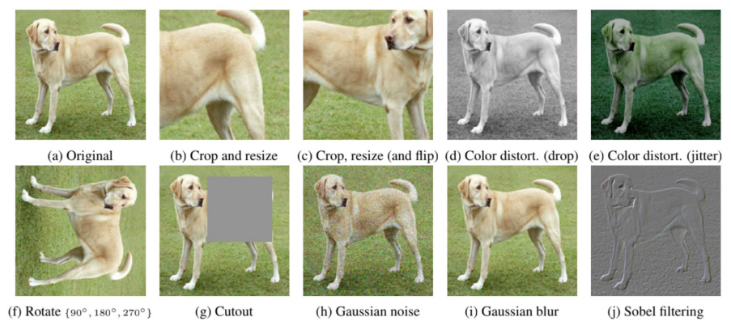
Pretext-Invariant Representation Learning (PIRL)
Pretext Tasks in Self Supervised Learning

Slide 5
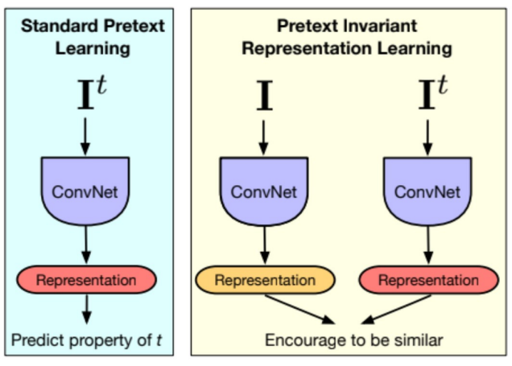
PIRL vs Standard Pretext Learning

Slide 6
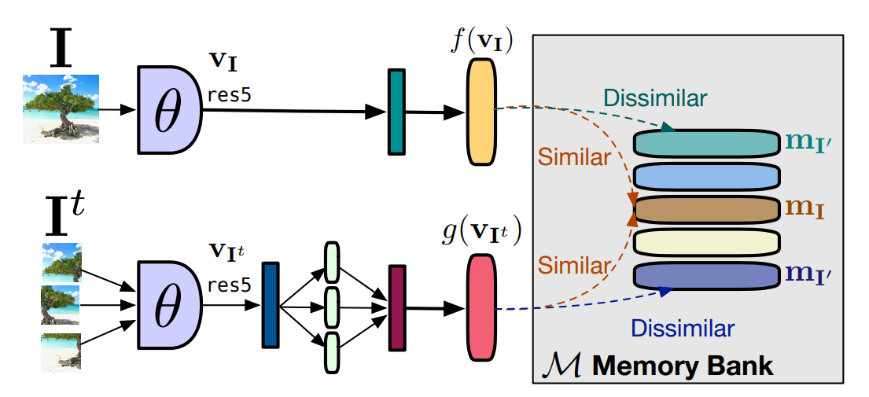
Overview of PIRL

Slide 7
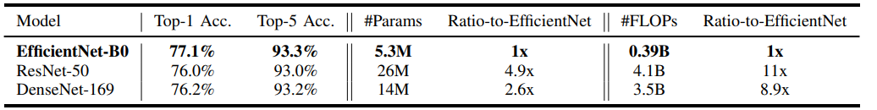
Mobile Networks
Requirements of real-life applications
Less number of parameters – Small inference time
Similar performance with other CNNs with higher number of parameters (ResNet50)

Slide 8
What we have done
Research about PIRL implementations (github)
Research about dataset can be used (stl10 - Stanford)
Research about the hardware we can use to train models (colab)
Research about mobile networks (efficientnet_b0, mobilenet_v3_small, mnasnet_A1, shufflenet_v2)
Modifying and testing the PIRL implementations

Slide 9
Results – 50 epoch pretrained
Model | Number of Parameters | Accuracy
Resnet50 | 26M | 25.12%
Efficientnet_B0 | 5.3M | 23.25%
Mobilenet_v3 small | 2.49M | 30.62%

Slide 10
Future work
Continue to do experiments with different mobile networks
Continue to do experiments with different image transformations

Slide 11
Thanks for Listening

