Slide 1
WEDDING SERVICE CONSULTANCY SYSTEM
CMT 400 : Research Project Proposal
Name : Chelsea Nyaga| REG. Num: 1042467
Supervisor: Mr.Nandasaba

Slide 2
Content
Background of the Research
Problem Statement
AIM/Main Objective and Specific Objectives
Review of literature/ Systems [5 cases (CMT 400) | 3 cases (DIT 020)]
Research Methodology

Slide 3
Background of the research
The wedding service consultancy System is an application intended to automate the process of couples planning their wedding.
The traditional wedding planning process relies heavily on in-person visits to vendors, resulting in planning challenges and time constraints for couples.
Social media platforms have begun influence the planning process by enabling the vendors to showcase their work but comprehensive online planning systems are still emerging.

Slide 4
Problem statement
The wedding planning industry is currently challenged by traditional practices that involve time-consuming, in-person visits to vendors, leading to difficulties in finding reliable services and in the planning process.
couples to spend more time and money in the planning process and are unable to vet service quality and have efficient communication with the vendors.
Notes:
They spend more time and money because they have to take time to go see the vendors in person, which is time consuming and these also incur transportation costs.
And even after visiting the vendors they may not be satisified and have to look for other vendors this increases the whole planning process.
They also mostly get to know the quality of a vendors service when they visit them or from word of mouth from someone else but they are not able to know before hand that these services offered are actual per their standard.

Slide 5
Main Objective
The main objective of this project is to provide a centralized digital platform that efficiently facilitates wedding planning for couples

Slide 6
Specific objectives
Provide a wide array of services for complete wedding planning.
Enable communication between clients and the vendors.
To enable couples to rate and review the quality of services.
Incorporate payment gateways for secure and seamless financial transactions.

Slide 7
Review of Literature
Case 1
Janseson wedding planning company : This is website where couples can apply for wedding planning services. They offer various wedding planning packages tailored to individual needs. Such as planning packages or assistance with specifc aspects of wedding preparation
However the system does not enable users to plan their wedding rather to hire others to do it on their behalf and thus they do not get to get exactly what they want
Case 2
WeddingWire is a leading global platform with features such as vendor listings, budget management, and guest list management and offers comprehensive wedding planning tools and services for couples.
However because the system is gloabal platrform, it does not cater to cultural aspect of local weddings. The cost is also higher
Notes:
Literature review methods encompassed a systematic review of relevant academic journals and conference papers and following previous case studies of other researchers who conducted this project.

Slide 8
Review of Literature…
Case 3
Enzi wedding film based in kenya, offers wedding videography services. enziweddings(2019) They work across the country and are flexible to go around to meet their clients needs.
However, they do not offer comprehensive wedding planning services. So couples only have access to videography services. Therefore couples still need to seek additional services for other aspects of their wedding planning.

Slide 9
Research Gap
Despite the abundance of wedding planning platforms, there's a notable gap in a centralized digital platform tailored to couples' needs in the wedding industry context (Mariana, 2023).
Traditional wedding planning methods involve in-person vendor visits, leading to chaotic experiences. Existing platforms lack integrated solutions that combine various planning services, seamless communication, and secure payment gateways and that enable couples to vet the quality of services before hand.

Slide 10
Research Methodology
Requirement Gathering
Interviews: Structured and semi-structured interviews will be conducted with couples planning their weddings and vendors offering services. Couples will share their needs and expectations, while vendors will provide insights into their capabilities.
Questionnaires: Both qualitative and quantitative data will be gathered from a large number of participants, including vendors and couples. This method will help in understanding preferences and gathering diverse perspectives.
Surveys: Surveys will focus on collecting data about user preferences, market trends, and areas for improvement. They will provide valuable insights into customer expectations and help in shaping the development of the system.
System Analysis
The existing system is manual
Context diagrams and Data Flow Diagrams were used as SSAD tools for depiction of the current system
Structured data was represented as the 3rd Normal Form
Notes:
Functional requirements of this system include: User Registration and Authentication, appointment scheduling, notification alerts, user profile management, data storage and retrieval payment integration.
Non Functional requirements of this system include: Response Time, Data Privacy, User-Friendly Interface and Scalability.
Structured system analysis and design (SSAD)

Slide 11
Research Methodology…
System Design of the proposed system
Context diagrams, UML diagrams and ERDs will be deployed as OOSAD tools to depict the proposed system.
System Implementation
HTML, CSS, and JavaScript are the core technologies used for the system's front end.
Tools used for back end development include PHP for side scripting together with the apache web server.
PostgreSQL is the database technology that will be used.
Daraja payment integration API for C2B will be used will be used as an API tool for payment processing.
Notes:
XAMPP server is used to test clients or websites before publishing them to a remote web server. Object Oriented System analysis and Design

Slide 12
Research Methodology…
Testing
Various testing techniques including unit tests, integration tests, system tests and user acceptance tests will be used.
System Deployment
Methodology used for system deployment will be Phased Deployment.
It will also include data migration and user deployment.
Approach that will be used in user’s training will include use of user guides.

Slide 13
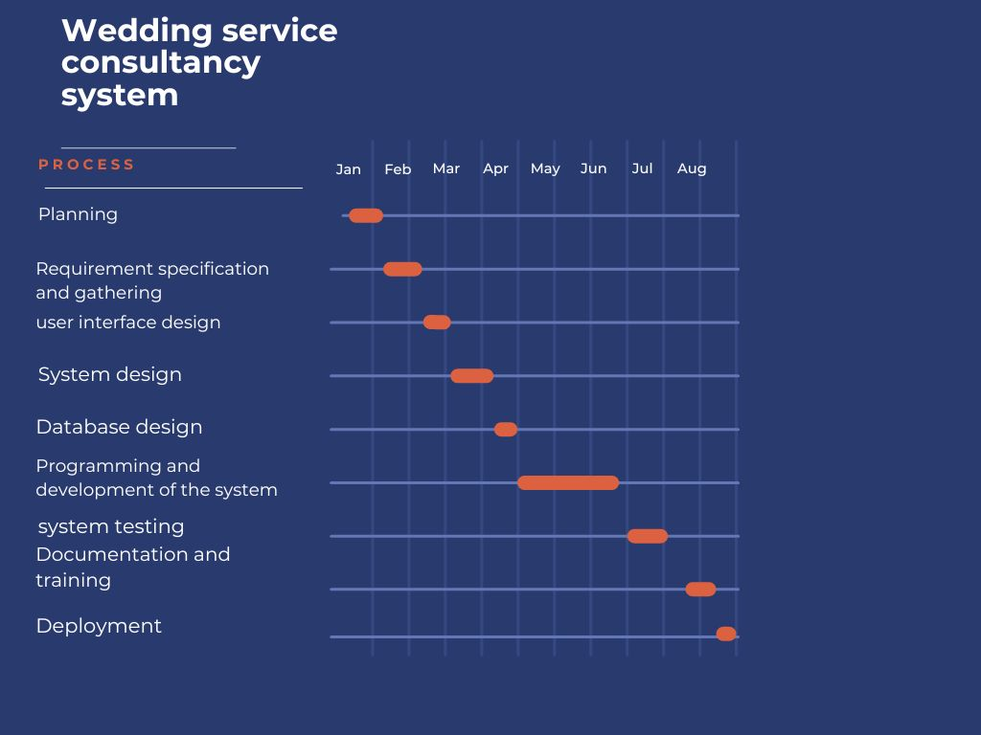
Schedule & Budget
Gantt chart

Slide 14
Schedule & Budget…
The project’s budget
Item | Amount
Transport | 12000
Hardware: Laptop | 80000
Printing | 2000
Internet | 10000
Miscellaneous | 7000
Total | 111000

Slide 15
The End
Thank you

