Slide 1

Sign language recognition.

Slide 2
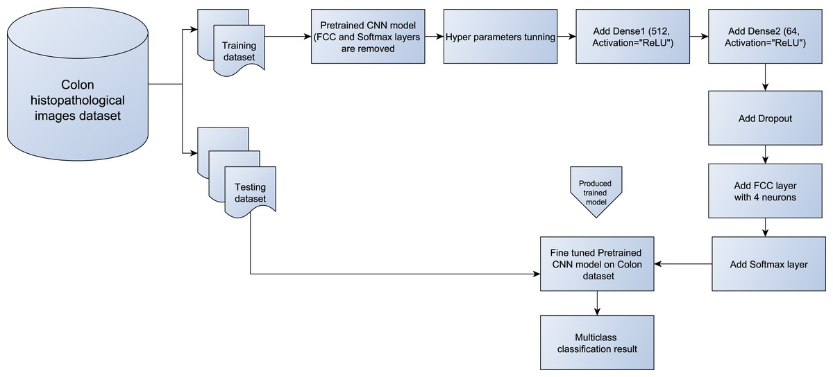
Image Classification Using CNN
Image classification using Convolutional Neural Networks (CNNs) is a popular application of deep learning in computer vision. CNNs are a type of neural network that are particularly well-suited for image classification tasks because they can automatically learn features from the input images.
The basic architecture of a CNN consists of several layers, including convolutional layers, pooling layers, and fully connected layers. The convolutional layers apply a set of filters to the input image to extract features, while the pooling layers downsample the feature maps to reduce the dimensionality of the data. The fully connected layers are used to classify the input image based on the extracted features.

Slide 3
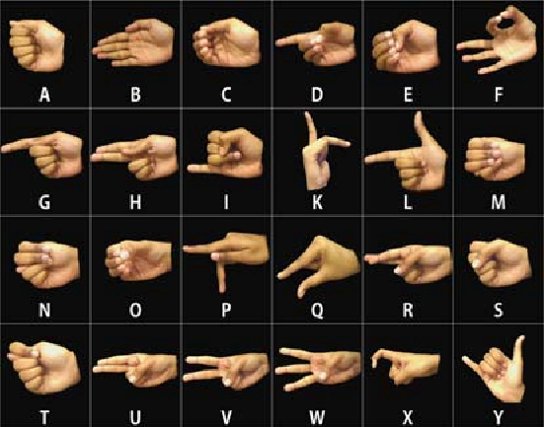
Sign language recognition
Information About Dataset
The data set is a collection of images of alphabets from the American Sign Language, separated in 29 folders which represent the various classes.
Content
The training data set contains 23347 images which are 227x227 pixels. There are 29 classes, of which 26 are for the letters A-Z and 3 classes for SPACE, DELETE and NOTHING.
These 3 classes are very helpful in real-time applications, and classification.

Slide 4
Project steps

Slide 5
1st point : import necessary libraries
Import several libraries that are commonly used in data analysis and machine learning. Some of the libraries imported include numpy, pandas tensorflow, matplotlib, and seaborn.
These libraries provide tools for numerical computing, data manipulation and visualization, and building machine learning models.
Additionally, the code imports specific functions and classes from other libraries such as keras and sklearn to build and train a neural network model.

Slide 6
2st point : Load The Dataset and Data visualization
Loading and visualization of image data for sign language recognition data using OpenCV and Keras.
Here is a summary of the code:
train_dir and test_dir are the directories containing the training and testing images, respectively.
classes is the number of classes in the dataset.
img_size is a tuple specifying the size of the input images.
load_unique() is a function that loads a single image from each class in the training dataset for visualization purposes.
images_for_plot and labels_for_plot are lists containing the loaded images and their corresponding labels, respectively.
plot_images() is a function that plots an image and its label in a subplot of a figure.
The for loop in load_unique() loads a single image from each class in the training dataset and appends it to images_for_plot and labels_for_plot

Slide 7
The for loop in the main code block plots the images and their labels using plot_images() and fig
Load_image_data() is a function that loads and preprocesses the image data using Keras.
The for loop in Load_image_data() loads each image in the dataset, resizes it to img_size, converts it to grayscale, and appends it to X. The corresponding label is appended to y.
X and y are returned as numpy arrays.
The code uses OpenCV and Keras to load and preprocess the image data. OpenCV is used to load and resize the images, while Keras is used to convert the images to arrays and preprocess them. The load_unique() function is used to visualize a single image from each class in the dataset.
The Load_image_data() function is used to load and preprocess the image data for training a CNN.

Slide 8
3st point : Data preprocessing
The function calledpreprocess_image_data() that preprocesses the input data for training a CNN for sign language recognition.
Here's a summary of the code:
X is the input data, which is a numpy array of images.
y is the labels for the input data.
num_classes is the number of classes in the dataset.
le is a LabelEncoder object that encodes the labels as integers.
y is encoded using le and then converted to one-hot encoded vectors using np_utils.to_categorical()

Slide 9
The input data and labels are split into training and testing sets using train_test_split().
test_size is set to 0.15, which means that 15% of the data is used for testing.
The input data is reshaped to(num_samples, img_size[0], img_size[1], 1) to match the input shape of the CNN.
The pixel values of the input data are normalized to the range of [0, 1].
The data is returned as x_train , x_test , y_train , and y_test
The code uses scikit-learn and Keras to preprocess the input data. Scikit-learn is used to split the data into training and testing sets, while Keras is used to encode the labels, reshape the input data, and normalize the pixel values. The preprocess_image_data() function can be used as a preprocessing step before training a CNN for sign language recognition.

Slide 10
4st point : Define CNN model
Defines a LeNet model for sign language recognition using Keras.
Here's a summary of the code:
input_shape is a tuple specifying the shape of the input images.
modelLeNet is a Sequential model that consists of several layers:
The first layer is a Conv2D layer with 128 filters, a kernel size of (5, 5), and a stride of (2, 2) The activation function is ReLU.
The second layer is a MaxPooling2D layer with a pool size of (2, 2) and a stride of (2, 2).
The third layer is a Conv2D layer with 256 filters, a kernel size of (5, 5), and a stride of (2, 2). The activation function is ReLU.
The fourth layer is a MaxPooling2D layer with a pool size of (2, 2) and a stride of (2, 2).
The fifth layer is a Flatten layer that flattens the output of the previous layer.
The sixth layer is a Denselayer with 1280 units and an activation function of ReLU.
The seventh layer is a Dense layer with 256 units and an activation function of ReLU.
The eighth layer is a Dense layer with classesunits and an activation function of softmax.
The model is compiled using the Adam optimizer, categorical cross-entropy loss, and accuracy as the evaluation metric.
The model summary is printed using the summary() method.

Slide 11
AlexNet is a more complex convolutional neural network that consists of five convolutional layers followed by three max pooling layers, then three fully connected layers and an output layer. The first convolutional layer has 128 filters with a kernel size of (11, 11) and a stride of (4, 4). The second convolutional layer has 256 filters with a kernel size of (5, 5) and a stride of (1, 1). The third, fourth and fifth convolutional layers have 384, 384 and 256 filters respectively, all with a kernel size of (3, 3) and a stride of (1, 1).
Both models are compiled using the Adam optimizer with categorical crossentropy loss and accuracy as the evaluation metric. The model.summary() method is called to print a summary of the AlexNet model.

Slide 12
5st point : Function Evaluate model
Then we define two functions: evaluate_model and plot_results.
The evaluate_model function takes as input a trained model, training data (X_train, y_train) and testing data (X_test, y_test). The function evaluates the model on both the training and testing data using the model.evaluate method and prints the accuracy of the model on both datasets. The function returns the training and testing accuracy.
The plot_results function takes as input a trained model and plots the training and validation accuracy and loss over epochs using the Matplotlib library. The function creates a figure with two subplots: one for accuracy and one for loss. In each subplot, the training and validation metrics are plotted against the number of epochs. The function does not return any value.
Note that the history variable used in the plot_results function is not defined in the provided code. It is likely that this variable is defined elsewhere in the code and contains the training history of the model.

Slide 13
6st point : Train Model
Train two artificial neural network models.
The first model is a LeNet model and the second is an AlexNet model.
Each model is trained on the training data x_train and y_train with a specified batch size and number of epochs. 15% of the training data is used for validation during training.
The evaluate_model function is then used to evaluate the trained models on the training and test data.
Finally, the plot_results function is called to plot the results of the trained models.
It’s important to note that without more context or information about the functions and variables used in this code
train_acc, test_acc = evaluate_model(modelLeNet, X_train, y_train, X_test, y_test)

Slide 14
THANK YOU

