Slide 1
End-to-End Sales, Operations & Finance Analytics
Business Context:
The organization works with multiple raw datasets across sales, operations, CRM, and finance.
Project Objective:
Clean and standardize raw data, perform analysis using Excel, Power BI, and SQL, and implement automation.
Project Phases:
Data Cleaning & Standardization
Excel & Pivot Table Analysis
Power BI Dashboards
SQL-Based Analysis
Automation & Reporting

Slide 2
Data Sources & Analytical Tools
Data Sources:
Sales
Operations
CRM
Finance
Tools:
Excel
Power BI
SQL (SQLite)
Google Apps Script
Workflow:
Raw CSV → Cleaned Excel → Pivot Tables → Power BI → SQL → Automated Reporting

Slide 3
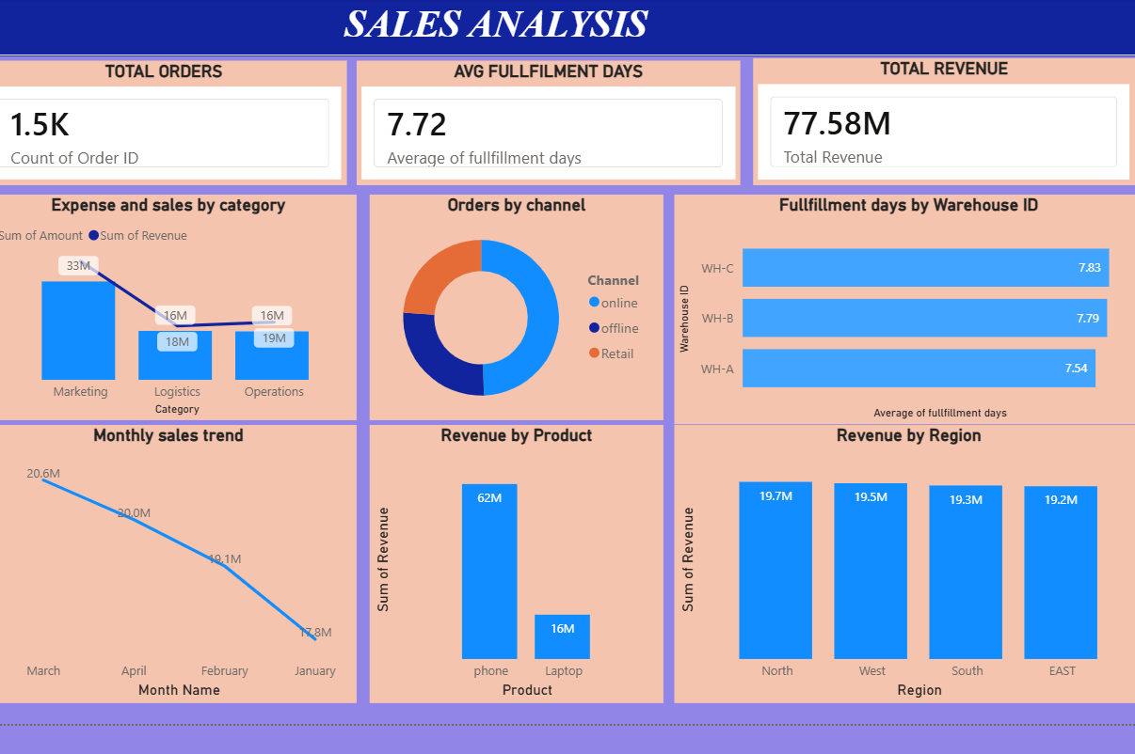
Key Business Insights from Dashboards
Key Insights:
Revenue concentration among top customers
Regional overdue exposure
Warehouse fulfillment variation
Lead conversion differences

Slide 4
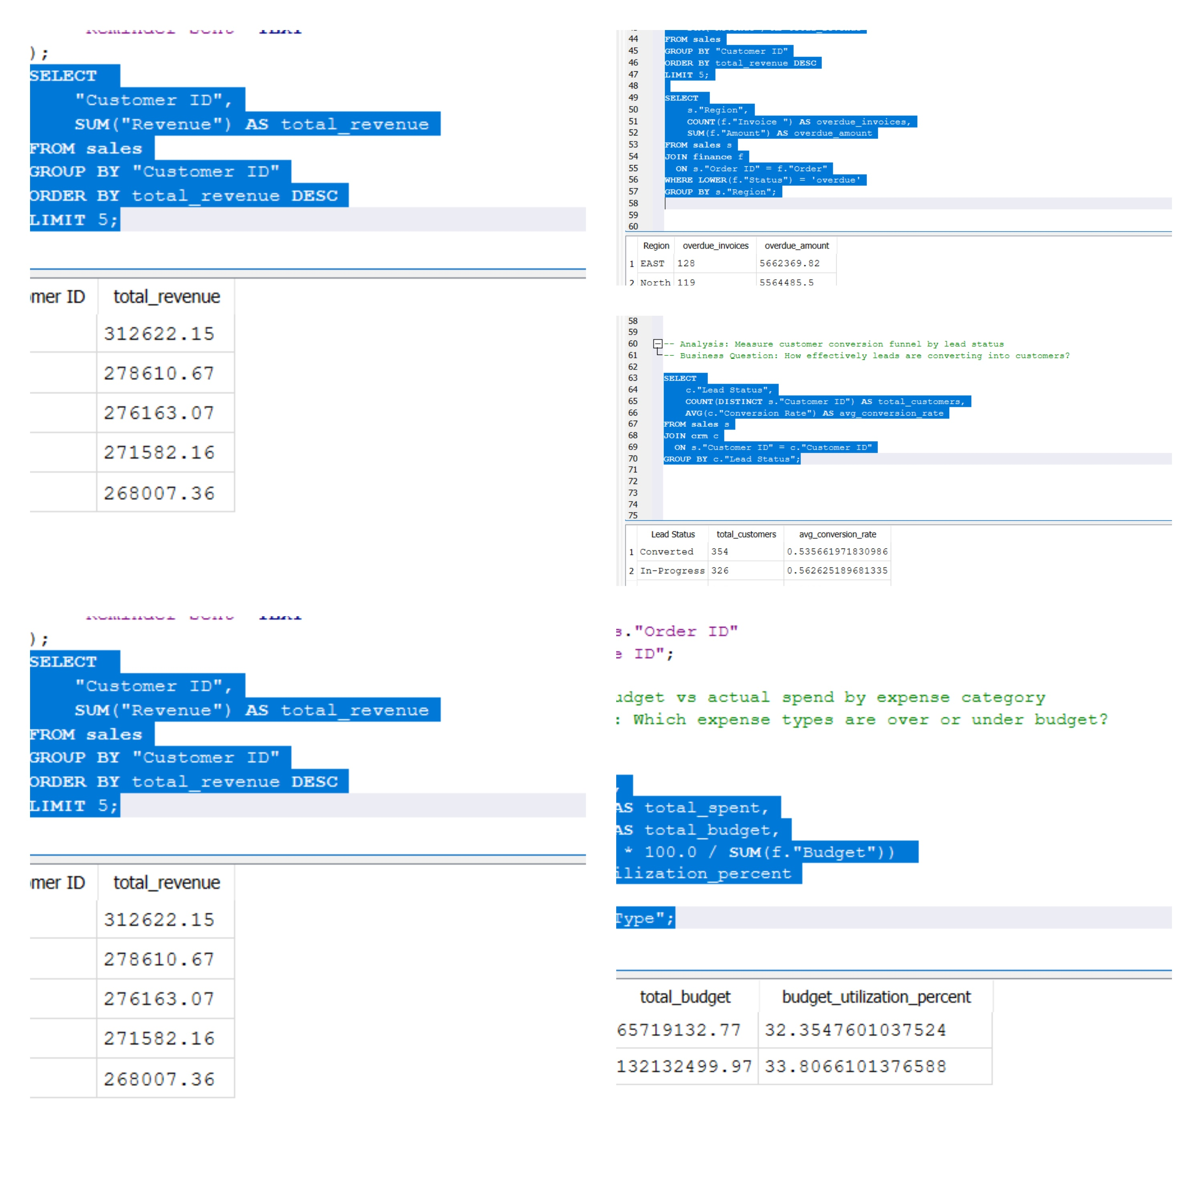
SQL Analysis: Use Cases & Findings
Use Cases:
Top customers by revenue
Overdue by region
Conversion funnel
Warehouse fulfillment
Budget utilization
Key Findings:
High-value customers drive majority revenue
Certain regions have higher overdue risk
Fulfillment efficiency varies

Slide 5
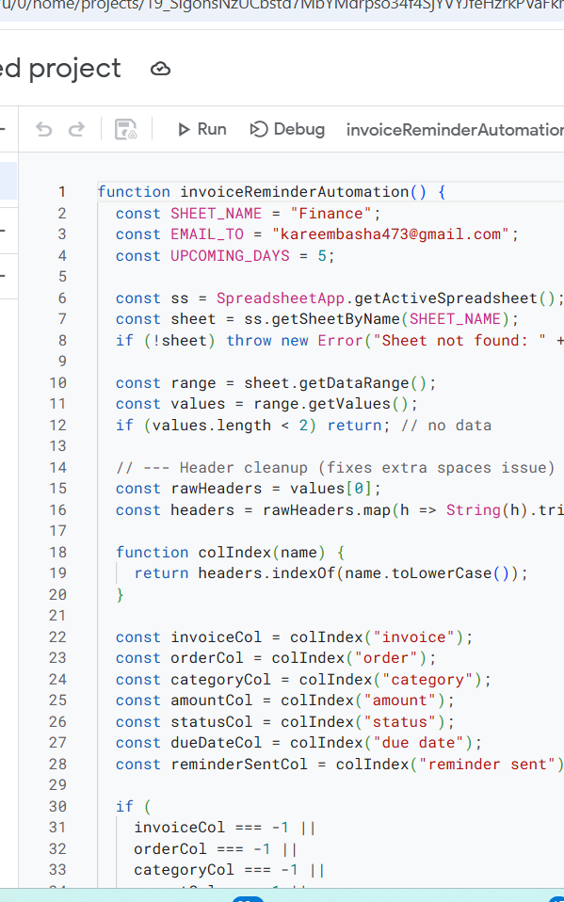
Automation Implemented: Logic & Business Impact
Automation:
Automated refresh
Automated dashboard updates
Automated reporting
Logic:
Trigger → Fetch Data → Refresh →
Update Dashboards → Share Reports
Business Impact:
Reduced manual effort
Faster reporting
Improved consistency

Slide 6

Key Recommendations & Next Steps
Improve collections in high-overdue regions
Optimize slow warehouses
Focus on high-conversion leads
Reallocate overspend budgets
Improve data quality controls
Better cash flow, efficiency, and reporting reliability

