Slide 1

ShelbyFirst
Advancing Inclusive Growth in Low-IGS Shelby County Through Health Access, Nutrition, and Affordable Mobility
Community Analyzed: Shelby County / Memphis Low-Growth Recovery Cluster
Challenge Topic: Inclusive Growth / Community Health Access
96
273K
35.8
Low-IGS Tracts
Population
Avg IGS Score
Source: IGS, ACS/Census, healthcare enrichment, uploaded analysis charts.

Slide 2



Data-driven selection process
Why this community, and why this problem
Economic Vulnerability
Compared communities across three periods
Scored communities based on
IGS Economy
poverty
unemployment
median household income
labor-force participation
low recovery-period IGS
economic vulnerability in recovery
COVID shock
weak recovery
pre-COVID: 2017-2019
COVID: 2020-2021
recovery: 2022-2024
Source: IGS, ACS/Census, healthcare enrichment, uploaded analysis charts.

Slide 3



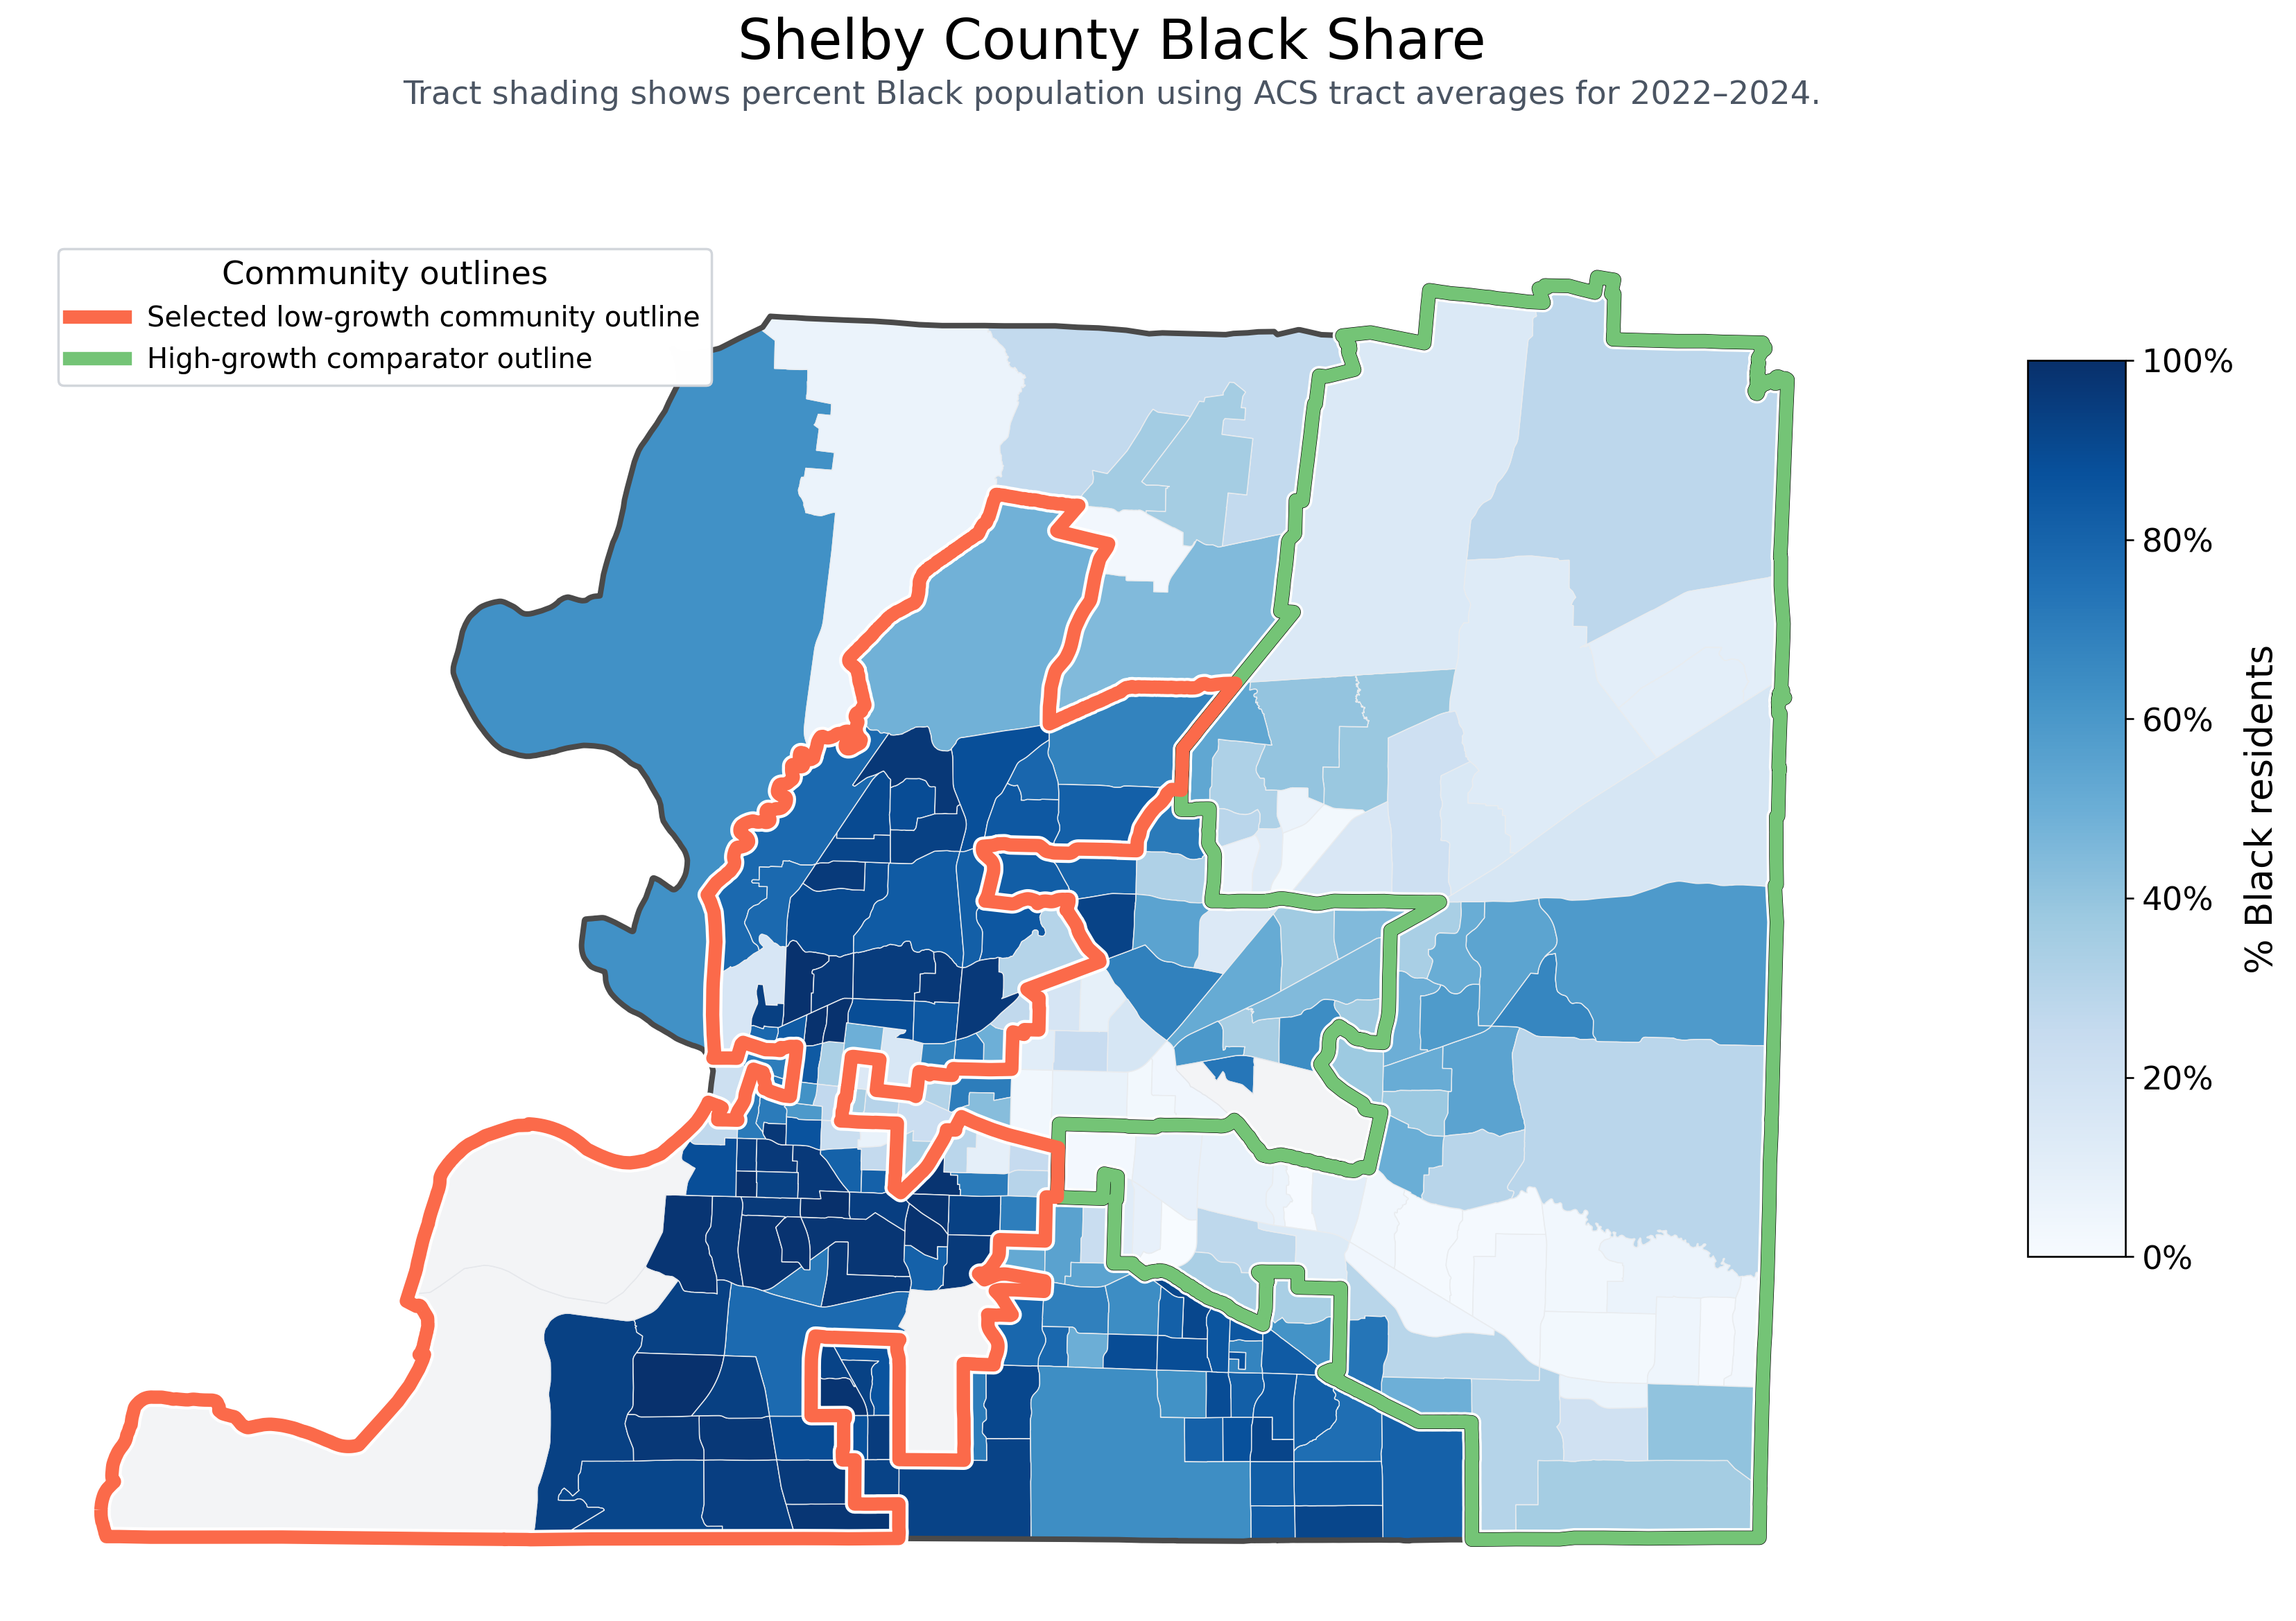
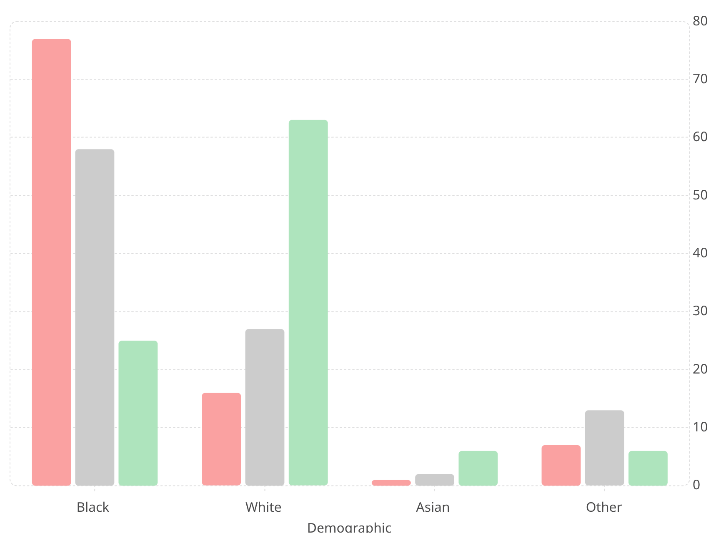
Community Overview
A large, clearly vulnerable Shelby recovery cluster
Our Shelby Community
Rest of Shelby County
High-Growth Shelby Community
77
63
58
25
27
16
Whitehaven ZIPs of Focus
13
ZIP
Population
Area
1
2
6
7
6
38109
~50K
62 sq mi
38116
~40K
12 sq mi
38117
~26K
9 sq mi
Source: IGS, ACS/Census, healthcare enrichment, uploaded analysis charts.

Slide 4


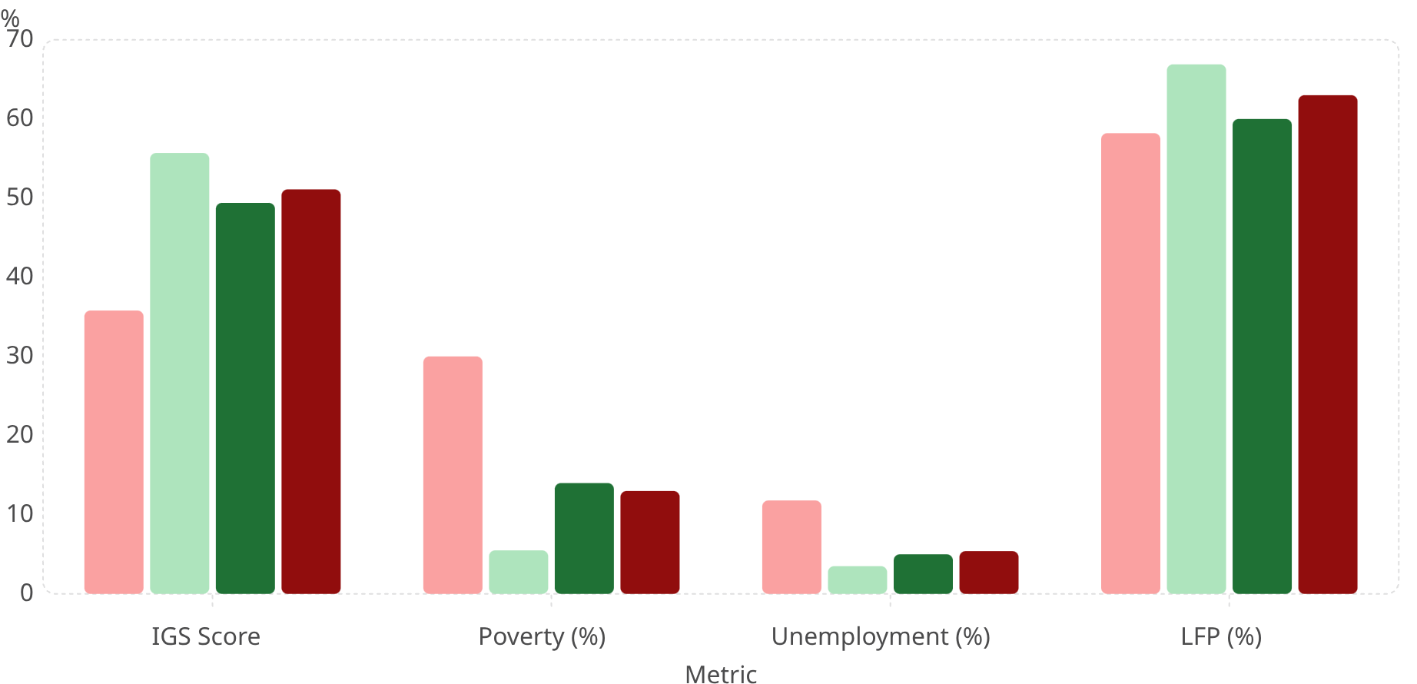
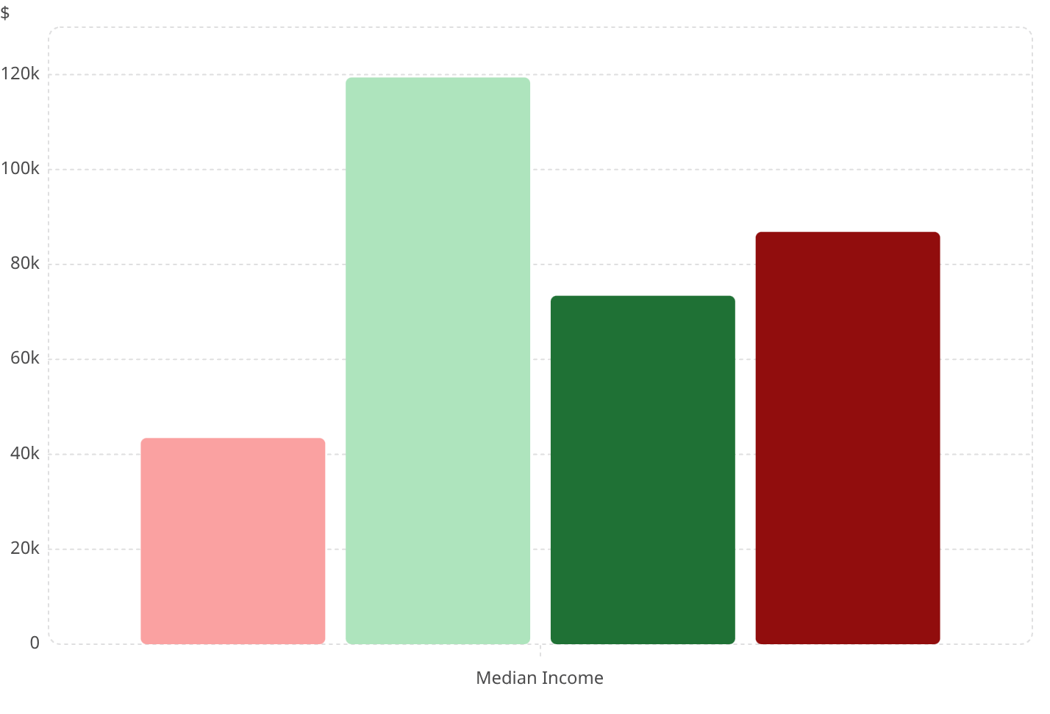

Benchmarking
This community underperforms county, state, and national benchmarks
Economic Gaps Median Income
Low-IGS Shelby
High-Growth Shelby
Tennessee
U.S.
Low-IGS Shelby
High-IGS Shelby
Tennessee
U.S.
66.9
119k
60
63
55.7
58.2
49.4
51.1
86.9k
35.8
73.4k
30
43.4k
5.5
14
13
11.8
3.5
5.4
5
"Low-IGS Shelby is not slightly behind — it is structurally disconnected from the county's higher-growth trajectory."
Source: IGS, ACS/Census, healthcare enrichment, uploaded analysis charts.

Slide 5
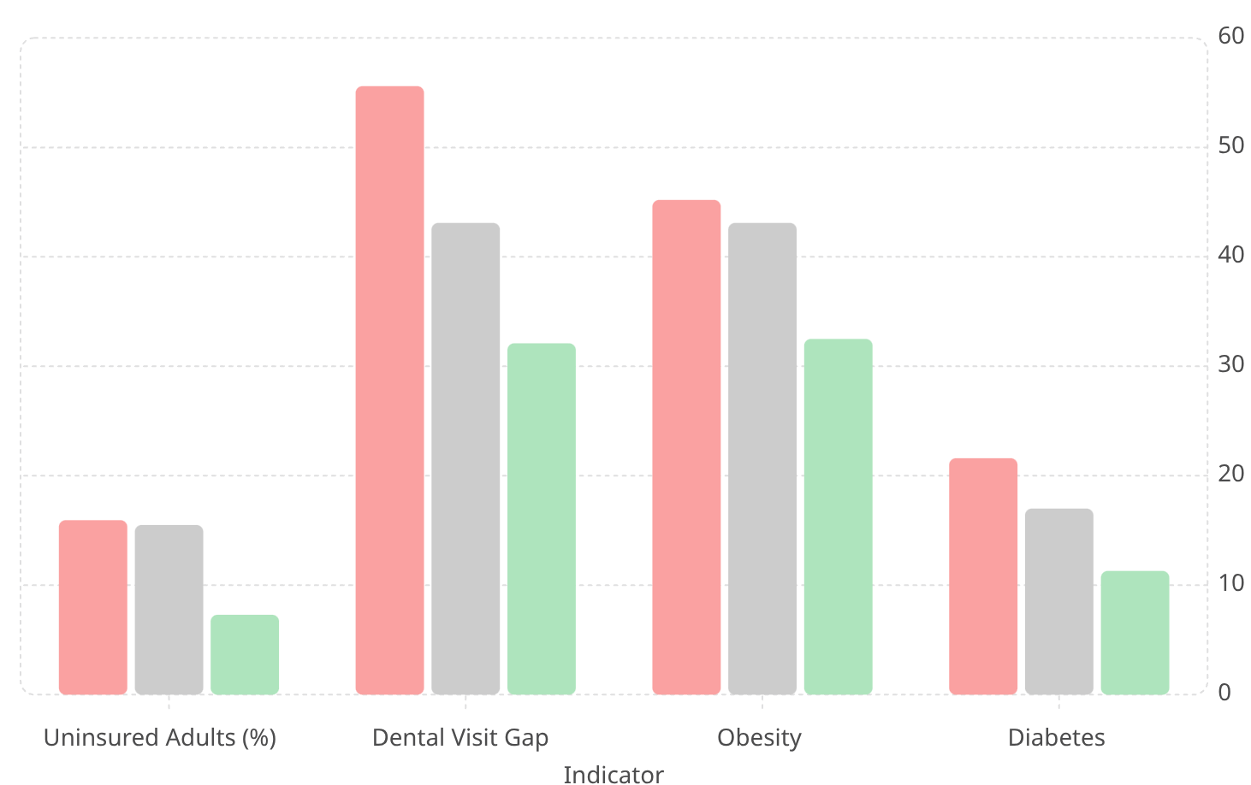
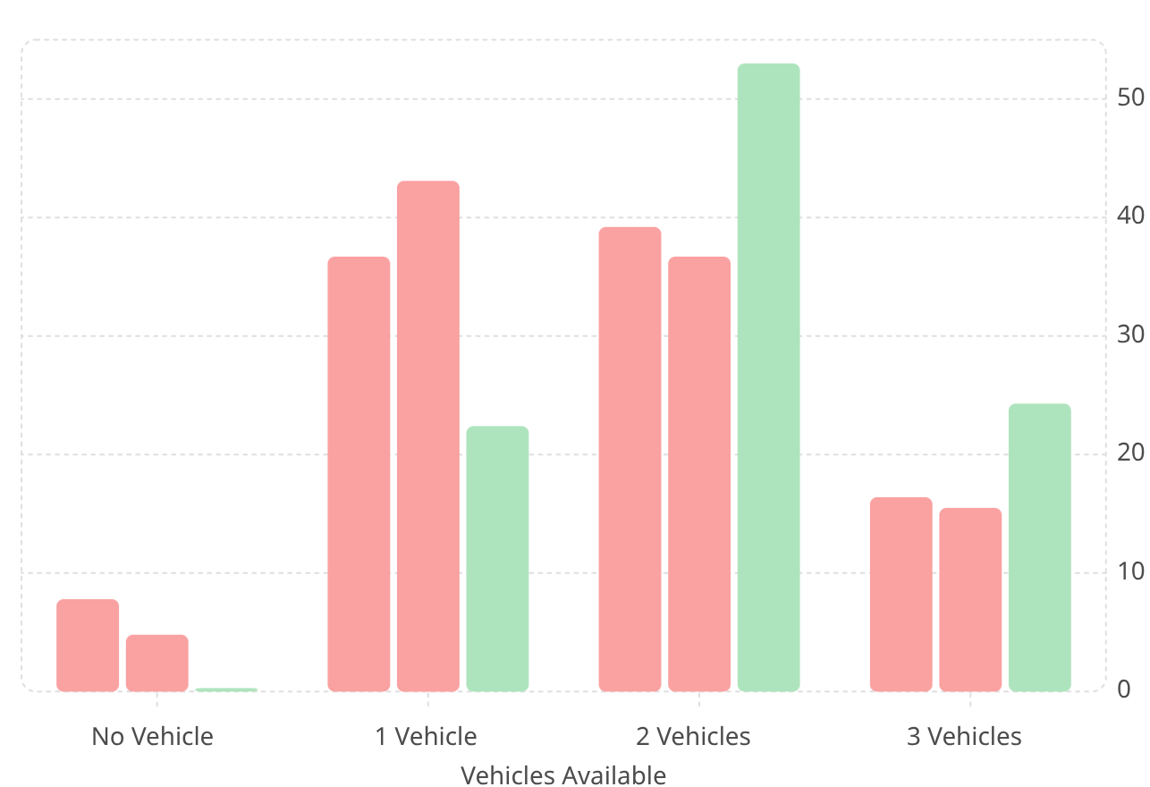

Key Findings
Economic vulnerability overlaps with worse healthcare access and health strain
Health Outcomes
Vehicle Access by zip-code+
Low-IGS Shelby
Average-IGS Shelby
High-IGS Shelby
38109 (Low-growth)
38116 (Low-growth)
38117 (High-growth)
55.6
43.1
45.2
43.1
32.1
32.5
21.6
15.9
15.5
17
11.3
7.3
1. Compounding Health-Access Penalty
2. Transportation Friction
Low-IGS tracts face a compounding health-access penalty across insurance, providers, and preventive care.
Transportation friction appears to reduce preventive and dental care completion rates.
The strongest story: Economic vulnerability + transportation/access friction → lower preventive care + missed appointments → worse chronic disease burden.
Source: IGS, ACS/Census, healthcare enrichment, uploaded analysis charts.

Slide 6



Implementation Plan
A practical 3-year rollout built on existing Memphis health infrastructure
Phase 1 — Pilot (Year 1)
Phase 2 — Expand (Year 2)
Phase 3 — Scale (Year 3)
Launch in highest-need South Memphis service area
Start one community garden site
Build referral and ride coordination with ShelbyCares and trusted providers
Enroll founding households and begin subsidized health rides
Add more ride destinations and health event partners
Expand produce distribution and awareness
Grow membership base and app usage
Expand across more low-IGS tracts
Formalize healthcare referral loops
Move toward blended nonprofit sustainability
Funding Architecture
Startup & Pilot Grants
Institutional Partnerships
Blended Earned Revenue
Public-health and foundation grant funding for Year 1 launch
ShelbyCares, UTHSC-aligned care ecosystem, local government, and public-health stakeholders
Memberships, subsidized rides, and produce/garden programs
Source: IGS, ACS/Census, healthcare enrichment, uploaded analysis charts.

Slide 7

Proposed Solutions
ShelbyFirst connects mobility, nutrition, and care access in one platform
Move
Nourish
Connect
Affordable healthcare-focused rides priced below typical rideshare alternatives.
Member: $4–$6 one-way / ~$8 round trip in-zone
Non-member: $7–$9 one-way
Community garden in southern Memphis providing healthy food access, physical activity, and community participation.
Optional add-on: $10–$15/month
App integrating ride access, garden engagement, health events, referrals, and partner services including ShelbyCares.
Access Membership: $9.99/mo | Care Membership: $19.99/mo (2 subsidized rides)
Source: IGS, ACS/Census, healthcare enrichment, uploaded analysis charts.

Slide 8
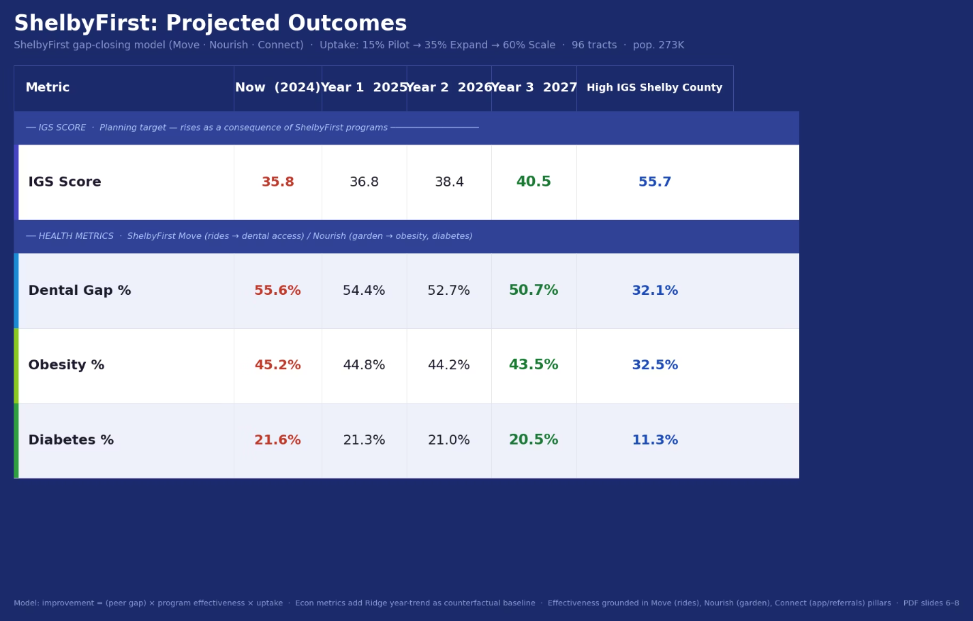
Predicted Outcomes
A realistic 3-year pathway to healthier and more inclusive growth
Base-Case Story
1
Year 1 — Modest Pilot Effects
Founding household enrollment, initial ride utilization, garden launch, early referral loops with ShelbyCares.
2
Year 2 — Stronger Engagement
Growing membership, dental screening events, expanded produce distribution, preventive-care campaign uptake.
3
Year 3 — Measurable Improvements
Measurable improvements in utilization and access; directional uplift in Inclusive Growth performance over time.
ShelbyFirst influences IGS indirectly through better mobility, healthier food access, stronger preventive care participation, and deeper community engagement.
Source: IGS, ACS/Census, healthcare enrichment (ACS).

Slide 9

Metrics for Success
How ShelbyFirst will track impact and accountability over time
Access
Care Utilization
Nutrition & Community
Inclusive Growth Monitoring
Active members
Rides completed
Average ride cost
% of rides to healthcare destinations
Appointment attendance
Dental/preventive visit completion
Referral-to-appointment conversion
Repeat clinic engagement
Garden participation
Produce distributed
Class/workshop attendance
Repeat engagement
Ongoing comparison of target tracts against IGS-linked indicators over time
Transportation access proxies
Preventive care proxies
Community-level health access measures
Measure Outcomes
Learn from Data
Scale What Works
Improve Programs

Slide 10
Conclusion
ShelbyFirst transforms disconnected resources into a pathway for healthier, more inclusive growth
Economically Vulnerable & Health-Access Constrained
Practical, Community-Based Intervention
Built for Measurable Impact
The initiative is built for measurable impact, not just awareness — with clear metrics, phased rollout, and blended nonprofit sustainability.
The selected Shelby community faces overlapping disadvantage across income, transportation, preventive care, diabetes, obesity, and dental access.
ShelbyFirst coordinates affordable rides, healthy food access, and trusted care connectivity — using existing infrastructure, not building new systems.
"ShelbyFirst turns mobility, nutrition, and care access into a scalable engine for inclusive growth in Shelby County."
Healthier Residents
Stronger Communities
More Inclusive Growth
Source: IGS, ACS/Census, healthcare enrichment, uploaded analysis charts.

