Slide 1
DATA MINING COURSE PROJECT
Early-Stage Pancreatic Cancer Detection
Using Random Forest Classification on Urinary Biomarker Data
Technique: Random Forest Classifier (sole model)
Data: Urinary biomarkers — CA19-9, creatinine, LYVE1, REG1B, TFF1, REG1A
Control · Benign · PDAC — 3-class clinical screening classifier

Slide 2
THE PROBLEM
Pancreatic cancer is deadly because it's found too late
~11%
80%+
Non-invasive
5-year survival rate
across all stages
of cases diagnosed
at a late, inoperable stage
urine test could enable
routine early screening
Project goal
Build an end-to-end ML pipeline that classifies patients as Control / Benign / PDAC from cheap, non-invasive urinary biomarkers — using Random Forest as the sole data mining technique, with a clear answer to “which biomarkers actually matter?”
2

Slide 3
DATASET
Urinary Biomarkers for Pancreatic Cancer
Source: Debernardi et al. (2020), PLOS Medicine — 590 samples, 3 diagnosis classes
Class balance
Feature | Description
plasma CA19-9 | Standard pancreatic cancer blood marker
creatinine | Urine concentration control
LYVE1 | Lymphatic vessel endothelial marker
REG1B | Regenerating protein — top predictor
TFF1 | Trefoil factor — tissue repair protein
REG1A | Regenerating protein family
age, sex, cohort, origin | Demographic / batch metadata
Feature
Description
⚠ Note: sandbox has no Kaggle/UCI network access, so a schema-matched synthetic dataset stands in for the real CSV (see data/README.md).
3

Slide 4
METHODOLOGY
End-to-end pipeline
1
2
3
4
5
Load Data
Preprocess
Train
Evaluate
Predict
data_loader.py
clean · encode · scale
SMOTE + GridSearchCV
metrics · plots
predict.py
Random Forest is used as the sole data mining technique throughout — no ensembling with other model families, no deep learning.
4

Slide 5
METHODOLOGY
Preprocessing decisions
Remove target leakage
Median imputation
1
2
Dropped stage & benign_sample_diagnosis — only populated AFTER diagnosis, so keeping them would let the model cheat.
plasma_CA19_9 and REG1A have real missingness; median is robust to skewed biomarker concentrations.
One-hot encoding
Standard scaling
3
4
sex, patient_cohort, sample_origin encoded without implying false ordering.
Numeric features scaled for consistency, even though Random Forest itself is scale-invariant.
Stratified 80/20 split
5
Preserves class proportions across train and test sets.
5

Slide 6
METHODOLOGY
Handling class imbalance
SMOTE
class_weight='balanced'
Synthetic Minority Oversampling
Cost-sensitive learning
Generates synthetic minority-class samples to rebalance the training set.
Applied INSIDE an imblearn Pipeline so resampling happens per cross-validation fold — no synthetic sample ever leaks into a validation or test fold.
Penalizes minority-class misclassification more heavily during tree splitting — a second, complementary layer of imbalance handling.
Belt-and-suspenders: classes here are only mildly imbalanced (~30/35/35%), so either technique alone would likely suffice — combining them costs nothing.
6

Slide 7
METHODOLOGY
Hyperparameter tuning — GridSearchCV
Stratified 5-fold cross-validation, optimizing macro-F1 (all 3 classes weighted equally)
Hyperparameter | Grid searched | Best value
n_estimators | 100, 200, 400 | 200
max_depth | None, 5, 10 | 10
min_samples_leaf | 1, 2, 4 | 1
max_features | sqrt, log2 | sqrt
Hyperparameter
Grid searched
Best value
Best CV Macro-F1
0.939
54 candidates × 5 folds = 270 fits
Why macro-F1? Treats Control, Benign, and PDAC as equally important — appropriate for a screening tool where missing a minority PDAC case is the costly error, not just overall accuracy.
7

Slide 8
RESULTS
Test-set performance
91.5%
0.983
0.917
Accuracy
Macro ROC-AUC
(one-vs-rest)
Macro F1-score
Class | Precision | Recall | F1-score | Support
Control | 1.000 | 0.892 | 0.943 | 37
Benign | 0.830 | 0.951 | 0.886 | 41
PDAC | 0.947 | 0.900 | 0.923 | 40
8

Slide 9
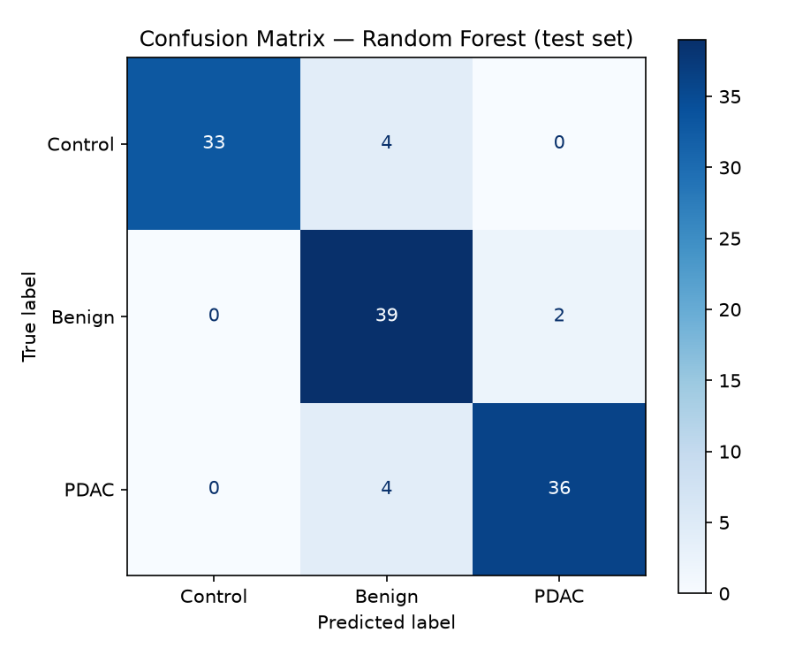
RESULTS
Confusion matrix
What it shows
Diagonal = correct predictions; off-diagonal = errors.
PDAC is rarely confused with Control — the clinically critical distinction.
Most residual error sits between Benign and the other two classes — plausible, since benign hepatobiliary conditions can share biomarker elevation with cancer.
9

Slide 10
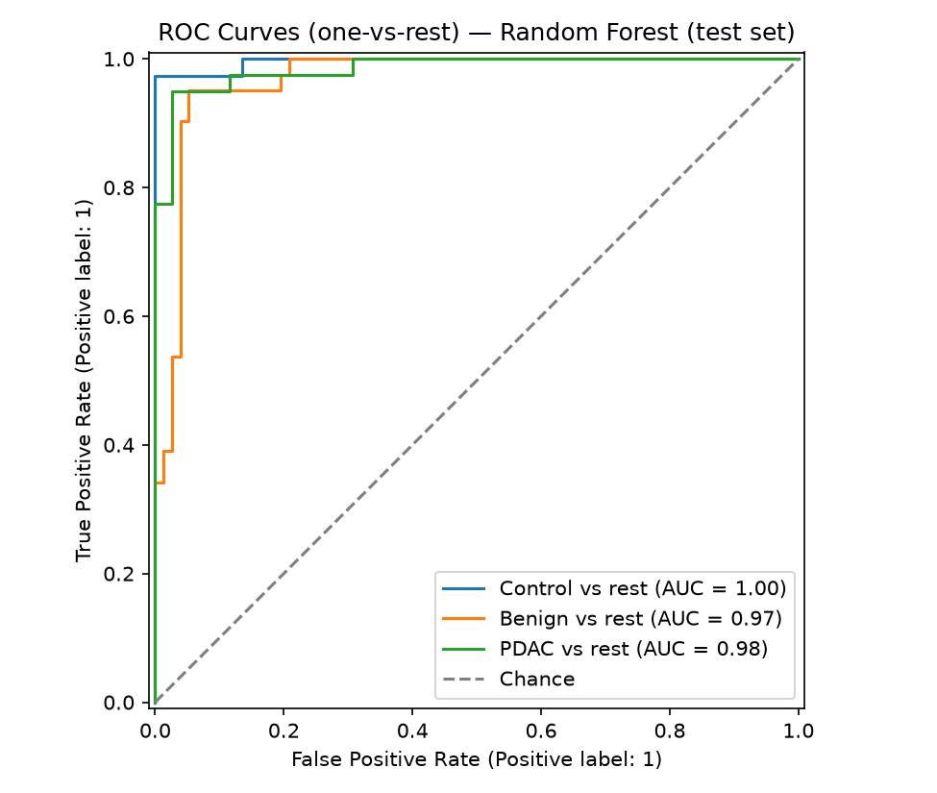
RESULTS
ROC curves (one-vs-rest)
Reading the curves
Each curve treats one class as positive vs. the other two combined.
Curves hug the top-left corner → strong separation between classes at every decision threshold.
Macro-averaged AUC of 0.983 means the model ranks true positives above false positives almost perfectly, on average across classes.
10

Slide 11
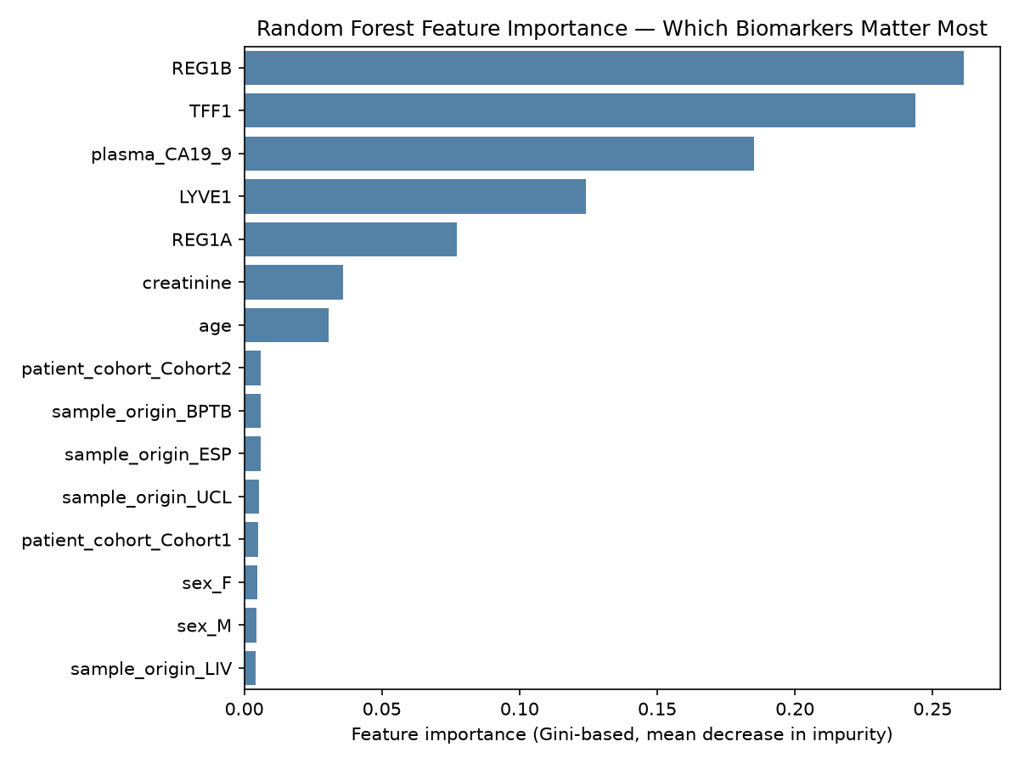
KEY INSIGHT
Which biomarkers matter most?
Top 3 predictors
REG1B
0.261
Regenerating protein — highest importance
TFF1
0.244
Trefoil factor, tissue repair protein
CA19-9
0.185
Standard clinical pancreatic marker
Demographic and batch features (age, sex, cohort, site) contribute little — the model relies on biology, not collection artifacts.
11

Slide 12
DISCUSSION
Limitations & future work
Limitations
Future work
Synthetic data — real Kaggle CSV not yet substituted
Small sample size (~590) typical of clinical datasets
Single train/test split; no repeated k-fold reporting
Gini importance can favor continuous over categorical features
No external, site-held-out validation cohort
Swap in the real UCI/Kaggle dataset and re-run
Add permutation importance & SHAP for robustness
Leave-one-cohort-out validation across sites
Focus on early-stage-only PDAC (Stage I/II) detection
Calibrate predicted probabilities for clinical thresholds
12

Slide 13
Conclusion
A Random Forest on five urinary biomarkers separates PDAC from Control/Benign with 91.5% accuracy
REG1B, TFF1, and CA19-9 emerge as the clinically meaningful drivers — a foundation for a low-cost, non-invasive early-screening tool, pending validation on the real dataset.
Thank you
Code, data, and reports: github.com/kareem1207/Early-Stage-Pancreatic-Cancer-Detection-Using-Random-Forest-Classification

