Slide 1

SVN in Eclipse
Presented by David Eisler
10/09/2014

Slide 2
Agenda
Pre-Requirements
Free SVN Hosting
Update Site
SVN Repository Exploring
Share Project
Team Synchonization

Slide 3
Pre-Requirements
Eclipse. I am using Eclipse Standard 4.4 (Luna) for 64 bit version in this tutorial.
You can download Eclipse at: https://www.eclipse.org/downloads/
Eclipse will run on most Windows and Linux OS’s (See previous link)

Slide 4
Free SVN Hosting
Assembla: http://offers.assembla.com/free-subversion-hosting/
xp-dev: https://xp-dev.com/
RiouxSNV: https://riouxsvn.com/
To name a few!
Just create an account and repository. The repository should have a download link. Take note of that.

Slide 5
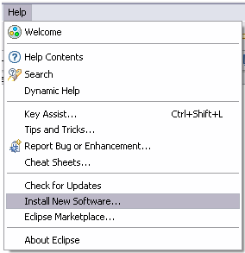
Install Subversive in Eclipse
Start Eclipse and select menu item 'Help > Install New Software...'

Slide 6
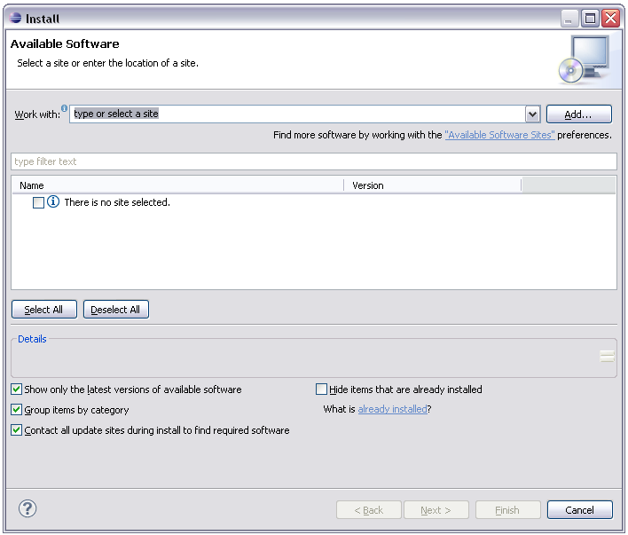
Directly add the subversive update site by pressing the Add button

Slide 7
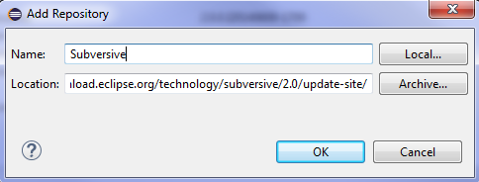
Within the Add Repository Dialog copy and paste the update site to the Location test field: http://download.eclipse.org/technology/subversive/2.0/update-site/
Press OK

Slide 8
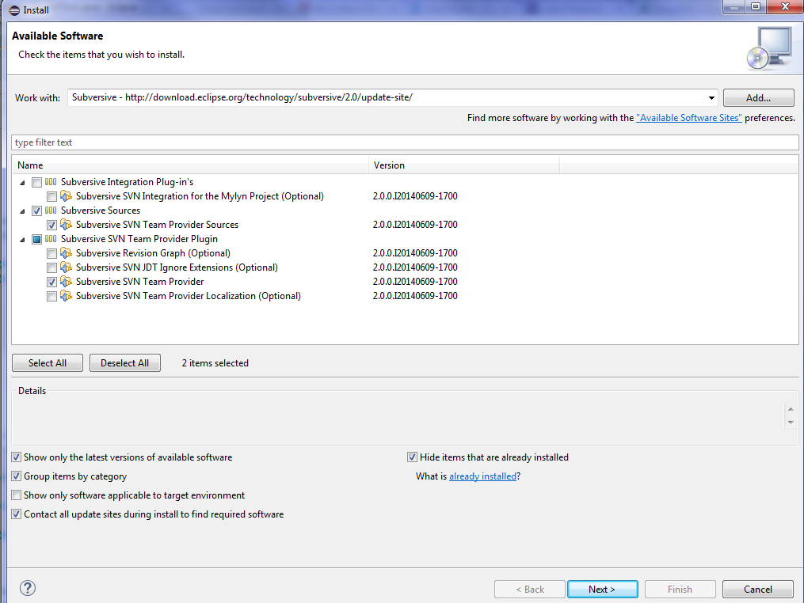
You only need to select the required components
Press Next

Slide 9
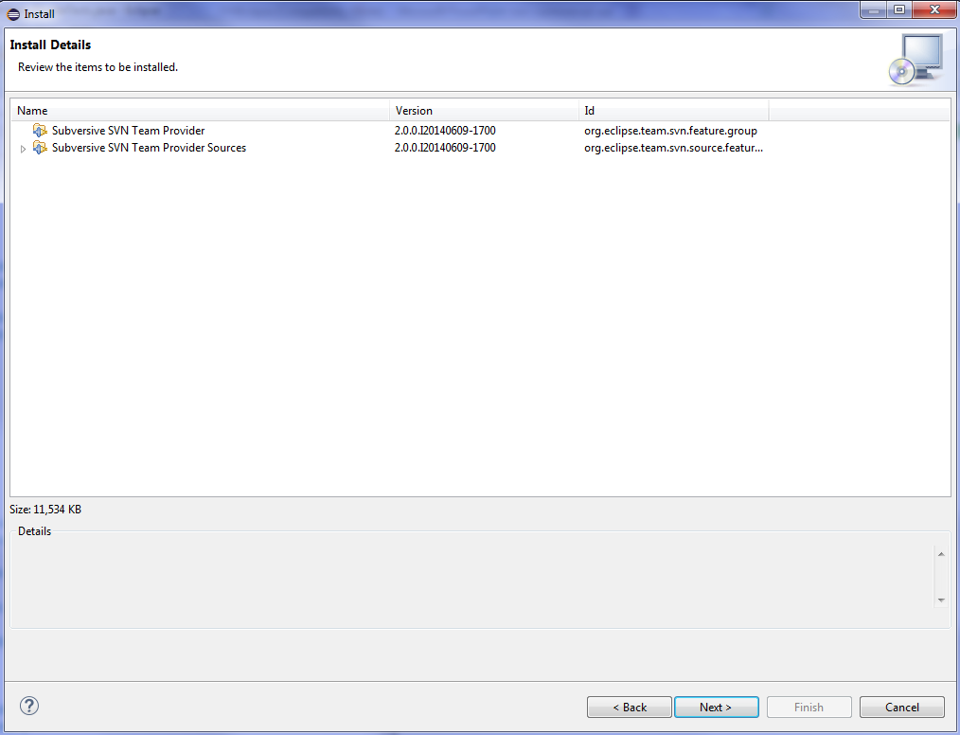
This is the resulting screen
Press Next

Slide 10
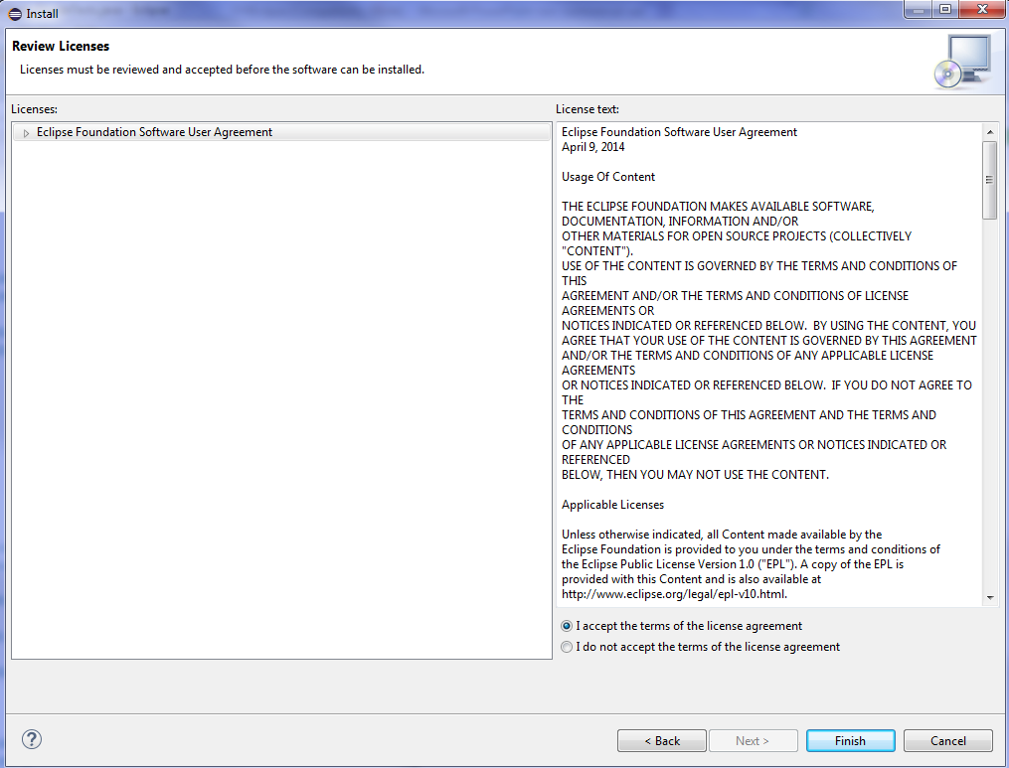
Agree and click Finish

Slide 11
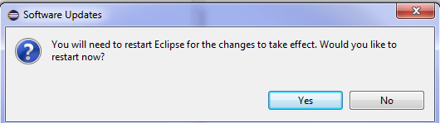
Restart Eclipse
Notes:
Note: this install will just be for this instance of Eclipse. If you have multiple instances for different workspaces you want to repeat all these actions in an Administrator mode if you are in Windows or in Sudo mode if you are in Linux

Slide 12
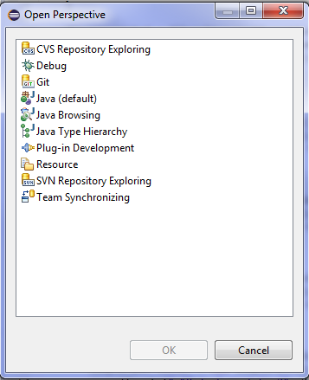
‘Windows>Open Perspective>Other’
See SVN Repository Exploring and Team Synchronization

Slide 13
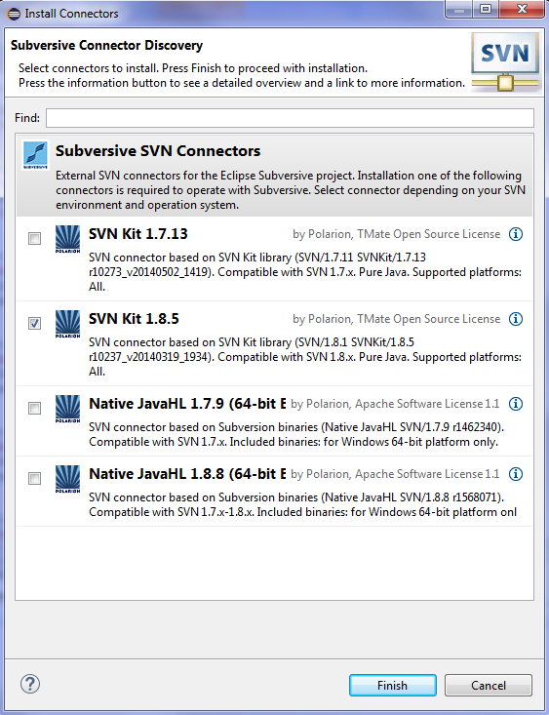
After Eclipse restart you'll see connectors discovery dialog which will allow you to install Subversive Connectors without registering connectors update site manually.
Select the newest SVN Kit version and press Finish.

Slide 14
Click on SVN Repository Exploring to add your repository to the workspace.
Click on the:
To add your repository

Slide 15
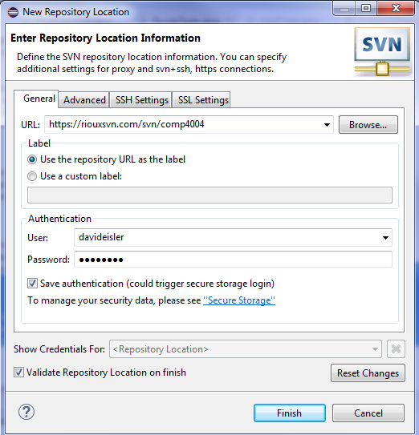
Copy and paste the link to your repository below:
Press Finish

Slide 16
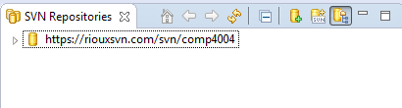
You will now see the repository in your SVN Repository Exploring perspective:

Slide 17
The repository is empty. To upload our work we can share a project.
For example, go to the Unit testing project we created earlier.
Right Click>Team>Share Project

Slide 18
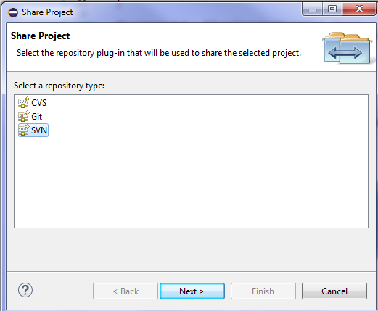
Highlight SVN and click next:

Slide 19
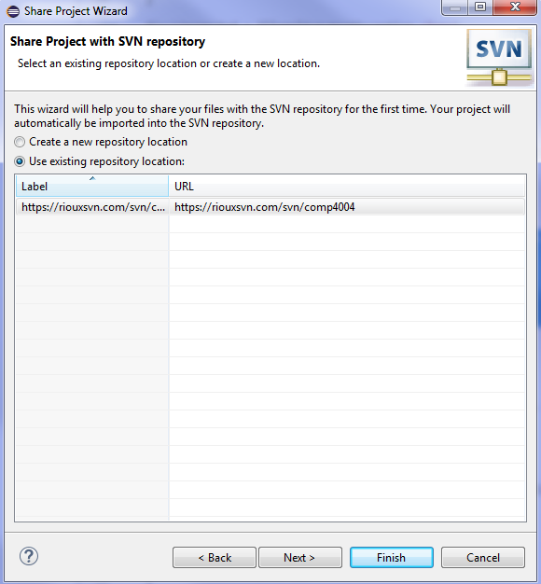
Ensure that the repository that we just created is highlighted:
Press Finish

Slide 20
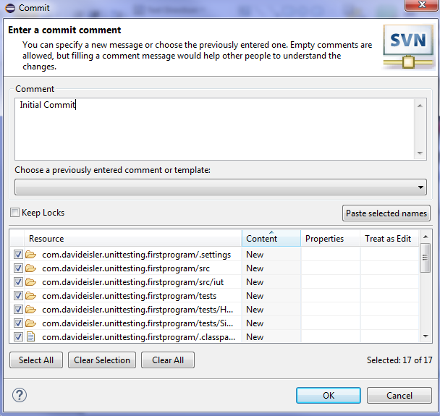
A screen will prompt you to leave a comment for your initial commit:
Write comment
and press OK

Slide 21
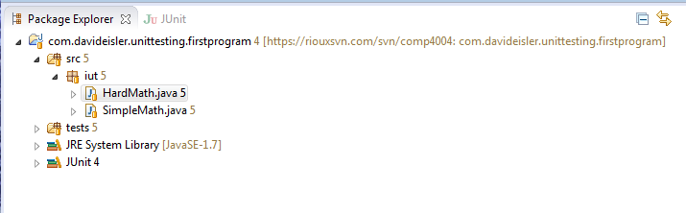
Within the Package Explorer in the Java perspective you will see this:
Our project is now saved in our repository and is synchronized

Slide 22
Alternatively, if we already have a project saved within our repository but not in our workspace we can check it out.
‘Go to SVN Repository Exploring perspective>Right click project>Check Out’

Slide 23
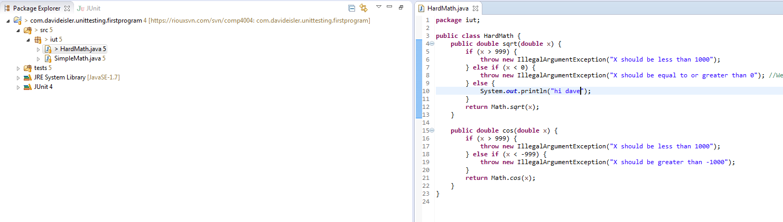
Let’s make a change to the project in our workspace.
You will notice a > in the name of the project. This indicates that there is an outgoing change in our project.

Slide 24
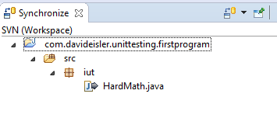
If we go to the Team Synchronization perspective and click on:
This will compare our workspace to what is in the repository.
I made a change in the HardMath class:

Slide 25
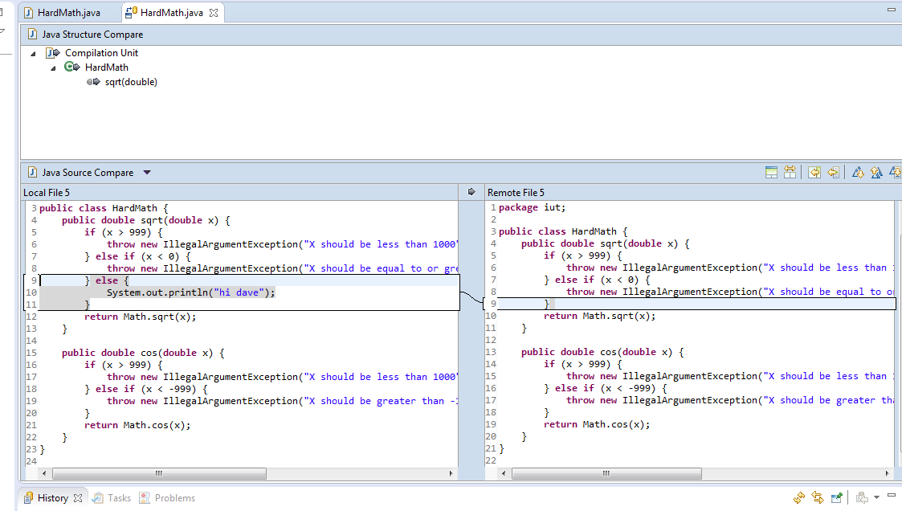
If we double click on HardMath we will have a comparison view open:
We can see here that I added an else statement.

Slide 26
If we decide to commit this to the repository we can either right click on HardMath and commit or if we have multiple commits we can click on the:
To commit all outgoing changes.
Warning: We must ALWAYS synchronize before we commit!!!
If another team member has committed something we need to synchronize with their work or we risk corrupting files in the repository.

Slide 27
Much like we review our changes as outgoing changes (Our workspace to the repository) after we synchronize we can review our team members changes as ingoing changes (Repository to your workspace).
These will show up in the Team Synchronization perspective much like our outgoing changes did. We can accept all incoming changes by pressing:
Or we can accept each change individually by right clicking and pressing update.

