Slide 1



prototyping

Slide 2
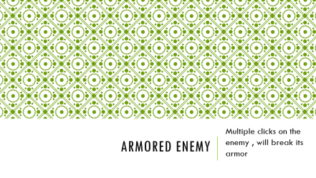

Enemies

Slide 3
Wolfman
Only a wizard can turn him back to a normal human

Slide 4
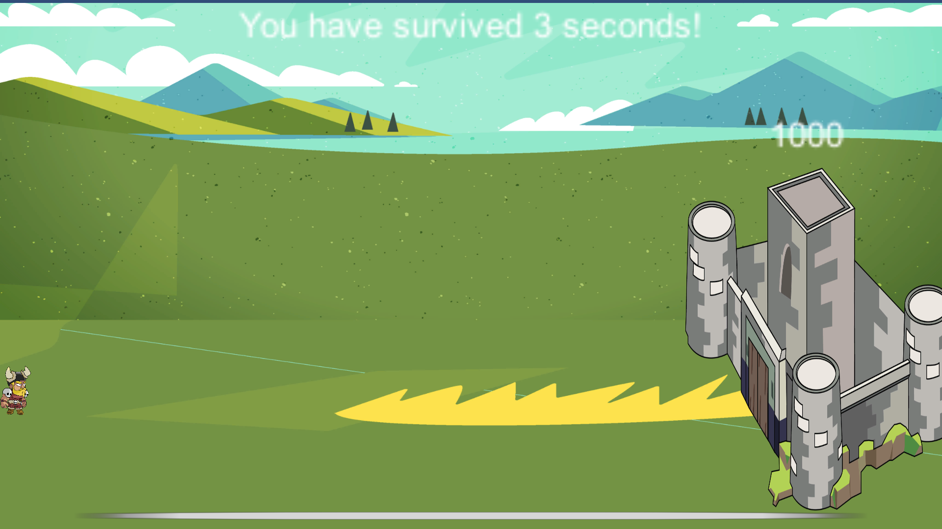
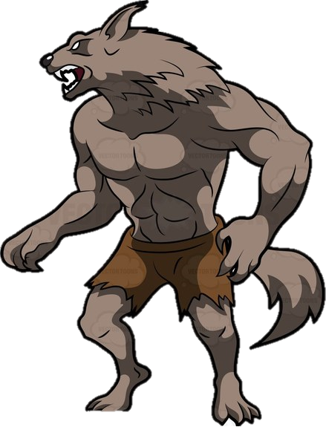


Slide 5
The wolfman cannot be thrown

Slide 6
The wolfman will attack the castle a few times then leave
900

Slide 7


-40
A wizard can turn a wolfman to a normal soldier, but the wizard itself will cost you XX seconds
which means you need to stay alive more time, to get a high score
900

Slide 8
-40
900

Slide 9
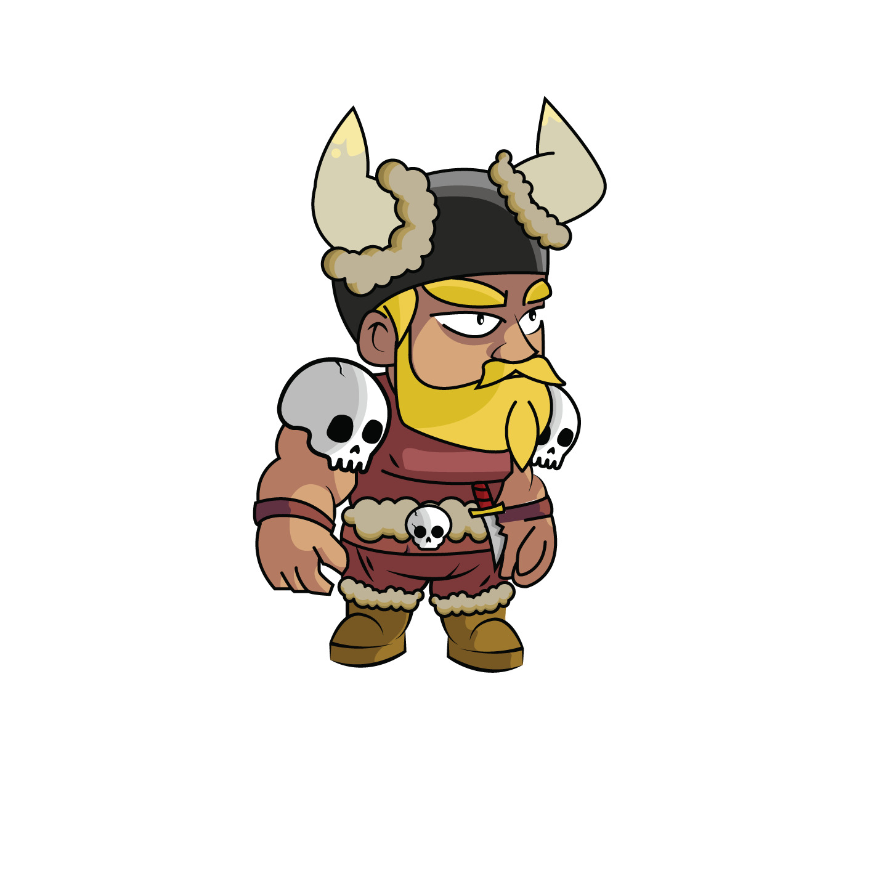
-40
900

Slide 10
-40
900

Slide 11
-40
900

Slide 12
Armored enemy
Multiple clicks on the enemy , will break its armor

Slide 13
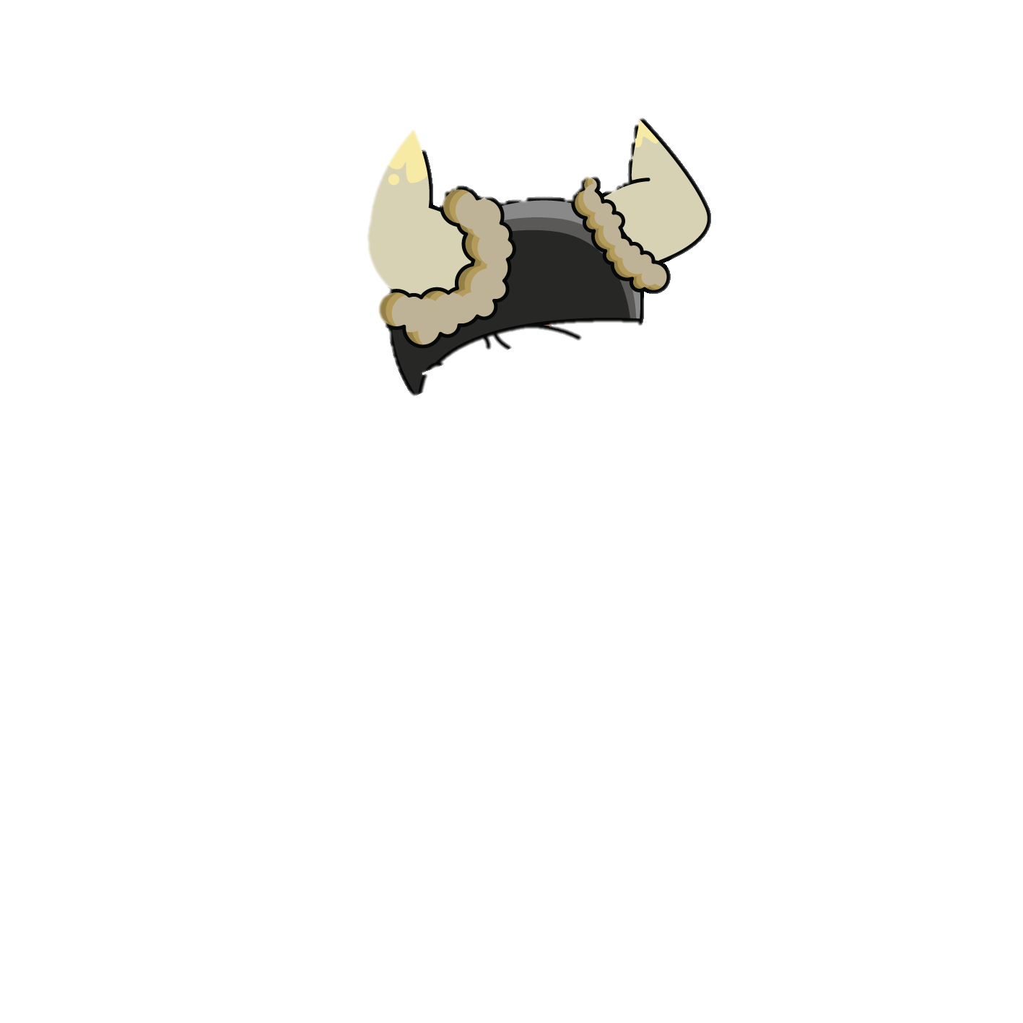

Slide 19


Slide 24
boss
-A Boss arrives every 3 minutes,
-the boss will stop the time counter
-After killing the boss , the time will resume
-Every boss counts to a “level”
-the main goal is still to get the longest time
-damage dealt to your castle from the boss remains in the next “level”

Slide 25
Doodle boss
You need to match the Boss’ doodle to kill him

Slide 26
Time stopped

Slide 27
Time stopped
The boss tells you the doodle, if you don’t write the doodle quick enough on the screen
The boss will attack

Slide 28
Time stopped

Slide 29
Time stopped
If you do write the doodle, it will hurt the boss, and stops him from attacking
800

Slide 30
Time stopped
If you do write the doodle, it will hurt the boss, and stops him from attacking
800

Slide 31
Time stopped
800

Slide 32
Castle upgrades

