Slide 1

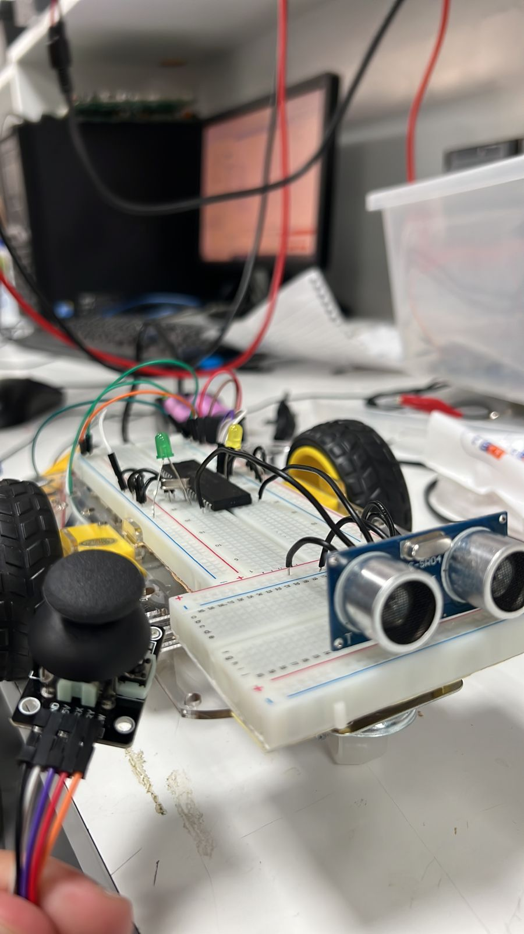
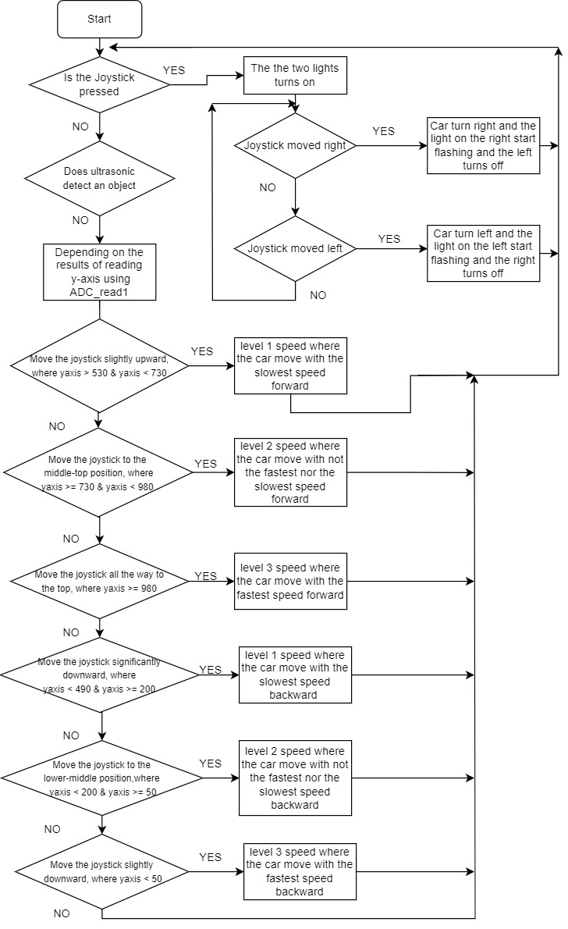
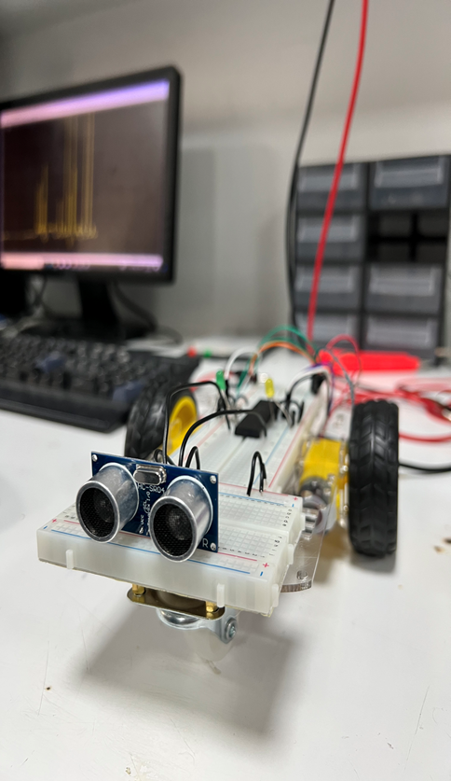
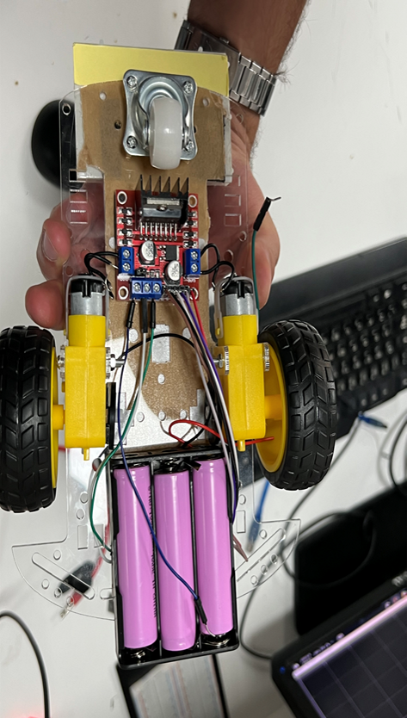
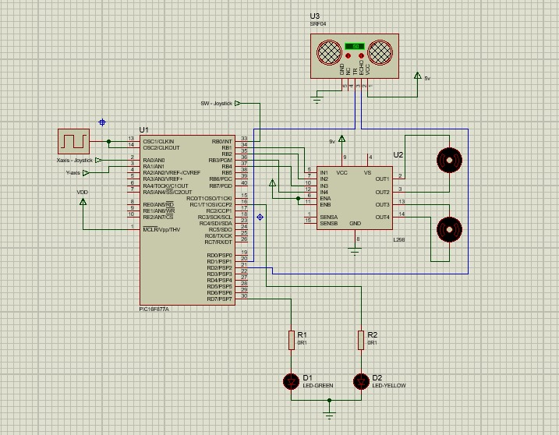
Joystick-Controlled Car
K.Alkhatib, O.Abushaqra, M.Abulaila
Supervisor: Dr. Belal Sababha Embedded Systems Final Design Project, Spring 2023 King Abdullah II School of Engineering
Princess Sumaya University for Technology
Introduction
We created an embedded system project utilizing the PIC 16F877A microcontroller. The project focuses on designing and implementing a wired joystick module-controlled car capable of movement in four directions (forward, backward, left, and right) with three levels of speed control. Additionally, an ultrasonic sensor is incorporated to detect nearby objects, interrupt the system, and activate LEDs as a visual indication.
Results
Developed an embedded system that allows users to control a car's movement and speed using a wired joystick module, Verify that the car responds accurately to each joystick input and moves in the desired direction.
Figure 4: Hardware Design
Interface the PIC16F877A microcontroller with the wired joystick module to read analog signals representing the desired speed and direction.
Figure 5: Ultrasonic Sensor Position
The ultrasonic sensor continuously measures the distance between the car and nearby objects. When an object is detected within the specified range, the microcontroller activates the corresponding LEDs to indicate the proximity.
Figure 6: Motor Control using H-Bridge
The H-Bridge circuit, connected to the PIC microcontroller, controls the DC motors' rotation and speed. The microcontroller generates the necessary control signals (PWM) to activate the motors and adjust their speed based on the joystick inputs.
Design
Embedded system project designed to control a car using a wired joystick module with three levels of speed. The project utilizes the PIC16F877A microcontroller as the core component to interface between the joystick module and the car's control system.
Figure 1: Software Design (Flow chart)
Figure 2 Electrical Design
Conclusion
The embedded system project successfully implements a wired joystick module-controlled car utilizing the PIC 16F877A microcontroller, H-Bridge motor control, and ultrasonic proximity detection. The project's architecture and implementation provide users with intuitive control over the car's movement while ensuring safety through object detection and LED indication. The system demonstrates the capabilities of the chosen microcontroller and serves as a foundation for further enhancements and applications in the field of robotics and automation.

