Slide 1


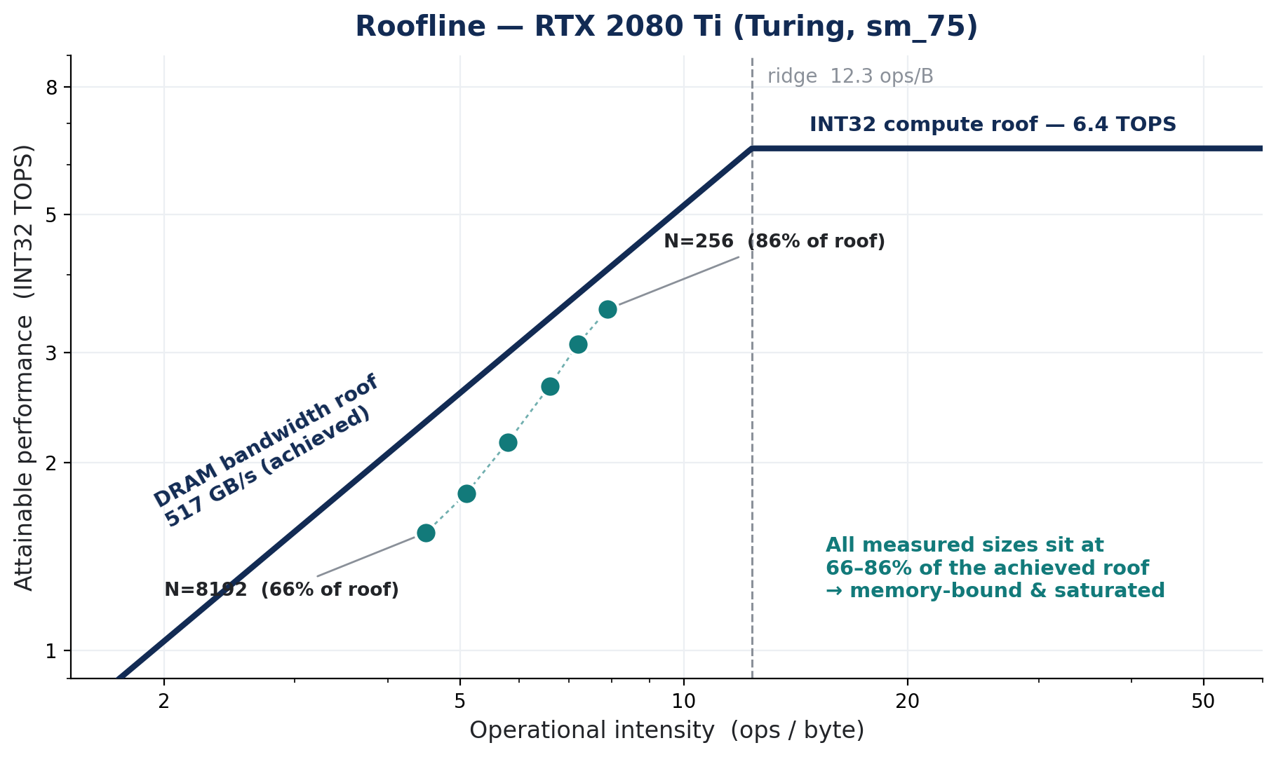
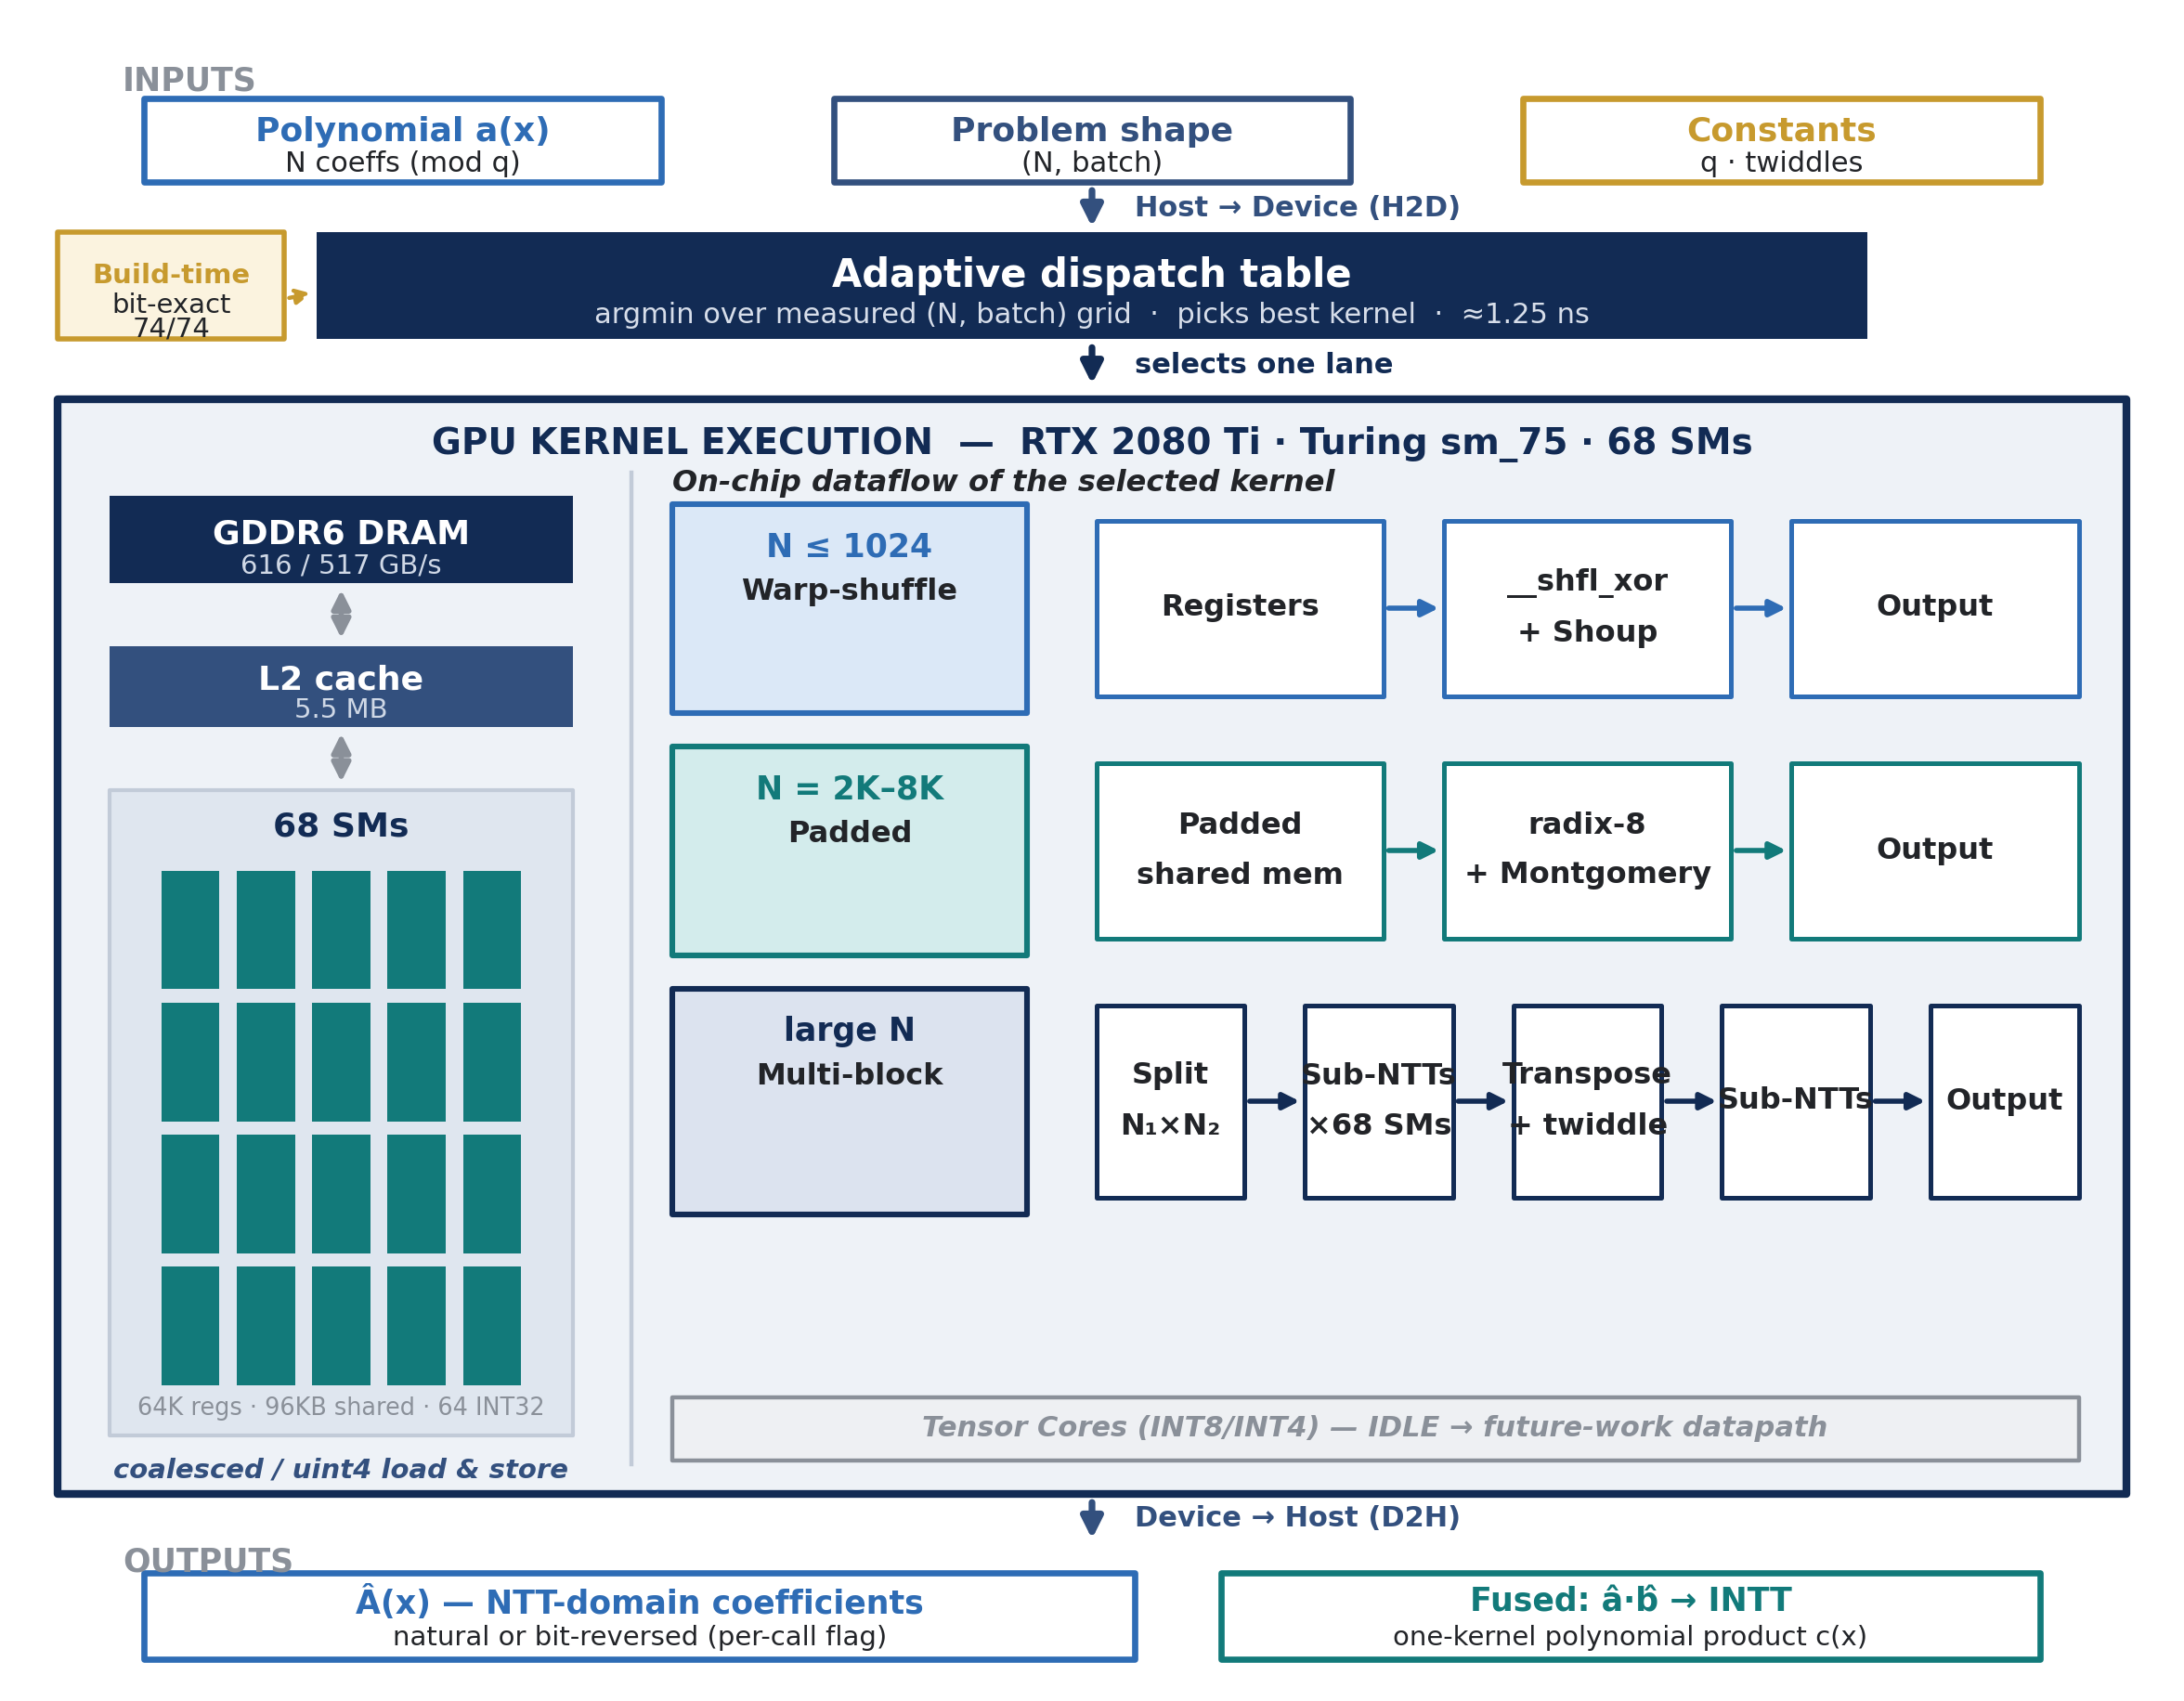
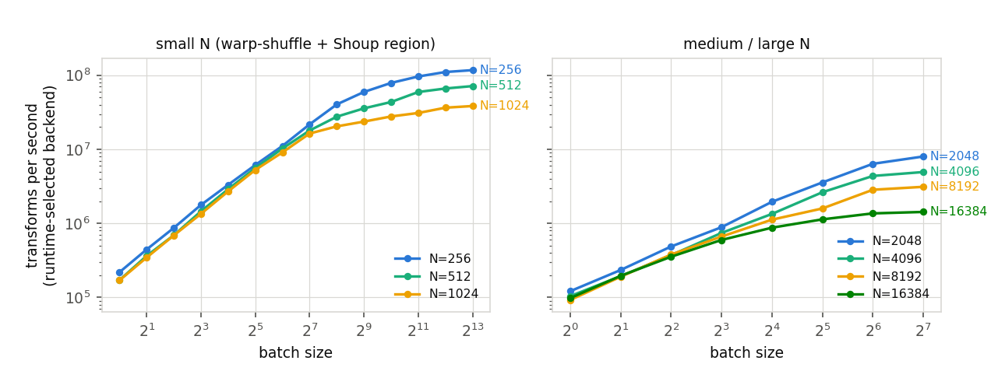
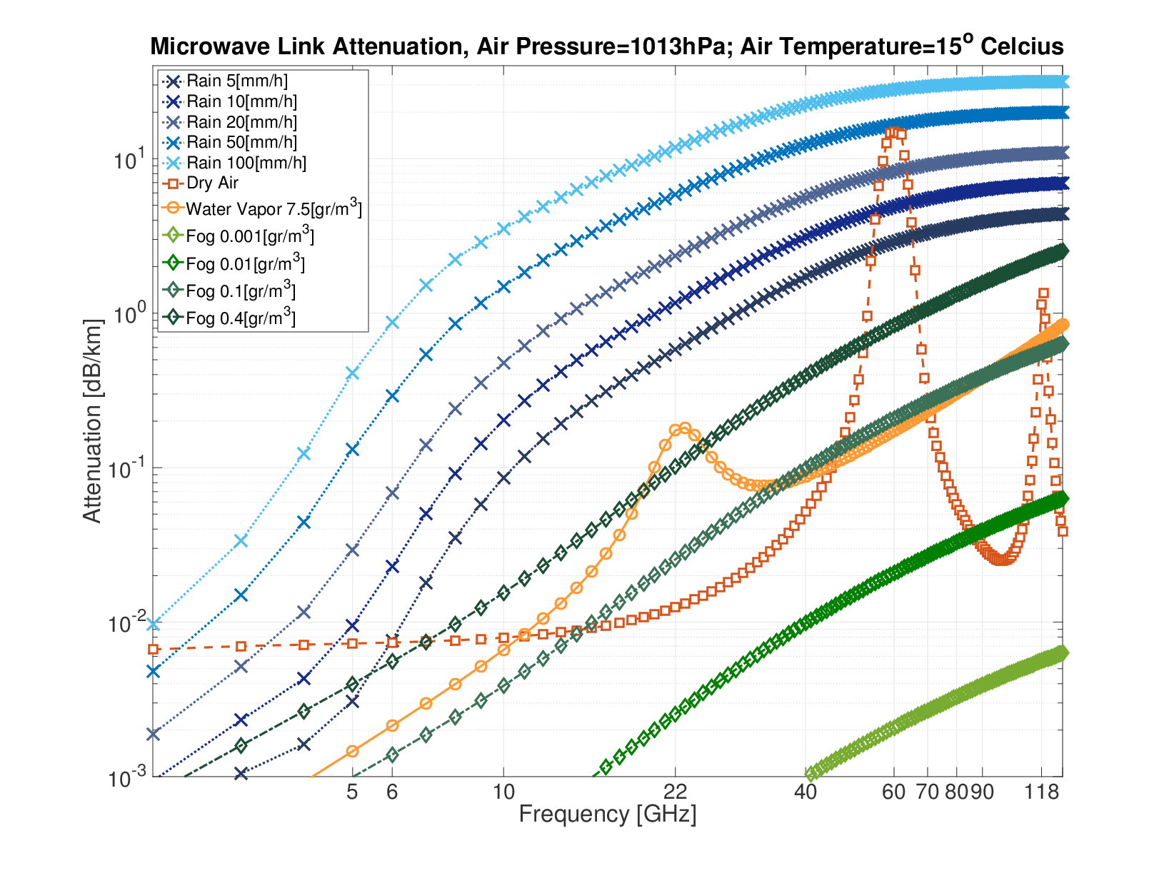
GPU-Accelerated Number Theoretic Transform (NTT)
Kareem Bwakny, Hakeem Najjar
Advisor: Mr. Oren Ganon
Project Number: 3363
Introduction
Implementation
Performance analysis
The Number Theoretic Transform (NTT) is the modular-arithmetic analogue of the FFT and the computational core of post-quantum (lattice) cryptography, homomorphic encryption, and zero-knowledge proofs — workloads that evaluate millions of transforms.
Goal: implement and optimize the NTT as a family of architecture-aware CUDA kernels on an NVIDIA RTX 2080 Ti (Turing, sm_75), tuning each problem regime for the specific hardware limit that binds it.
▸ Warp-shuffle + Shoup (N ≤ 1024): early butterfly stages run in registers via __shfl_xor — no shared memory, no barriers (4.5 µs latency floor).
▸ Padded shared memory (N = 2048–8192): one pad word per 32 elements → bank-conflict-free; radix-8 butterflies cut synchronization barriers 13 → 5.
▸ Multi-block 4-step (large N, low batch): one transform across all 68 SMs; a radix-4 + coalescing rewrite adds 1.65×, extending cleanly to N = 16384.
▸ Fused polynomial multiply (NTT → pointwise → INTT): one kernel replaces four, cutting DRAM traffic 9N → 3N words.
▸ Compiled adaptive selector routes the measured-best kernel per (N, batch); 0 register spills.
Motivation
Results
Single-NTT latency and throughput set whole-system performance. Crucially, no single kernel is optimal across all sizes — the binding hardware limit changes with the (size, batch) regime:
▸ latency · bank conflicts · synchronization barriers · grid occupancy · DRAM bandwidth.
2.12×
vs existing models
58.6×
vs optimized C++ CPU
86%
of DRAM roofline
Fig. 3 — every measured size sits at 66–86% of the achieved DRAM roofline: memory-bound and saturated.
Conclusions
System architecture
110.9 M
transforms / s (peak)
4.5 µs
small-N latency floor
74/74
configs bit-exact
The NTT meets a chain of distinct hardware limits — barrier count (radix-4/8), then barrier cost (block size), then twiddle-table footprint (Montgomery at large N). Each regime is bound by a different resource, so specialization is necessary and the selector makes it automatic.
Future work
INT8 tensor-core sub-transforms · Nsight profiling · persistent small-N megakernel · self-calibrating dispatch · full ML-KEM pipeline.
Fig. 1 — end-to-end pipeline; the GPU stage is opened to its memory hierarchy and per-regime on-chip dataflow.
Fig. 2 — throughput (transforms/s) vs batch size for each N; the DRAM-saturation knees are visible across the grid.

