Slide 1

Sales price for Properties in
DATA ANALYTICS | Karim November, 2022

Slide 2
Note: My coworker (Ahmed Gaber) and I decided to solve the same problem, but we each have our own way of cleaning, and we also have different research questions.

Slide 3
Goal
For this project, I'm going to build a machine learning model that could predict the property sales price for properties in NYC. I'm dividing my project into the following sections:
EDA
Data Preparation
Modelling

Slide 4
EDA, Feature Engineering, and AutoML
We will apply learned concepts from Day 3-4 lectures to perform ‘data exploration’, ‘feature engineering’, and ‘autoML’ on a ‘House Sale’ dataset.
The goal of this assignment is to analyze 3 years’ ”(2018-2020) House Sales” data provided by “New York City” (NYC) government and build regression model to predict house price.
NYC has five boroughs, i.e., “Bronx”, “Brooklyn”, “Manhattan”, “Queens” and “Staten Island”.
Sales of houses in each borough has been provided.

Slide 5
Exploratory Data Analysis (EDA)
The EDA is divided in the following steps:
Basic data exploration
Identification of variables and data types
Missing values
Univariate Analysis
Bivariate Analysis
Correlation matrix
Conclusion
Note :
The data size before EDA was 277,803 rows x 21 columns.
And after EDA it was 223,426 rows x 19 columns.

Slide 6

Research questions:
Hypothesis: Manhattan is the most densely populated of New York City’s 5 boroughs source
What is the most real estate properties in New York City for each Boroughs ?

Slide 7
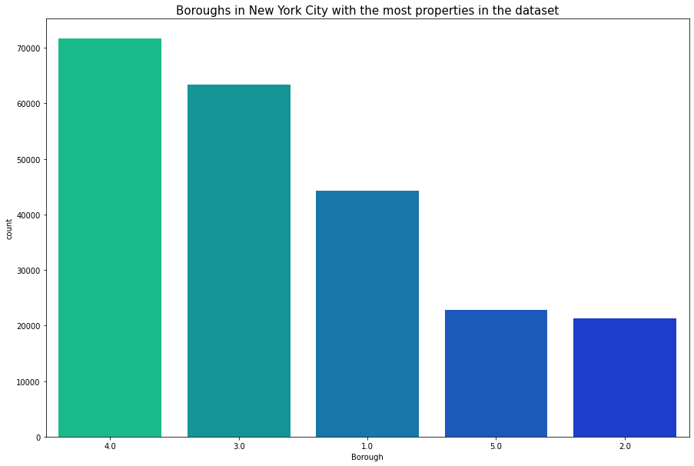
Research questions CONT. :
Ans: Although Manhattan is the most densely populated neighborhood in New York City, Queens in New York City with the most properties in this dataset.
More than 32% just for Queens Borough , Which is more than Manhattan's percentage ~19%
This will be useful for governments because they will think that the neighborhoods with more real estate have more population density, which is not true, and therefore they will focus their efforts to provide public services to the most crowded neighborhoods
Note : BOROUGH -> A digit code for the borough the property is located in; in order these are Manhattan (1), Bronx (2), Brooklyn (3), Queens (4), and Staten Island (5).

Slide 8
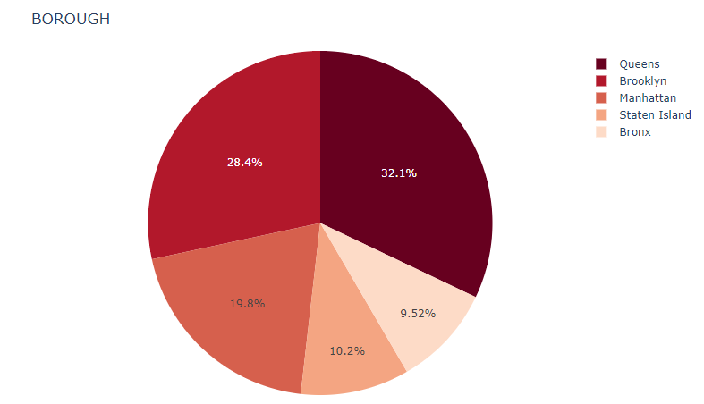
Research questions CONT. :
Now let’s start making our Pie chart for the first 6 highest values int the BOROUGH column.
It seems that Queens has the most properties of all the boroughs in New York City in this dataset.

Slide 9

Research questions CONT. :
What is the distribution of real estate prices for each BOROUGH during the months of the year, and what is the number of units sold for each month as well?
The importance of this question for the buyer so that he can know the right time to buy the best property at an appropriate price.
It is obvious to see that the more units sold during a particular month of the year, the lower the real estate prices in that month also, according to the theory of supply and demand.

Slide 10
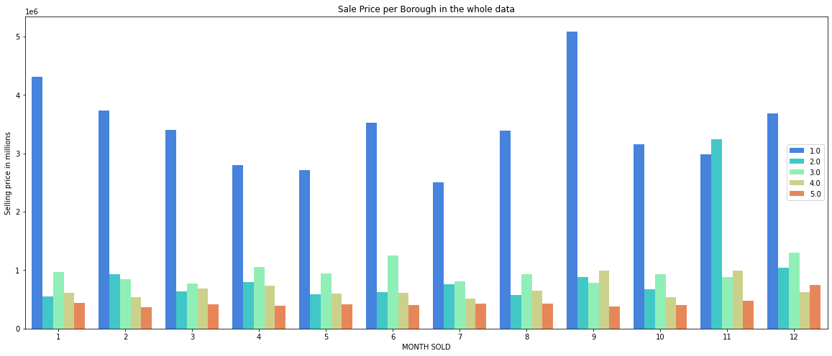
Research questions CONT. :
It seems that the most expensive property sold in all data was in the city of Manhattan.
And its value was approximately $ 5 millions ,and that was in September .

Slide 11
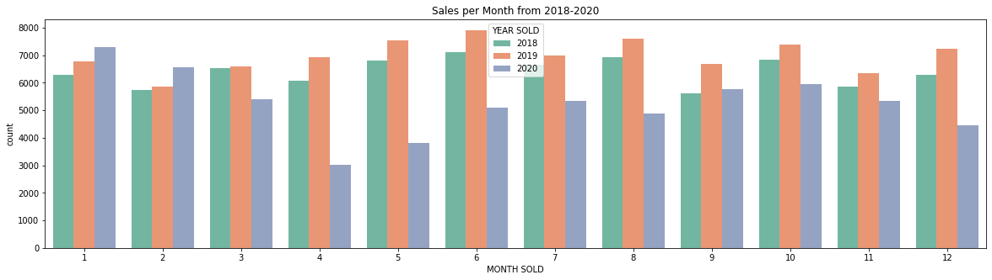
Research questions CONT. :
It seems that in June 2019, the largest number of properties were sold, which is more than 700 properties.

Slide 12
Data Exploration via Statistical Test
Is there a difference between the Average Land square feet in each Borough and Average Gross square feet in each Borough ?
This will be useful for people who are looking for cheap prices for real estate without looking at the difference between the average ratio for Gross square feet and Land square feet.
Null hypothesis: The Average Land Square feet for each Borough will be equal to the Average Gross square feet .
Alternative hypothesis: The Average Land Square feet for each Borough will be different to the Average Gross square feet .

Slide 13
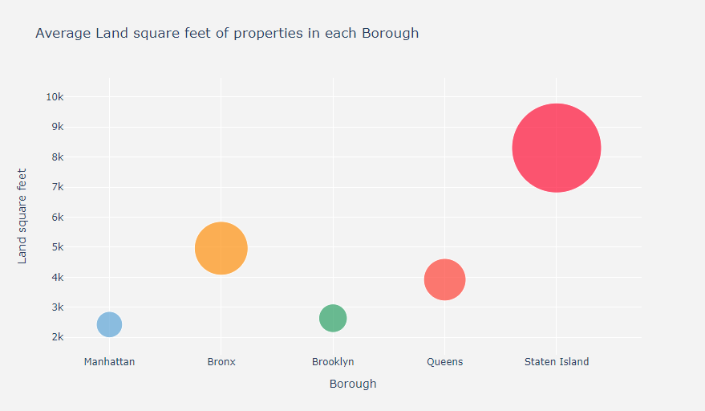
Average Land square feet in each Borough
To plot average land square feet in each borough I am using bubble chart, In this type of chart the size of the bubble indicates the magnitude of the variable.
Manhatten price mean : 2423.697
Bronx price mean : 4962.092
Brooklyn price mean : 2634.649
Queens price mean : 3917.403
Staten_Island price mean : 8304.309

Slide 14
The ANOVA for Statistical Hypothesis Testing
With ANOVA, you get to discover obvious differences between the means of your independent features. Upon getting a clearer picture of the differences.
you can understand how each of them connects to your dependent variable. You can see what are the influencing factors for the relationship.
stat=47.237, p=0.000
Probably different distributions

Slide 15
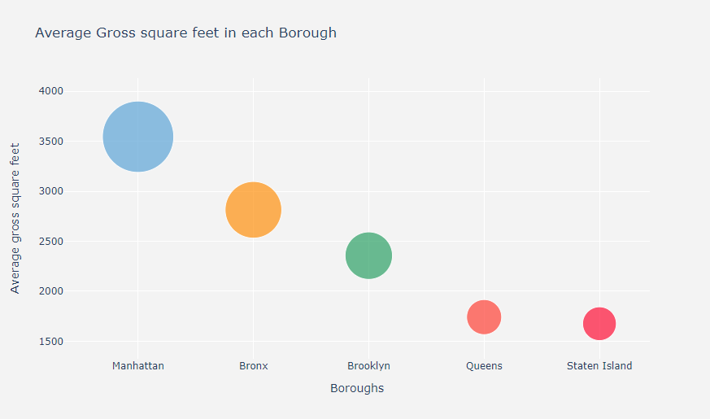
Average Gross square feet in each Borough
Manhatten : 3546.027
Bronx : 2814.955
Brooklyn : 2356.357
Queens : 1741.704
Staten_Island : 1675.586
stat=57.698, p=0.000
Probably different distributions
As we can see both of them are different in distributions the first one give us ~47 and the second one give us ~57 in statistics testing with ANOVA test.
So my Alternative Hypothesis is true.

Slide 16

Machine Learning Part
This is what my modelling part looks like so far:
1. Modelling
2.Predictions and evaluation
3.Feature Engineering
4.Compare results

Slide 17
Modelling:
For the modelling part, I'm going to use pipelines. Pipelines are a simple way to keep your preprocessing and modelling code organized.
These are the steps that I'm taking for building a machine learning model:
Splitting the data
Using OneHotEncoding to transform the categorical features into numerical values
Using ColumnTransformer to bundle the different preprocessing steps
Instantiate a model
Bundle the preprocessing and model code in a pipeline

Slide 18
Predictions and evaluation
Mean Absolute Error (MAE): Every residual (distance between fitted line and observation) needs to be calculated for every data point, taking only the absolute value of each. Then the average of the residuals is the MAE.
Mean Squared Error (MSE): The MSE is just like the MAE, but squares the difference before summing them all instead of using the absolute value. MSE is more popular because it punishes larger which tend to be useful in the real world.
R2: In regression, R2 a statistical measure of how well the regression predictions approximate the real data points.

Slide 19
Feature Engineering
To improve my model's performance, I'm going to use feature engineering. Feature engineering is the process of creating new features that didn't exist before to improve my models predicting performance.
Mathematical transforms: Using arithmetic operations to create new numerical features.
Group Transforms: Groups transforms aggregate information across multiple rows grouped by some category.
Features I'm thinking about:
Price per land square feet
Price per gross square feet
Median sale price per neighboorhood
Median sale price per borough
Median sale price per zipcode

Slide 20
Compare results
To compare the results, I'm taking a look at the performance on the validation data.
For the predictions and evaluation part of this project I'm using the Random Forest Regressor.
Before Feature Selection
Validation MAE | 72.01%
Validation MSE | 84.71%
Validation R2 | 15.18%
After Feature Selection
Validation MAE | 0.098%
Validation MSE | 0.025%
Validation R2 | 99.75%

Slide 21
Compare results cont.
Algorithm | Train Score | Val MAE | Val MSE | Val RMSE | Val R^2
AutoML | 0.9993 | 0.014 | 0.003 | 0.051 | 0.997
Random Forest Model | 0.9997 | 0.014 | 0.003 | 0.051 | 0.997
Linear Regression Model | 0.091 | 0.771 | 0.918 | 0.958 | 0.085
KNN MODEL | 0.804 | 0.243 | 0.310 | 0.557 | 0.691
SVR MODEL | 0.114 | 0.649 | 0.901 | 0.949 | 0.109
Decision Tree Regressor MODEL | 1.0 | 0.017 | 0.007 | 0.081 | 0.993
GBM MODEL | 0.969 | 0.101 | 0.033 | 0.182 | 0.967
AdaBoost Regressor MODEL | 0.715 | 0.451 | 0.283 | 0.532 | 0.823
XGB MODEL | 0.969 | 0.099 | 0.033 | 0.181 | 0.967

Slide 22

Some comments on the results
The models with the highest performance ware the Decision Tree Regressor and Random Forest Models with (0.997 for R^2). Knowing that they were the fastest to train.
On the other hand, the SVR model (with 0.109 for R^2) and the linear regression model (with 0.085 for R^2) were not good and they took a lot of time training as well, unlike the other models.
In the end, choosing the right model depends on the problem that I want to solve.

Slide 23

Thank you.

