Slide 1
Name : Kareem Gamal Mahmoud prj name : Company Payroll System

Slide 2
Hi Dr. Mohamed !
In my project I created two ways one with Database witch I try to learn it from some tutorials I linked it in the end of this presentation. Other one I used the normal Arraylist as in the lectures
Why I use Database ! Because I see with Database the project will be more Reliably. But i found some problems so I created it with normal way auxiliary.

Slide 3
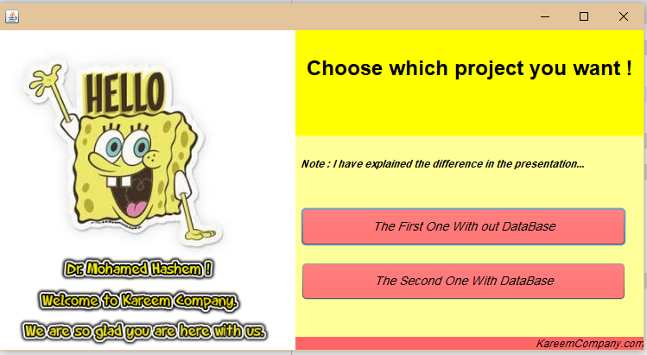
Here you make the choice between the two projects as explained to you above
The first without databases
The second using databases
Its name login.java
This is a welcome text for you

Slide 4
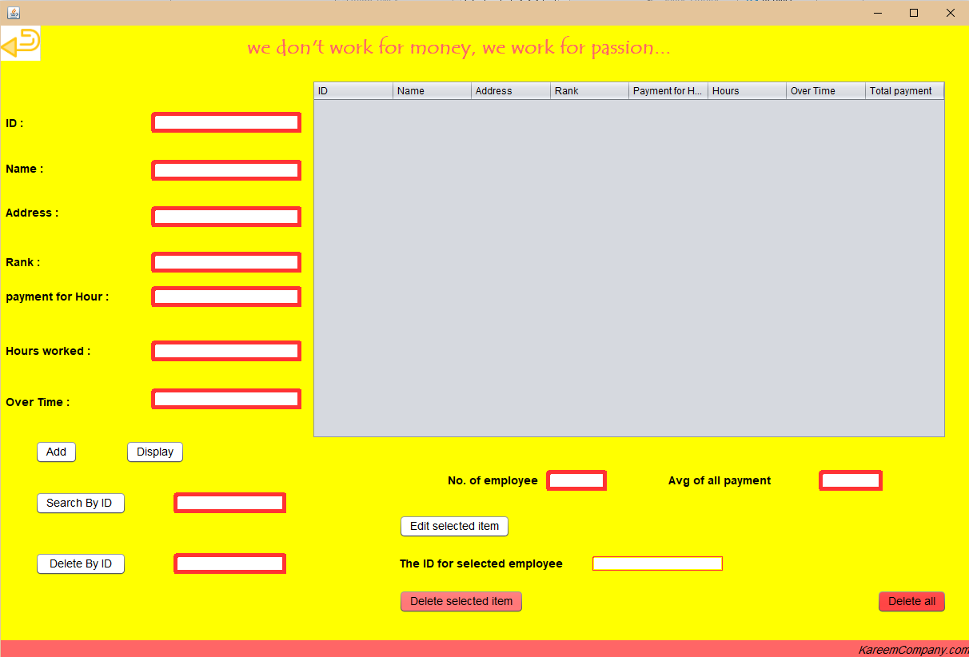

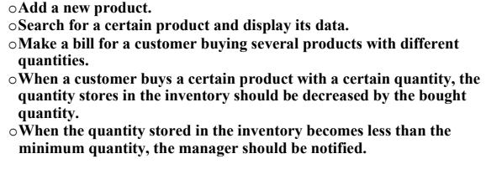

When you click on
You will be taken to this page witch you can be able to
Note : when you press on this you will get back two the first page to make you able to choose the another project .
And also you can Delete or Delete all employee
جملة كده عشان احفز بيها الموظفين و اشيل الضغط من علهم ☺

Slide 5
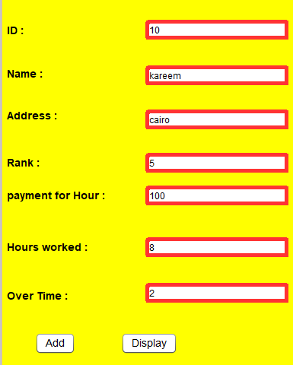
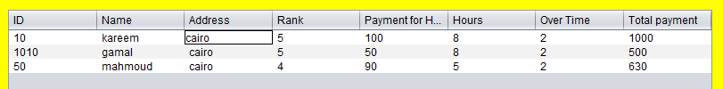

When you press on add the data saved in some of arraylistes as I said above .
Note : The ID cannot be repeated when you insert the data .
When you press on Display the all data you have insert it will be shown in a table and also the no. of employee and the average of all payment will be appeared automatically as shown below .
Some of tables tutorials :
https://www.youtube.com/watch?v=RXhMdUPk12k
https://www.youtube.com/watch?v=6cNYUc2PIag

Slide 6




You can search for an employee by enter his ID in this textfield and click the button and his data will be shown in the table
You can delete an employee by enter his ID in this textfield and click the button and his data will be disappeared from the table
There is no employee his ID is 10 as you see

Slide 7





You can select a row in the table to edit it when you select , all data of this employee go to the thexfield to make you edit it after you change the variable you want click on the button the tha data will be edited to certain press at the display button and you will see the data is updated .
Also you can delete the selected row or all data as you like.
The selected row is gone .
The all data is gone alos .

Slide 8

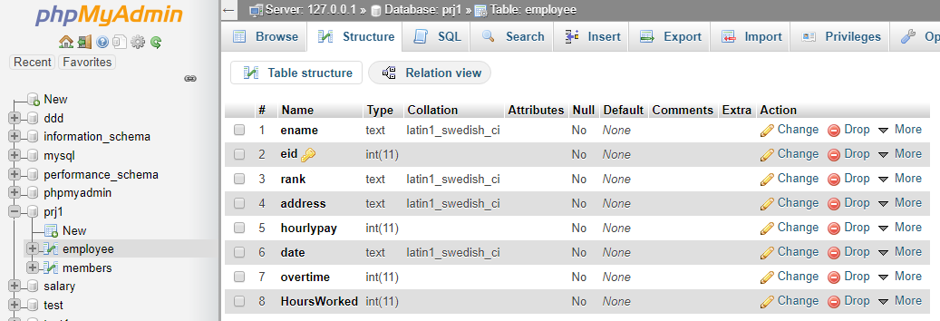
You need the driver to make the project connected with database
You need to import it in the library in the packed as shown
This is a photo for the table and we use only employee table no else
And also the file for this is in the folder
Some of Database tutorials :
And all other function are same .
https://www.youtube.com/watch?v=geyJLEbpp2s&list=PLMYF6NkLrdN_7IJL546hMEatfQLCPKp_T
https://www.youtube.com/watch?v=6IgIyq4QIRI&list=PLfJcnsgJ9GzLVLl0yxtp9lWB8eXKeWpcT

Slide 9
That’s it thank you dr for all your favers to us ☺

