Slide 1

Project Seminar
OPTIMIZING KERAS ANNs FOR PREDICTING MOLECULES MUTAGENICITY
Abd Alkareem AlJEIROUDI
Supervised by
Kristina Preuer, MSc
14.03.2019

Slide 2
OUtline
Molecule Mutagenicity
Introduction to Morgan Fingerprints
AUC as a metric
Strategy of hyperparameter tuning
Summary of tuning data
Statistical analysis
Future work
Project Seminar – Abd Alkareem ALJEIROUDI

Slide 3
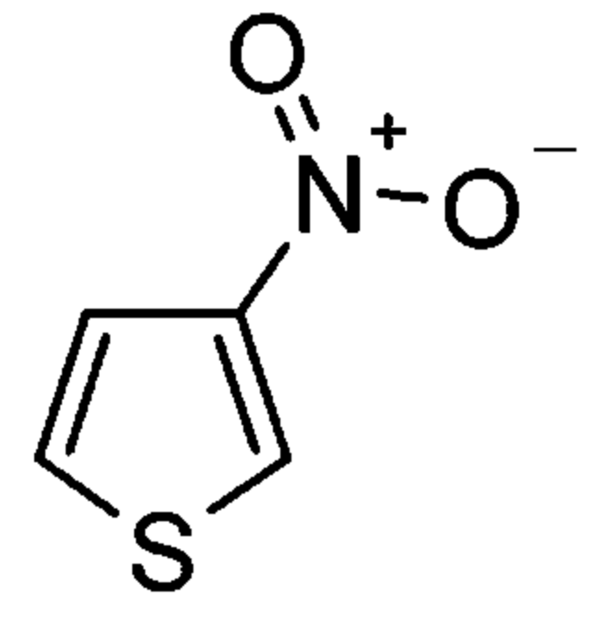
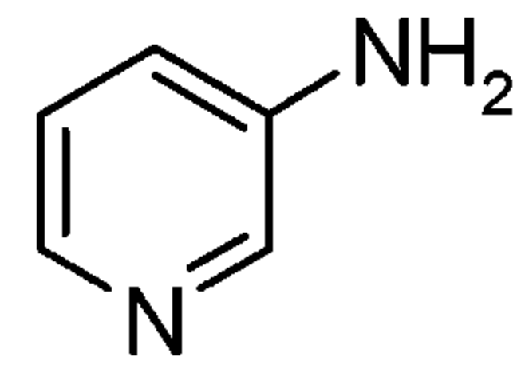
mutagenicity
Avoidance of toxicophores in drug synthesis
Dataset consisting of 4337 molecular structures approved by Ames test:
2401 mutagens (+) and 1936 non-mutagens (-)
Error percentage of 15% ~ labor reproducibility error of Ames tests
Presence of substructural toxicophores detect a mutagen (e.g. aromatic nitro and amine groups)
Aromatic nitro
Aromatic amine
Project Seminar – Abd Alkareem ALJEIROUDI
Notes:
In drug design, chemists try to identify some toxicophores they help with the assessment of toxicity degree.
Approved toxicophores can aid the prediction of mutagenicity in early risk assessment. Since these error percentages approach the average interlaboratory reproducibility error of Ames tests, which is 15%, it was concluded that these toxicophores can be applied to risk assessment processes and can guide the design of chemical libraries for hit and lead optimization.
There are limitations to this though, but we’re gonna discuss them at the end.
Introduce the aim of the project here! Right now, compare to the other paper (Good specificity and sensitivity values up to 85% depending on the descriptors).
Compared to other commercial solutions such as Pipeline Pilot and DEREK.

Slide 4
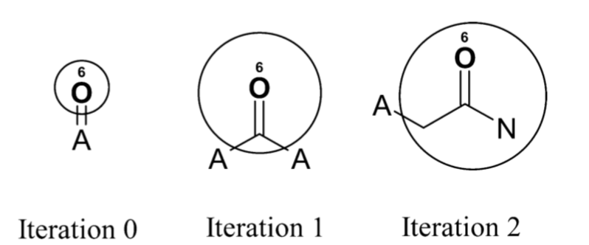
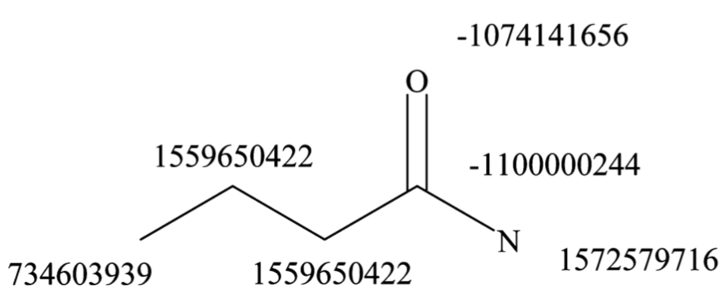
Morgan Fingerprints
Solving molecule Isomorphism
Use of identifiers (e.g. ECFP_6)
Identifiers are calculated using hash function
“Core” atom
Next heavy element
Notes:
Historically, topological fingerprints were developed for substructure and similarity searching.
Molecule Isomorphism: to identify when two molecules, with different atom numberings, are the same)
The way this works: it’s basically an iterative process. First, you have some invariant atoms information, you assign initial identifiers, then you take a larger radius and the identifier used in the previous iteration have canonical information for the next ones. The iterations go on until u have a unique identifier for each atom. There are other variations to this algorithm such as Extended-Connectivity fingerprints but we’re not gonna discuss them because this isn’t the content of this seminar.
Practically, one good example for fingerprints is functional classes in organic chemistry.
In the literature, whenever you read fingerprints it means that there are no duplicate identifiers.

Slide 5
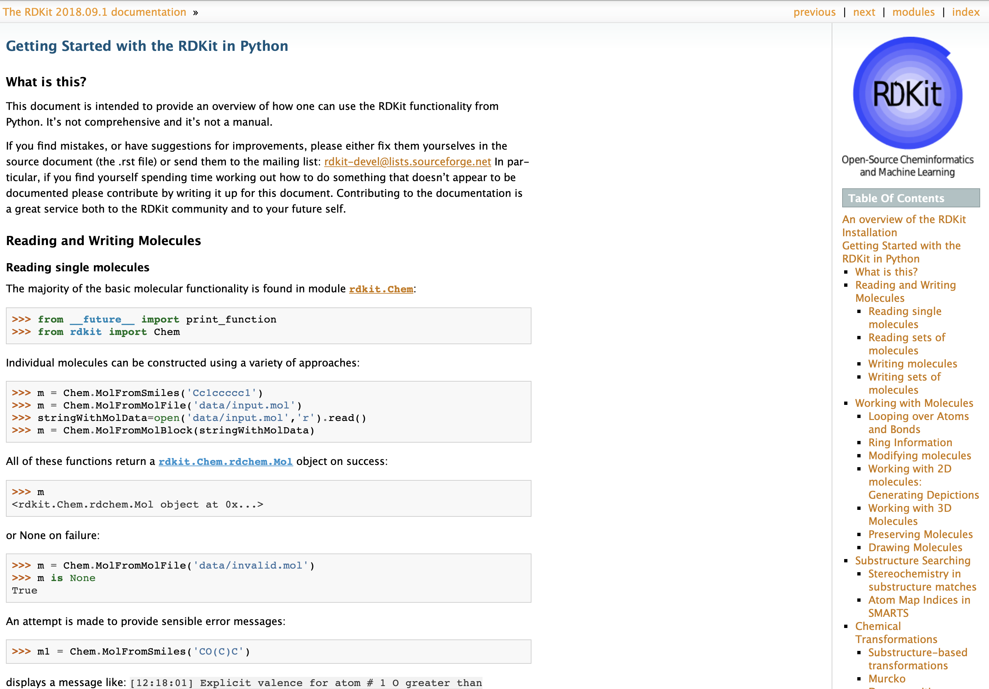
Project Seminar – Abd Alkareem ALJEIROUDI
Notes:
I used the RDKit python library. It has a handful of functions that calculate chemical properties for you.

Slide 6
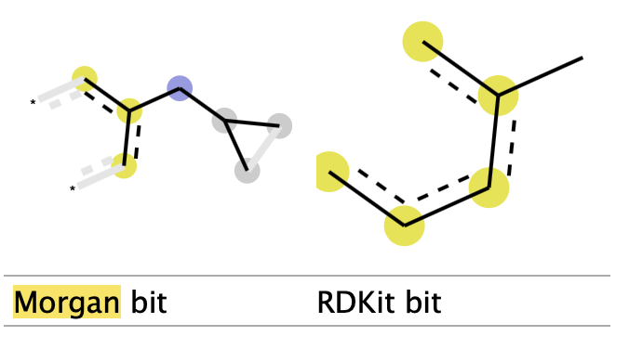
Interpreting the Bits
values are lists of (atom index, radius) tuples
>>> fp = AllChem.GetMorganFingerprint(m,2,bitInfo=info)
>>> len(fp.GetNonzeroElements()) 16
>>> len(info) 16
>>> info[98513984] ((1, 1), (2, 1))
>>> info[4048591891] ((5, 2),)
>>> mfp2_svg = Draw.DrawMorganBit(mol, 872, bi)
Project Seminar – Abd Alkareem ALJEIROUDI
Notes:
Interpreting the above: bit 98513984 is set twice: once by atom 1 and once by atom 2, each at radius 1. Bit 4048591891 is set once by atom 5 at radius 2.
Focusing on bit 4048591891, we can extract the submolecule consisting of all atoms within a radius of 2 of atom 5:

Slide 7
Morgan Fingerprints
A literature from 2014 by Li Qingliang 24 describing drug-like models using support-vector machines. They found out that ECFP fingerprints gave a “consistently superior performance compared to MOLPRINT_2D on all four performance measures (accuracy, sensitivity, specificity, and Matthews correlation coefficient)” [3]
Project Seminar – Abd Alkareem ALJEIROUDI
Notes:
Here I’d like you to read only this “consistently superior performance“, therefore it’s convenient to use these Morgan Fingerprints for drug-like classification problems.
In comparison to MOLPRINT_2D on all performance measures.
Other types of fingerprinting is there too such as 3D-fingerprinting and
The question remained, however, as to whether a better performance of such an in-silico tool could be expected.

Slide 8
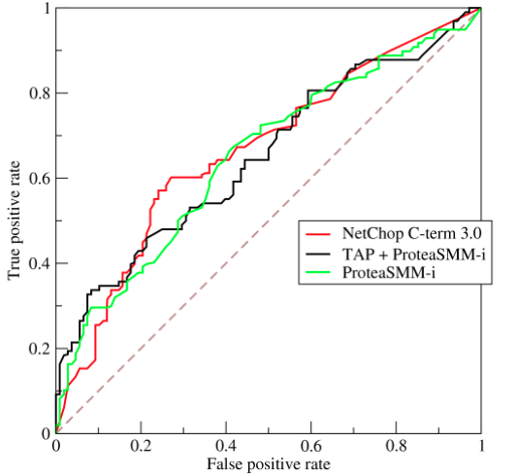
ROC Curve & AUC
Tradeoff between true positives and false positives
Insensitive to changes to class distributions
Can compare two classifiers using (AUC score)
Value between 0 and 1.0
Widely accepted performance measure for classifiers
liberal
conservative
Bai Li, Useful properties of ROC curves and AUC scoring, https://www.kaggle.com/learn-forum/53782
Notes:
A ROC curve plots the performance of a binary classifier under various threshold settings; this is measured by true positive rate and false positive rate. If your classifier predicts “true” more often, it will have more true positives (good) but also more false positives (bad). If your classifier is more conservative, predicting “true” less often, it will have fewer false positives but fewer true positives as well. The ROC curve is a graphical representation of this tradeoff.
Any performance metric that uses values from both columns such as accuracy precision lift F-score will be inherently sensitive to class skews.
the performance of a binary classifier under various threshold settings;

Slide 9

Summary of tuning Data
index | batch_size | activation | learning_rate | num_layers | units | AUC | optimizer | epochs
24 | 100 | relu | 0.1 | 5 | 512 | 0.891622 | SGD | 10
567 | 100 | relu | 0.1 | 9 | 2048 | 0.885265 | SGD | 10
571 | 200 | relu | 0.2 | 2 | 2048 | 0.882464 | SGD | 10
561 | 100 | relu | 0.1 | 2 | 2048 | 0.882105 | SGD | 10
293 | 50 | relu | 0.1 | 5 | 1024 | 0.880005 | SGD | 10
562 | 200 | relu | 0.1 | 2 | 2048 | 0.879607 | SGD | 10
195 | 100 | selu | 0.01 | 5 | 512 | 0.879323 | SGD | 10
299 | 50 | relu | 0.2 | 2 | 1024 | 0.877356 | SGD | 10
21 | 100 | relu | 0.1 | 2 | 512 | 0.876826 | SGD | 10
738 | 100 | selu | 0.01 | 9 | 2048 | 0.876750 | SGD | 10
551 | 50 | relu | 0.01 | 2 | 2048 | 0.875842 | SGD | 10
52 | 200 | relu | 0.001 | 5 | 512 | 0.875577 | Adam | 10
576 | 100 | relu | 0.2 | 9 | 2048 | 0.874612 | SGD | 10
464 | 50 | selu | 0.01 | 5 | 1024 | 0.874366 | SGD | 10
$$≥$$
Project Seminar – Abd Alkareem ALJEIROUDI
Notes:
An Adam outlier
I don’t know what this high learning rate is doing

Slide 10
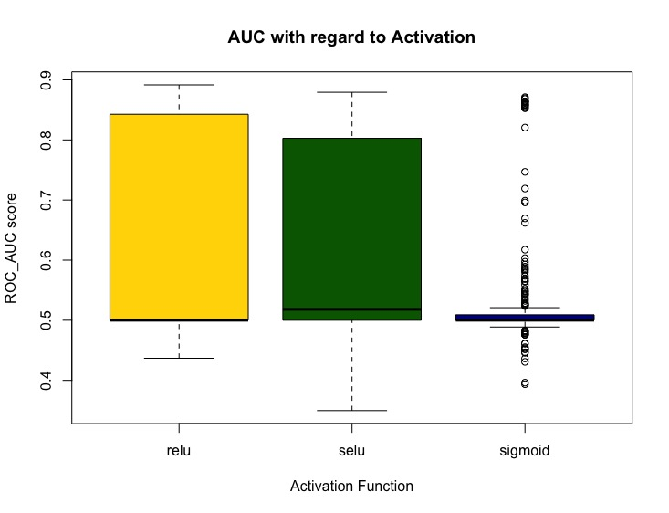
Comparison of Activation Functions
Project Seminar – Abd Alkareem ALJEIROUDI
Notes:
75% of the data lie below the upper quartile
25% of the data lie below the lower quartile
Obviously the data is skewed to the left and that ‘s why the mean lies close to 0.5.
As you might guess the majority of auc score will lie in the interval between 0.5 0.6

Slide 11
Relu vs. SELU
wilcox.test(auc~activation, data=data2_no_sigmoid, paired=F)
Wilcoxon rank sum test with continuity correction
data: auc by activation
W = 37419, p-value = 0.5781
alternative hypothesis: true location shift is not equal to 0
> 0.05
Project Seminar – Abd Alkareem ALJEIROUDI
Notes:
So which performed better Relu or Selu

Slide 12
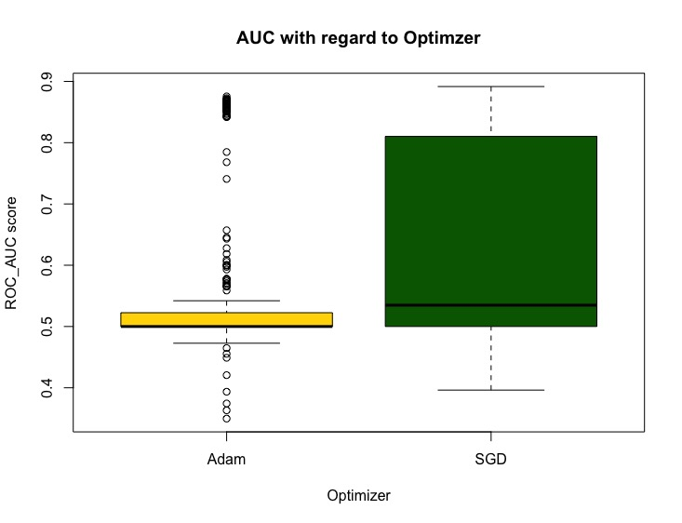
Comparison of optimizers
Project Seminar – Abd Alkareem ALJEIROUDI
Notes:
75% of the data lie below the upper quartile
25% of the data lie below the lower quartile
Obviously the data is skewed to the left and that ‘s why the mean lies close to 0.5.
As you might guess the majority of auc score will lie in the interval between 0.5 0.6

Slide 13
SGD vs. Adam
> wilcox.test(auc~optimizer, data=data2, paired=F)
Wilcoxon rank sum test with continuity correction
data: auc by optimizer
W = 62130, p-value = 2.508e-10
alternative hypothesis: true location shift is not equal to 0
< 0.05
Significant difference!
Project Seminar – Abd Alkareem ALJEIROUDI
Notes:
So which performed better Relu or Selu

Slide 14
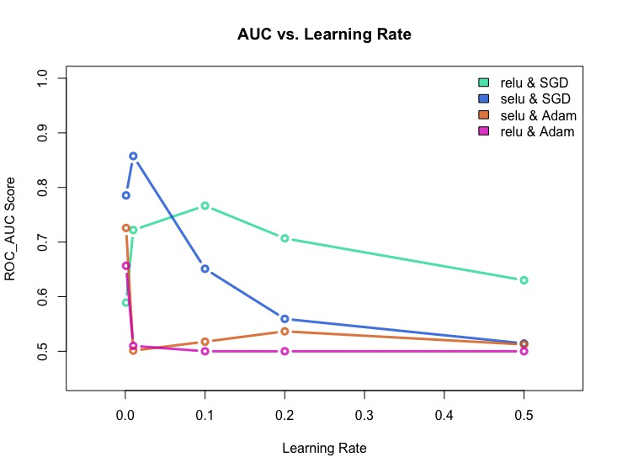
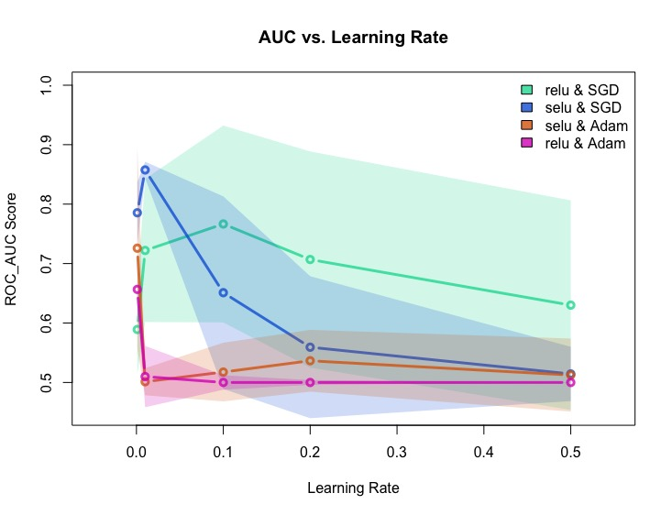
Learning Rate interpretation

Slide 15
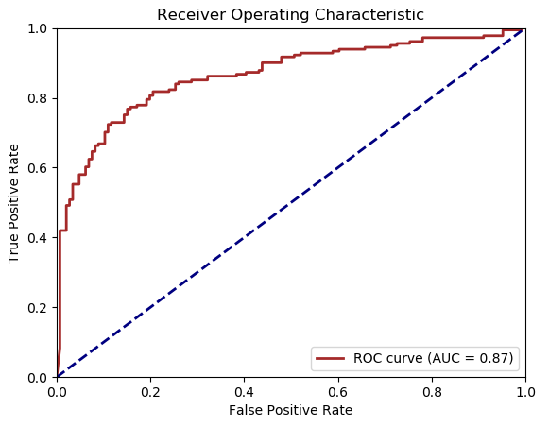
Evaluation of Best selected Model
batch size | activation | learning rate | num of layers | units | AUC | optimizer | epochs | dropout rate | initializer | epochs | batch size
100 | relu | 0.1 | 5 | 512 | 0.89162 | SGD | 10 | 0.1 | he_uniform | 10 | 100
Evaluation of best selected model on validation set
AUC = ﻿0.865227
Project Seminar – Abd Alkareem ALJEIROUDI

Slide 16
Evaluation of Best selected Model
batch size | activation | learning rate | num of layers | units | AUC | optimizer | epochs | dropout rate | initializer | epochs | batch size
100 | relu | 0.1 | 5 | 512 | 0.89162 | SGD | 10 | 0.1 | he_uniform | 10 | 100
121
25
Non-mutagen
Evaluation of best selected model on validation set
40
141
True Label
Mutagen
AUC = ﻿0.865227
Mutagen
Non-mutagen
Predicted
Project Seminar – Abd Alkareem ALJEIROUDI
Notes:
121+25+40+141=327 validation set size

Slide 17
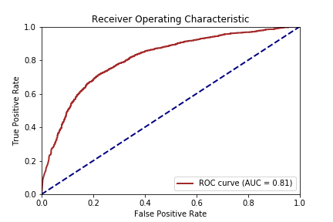
Evaluation of Best selected Model
batch size | activation | learning rate | num of layers | units | AUC | optimizer | epochs | dropout rate | initializer | epochs | batch size
100 | relu | 0.1 | 5 | 512 | 0.89162 | SGD | 10 | 0.1 | he_uniform | 10 | 100
Evaluation of best selected model on test set
AUC =﻿ 0.809532
Project Seminar – Abd Alkareem ALJEIROUDI

Slide 18
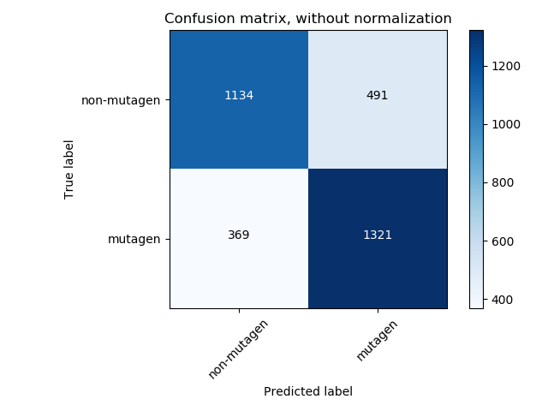
Evaluation of Best selected Model
batch size | activation | learning rate | num of layers | units | AUC | optimizer | epochs | dropout rate | initializer | epochs | batch size
100 | relu | 0.1 | 5 | 512 | 0.89162 | SGD | 10 | 0.1 | he_uniform | 10 | 100
Evaluation of best selected model on test set
1134
491
369
1321
AUC =﻿ 0.809532
Project Seminar – Abd Alkareem ALJEIROUDI

Slide 19
Conclusion
Fingerprints are ‘good’ predictors
Downside:
Measures very dependent on the dataset composition
Hyperparameters tuning:
Both Relu and Selu perform equally good (we cannot reject H₀)
SGD outperformed Adam for this dataset with the test hyperparameters
Keras deep networks performed well
Validation: AUC = 0.87, test: AUC = 0.81
Downsides:
Training and tuning are both tedious and lengthy
More parameters to set
Addressing the issue requires further analysis (Future Work)
Project Seminar – Abd Alkareem ALJEIROUDI
Notes:
First summarize what we’ve talked about and then:
- We've roughly described what Mutagenicity is and the type of classification problem we have in our dataset
- Then I introduced the Morgan Fingerprints algorithm
- we've also talked about the AUC as a performance metric
- discussed the strategy I used
- then we made a couple of observations on the tuning data obtained from the Grid search
- after that we saw some comparisons of the hyperparameters
- prediction on test data
Conclude and make a final statement
Ames tests are often accompanied with 15% error. Predictions, therefore approach is clearly incapable of converying consecutive metabolic activation steps.

Slide 20
Future Work
Integrated Gradients
Attribution to features (‘crediting’ or ‘blaming’ features)
Tokenization of atoms and bonding types
Project Seminar – Abd Alkareem ALJEIROUDI
Notes:
Some peak on my future work. I’ll be calculating the integrated gradients in order to understand how some features relate to the molecule mutagenicity in a more direct way than others.
The aromatic nitro and amine groups are well recognized toxicophores for mutagenicity.

Slide 21

Github link
If you are interested in the script (Data Preprocessing & Training): https://github.com/kareemjeiroudi/molecules_and_ml
git clone https://github.com/kareemjeiroudi/molecules_and_ml.git
But still needs some refinement!
Project Seminar – Abd Alkareem ALJEIROUDI

Slide 22
references
Derivation and Validation of Toxicophores for Mutagenicity Prediction Jeroen Kazius, Ross McGuire, and, and Roberta Bursi, Journal of Medicinal Chemistry 2005 48 (1), 312-320 DOI: 10.1021/jm040835a
Benchmark Data Set for in Silico Prediction of Ames Mutagenicity Katja Hansen, Sebastian Mika, Timon Schroeter, Andreas Sutter, Antonius ter Laak, Thomas Steger-Hartmann, Nikolaus Heinrich, and Klaus-Robert Müller Journal of Chemical Information and Modeling 2009 49 (9), 2077-2081 DOI: 10.1021/ci900161g
Extended-Connectivity Fingerprints David Rogers and Mathew Hahn Journal of Chemical Information and Modeling 2010 50 (5), 742-754 DOI: 10.1021/ci100050t

Slide 23
references
Li, Q.; Bender, A.; Pei, J.; Lai, L. A Large Descriptor Set and a Probabilistic Kernel-Based Classifier Significantly Improve Drug- likeness Classification. J. Chem. Inf. Model. 2007, 47
Tom Fawcett. 2006. An introduction to ROC analysis. Pattern Recogn. Lett. 27, 8 (June 2006), 861-874. DOI=http://dx.doi.org/10.1016/j.patrec.2005.10.010
Mukund Sundararajan, Ankur Taly, and Qiqi Yan. 2017. Axiomatic attribution for deep networks. In Proceedings of the 34th International Conference on Machine Learning - Volume 70 (ICML'17), Doina Precup and Yee Whye Teh (Eds.), Vol. 70. JMLR.org 3319-3328.
Project Seminar – Abd Alkareem ALJEIROUDI

Slide 24
Thank You!
https://potatoparcel.com/products/potato-pal
Project Seminar – Abd Alkareem ALJEIROUDI
Notes:
Lastly, I’d like to thank u all for being an insightful community, some of you happened to give helpful comments. And I’d also like to specially thank Kristina Preuer my supervisor for being constantly supportive and providing me with guidance on different matters throughout my work.

Slide 25
Q & A
Project Seminar – Abd Alkareem ALJEIROUDI
Notes:
Data is obtainable in this link: http://cheminformatics.org/datasets/bursi/

