Slide 1

A MARKET RESEARCH TO
Create Visibility and Acceptance
HOMEBOYZ CAFÉ WHISKY
A Research Proposal

Slide 2

TABLE OF CONTENTS
BACKGROUND
MARKET SIZE & INDUSTRY PLAYERS
OBJECTIVES
CURRENT BRAND PERFORMANCE OF HOMEBOYZ CAFÉ WHISKY
INTENDED OUTCOMES
TARGET DEMOGRAPHICS
DATA COLLECTION
APPROACH
REPORTING
TIMELINE
PROPOSED BUDGET
TIMELINE

Slide 3
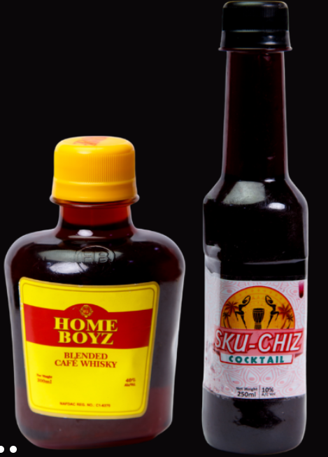
BACKGROUND
Homeboyz Café Whisky is one of the products from the stable of V-Martins Nig Plc which includes Sku-Chiz Cocktail, Homeboyz Dry Gin
The company believes believe in growing organically and value creation, hence 100% of her raw materials are sourced locally to encourage and endorse other native producers and businesses

Slide 4


Market Size
Industry Players
Nigeria’s alcoholic beverage sector is an increasingly lucrative industry, with market research forecasting annual consumption growth of over 6% through 2022.
Nigeria’s beer market is the second largest in Africa, though it remains well behind top-ranked South Africa in terms of scale.
The country’s three main breweries are all publicly listed and majority owned by the global behemoths that dominate worldwide trade: AB-InBev is the majority shareholder of International Breweries, Heineken is the majority shareholder of Nigerian Breweries and Champion Breweries, while Diageo is represented by its subsidiary Guinness Nigeria.
An estimate from the National Bureau of Statistics (NBS) figures show Nigerians spent $570 million in a singular year- the figure is expected increase with time.

Slide 5
OBJECTIVES
The purpose of this market research is to create visibility and acceptance for Homeboyz café whisky brand.
The main objectives of this research include;
To understand the perception of the consumers of the brand vis-à-vis price, availability, quantity, quality
To assess the awareness of the brand within the study area- Lagos and Ogun State

Slide 6



INTENDED OUTCOMES
Based on the brief shared, we understand Sellmedia Group expect this study to guide their market plan designs and most efficient marketing approach towards the target demographics.
The report of this study will guide SellMedia Group in helping V-Martins Nig Ltd increase its create visibility and acceptance for Homeboyz café whisky.
Gain an understanding of the perception of the current consumer base
Help identify the pain points of consumers
Help measure the extent of awareness of the brand within the coverage areas

Slide 7
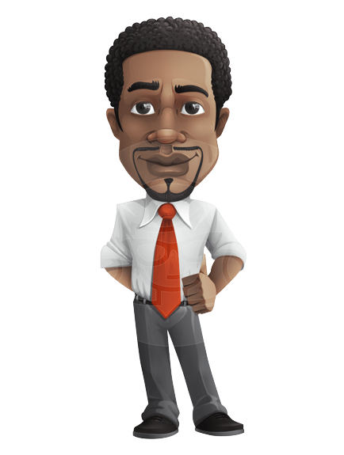

TARGET DEMOGRAPHICS
The research would also incorporate males at the lower economic strata.
Gender: Male
Age: 18-35
Older Males that are young at heart

Slide 8

DATA COLLECTION
Data will be collected through mobile application designed questionnaire, qualitative research tools(voice recorder, AI note taker board and interview timer)

Slide 9

APPROACH
Qualitative Approach
Quantitative Approach
The Snowball method of non-probability sampling will be employed for this research.
Following best practices, a sample size of population of the study area is estimated such as;
Individuals/Customers/Consumers who have identified with the brand will be grouped in 10s for focus group discussion.
Lagos: 231
Ogun: 154
Delineated Area
A question format will be drafted that incorporates the objectives of the research.
The coverage areas will be delineated into its senatorial districts:
Alimosho: 80
Lagos East: 60
Lagos West: 41
Lagos Central: 50
Ogun
Ogun Central: 50
Ogun East: 52
Ogun West: 52
Type of Data Collection
Lagos
Ogun
Focus Group Discussion
20
10
In-depth Interviews
50
40

Slide 10

REPORT ANALYSIS
Data collected will be extracted and transformed into insights and visuals that will guide the decision-making of Sellmedia Group.
The data collected will be analyzed using business intelligence tools like Microsoft PowerBI and Tableau.

Slide 11
BUDGET
TOTAL COSTING FOR THE RESEARCH
N14.03Million
See Excel sheet attached in mail for details of cost breakdown

Slide 12
TIMELINE

Slide 13




Contact Us
Head Office : 9, Jogunomi Street,
Gbagada Phase 2, Lagos
https://retailscope.africa
info@retailscope.africa
kareem@hazonholdings.com
08178329565|08032679331

