Slide 1
Feasibility Study

Slide 2
Feasibility study
Feasibility studies are short-term, relatively cheap studies that inform the decision of whether or not to go ahead with a more detailed analysis

Slide 3
Feasibility Components
Economic
Technical
Organizational
Scheduling
Legal and contractual
Political

Slide 4
Economic feasibility
Economic feasibility: a process of identifying the financial benefits and costs associated with a development project.
Often referred to as cost-benefit analysis.
Project is reviewed after each SDLC phase in order to decide whether to continue, redirect, or kill a project.

Slide 5

Determining Project Benefits
Tangible benefits refer to items that can be measured in dollars and with certainty.
Examples include:
reduced personnel expenses,
lower transaction costs, or
higher profit margins.

Slide 6
Determining Project Benefits (Cont.)
Most tangible benefits will fit within the following categories:
Cost reduction and avoidance
Error reduction
Increased flexibility
Increased speed of activity
Improvement of management planning and control
Opening new markets and increasing sales opportunities

Slide 7
Determining Project Benefits (Cont.)
Intangible benefits are benefits derived from the creation of an information system that cannot be easily measured in dollars or with certainty.
May have direct organizational benefits, such as the improvement of employee morale.
May have broader societal implications, such as the reduction of waste creation or resource consumption.

Slide 8
Determining Project Costs
Tangible costs: a cost associated with an information system that can be measured in dollars and with certainty.
The development tangible costs include:
Hardware costs,
Labor costs, or
Operational costs including employee training and building renovations.

Slide 9
Determining Project Costs (Cont.)
Intangible costs: a cost associated with an information system that cannot be easily measured in terms of dollars or with certainty.
Intangible costs can include:
Loss of customer goodwill,
Employee morale, or
Operational inefficiency.

Slide 10
Determining Project Costs (Cont.)
One-time cost: a cost associated with project start-up and development or system start-up.
These costs encompass activities such as:
Systems development,
New hardware and software purchases,
User training,
Site preparation, and
Data or system conversion.

Slide 11
Determining Project Costs (Cont.)
Recurring cost: a cost resulting from the ongoing evolution and use of a system.
Examples of these costs include:
Application software maintenance,
Incremental data storage expenses,
Incremental communications,
New software and hardware leases, and
Supplies and other expenses (i.e. paper, forms, data center personnel).

Slide 12
Determining Project Costs (Cont.)
Both one-time and recurring costs can consist of items that are fixed or variable in nature.
Fixed costs are billed or incurred at a regular interval and usually at a fixed rate.
Variable costs are items that vary in relation to usage.

Slide 13
Determining Project Costs (Cont.)
Procurement
Consulting, equipment, site preparation, capital, management time
Start-up
Operating systems, communications installation, personnel hiring, organizational disruption
Project-related
Application software, software modification, personnel overhead, training, data analysis, documentation
Operating
System maintenance, rental, asset depreciation, operation and planning

Slide 14
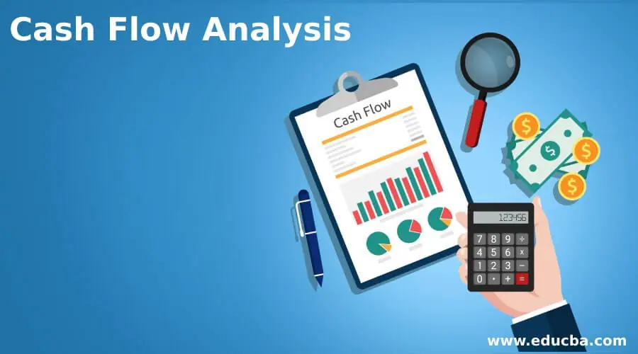

Slide 15

Cash Flow Analysis and Measures
A cash flow analysis determines a project working budget .
Cash flow analysis helps you understand if your business is able to pay its bills and generate enough cash to continue operating indefinitely. Long-term negative cash flow situations can indicate a potential bankruptcy while continual positive cash flow is often a sign of good things to come.

Slide 16
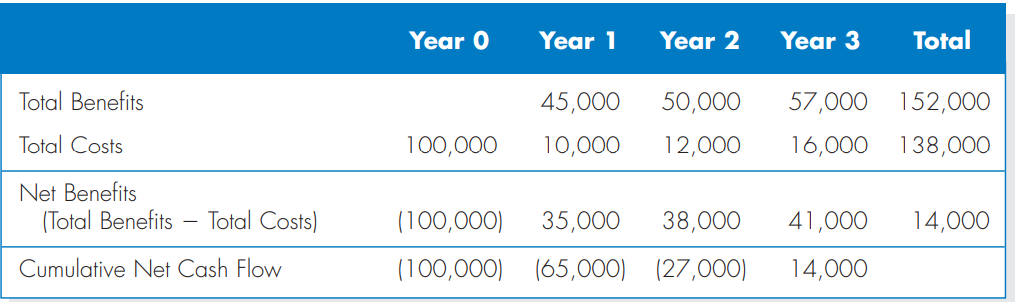
Cash Flow Projection Example

Slide 17
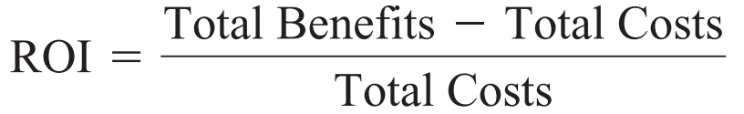
Evaluating a project’s worth
Return on Investment (ROI): it is a calculation that measures the average rate of return earned on the money invested in the project. ROI is a simple calculation that divides the project’s net benefits (total benefits total costs) by the total costs.
The ROI formula is:

Slide 18
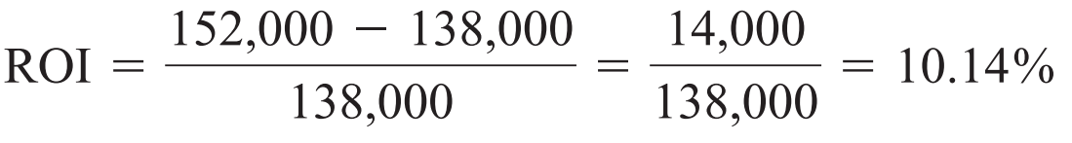
ROI Example

Slide 19
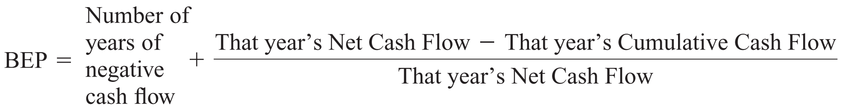
Evaluating a project’s worth Cont.
Break-Even Point BEP (also called the payback method) it is the number of years it takes a firm to recover its original investment in the project from net cash flows. The BEP formula is:

Slide 20
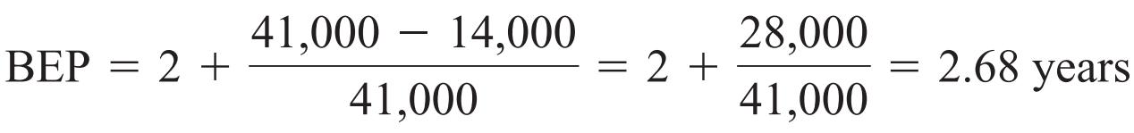
BEP Example

Slide 21

Assessing Technical Feasibility
Technical feasibility: a process of assessing the development organization’s ability to construct a proposed system.

Slide 22
Assessing Technical Feasibility
The potential consequences of not assessing and managing risks can include the following:
Failure to attain expected benefits from the project,
Inaccurate project cost estimates,
Inaccurate project duration estimates,
Failure to achieve adequate system performance levels, and
Failure to adequately integrate the new system with existing hardware, software, or organizational procedures.

Slide 23
Project Risk Factors
Project size
Team size, organizational departments, project duration, programming effort
Project structure
New vs. renovated system, resulting organizational changes, management commitment, user perceptions
Development group
Familiarity with platform, software, development method, application area, development of similar systems
User group
Familiarity with IS development process, application area, use of similar systems

Slide 24
Assessing Technical Feasibility (Cont.)
Risk can be managed on a project by:
Changing the project plan to avoid risky factors,
Assigning project team members to carefully manage the risky aspects,
Setting up monitoring methods to determine whether or not potential risk is, in fact, materializing.

Slide 25
Assessing Technical Feasibility (Cont.)
The four primary factors associated with the amount of technical risk on a given project are:
Project size,
Project structure,
The development group’s experience with the application and technology area, and
The user group’s experience with systems development projects and the application area

Slide 26
Assessing Technical Feasibility (Cont.)
Four general rules emerged as technical risk assessments:
Larger projects are riskier than smaller projects.
A system in which the requirements are easily obtained and highly structured will be less risky than one in which requirements are messy, ill structured, ill defined, or subject to the judgment of an individual.
The development of a system employing commonly used or standard technology will be less risky than one employing novel or nonstandard technology.
A project is less risky when the user group is familiar with the familiar with the systems development process and application area than if unfamiliar.

Slide 27
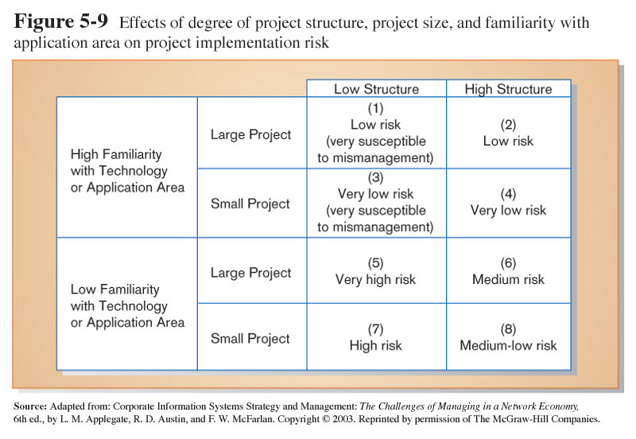
Assessing Technical Feasibility (Cont.)

Slide 28
Organizational Feasibility
How well the system ultimately will be accepted by its users and incorporated into the ongoing operations of the organization.
An organizational feasibility analysis attempts to answer the question “If we build it, will they come?”
A stakeholder is a person, group, or organization that can affect (or can be affected by) a new system

Slide 29
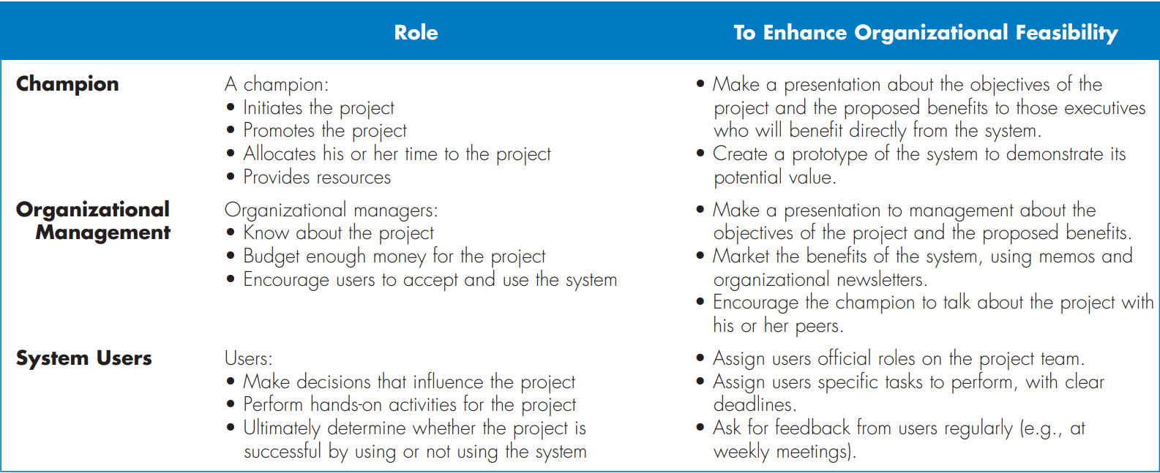
Stakeholders

Slide 30

Scheduling Feasibility
This assessment is the most important for project success; after all, a project will fail if not completed on time. In scheduling feasibility, an organization estimates how much time the project will take to complete.
Can the project time frame and completion dates meet organizational deadlines?

Slide 31
Legal and Contractual
We check whether the project meets the cyber law rules and other regulatory frameworks.
What are legal and contractual ramifications of the proposed system development project?

Slide 32
Political Feasibility
Political feasibility is a measure of how well a solution to a policy problem, will be accepted by a set of decision makers and the general public. For a policy to be enacted and implemented, it must be politically acceptable, or feasible.
How do key stakeholders view the proposed system?

