Slide 1
Chapter 3
Vectors
3-1 Coordinate System
3-2 Vector and Scalar Quantities
3-3 Adding Vectors Geometrically
3-3 Components of Vectors
3-4 Adding Vectors by Components

Slide 2
3-1 Coordinate Systems
Used to describe the position of a point in space
Common coordinate systems are:
  Cartesian
  Polar

Slide 3
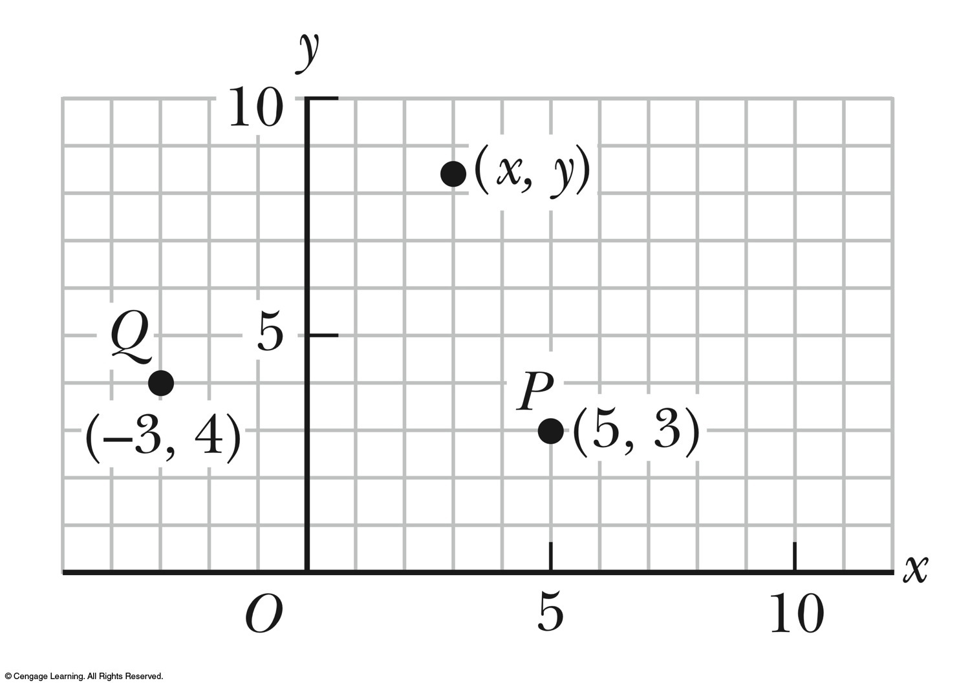
Cartesian Coordinate System
Also called rectangular coordinate system
x- and y- axes intersect at the origin
Points are labeled (x,y)

Slide 4
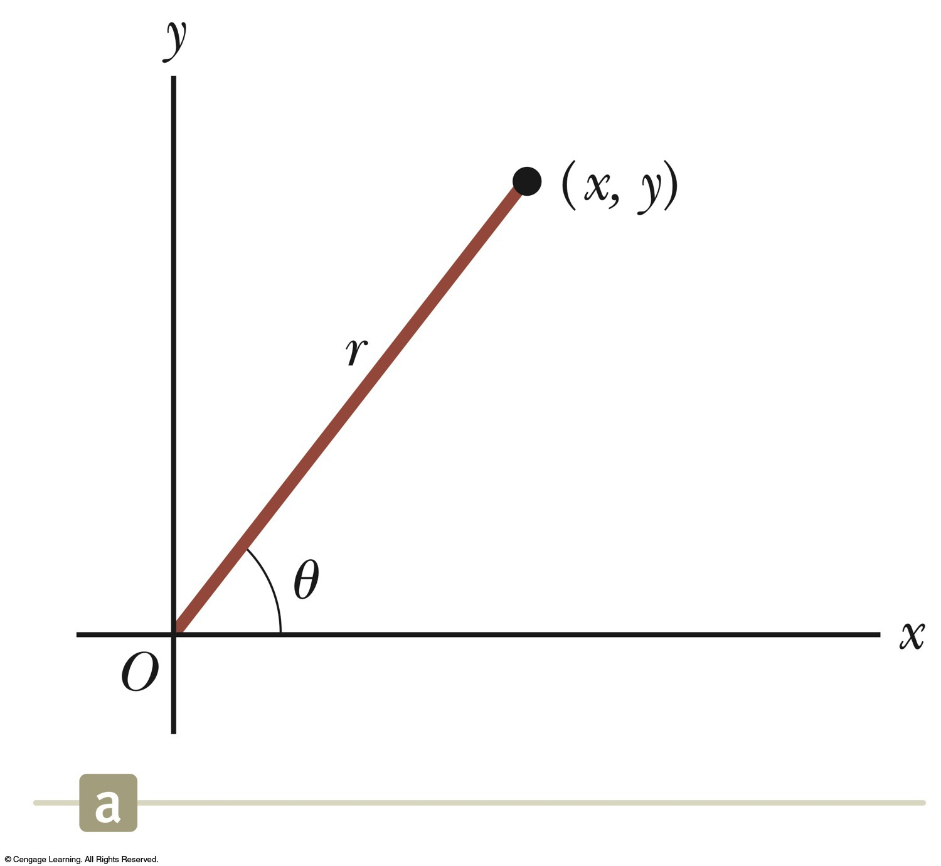
Polar Coordinate System
Origin and reference line are noted
Point is distance r from the origin in the direction of angle θ, ccw from reference line
  The reference line is often the x-axis.
Points are labeled (r,θ)

Slide 5
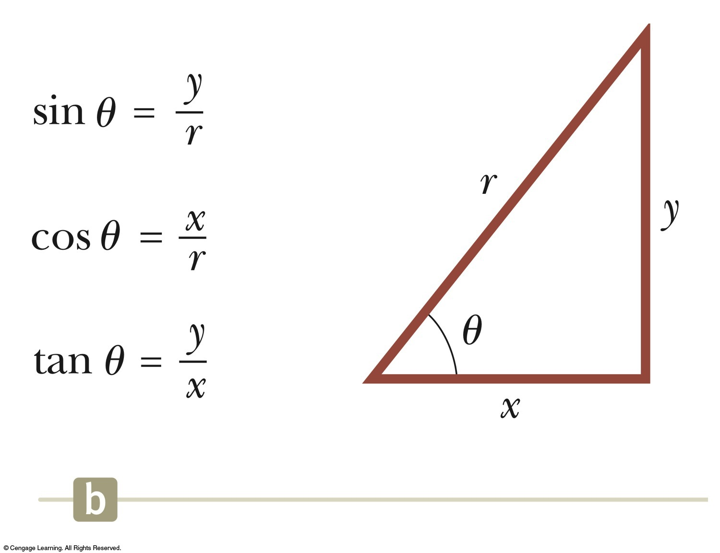
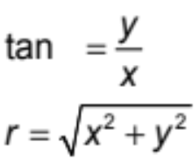
Polar to Cartesian Coordinates
Based on forming a right triangle from r and θ
x = r cos θ
y = r sin θ
If the Cartesian coordinates are known:

Slide 6
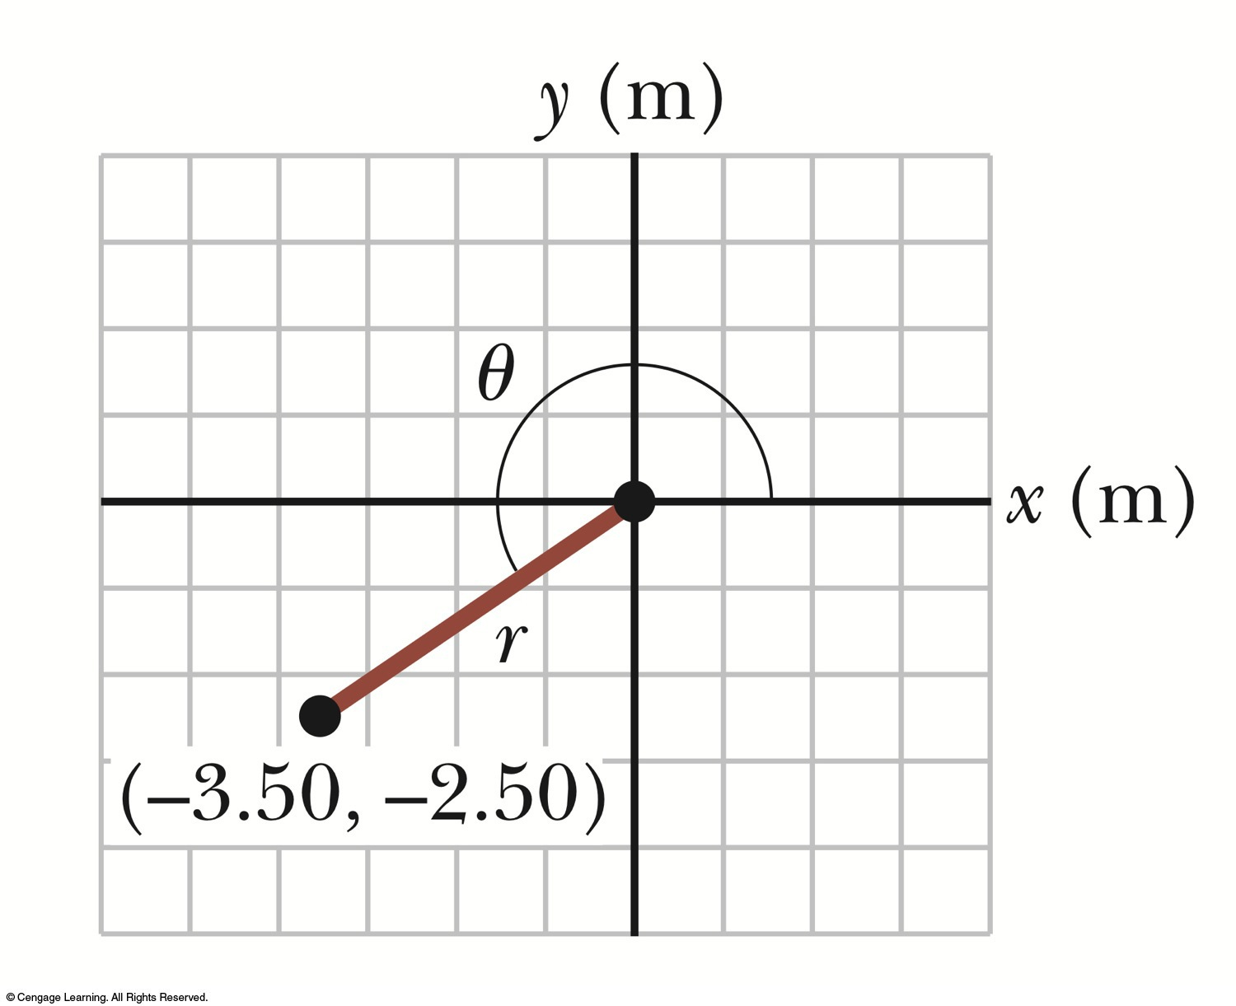
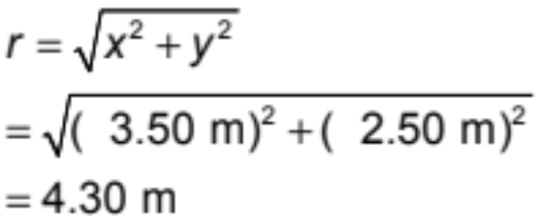
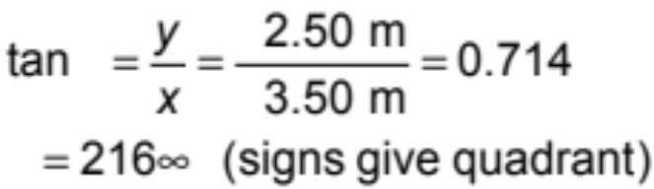
Example
The Cartesian coordinates of a point in the xy plane are (x,y) = (-3.50, -2.50) m, as shown in the figure. Find the polar coordinates of this point.
Solution: From Equation 3.4,
and from Equation 3.3,

Slide 7
3-2 Vectors and Scalars
Introduction
Physical quantities
Vector quantities
Scalar quantities
A vector quantity has a direction.
A scalar quantity has no direction.
Wind's velocity is 3 m/s towards east.
Temperature is 25⁰ C.
A vector quantity is specified by
1- a value with appropriate unit (a magnitude)
2- a direction.
A scalar quantity is specified by
a value with appropriate unit.
The magnitude of a vector is always positive quantity.
Scalars can be negative.
Temperature = - 2⁰ C means that it is 2 degrees below zero. This negative sign has noting to do with direction.

Slide 8
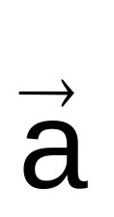
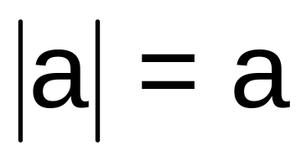

3-2 Vectors and Scalars
Notations
A vector quantity is denoted by an arrow placed over its symbol.
The magnitude (absolute value) of a vector quantity is indicated by its symbol without an arrow.
On a graph, a vector quantity is drawn as an arrow.
The length of the arrow is proportional to the magnitude of the vector quantity.
The arrow has the same direction as the vector quantity direction.

Slide 9
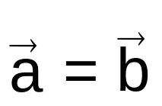

3-2 Adding Vectors Geometrically
Equality of two vectors
Two vectors are equal if they have the same magnitude and point in the same direction.
In a diagram, a vector may be moved to a new position provided its length and direction are not changed.
It is allowed to shift a vector to a position parallel to itself.

Slide 10
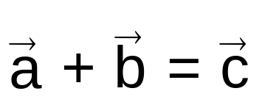


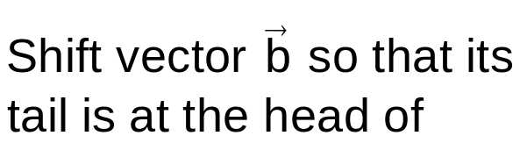
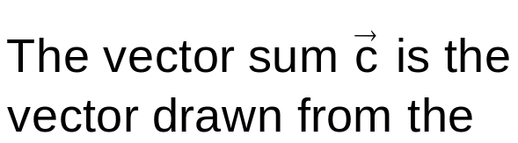
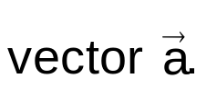
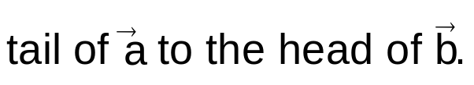
3-2 Adding Vectors Geometrically
Adding two vectors

Slide 11
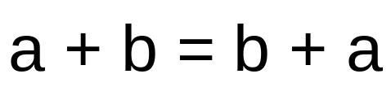



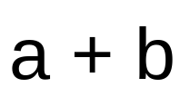
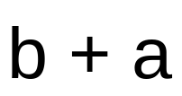
3-2 Adding Vectors Geometrically
Commutative law

Slide 12
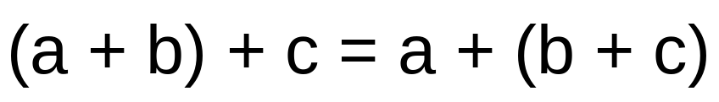


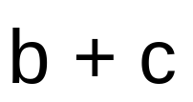

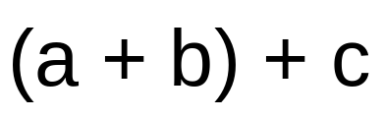
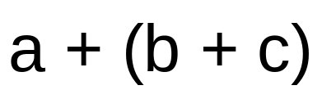
3-2 Adding Vectors Geometrically
Associative law

Slide 13
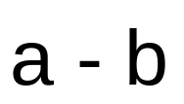
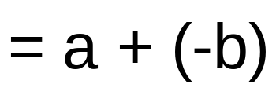
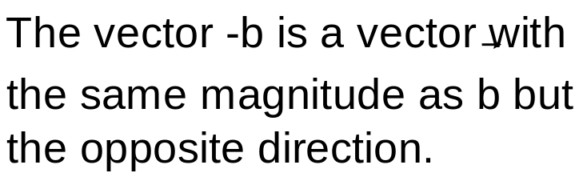


3-2 Adding Vectors Geometrically
Subtracting vectors

Slide 14
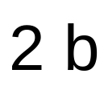
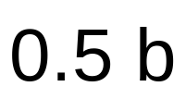
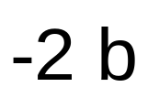
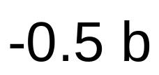
3-2 Adding Vectors Geometrically
Multiplying a vector by a scalar

Slide 15
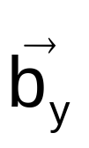
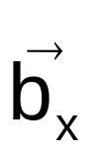
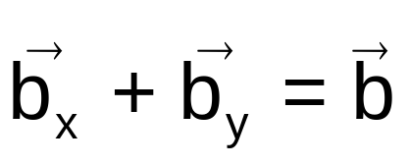
3-3 Components of Vectors
Projecting a vector on an axis
To find the projection of a vector along an axis,
draw perpendicular lines from the two ends of the vector to the axis.
y
y
x
x
The projection has the same direction along an axis as the vector.

Slide 16
3-3 Components of Vectors
Checkpoint 2
Indicate the correct projections.
y
y
y
x
x
x
Solution
Wrong
Wrong
Correct
y
y
y
x
x
x
Solution
Correct
Wrong
Correct

Slide 17



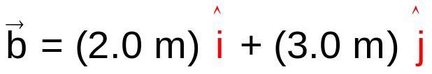
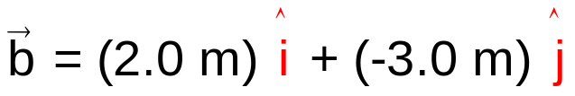
3-3 Components of Vectors
Unit vectors
A unit vector is a vector used to specify a direction.
It has a magnitude of one.
It has no dimension and thus has no unit.
y
x
z
y(m)
y(m)
4
4
3
3
2
2
1
1
x(m)
x(m)
0
1
2
3
4
0
1
2
3
4

Slide 18
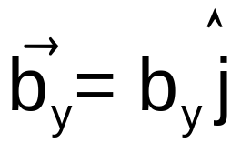
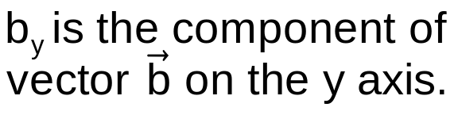
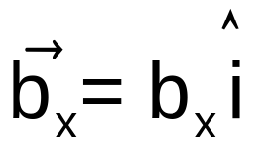
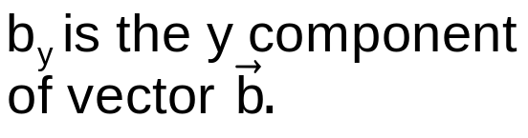
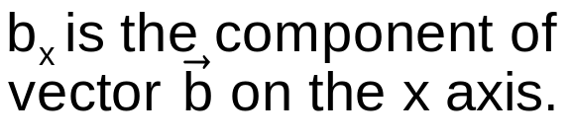

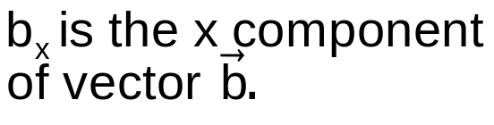
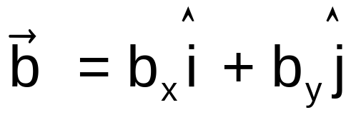

3-3 Components of Vectors
Components of a vector
y
x
We resolve a vector by finding its components.

Slide 19
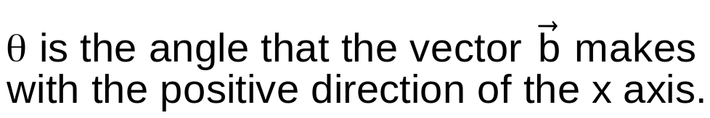
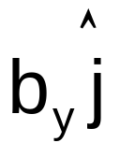

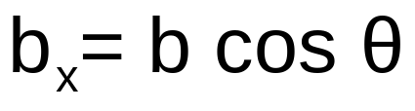
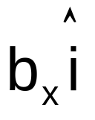
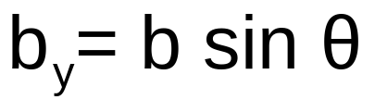


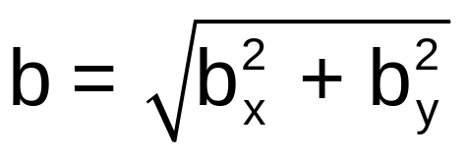

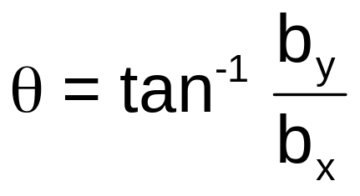
3-3 Components of Vectors
Finding components
y
x

Slide 20

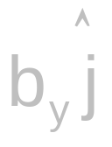


3-3 Components of Vectors
Specifying a vector
When working with a vector, you can use
its magnitude and direction
or
its components
y
Two dimensions
(a plane)
y
x
x
Magnitude and one angle
b and θ
Two components
x and y components
Three dimensions
(a space)
Magnitude and two angles
b, θ and φ
Three components
x, y, and z components

Slide 21





3-3 Components of Vectors
Example 2
A man walks 4.5 km in a direction making an angle of 35⁰ east of due north. How far east and north is the man from his starting point?
Solution
We are given the magnitude and the angle of a vector and need to find the components of the vector.
N
y(km)
W
E
5
S
4
3
2
1
35⁰
The man is 2.6 km east and 3.7 km north of his starting point.
0
x(km)
1
2
3
4
5

Slide 22
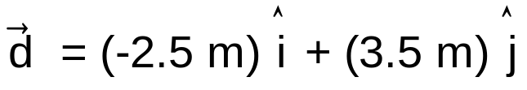








3-3 Components of Vectors
Example 3
Find the magnitude and direction of the following displacement vector
Solution
y(m)
4
3
Using a calculator
2
1
0
x(m)
-4
-3
-2
-1
1
2
3
4
-1
This answer is not consistent with the directions of the components.
The correct answer is
-2
-3
-4
When taking the inverse of a trig function, always check the validity of your answer!

Slide 23

















3-4 Adding Vectors by Components
Formulas
Two vectors are equal if their components are equal.
y
x

Slide 24













3-4 Adding Vectors by Components
Example 4
Add the following three vectors:
Write your answer in unit-vector notation and in magnitude-angle notation.
Solution
y(m)
3
2
1
x(m)
-3
-2
-1
0
1
2
3
-1
The magnitude of the vector sum is
-2
-3
The angle from the positive direction of x is

