Slide 1
Chapter 4
Motion in Two Dimensions
4-1 The Position, Velocity, and Acceleration Vectors
4-2 Two-Dimensional Motion with Constant Acceleration
4-3 Projectile Motion
4-4 Uniform Circular Motion

Slide 2

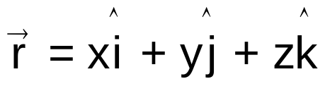

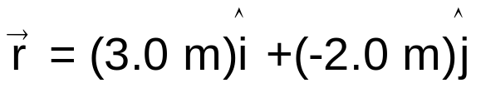
4-1 The Position, Velocity, and Acceleration Vectors
Position vector
The position vector r of a particle is a vector that extends from a reference point to the particle.
y(m)
Usually the reference point is the origin of a coordinate system.
2
1
x(m)
0
1
2
3
4
-1
x is the component of position vector r along the x axis
-2
Particle
The particle has position vector
and rectangle coordinates
(3.0 m, -2.0 m, 0)
The particle has the rectangle coordinates (x, y, z)

Slide 3
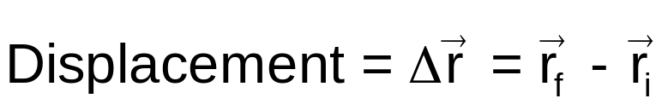

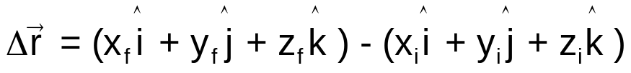

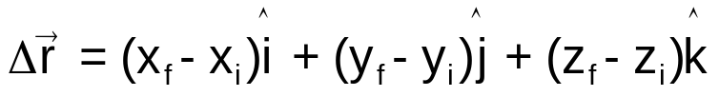

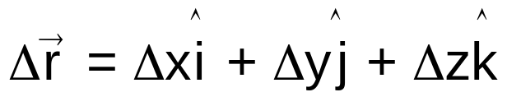
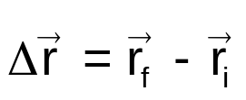
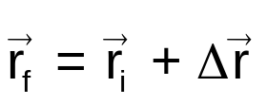
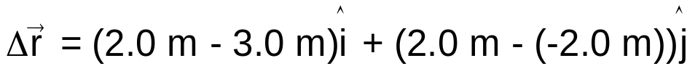
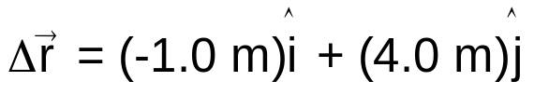
4-1 The Position, Velocity, and Acceleration Vectors
Displacement
The displacement of a particle is the change in its position vector.
y(m)
2
1
x(m)
0
1
2
3
4
-1
-2
Change in the x component of the position vector r

Slide 4
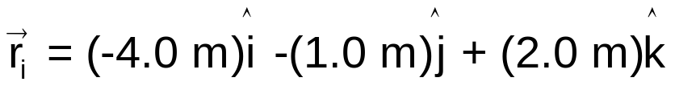
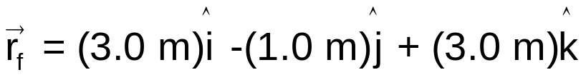
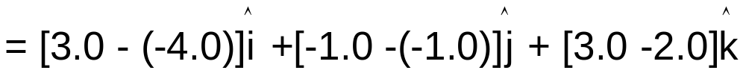
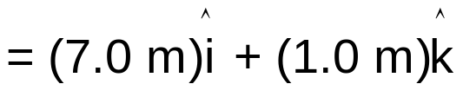
4-1 Position and Displacement
Example 1
The position vector for a particle is initially
and then later is
Solution

Slide 5
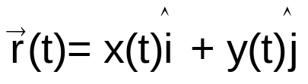
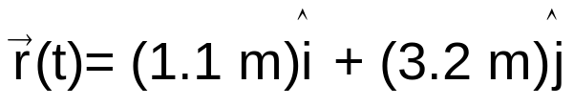

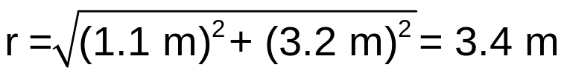
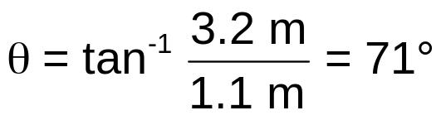
4-1 Position and Displacement
Example 2
A particle is moving in xy plane. The coordinates of its position are given by
x = -0.4 t² + 2.5 t - 1.0 and y = -0.3 t² + 0.5 t + 3.0,
where t in seconds and x and y in meters.
At t = 1 s, what is the particle's position vector in unit-vector notation and in magnitude-angle notation?
Solution
y(m)
4
At t = 1 s,
x = -0.4 (1)² + 2.5 (1) - 1.0 = 1.1 m
y = -0.3 (1)² + 0.5 (1) + 3.0 = 3.2 m
3
2
Unit-vector notation
1
x(m)
Magnitude-angle notation
-2
-1
0
1
2
3
4
-1
-2

Slide 6
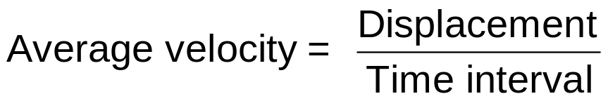
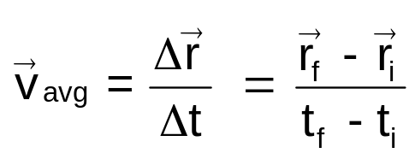
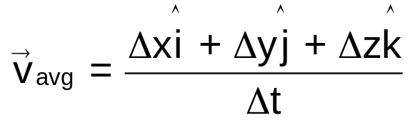

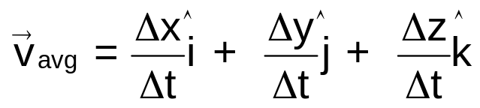

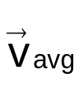
4-1 The Position, Velocity, and Acceleration Vectors
Average velocity
The average velocity v_{avg} of a particle during a time interval is
y
v_{avg} has the same direction as that of Δr.
x

Slide 7
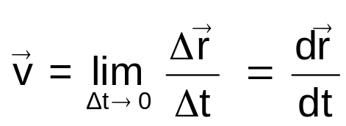




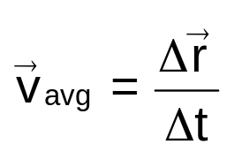
4-1 The Position, Velocity, and Acceleration Vectors
Instantaneous velocity
The velocity of a particle at some instant is
Average velocity
over a time period Δt
Velocity
at an instant t
y
y
Tangent line
x
x
velocity ≡ instantaneous velocity

Slide 8
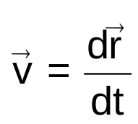
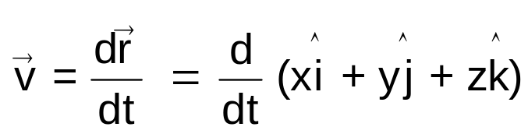
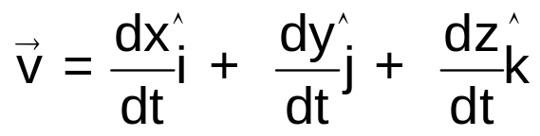
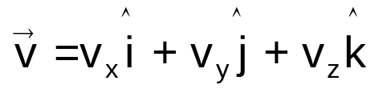
4-1 The Position, Velocity, and Acceleration Vectors
Instantaneous velocity
The velocity of a particle at some instant is
The direction of the instantaneous velocity of a particle is always tangent to the particle's path at the particle's position.
y
Tangent line
the x component of velocity vector v along the x axis
x

Slide 9
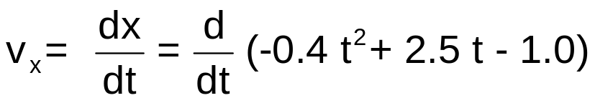
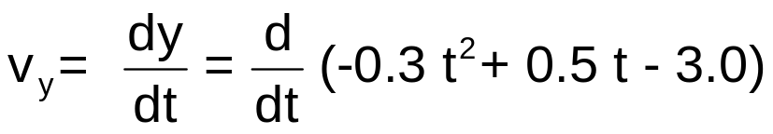

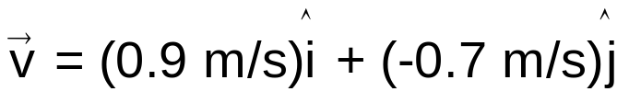
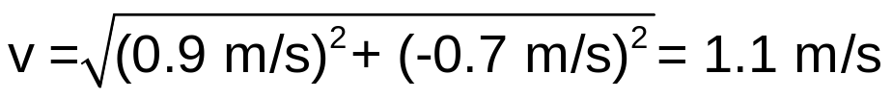
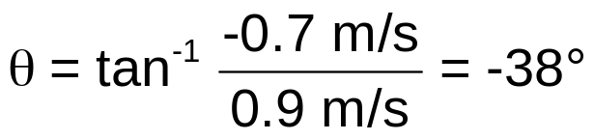
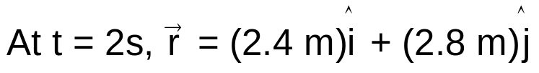
4-1 The Position, Velocity, and Acceleration Vectors
Example 3
A particle is moving in xy plane. The coordinates of its position are given by
x = -0.4 t² + 2.5 t - 1.0 and y = -0.3 t² + 0.5 t + 3.0,
where t in seconds and x and y in meters.
What is the particle's velocity at t = 2 s?
Solution
y(m)
4
3
2
1
x(m)
-2
-1
0
1
2
3
4
-1
-2

Slide 10

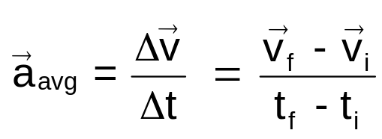



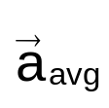
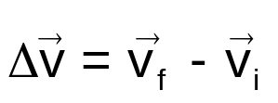
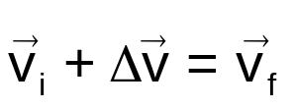
4-1 The Position, Velocity, and Acceleration Vectors
Average acceleration
The average acceleration a_{avg} of a particle during a time interval is
y
a_{avg} has the same direction as that of Δv.
Since multiplying a vector quantity (Δv) by a positive scalar quantity (1/Δt) changes only the magnitude of the vector, not its direction.
x

Slide 11
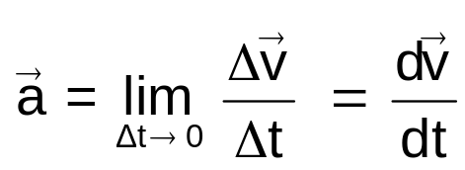
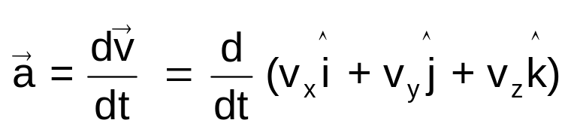
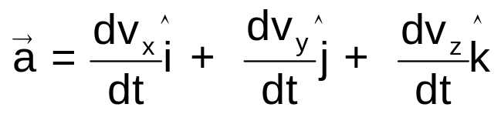
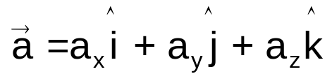

4-1 The Position, Velocity, and Acceleration Vectors
Instantaneous acceleration
The acceleration a of a particle at some instant is
y
the x component of acceleration vector a along the x axis
x

Slide 12
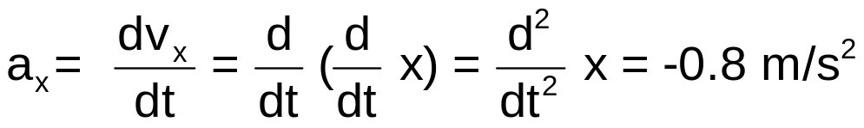
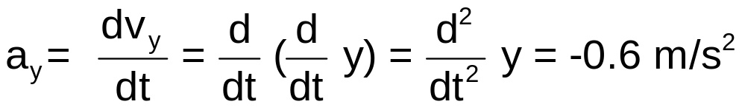

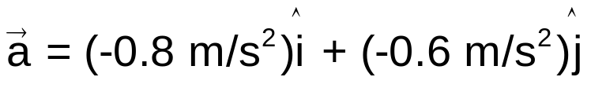


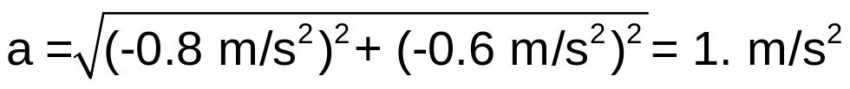

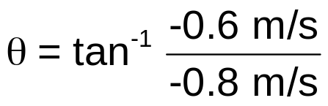


4-1 The Position, Velocity, and Acceleration Vectors
Example 4
A particle is moving in xy plane. The coordinates of its position are given by
x = -0.4 t² + 2.5 t - 1.0 and y = -0.3 t² + 0.5 t + 3.0,
where t in seconds and x and y in meters.
What is the particle's acceleration at t = 2 s?
Solution
y(m)
t = 2 s
4
3
2
1
Using a calculator
x(m)
This angle is not consistent with the directions of the acceleration.
The correct answer is
-2
-1
0
1
2
3
4
-1
-2

Slide 13
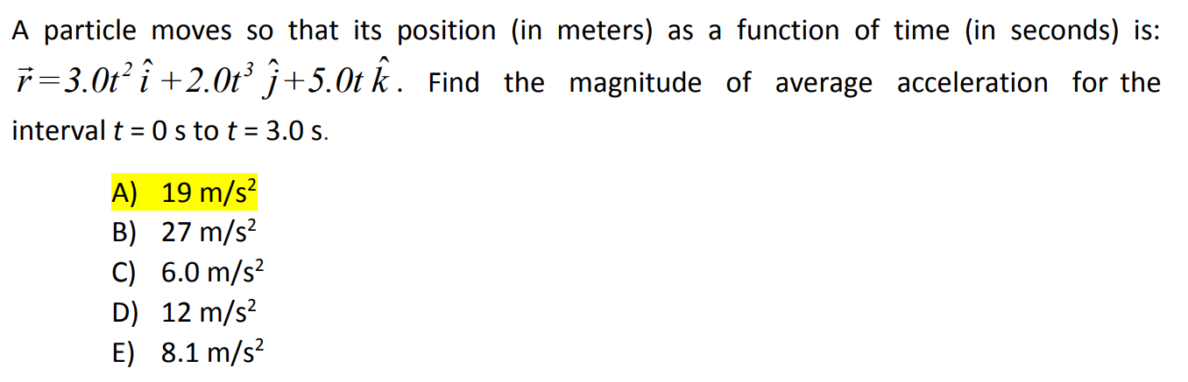
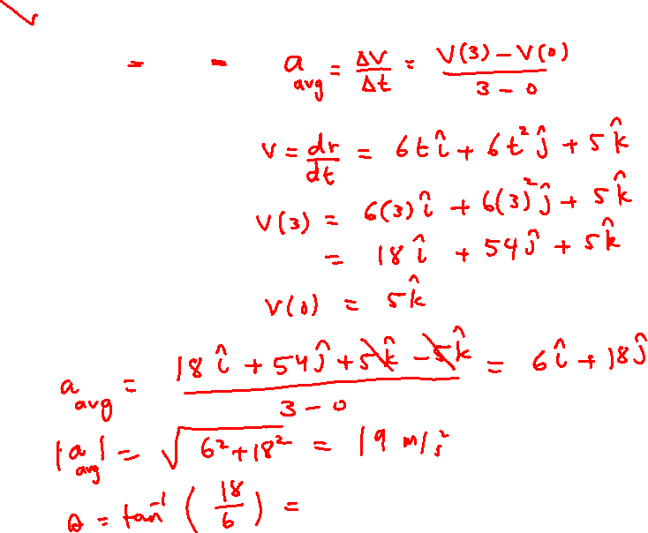

Slide 14



Slide 15



Slide 16






4-2 Two-Dimensional Motion with Constant Acceleration
Motion in two dimensions
Motion in two dimensions is equivalent to
two independent one-dimensional motions:
one in the x direction and one in the y direction.
For constant acceleration,
motion in two dimensions
is equivalent to two independent one-dimensional motions.
motion parallel the x direction
motion parallel the y direction

Slide 17




Slide 18



Slide 19



4-3 Projectile Motion
Projectile
trajectory (path)
projectile
A projectile is an object that is thrown or launched in air and moves only under the influence of Earth's gravity.
We will ignore air effects.
The projectile has no acceleration in the horizontal direction.
The projectile's acceleration is the free-fall acceleration

Slide 20










4-3 Projectile Motion
Equations of motion
y
x
The horizontal motion
The vertical motion

Slide 21


4-3 Projectile Motion
The horizontal range
The horizontal range R of the projectile is the horizontal distance the projectile has traveled when it returns to its initial launch height.
y
x

Slide 22


Height of a Projectile
4-3 Projectile Motion

Slide 23

4-3 Projectile Motion
The horizontal range
θ₀ = 75⁰
To use the formula for the horizontal range, the final height should be the same as the launch height.
y
θ₀ = 65⁰
θ₀ = 45⁰
θ₀ = 25⁰
θ₀ = 15⁰
x
The horizontal range is maximum for a launch angle of 45⁰
The horizontal range is maximum when sin 2θ₀ = 1
→ 2θ₀ = 90⁰ or θ₀ = 45^{0.}

Slide 24









4-3 Projectile Motion
Checkpoint
During the flight of a projectile, what happens to its
a_{x},
a_{y,}
v_{x}, and
v_{y}?
v_{x} does not change.
Solution
v_{y} decreases linearly with time.
Constant acceleration in the vertical direction.

Slide 25


The Long Jump
A long jumper leaves the ground at an angle of 20.0° above the horizontal and at a speed of 11.0 m/s.
(A) How far does he jump in the horizontal direction?

Slide 26

(B) What is the maximum height reached?

Slide 27








4-3 Projectile Motion
Example
what is the maximum range?
ball
Solution
The maximum range corresponds to elevation angle θ₀ of 45⁰

Slide 28



Slide 29



Slide 30



Slide 31

4-4 Uniform Circular Motion
Acceleration and velocity direction
Uniform motion = constant speed.
A particle moves in a circular path at a constant speed.
The magnitude of its velocity (speed) does not change.
The direction of its velocity changes.
Although its speed is constant,
the particle accelerates because of the change in the direction of its velocity.

Slide 32



4-4 Uniform Circular Motion
Centripetal acceleration
The velocity is always directed tangent to the circle in the direction of motion.
Centripetal acceleration
speed of the particle
radius of the circle
The acceleration is always directed radially inward. It is called a centripetal acceleration
SI units
centripetal ≡ center seeking.

Slide 33



4-4 Uniform Circular Motion
Period of revolution
The period is the time the particle takes to make one revolution.
The distance traveled by the particle in one revolution
= the circumference of the circle
= 2πr
Period
radius of the circle
speed of the particle
SI units

Slide 34




4-4 Uniform Circular Motion
Example
What is the centripetal acceleration of a particle moving at speed of v = 1000 km/h in a circular path of radius r = 10.0 km?
Solution

Slide 35






4-4 Uniform Circular Motion
Checkpoint
A particle moves at a constant speed along a circular path in an xy plane, with the center located at the origin.
When the particle at x = 10 m, its velocity is - (5.0 m/s) j.
What is the particle's velocity and acceleration when it is at y = 10 m.
Solution

Slide 36





Tangential and Radial Acceleration
Notes:
Consider more general motion
Particle moves to right along curved path → velocity changes both in direction and in magnitude (figure)
Velocity vector always tangent to path
Acceleration vector a at some angle to path
At each of three points A, B, and C: dashed blue circles represent curvature of actual path at each point
Radius of each circle = path’s radius of curvature at each point
As particle moves along curved path → direction of total acceleration vector a changes from point to point
At any instant: this vector can be resolved into two components based on origin at center of dashed circle corresponding to that instant:
Radial component a_{r} along radius of circle
Tangential component a_{t} perpendicular to radius
Total acceleration vector a written as vector sum of component vectors: [click to show equation]
Tangential acceleration component causes change in speed v of particle
Component parallel to instantaneous velocity
Magnitude given by: [click to show equation]
Radial acceleration component arises from change in direction of velocity vector: [click to show equation]
r = radius of curvature of path at point in question
Magnitude of radial component of acceleration: centripetal acceleration
Even in situations in which particle moves along curved path with varying speed → can still use centripetal acceleration equation
Gives instantaneous centripetal acceleration at any time
Negative sign in last equation indicates that direction of centripetal acceleration toward center of circle representing radius of curvature
Direction opposite that of radial unit vector r (always points away from origin at center of circle)
Because a_{r} and a_{t} ⊥ component vectors of a: magnitude of a is: [click to show equation]
For given speed:
a_{r} large when radius of curvature small (points A and B)
a_{r} small when r large (point C).
Direction of a_{t} either in same direction as v (if v increasing) or opposite v (if v decreasing) (e.g., at point B)
Uniform circular motion:
v constant
a_{t} = 0
Acceleration always completely radial
Uniform circular motion: special case of motion along general curved path
If direction of v does not change → no radial acceleration:
motion one dimensional (in this case, a_{r} = 0, but a_{t} may not be zero)

Slide 37

Over the Rise
A car leaves a stop sign and exhibits a constant acceleration of 0.300 m/s² parallel to the roadway. The car passes over a rise in the roadway such that the top of the rise is shaped like an arc of a circle of radius 500 m. At the moment the car is at the top of the rise, its velocity vector is horizontal and has a magnitude of 6.00 m/s. What are the magnitude and direction of the total acceleration vector for the car at this instant?
Notes:
Conceptualize
Conceptualize the situation using the figure and any experiences you have had in driving over rises on a roadway.
Categorize Because the accelerating car is moving along a curved path, we categorize this problem as one involving a particle experiencing both tangential and radial acceleration. We recognize that it is a relatively simple substitution problem. The tangential acceleration vector has magnitude 0.300 m/s² and is horizontal. The radial acceleration is given by −v²/R, with v = 6.00 m/s and r = 500 m. The radial acceleration vector is directed straight downward.

Slide 38




Over the Rise
Notes:
Evaluate the radial acceleration.
Find the magnitude of a. [click to show equation]
For the angle, use a sketch of the vectors. [click to show figure]
Find the angle φ between a and the horizontal. [click to show equation]

Slide 39

Examples:

Slide 40


Slide 41


